Slide 1
Part 1 “Biblical Example and Qualifications of Elders” Part 2 “Elders Responsibilities and our Responsibility to the Elders”

Slide 2
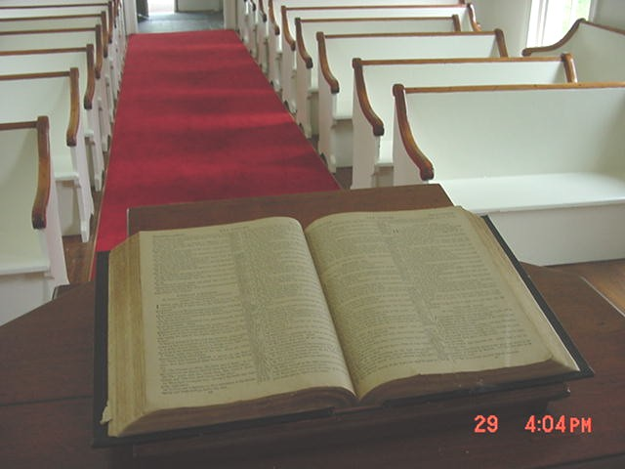
WE MUST DO THIS SCRIPTURALLY

Slide 3
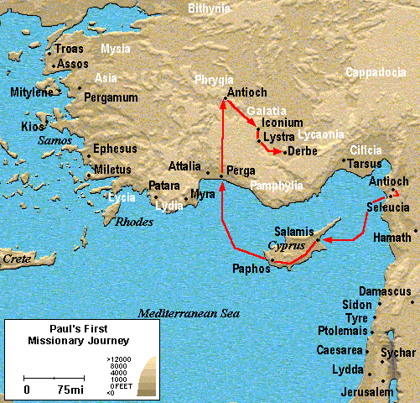
Notes:
Paul and Barnabas left Antioch in Syria. 2 yrs.

Slide 4
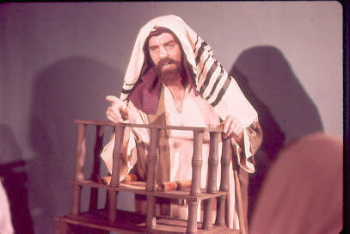
Paul preached in the synagogues
Going first to the Jews,
Then to the Gentiles . . .

Slide 5
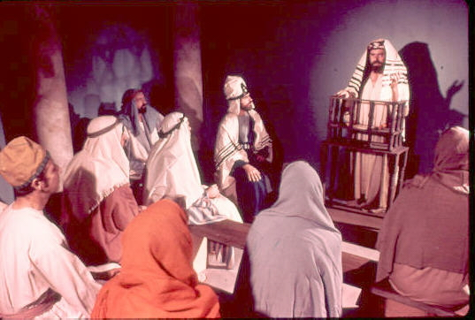
Many believed and obeyed the gospel . . .
Acts 13:48; 14:1; 14:21

Slide 6
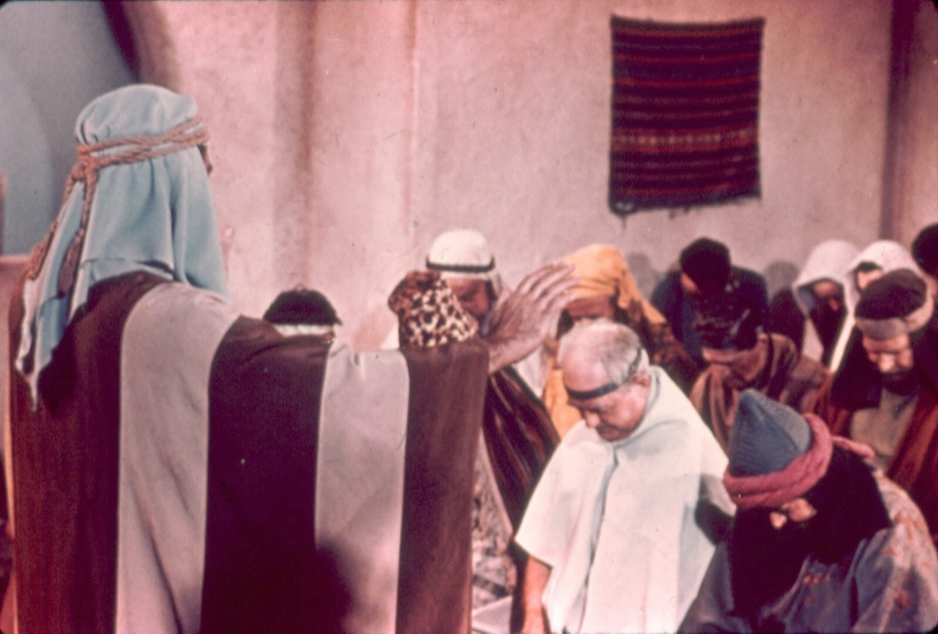
Paul appointed elders in every church . . .
^{Acts 14:23} So when they had appointed elders in every church, and prayed with fasting, they commended them to the Lord in whom they had believed.

Slide 7
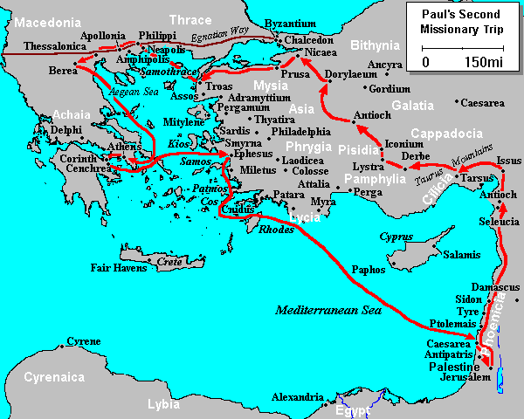
2nd journey
“Let us go back and visit the brothers in all the towns where we preached The Word of The Lord and see how they are doing” Acts 15:36
Notes:
Acts 15:36 Paul said to Barnabas, "Let us go back and visit the brothers in all the towns where we preached The Word of The Lord and see how they are doing." Disagreement so Paul took Silas

Slide 8
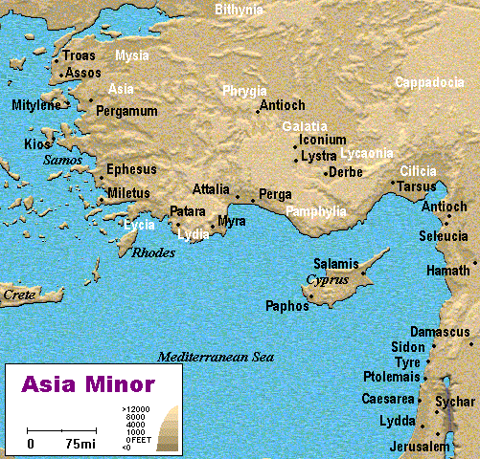
Acts 20:28
Paul returning from his Third Missionary Journey
Notes:
3rd missionary journey remained in Ephesus for 2 ½ years and left. On his way back, Paul called for the elders at Ephesus to come up and meet with him where he was preaching in Miletus

Slide 9
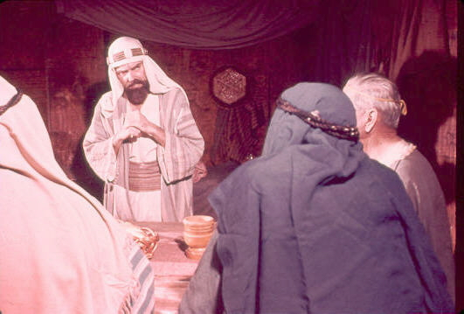
Paul reminded them they had been made Elders by the Holy Spirit
“Therefore take heed to yourselves and to all the flock, among which the Holy Spirit has made you overseers, to shepherd the church of God”
Acts 20:28

Slide 10
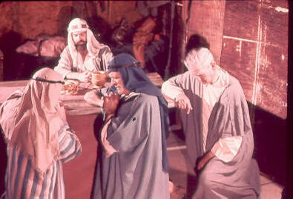
Paul praying with the Elders from Ephesus
“And when he had said these things, he knelt down and prayed with them all”
Acts 20:36

Slide 11
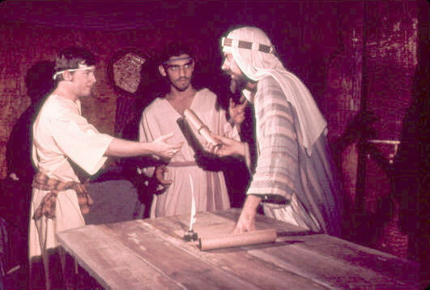
Paul penned letters to Timothy and Titus
Paul wrote by the Spirit – 1 Cor. 2:10; Eph. 3:3-5
Paul’s writing was called “Scripture” – 2 Pet. 3:15-16
Notes:
1. From that point forward, Paul began to write letters to Timothy and Titus, 2 evangelists, in order to instruct them on how the Lord’s church should be organized, by the appoint of elders and deacons, and he told them of the qualifications one had to meet in order to be become an elder and a deacon
2. Paul’s writings on this matter were not his words, they were God’s instructions.
A. Paul wrote by the Spirit – 1 Cor. 2:10; Eph. 3:3-5
B. Paul’s writing was called “Scripture” – 2 Pet. 3:15-16

Slide 12
A Biblical Eldership
1. A plural number appointed (never just one)
2. Each congregation was autonomous
3. Paul appointed elders “in every church” Acts 14:23
- “For this reason I left you in Crete, that you should set in order the things that are lacking, and appoint elders in every city as I commanded you” Tit. 1:5

Slide 13
Biblical Terms for Elders
“Elders” (“presbuteros”, presbyters) for they were mature Christian men
^{Acts 14:23} So when they had appointed elders in every church, and prayed with fasting, they commended them to the Lord in whom they had believed.

Slide 14
Biblical Terms for Elders
“Elders” (“presbuteros”, presbyters) for they were mature men
“Bishops” (“episkopos”, overseers) for their task was to oversee the congregation.
^{Acts20:28} Therefore take heed to yourselves and to all the flock, among which the Holy Spirit has made you overseers, to shepherd the church of God which He purchased with His own blood.

Slide 15
Biblical Terms for Elders
“Elders” (“presbuteros”, presbyters) for they were mature men
“Bishops” (“episkopos”, overseers) for their task was to oversee the congregation.
“Pastors” (“poimen”, shepherds) for their task was to shepherd and feed the flock of God.
Acts 20:17; 1 Peter 5:1-2

Slide 16
Biblical Terms for Elders
“Elders” (“presbuteros”, presbyters) for they were mature men
“Bishops” (“episkopos”, overseers) for their task was to oversee the congregation.
“Pastors” (“poimen”, shepherds) for their task was to shepherd and feed the flock of God.
Not 3 distinct offices, but different ways to describe the same men and their work.

Slide 17
Qualification of Elders
1 Timothy 3:1-7; Titus 1:5-9
1 Tim. 3:1-7
“This is a faithful saying: If a man desires the position of a bishop, he desires a good work. A bishop then must be blameless, the husband of one wife, temperate, sober-minded, of good behavior, hospitable, able to teach; not given to wine, not violent, not greedy for money, but gentle, not quarrelsome, not covetous; one who rules his own house well, having his children in submission with all reverence (for if a man does not know how to rule his own house, how will he take care of the church of God?); not a novice, lest being puffed up with pride he fall into the same condemnation as the devil. Moreover he must have a good testimony among those who are outside, lest he fall into reproach and the snare of the devil”

Slide 18
Qualification of Elders
1 Timothy 3:1-7; Titus 1:5-9
Tit. 1:5-9
“For this reason I left you in Crete, that you should set in order the things that are lacking, and appoint elders in every city as I commanded you—if a man is blameless, the husband of one wife, having faithful children not accused of dissipation or insubordination. For a bishop must be blameless, as a steward of God, not self-willed, not quick-tempered, not given to wine, not violent, not greedy for money, but hospitable, a lover of what is good, sober-minded, just, holy, self-controlled, holding fast the faithful word as he has been taught, that he may be able, by sound doctrine, both to exhort and convict those who contradict”

Slide 19
Qualification of Elders
1 Timothy 3:1-7; Titus 1:5-9
Temperate –
Self-denying, self-controlled; watchful over self
Sober –
Of sound mind, with mature judgment, self-restrained, one who is not under the control of passions
Good Behavior–
Well-mannered; well ordered life, modest

Slide 20
Qualification of Elders
“Holding fast the faithful word as he has been taught, that he may be able, by sound doctrine, both to exhort and convict those who contradict. For there are many insubordinate…whose mouths must be stopped, who subvert whole households, teaching things which they ought not.”
1 Timothy 3:1-7; Titus 1:5-9
Given to hospitality –
Friendly, helpful to strangers
Apt to Teach –
Capable and ready to teach. Could be through various mediums: class, one-on-one, through their example. Able to use sound doctrine to convict, stop the mouths of false teachers. Tit. 1:9-11
Desire the work
Wants to serve the Lord in a leadership role

Slide 21
Qualification of Elders
1 Timothy 3:1-7; Titus 1:5-9
He must not be a novice –
Or a new convert
He must not have quick temper –
Not vengeful, hotheaded, or impulsive with his feelings
He must not be self-willed –
Or not haughty, overbearing, and arrogant

Slide 22
Qualification of Elders
1 Timothy 3:1-7; Titus 1:5-9
He must not be given to wine –
One who does not drink wine or any other intoxicating drink
He must not be a brawler –
Not one who is given to strife or apt to fight
He must not be a striker –
Not one who is quarrelsome, pugnacious, or physically combatant, a man of peace

Slide 23
Qualification of Elders
1 Timothy 3:1-7; Titus 1:5-9
He must not be greedy –
Or not one who gets money by dishonorable means, free from love of money
He must not be covetous –
A lover of money and material things of the world

Slide 24
Qualification of Elders
1 Timothy 3:1-7; Titus 1:5-9
He must be husband of one wife –
Male, having one wife
He must have believing children
He must be of good behavior –
Dignified, modest, godly behavior

Slide 25
Qualification of Elders
1 Timothy 3:1-7; Titus 1:5-9
He must be vigilant –
Alert and watchful over his own conduct
He must be patient –
Man of mild and kind demeanor

Slide 26
Qualification of Elders
1 Timothy 3:1-7; Titus 1:5-9
He must be just –
Upright and fair in his dealings with others. Not ruled by prejudice in dealing with others, treats all equally.
He must be gentle –
Not unkind, or harsh, or unfair
He must be devout–
Fully dedicated and consecrated to the Lord

Slide 27
Qualification of Elders
1 Timothy 3:1-7; Titus 1:5-9
He must love what is good–
Not seeking to participate with evil men in their schemes. Love what God defines as good
He must be given to hospitality –
Concerned about the welfare of others, both strangers and brethren

Slide 28
Qualification of Elders
1 Timothy 3:1-7; Titus 1:5-9
He must be able to --
Exhort and refute the “gainsayers”
With sound doctrine protect the flock against false teachers
He must be blameless –
Not perfect, but “upright”, a man against whom no charge of immorality, or holding false doctrine is alleged

Slide 29
Qualification of Elders To himself and his home
1 Timothy 3:1-7; Titus 1:5-9
To take heed to himself –
Be humble, dedicated, and Christ-like
Rule well his own family –
Doing this he gains experience to rule over the “family of God”
Hold fast to the Word –
Respect it, teach it, stand for it, and defend it

Slide 30
Qualification of Elders
1 Timothy 3:1-7; Titus 1:5-9
Every qualification for an elder is a qualification for a Christian, except:
Male
Married
Believing Children
Desire the office

Slide 31
GOD’S SIMPLE PLAN FOR SALVATION
Rev. 2:10
1 PET. 3:21
baptism
JN. 12:42
confess
LK. 13:3
repent
OBEDIENT
UNTIL DEATH
JN. 6:29
believe
ACTS 3:22
hear

