Slide 1
Part 1 “Biblical Examples and Qualifications of Elders” Part 2 “Elders Responsibilities and our Responsibility to the Elders”

Slide 2
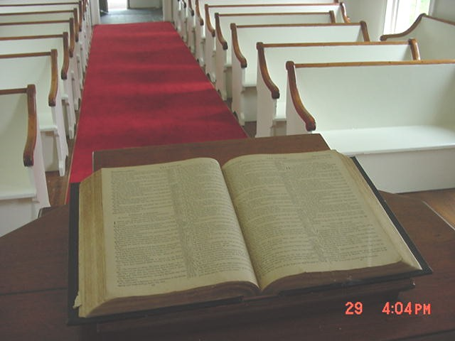
WE MUST DO THIS SCRIPTURALLY

Slide 3
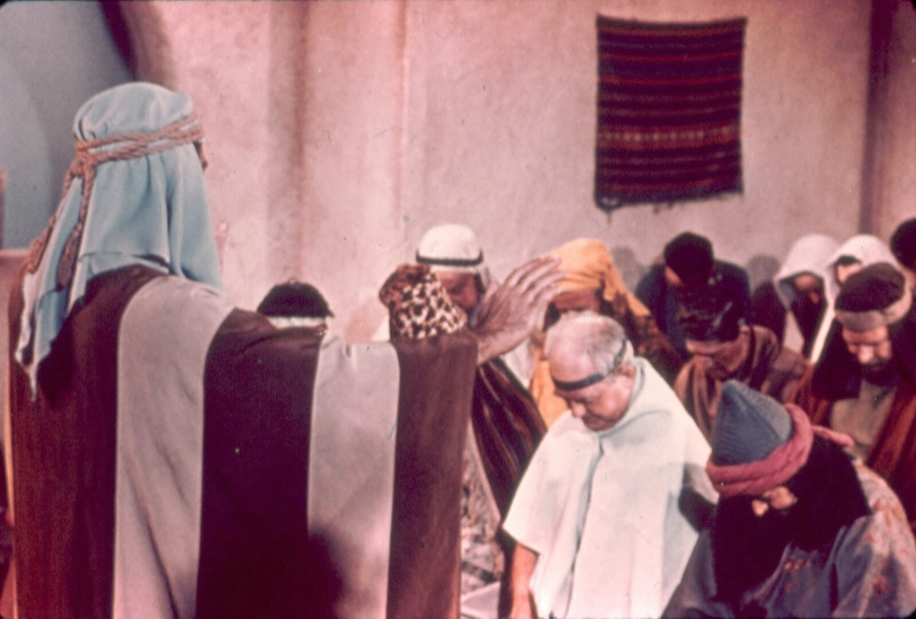
Paul appointed elders in every church . . .
^{Acts 14:23} So when they had appointed elders in every church, and prayed with fasting, they commended them to the Lord in whom they had believed.

Slide 4
A Biblical Eldership
1. A plural number appointed (never just one)
2. Each congregation was autonomous
3. Paul appointed elders “in every church” Acts 14:23
- “For this reason I left you in Crete, that you should set in order the things that are lacking, and appoint elders in every city as I commanded you” Tit. 1:5

Slide 5
Qualification of Elders
1 Timothy 3:1-7; Titus 1:5-9
Temperate
Sober
Good Behavior
Given to hospitality
Apt to Teach
Desire the work
He must not be a novice
He must not have quick temper
He must not be self-willed

Slide 6
Qualification of Elders
1 Timothy 3:1-7; Titus 1:5-9
He must not be self-willed
He must not be given to wine
He must not be a brawler
He must not be a striker
He must not be greedy
He must not be covetous
He must be husband of one wife
He must have believing children
He must be of good behavior

Slide 7
Qualification of Elders
1 Timothy 3:1-7; Titus 1:5-9
He must be vigilant
He must be patient He must be just
He must be gentle
He must be devout
He must love what is good
He must be able to exhort and refute the “gainsayers with sound doctrine protect the flock against false teachers
He must be blameless

Slide 8
Qualification of Elders
1 Timothy 3:1-7; Titus 1:5-9
To take heed to himself
Rule well his own family
Hold fast to the Word

Slide 9
Qualification of Elders
1 Timothy 3:1-7; Titus 1:5-9
Every qualification for an elder is a qualification for a Christian, except:
Male
Married
Believing or Faithful Children
Desire the office

Slide 10
Responsibilities of the Elders

Slide 11
The Work of an Elder Involves . . .
1.
Providing Example in
Character and Conduct
1 Peter 5:3 “ not lording it over those entrusted to you, but being examples to the flock.”
Hebrews 13:7 “Remember them which have the rule over you, who have spoken unto you the word of God: whose faith follow…”
Leadership involves showing,
not just telling

Slide 12
The Work of an Elder Involves . . .
2.
Planning, Decision-making,
and Direction
“Rule” “take care of” “manage”
Like a husband / father deals with his family
1Tim. 3:5
1 Timothy 3:5 “for if a man does not know how to rule his own house, how will he take care of the church of God?

Slide 13
The Work of an Elder Involves . . .
2.
Planning, Decision-making,
and Direction
“Oversight” – supervision of worship, preaching, teaching, and (flock) members
1 Peter 5:2 “Feed the flock of God which is among you, taking the oversight thereof…”

Slide 14
The Work of an Elder Involves . . .
2.
Planning, Decision-making,
and Direction
“Oversight” – supervision of worship, preaching, teaching, and (flock) members 1 Peter 5:2
Benevolence under oversight of elders – “Then the disciples, each according to his ability, determined to send relief to the brethren dwelling in Judea. This they also did, and sent it to the elders by the hands of Barnabas and Saul” Acts 11:29-30

Slide 15
The Work of an Elder Involves . . .
2.
Planning, Decision-making,
and Direction
Decision-making is a means of “shepherding” the flock
1 Peter 5:2 NKJV “Shepherd the flock of God which is among you, serving as overseers”
Acts 20:28 “…the Holy Spirit has made you overseers, to shepherd the church of God which He purchased with His own blood.”

Slide 16
The Work of an Elder Involves . . .
2.
Planning, Decision-making,
and Direction
Much involves organizing and coordinating
Formulating common goals
Assigning work
Seeing that each member is doing their best
Seeing that all are working well together

Slide 17
The Work of an Elder Involves . . .
2.
Planning, Decision-making,
and Direction
See that everything is “done for edification”
1 Cor. 14:26
and “done decently and in order”
1 Cor. 14:40

Slide 18
The Work of an Elder Involves . . .
3.
Prayer
James 5:14-16
14 Is anyone among you sick? Let him call for the elders of the church, and let them pray over him...

Slide 19
The Work of an Elder Involves . . .
3.
Prayer
James 5:14-16
Elders to pray for our physical needs….
“The effective, fervent prayer of a righteous man avails much” -- Jas. 5:16
Great good is accomplished by the prayers of godly elders.

Slide 20
The Work of an Elder Involves . . .
4.
Teaching
Eph. 4:11
1 Tim. 3:2
1 Tim. 5:17
Heb. 13:7

Slide 21
The Work of an Elder Involves . . .
4.
Teaching
Eph. 4:11
1 Tim. 3:2
1 Tim. 5:17
Heb. 13:7
11 And He gave some as apostles, and some as prophets, and some as evangelists, and some as pastors and teachers,

Slide 22
The Work of an Elder Involves . . .
4.
Teaching
Eph. 4:11
1 Tim. 3:2
1 Tim. 5:17
Heb. 13:7
“A bishop then must be … able to teach”

Slide 23
The Work of an Elder Involves . . .
4.
Teaching
Eph. 4:11
1 Tim. 3:2
1 Tim. 5:17
Heb. 13:7
“Let the elders who rule well be counted
worthy of double honor, especially those who labor in the word and doctrine.”

Slide 24
The Work of an Elder Involves . . .
4.
Teaching
Eph. 4:11
1 Tim. 3:2
1 Tim. 5:17
Heb. 13:7
“Remember those who rule over you, who have spoken the word of God to you …”

Slide 25
The Work of an Elder Involves . . .
“Holding fast the faithful word as he has been taught, that he may be able, by sound doctrine, both to exhort and convict those who contradict. For there are many insubordinate…whose mouths must be stopped, who subvert whole households, teaching things which they ought not.”
4.
Teaching
Eph. 4:11
1 Tim. 3:2
1 Tim. 5:17
Heb. 13:7
Public assemblies, private teaching, example
Positive teaching and refuting error (Tit 1:9-11)
Supervising other teachers, preachers, literature
Developing additional leaders
Stimulating spiritual growth
Notes:
Tit. 1:9-11 “holding fast the faithful word as he has been taught, that he may be able, by sound doctrine, both to exhort and convict those who contradict. whose mouths must be stopped, teaching things which they ought not”

Slide 26
The Work of an Elder Involves . . .
5.
Providing Counsel
Heb. 13:7, 17
Wise advice and guidance
As one who is watching for the souls of others.
Heb. 13:7 “Remember those who rule over you, who have spoken the word of God to you, whose faith follow, considering the outcome of their conduct.”

Slide 27
The Work of an Elder Involves . . .
5.
Providing Counsel
Heb. 13:7, 17
Men of godliness and wisdom
Men of maturity, stable, sound judgment, so brethren will be inclined to seek their advice and help.

Slide 28
The Work of an Elder Involves . . .
6.
Admonish, warn, rebuke, correct
1 Thess. 5:12-14
If problems are not dealt with, they invite crisis and catastrophe.
1Thess. 5:12 “And we urge you, brethren, to recognize those who labor among you, and are over you in the Lord and admonish you”

Slide 29
The Work of an Elder Involves . . .
6.
Admonish, warn, rebuke, correct
1 Thess. 5:12-14
Admonish, warn, rebuke, discipline
Unpentanent individuals may have to be disciplined
Rom. 16:17; 1 Cor. 5:1-13;
2 Thess. 3:6, 14, 15; Rev. 2:14-16, 20-24

Slide 30
The Work of an Elder
They must continue to grow spiritually themselves . . .
Faithful shepherds have a glorious reward awaiting them -- 1 Peter 5:1-4
“The elders who are among you I exhort . . . and when the Chief Shepherd appears, you will receive the crown of glory that does not fade away.”

Slide 31
The Church’s Responsibilities to Elders

Slide 32
1. A Congregation Is To Remember their Elders
Hebrews 13:7 “Remember those who rule over you, who have spoken the word of God to you, whose faith follow, considering the outcome of their conduct”

Slide 33
2. A Congregation Is To Obey And Submit To Its Elders
Hebrews 13:17 “Obey those who rule over you, and be submissive, for they watch out for your souls, as those who must give account. Let them do so with joy and not with grief, for that would be unprofitable for you”
I Timothy 5:17 "Let the elders who rule well be considered worthy of double honor..."

Slide 34
Jack Lewis- Leadership Questions Confronting the Church
“Rule means what it means… elders are in authority and the church is to submit to that authority, to their rule…”
Two words are used… proistemi and hegeisthai
“…have the sense of ‘to lead’ but in each case the context forces the meaning ‘to care for’.

Slide 35
“And He put all things under His feet, and gave Him to be head over all things to the church, which is His body”
Christ is the head of the church (Eph. 1:22-23)
Elders 1 Pet. 5:1-4
Deacons
Acts 6:1-6
Preachers
2 Tim. 4:1-4
All Members
Heb. 10:22-25

Slide 36
THE CHURCH IS NOT A DEMOCRACY
Ephesians 1:22-23 “And He put all things under His feet, and gave Him to be head over all things to the church, which is His body.”
The church is a theocracy with the Lord Jesus Christ as its head with trusted, proven, biblically approved elders carrying out His wishes.

Slide 37
3. A Congregation Is To Honor and Recognize Its Elders
1 Tim. 5:17
“Let the elders who rule well be counted worthy of double honor, especially those who labor in the word and doctrine”

Slide 38
3. A Congregation Is To Honor and Recognize Its Elders
1 Thess. 5:12
“And we urge you, brethren, to recognize those who labor among you, and are over you in the Lord”

Slide 39
3. A Congregation Is To Honor and Recognize Its Elders
1 Thess. 5:13
“and to esteem them very highly in love for their work's sake”

Slide 40
4. Receive no Accusation of Elder without Proof
1 Tim. 5:19
“Do not receive an accusation against an elder except from two or three witnesses”

Slide 41
The Work of an Elder Should be a work of JOY!
Heb. 13:17
“Obey your leaders, and submit to them; for they keep watch over your souls, … Let them do this with joy!”
Let us appreciate their “stewardship”
Our thanks, honor, esteem, & respect

Slide 42
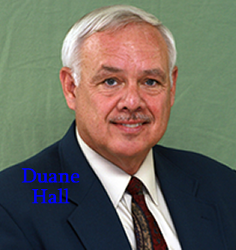
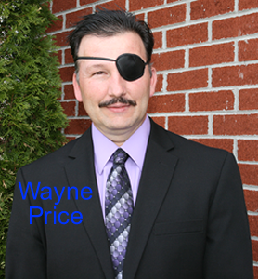
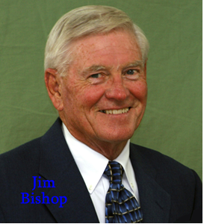
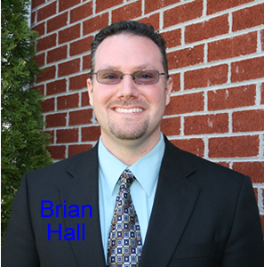
Radford Blessed with Elders
Loving Congregation
Unified Congregation
Mission Minded Congregation
Truth Practicing and Seeking Congregation
Teaching Congregation

Slide 43
GOD’S SIMPLE PLAN FOR SALVATION
Rev. 2:10
1 PET. 3:21
baptism
JN. 12:42
confess
LK. 13:3
repent
OBEDIENT
UNTIL DEATH
JN. 6:29
believe
ACTS 3:22
hear

