Slide 1
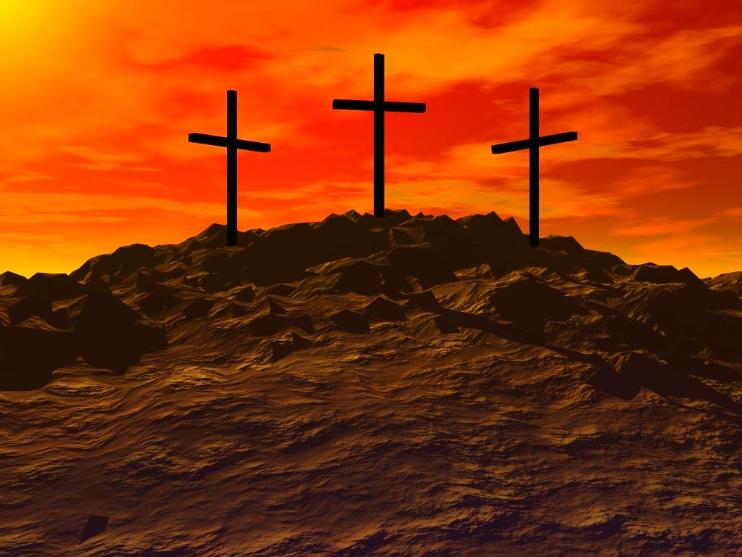
At Calvary
Notes:
To explain what it means to go to Calvary.

Slide 2
“And when they had come to the place called Calvary, there they crucified Him, and the criminals, one on the right hand and the other on the left.” Lk. 23:33
Greek word kranion = skull
Latin word for skull “calvaria”
“And He, bearing His cross, went out to a place called the Place of a Skull, which is called in Hebrew, Golgotha” Jn. 19:17
Notes:
1. Luke 23:33 “And when they had come to the place called Calvary, there they crucified Him, and the criminals, one on the right hand and the other on the left.”
a. Heart touching word - Calvary - His death would be a means of drawing men to him
a. Death of Christ
a. Occurred on a Friday - Described in Mt. 27
b. Uses the word Golgotha [v.33] - not as touching as the word Calvary.
c. Songs would sound strange with Golgotha instead of Calvary
2. Word Calvary only used 1 time - Luke 23:33
a. Jerome made a Latin translation of this passage and he used the Latin word Calvaria
b. In the KJV in this place they translated it “CALVARY” - from the Latin
c. The Word means “Cranion, or cranium, or skull.” - Golgotha - John 19:17

Slide 3
Notes:
A. 3 possible reasons why it was called “Skull”
(1) Skulls were found there - where men were beheaded for crimes
(2) Because it was a place of execution - crucifixion
(3) The site in some way resembled a skull
B. It is a hill - a place of the skull
C. We need to go there and Visit-- Have You ever been to Calvary?

Slide 4
“And I, if I be lifted up from the earth, will draw all men unto Me. This He said, signifying what death He should die.” Jn. 12:32-33

Slide 5
1. Story of Calvary
“outside the gate” - Heb. 13:11-12
“near the city” - Jn. 19:20
“they that passed by” - Matt. 27:39
“stood at a distance” - Lk. 23:49
A.D. 30
- When Jesus was crucified
A.D. 70
- City of Jerusalem burned
A.D. 135
- Jews destroyed by Rome
A.D. 325
- Constantine built church building
A.D. 1882
- British man “Gordon” found a hill
Notes:
I. STORY OF CALVARY
A. Spot outside the Gate
1. Heb. 13:11-12 “or the bodies of those animals, whose blood is brought into the sanctuary by the high priest for sin, are burned outside the camp. Therefore Jesus also, that He might sanctify the people with His own blood, suffered outside the gate.”
2. Outside the walls of Jerusalem - but close to the city - John 19:20 “Then many of the Jews read this title, for the place where Jesus was crucified was near the city; and it was written in Hebrew, Greek, and Latin.”
3. It was near some public travel area. Matt. 27:39 “and they that passed by reviled him, wagging their heads.”
4. And it was a spot visible from a distance. Luke 23:49 “But all His acquaintances, and the women who followed Him from Galilee, stood at a distance, watching these things.”
5. Present day walls are farther out than the original walls in the days of Jesus.
B. April 7, A.D. 30 possible date when Jesus was crucified on Calvary
C. A.D. 70
1. Rome under Titus burned the city
2. Not one stone was left unturned
3. Josepheus - an eye witness, said it looked as if it had never been inhabited.
D. In 135 A.D.
1. Another Jewish rebellion took place
2. The Roman Emperor was Adrian - They destroyed the Jews
E. 325 A.D.
1. An emperor named Constantine came to power
2. He was the first so called “Christian emperor”
3. He sent word to the bishop that he wanted to find the spot of the crucifixion and the burial of Jesus.
4. The bishop sent word that he had an answer in a dream. He said he knew where
the tomb was located and also Calvary.
5. Ten years later Constantine ordered that a church building be erected at both spots.
6. This is called the Church of the Holy Sepulchre.
F. 1882 A.D.
1. A British Captain named “Gordon” found another place which he called the real
place of Calvary
2. Close to this hill is a tomb.
3. And the Hill looks like a skull
4. This place is called “The Garden Tomb”
G. No one really knows where Calvary was!!

Slide 6
2. Have You Been to Calvary?
Some want to go to the physical place
Calvary refers to death, crucifixion
It is not:
Have you been immersed - Acts 2:38
Wearing the right name - Acts 4:12, 1 Pet. 4:16
Observing the Lord’s Supper - Acts 20:7
Singing A Cappella - Col. 3:16, Eph. 5:19
Giving liberally - 2 Cor. 9:6-7
Notes:
HAVE YOU BEEN TO CALVARY?
A. Preacher
1. Years ago some a preacher said that he believed in the Lord's death and burial. He said he was willing to go there and put his body, hands, feet and head in the exact place where Jesus lay. He would do this to show that he was not ashamed.
2. Jesus never told us to find the tomb and lay down in it.
B. We are commanded to be buried
1. We have been told to lay down in the tomb of water.
2. Col. 2:12 “buried with Him in baptism, in which you also were raised with Him through faith in the working of God, who raised Him from the dead.”
C. Have you been to calvary?
1. Not physical calvary
2. But the word refers to death, crucifixion.
D. It is not:
1. Have you been immersed.
a. It is important.
b. You cannot obey God without being baptized - Acts 2:38 "Repent, and let every one of you be baptized in the name of Jesus
Christ for the remission of sins; and you shall receive the gift of the Holy Spirit.”
c. But that is not going to Calvary
d. The question is: “have you been to Calvary?”
2. It is not wearing the right name
a. That's important - Acts 4:12 “Neither is there salvation in any other: for there is none other name under heaven given among men, whereby we must be saved.”
b. I Pet. 4:16 “Yet if any man suffer as a Christian, let him not be ashamed; but let him glorify God on this behalf.”
c. It's deeper than wearing the right name
3. Not - Do you observe the Lord's Supper every 1st day of the week.
a. That's important
b. Acts 20:7 “And upon the first day of the week, when the disciples came
together to break bread”
d. The communion is a very important part of our assembling together
e. But it is possible that people can put bread and grape juice in their mouth every Sunday who have never been to Calvary.
4. Not - do You sing A Cappella
a. That is important - Col. 3:16 Eph. 5:19 God has only authorized singing in worship
c. It shows our respect and loyalty to the N.T.
d. We must speak where the Bible speaks and remain silent where it is silent.
e. But there are people who sing A Cappella every Sunday but they have not been to Calvary
5. Not - Do you Give liberally
a. It is important to be a liberal giver
b. We must give as we have been prospered - II Cor. 9:7 “So let each one give as he purposes in his heart, not grudgingly or of necessity; for God loves a cheerful giver.”
c. There will be no stingy people in heaven.
d. We must learn the grace of giving. That it is more blessed to give than receive.
6. These things are all important but they are not Going to Calvary.
7. Going to Calvary means ...

Slide 7
3. Have You Been Crucified?
Rom. 6:1-12 - answers the question
v. 1 “What shall we say then? Shall we continue in sin, that grace may abound?”
Rom. 5:20-21 - sin abounded -- grace abounded
Should we continue to sin so that grace would continue to abound ?
God Forbid !
v. 2
Notes:
HAVE YOU BEEN CRUCIFIED ?
A. God Knows if we have been to calvary
1. Rom. 6:1 “What shall we say then? Shall we continue in sin, that grace may abound?”
a. Paul, by the inspiration of the Holy Spirit, now gives encouragement to help keep us from sinning. He shows that justification
produces the fruit of holiness.
b. “Shall we continue in sin..?” - This question comes from the previous verse Rom. 5:20-21
c. Since Grace much more abounded where there was sin, should we continue to sin so that grace would continue to abound?
2. Romans 6:2-11
a. “God Forbid” = let it not be - by no means - let not such a thing be mentioned
b. Absolutely not ! God would never encourage sin by blessing the continuing of it.

Slide 8
3. Have You Been Crucified?
4 Reasons Why Christians Should Not Sin
#1 We Have Died to Sin
“God forbid. How shall we who died to sin live any longer in it?” Rom. 6:2
Dies Physically - no longer lives the former life
Dies Spiritually - no longer lives the former life
“…that we, having died to sins, might life for righteousness” 1 Pet. 2:24
Notes:
c. In verses 2-11 Paul gives 4 reasons why the Christian should not sin.
(1) The 1st reason: We have died to sin - v. 2
(a) Rom. 6:2 “God forbid. How shall we who died to sin live any longer in it?”
(b) Death to sin is to cease to live in sin
(c) When a person dies physically, he no longer lives the former life
(d) When a person dies spiritually, he no longer lives the former life
(e) Paul died to sin - it’s as if he died and was buried at Damascus
(f) 1 Pet. 2:24 “who Himself bore our sins in His own body on the tree, that we, having died to sins, might live for righteousness.”

Slide 9
3. Have You Been Crucified?
4 Reasons Why Christians Should Not Sin
#2 We have Been Baptized
“Or do you not know that as many of us as were baptized into Christ Jesus were baptized into His death?” Rom. 6:3
v. 4 - buried with Him through baptism
v. 5 - likeness of His death and resurrection
Our old self has died to sin, and Christ has taken his place
Notes:
2nd Reason: We have been baptized - v. 3-5
(a) Rom. 6:3-5 “Or do you not know that as many of us as were baptized into Christ Jesus were baptized into His death? Therefore we were buried with Him through baptism into death, that just as Christ was raised from the dead by the glory of the Father, even so we also should walk in newness of life. For if we have been united together in the likeness of His death, certainly we also shall be in the likeness of His resurrection”
(b) We are baptized into Christ and into a state free from sin
(c) We were baptized into the likeness of his death and resurrection
(d) Our old self has died to sin, and Christ has taken his place
(e) Just as Christ died, was buried, and was raised, we died to sin, are buried in baptism, and are raised to a new life.
(f) This newness of life is permanent

Slide 10
3. Have You Been Crucified?
4 Reasons Why Christians Should Not Sin
#3 We Are Dead To Sin
“Knowing this, that our old man was crucified with Him, that the body of sin might be done away with, that we should no longer be slaves of sin. For he who has died has been freed from sin.” Rom. 6:6-7
Old life of sin has been put to death
Every time a person becomes a Christian, a sinner dies
Notes:
3rd Reason: We are dead to sin - v. 6-7
(a) Rom. 6:6-7 “knowing this, that our old man was crucified with Him, that the body of sin might be done away with, that we should no longer be slaves of sin. For he who has died has been freed from sin.”
(b) Our old life of sin and corruption has been put to death
(c) While living in sin, we were slaves to that way of life.
(d) Every time a person becomes a Christian, a sinner dies !
(e) Shall we continue in sin? No way! We are dead to sin.
(f) Illustration: Marshall Keeble told of a man who was mean to wife and children. The father of the wife came and took her and the children away from the man and took them to his home. Later the man obeyed the gospel and went to get his wife and children. The father said, No! But the husband said, “I am a changed man, the old man has moved out!”

Slide 11
3. Have You Been Crucified?
4 Reasons Why Christians Should Not Sin
#4 We Are Living with Him
“Now if we died with Christ, we believe that we shall also live with Him” Rom. 6:8
v. 9 - Christ raised from the dead
v.10 - He lives to God
v.11 - “Likewise you also, reckon yourselves to be dead indeed to sin, but alive to God in Christ Jesus our Lord.”
Notes:
4th Reason: We are looking forward to living with Him v. 8-11
(a) Rom. 6:8-11 “Now if we died with Christ, we believe that we shall also live with Him, knowing that Christ, having been raised from the dead, dies no more. Death no longer has dominion over Him. For the death that He died, He died to sin once for all; but the life that He lives, He lives to God. Likewise you also, reckon yourselves to be dead indeed to sin, but alive to God in Christ Jesus our Lord.”
(b) This new life is with Christ, who is not living for sin.
(c) He is our guide, our teacher, our king.
(d) Christ died one time to pay the penalty for our sin, but now he lives to God.
(e) We have died to sin and are living for God

Slide 12
3. Have You Been Crucified?
We Have Died to Sin
We Have Been Baptized
We Are Dead To Sin
We Are Living with Him
“Therefore do not let sin reign in your mortal body, that you should obey it in its lusts.” Rom. 6:12
Notes:
1. Conclusion - v. 12 “Therefore do not let sin reign in your mortal body, that you should obey it in its lusts.”
2. This is Calvary
There is more to it than getting wet.
Have you dies to sin?
We have been baptized
We are dead to sin
We are living with Him
b. In asking have you been to Calvary, we need to change the question to: “Have You been Crucified?”

Slide 13
3. Have You Been Crucified?
“And those who are Christ's have crucified the flesh with its passions and desires.” Gal. 5:24
We must do it to ourselves
It’s an inside job
“Therefore, if anyone is in Christ, he is a new creation; old things have passed away; behold, all things have become new.” 2 Cor. 5:17
Notes:
A. Gal. 5:24 “And those who are Christ's have crucified the flesh with its passions and desires”
1. If we have been to Calvary, we have crucified the flesh. We must do it to ourselves. Its an inside job.
2. When we have been crucified to Christ we bury a corpse and a new person is raised.
3. 2 Cor. 5:17 “Therefore, if anyone is in Christ, he is a new creation; old things have passed away; behold, all things have become new.”
a. We are the same outside
b. But on the inside we are a new person.

Slide 14
3. Have You Been Crucified?
“I am crucified with Christ: nevertheless I live; yet not I, but Christ lives in me: and the life which I now live in the flesh I live by the faith of the Son of God, who loved me, and gave Himself for me.” Gal. 2:20
Saul of Tarsus no longer lives
Contradiction “Nevertheless I Live”
The old Saul is not living. A brand new person is living.
Notes:
A. Gal. 2:20 “I am crucified with Christ: nevertheless I live; yet not I, but Christ lives in me: and the life which I now live in the flesh I live by the faith of the Son of God, who loved me, and gave Himself for me.”
1. Here is the testimony from one who had been to Calvary
2. Saul of Tarsus no longer lives.
3. Seems to be contradictory - “I am crucified” -- “Nevertheless I Live”
4. No longer is that old Saul living - the one who persecuted the Christians
5. But a Brand New Person is living.
6. From now until I die I will say “Would Jesus do what I am doing, saying, or practicing?”
7. They had a funeral and buried that old Saul of Tarsus in the watery grave of baptism.
8. But now he lives a new life in the son of God.

Slide 15
Hear John 12:48
Believe John 8:24
Repent Luke 13:3
Confess Matt. 10:32-33
Baptized Mark 16:16
Faithful Matt. 24:13
Have You Been to Calvary?
Notes:
1. Have you been to Calvary?
2. You can go! You must Go!
3. If you have not been will you go Now?
a. HBRCB
b. REPENT
4. The old man is crucified because we have gone to Calvary!
5. The New Man is living for Jesus !

