Slide 1
Working For God
“Study to show thyself approved unto God, a workman that needs not to be ashamed, rightly dividing the word of truth.” 2 Tim. 2:15
A toiler, laborer, worker
Notes:
1. Aim: To show some things we need and do not need to be of value in working for God.

Slide 2
Eph. 4:11-12 “work of the ministry”
Preaching ~ teaching
Caring for sick ~ use of talents
Working For God
I. Things Not Needed
II. Things Needed
Notes:
1. Each Christian today is a worker for God and he has his work to do.
b. Work of the ministry
i. Would include preaching the Gospel - Teaching Classes
ii. Also include other work - caring for the sick, feeding the hungry etc
2. The work of the Lord is the most important thing in all the world.
3. Here are some things we do not need and that we need to be of value in the work of the
Lord!

Slide 3
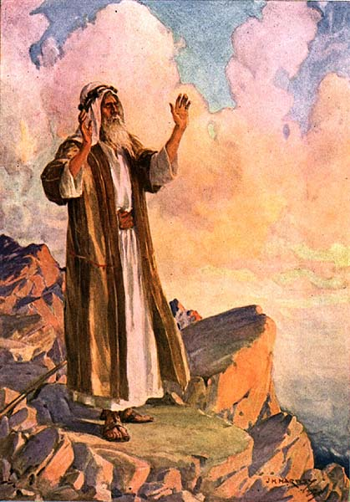
I. Things Not Needed
Eloquence
Moses - Ex. 4:10 “I am not eloquent”
Notes:
A. Eloquence
1. Eloquence means to be a great speaker - good use of words
2. Moses was slow of speech and of a slow tongue - Ex. 4:10 “And Moses said unto the LORD, O my Lord, I [am] not eloquent, but I [am] slow of speech, and of a slow tongue.”

Slide 4
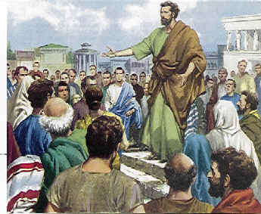
I. Things Not Needed
Eloquence
Paul
1 Cor. 2:1 “not with excellency of speech”
“his speech contemptible”
2 Cor. 10:10
Notes:
3. Paul was not an eloquent man:
a. I Cor. 2:1-4 “And I, brethren, when I came to you, came not with excellency of speech”
b. II Cor. 10:10 “For his letters," they say, "are weighty and powerful, but his bodily presence is weak, and his speech contemptible.”
4. We do not need eloquence and great speaking ability to work for God

Slide 5
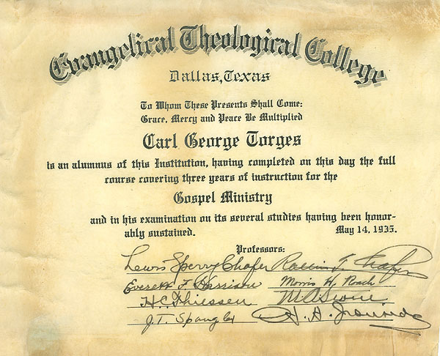
I. Things Not Needed
Education
Peter & John
Acts 4:13 “unlearned and ignorant” NKJV “uneducated and untrained”
Notes:
B. Education
1. Peter and John were unlearned and ignorant men - Acts 4:13 “Now when they saw the boldness of Peter and John, and perceived that they were unlearned and ignorant men, they marvelled; and they took knowledge of them, that they had been
with Jesus.” NKJV = uneducated and untrained
2. Ignorant - unskilled in any art [Thayer p. 297]
3. We do not need a prestigious education to be of value to the Lord in His work

Slide 6
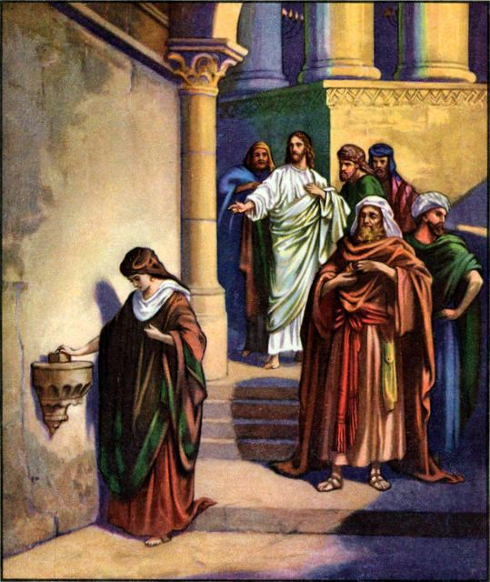
I. Things Not Needed
Riches
Mark 12:37 “...and the common people heard Him gladly.”
Mark 12:41-44 = 2 mites
Notes:
C. Riches
1. It is the common people who keep Christianity marching - Mark 12:37 Therefore David himself calls Him 'LORD'; how is He then his Son?“ And the common people heard him gladly.”
2. The poor widow did much for the Lord - Mk. 12:41-44 = 2 mites
3. Riches are often dangerous and a hindrance to our spirituality
4. We do not need riches to be able to work for the Lord

Slide 7
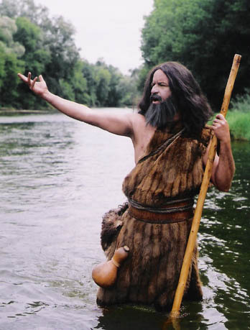
I. Things Not Needed
Fine Clothes
John the Baptizer
Matt. 3:4 - clothing of camel’s hair and leather girdle
1 Sam. 16:7
Notes:
D. Fine clothes
1. John the Baptist had clothing of camel’s hair and a leathern girdle - Mt. 3:4
2. The inward appearance is more important than the outward appearance
3. I Sam. 16:7 The Lord looks on the heart
4. Those who are beautiful within need not worry about the outside appearance
5. You do not need fine clothes to work for the Lord. God looks at the man and his
work not his designer clothing.

Slide 8
I. Things Not Needed
Perfect Health
Gaius - III John 2
Paul - Thorn in the Flesh - 2 Cor. 12:7
Notes:
E. Perfect physical health
1. Gaius - III Jn. 2 “Beloved, I pray that you may prosper in all things and be in health, just as your soul prospers.”
2. Paul had a thorn in the flesh - II Cor. 12:7
3. We do not need to be in perfect physical health to be of value in the work of the Lord.

Slide 9
I. Things Not Needed
Years of experience
Paul - Acts 9:19-20
We learn by working
If we wait until we know everything we will never be ready to work
Notes:
F. Years of Instruction and experience
1. After Paul became a Christian he straightway (immediately) preached Christ - Acts 9
2. We do not need years of instruction and experience before we can begin to work for the Lord.
3. We learn how to work by working
4. If we wait until we know everything before we work, then well never be ready to work for we’ll never know everything
5. To be of value in the Lord’s work you do not need years of instruction and experience !

Slide 10
I. Things Not Needed
Everything Convenient
Paul and Silas - Acts 16:19-34
Expects us to sacrifice
Jesus is an example
Be ready at all times / places
Notes:
G. Everything convenient and opportune
1. Paul and Silas didn’t have it convenient in the Philippian jail - Acts 16
2. We hear too much about convenience in the Lord’s work
3. The Lord expects us to make a sacrifice to work for Him
4. We do not need everything convenient and opportune to work for the Lord
5. Jesus taught: On a mountain, by a well, on the seashore, in houses, in public gatherings
6. We must be ready to teach others and help others even though everything is not convenient and opportune.
H. These are some things we do not need to be of value in the Lord’s work: eloquence,
education, money, fine clothing, perfect health, years of experience and convenience.

Slide 11
II. Things Needed
Faith
Heb. 11:24-25 ~ “Refused to be called the son of Pharaoh’s daughter...”
Faith produces self-denial
Notes:
A. Faith which produces the fruit of self-denial
1. Heb. 11:24-25 - “By faith Moses, when he was come to years, refused to be called the son of Pharaoh's daughter; Choosing rather to suffer affliction with the people of God, than to enjoy the pleasures of sin for a season;”
2. By faith Moses denied himself all the pleasure of sin in this world
3. To be of value in the Lord’s work today we must by faith deny our self the pleasures of sin in this world

Slide 12
II. Things Needed
A Godly Life
Acts 4:13 NKJV “they realized that they had been with Jesus.”
Can people tell by your life that you are a Christian ?
Notes:
B. A Godly Life
1. Our life must show that we have been with Jesus
2. Acts 4:13 “Now when they saw the boldness of Peter and John, and perceived that they were uneducated and untrained men, they marveled. And they realized that they had been with Jesus.”
3. Can people tell by your life that you are a Christian?
4. To be of value in the Lord’s work you must be.

Slide 13
II. Things Needed
Liberality
1 Cor.16:1-2 ~ “as prospered”
2 Cor. 8:1-7 - gave in poverty
Notes:
C. Liberality
1. We must be liberal givers to the cause of Christ
2. We have already seen the poor widow as an example
3. Give as we have prospered - 1 Cor. 16:1-2 - to succeed in business affairs
4. The brethren in Macedonia gave out of deep poverty. “they gave as much as they were able, and even beyond their ability” People today would say they were foolish - II Cor. 8
5. Notice what the Bible says: “... see that you also excel in this grace of giving.” II Cor. 8:7
6. The Lord wants cheerful givers
7. To be of value in the Lord’s work we must be liberal in giving our money, our time and our life.

Slide 14
II. Things Needed
Uncompromising
Matt. 14:3-10
Stand firm for the Word of God
Zeal, Faithfulness and Courage
Notes:
D. An Uncompromising spirit like that of John the Baptizer
1. Matt. 14:3-10
2. John did not fail to proclaim the truth to any man even though it meant giving up his life
3. God does not want us to compromise the truth with anyone for any reason.
4. We must stand firm for the Word of god as John did showing his ZEAL, FAITHFULNESS and COURAGE
5. To be of value in the Lord’s work we must have an uncompromising spirit concerning the truth

Slide 15
II. Things Needed
Spiritual Health
III John 1-2 “As your soul prospers”
Gaius had a healthy soul
Is your body as healthy as your soul?
Notes:
E. GOOD SPIRITUAL HEALTH
1. III John 1-2 “As your soul prospers”
2. “My heartfelt prayer for you, my very dear friend, is that you may be as healthy and prosperous in every way as you are in soul.” Phillips
3. Gaius had the healthy soul - therefore he had the assurance and promises of God that the other things of life would be taken care of
4. If your body and financial condition were as healthy as your soul, how would you
be:
a. Weak and sickly - nearly dead or on the verge of death
b. Financially would you be in poverty - begging for something to eat
c. Would you be strong and prosperous
6. To be of value in the Lord’s work it is a necessity to have good spiritual health

Slide 16
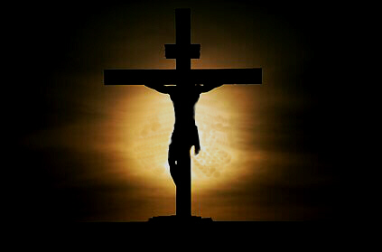
II. Things Needed
We are Debtors
Rom. 1:14-15 “I am a debtor...”
We are in debt to others because of what Christ did for us
Notes:
F. Realize that we are a debtor
1. Rom. 1:14-15 “I am a debtor both to Greeks and to barbarians, both to wise and to unwise. So, as much as is in me, I am ready to preach the gospel to you who are in Rome also.”
2. We are in debt to others because of what Christ did for us
3. We are in debt to others because others taught us
4. To be of value in the Lord’s work we must realize that we are in debt to help others know about God!

Slide 17
II. Things Needed
Love for Souls
Rom. 10:1 - “My hearts desire”
1 Cor. 9:22 “by all means save some”
1 Cor. 8:13 Not Offend
Notes:
G. A love for souls
1. Paul had a love for souls and was doing everything possible to save them - “My hearts desire is for people to be saved” Rom.10:1
2. 1 Cor. 9:22 “by all means save some.”
3. 1 Cor. 8:13 do everything in my power not to offend my brother or sister
4. We must have this same love for souls to be of value in the work for God.
5. Do you love souls as much or more than money ?

Slide 18
How hard do you work at your job?
How hard do you work for your God?

Slide 19
Working For God
“And, behold, I come quickly; and My reward is with Me, to give every man according as his work shall be.” Rev. 22:12

Slide 20
Working For God
Will your works condemn
you or save you?

Slide 21
Don’t let what you cannot do interfere with what you can do
Don’t let what you cannot do interfere with what you can do

Slide 22
GOD’S SIMPLE PLAN FOR SALVATION
Rev. 2:10
Acts 2:38
baptism
JN. 12:42
confess
LK. 13:3
repent
OBEDIENT
UNTIL DEATH
JN. 8:24
believe
ACTS 3:22
hear

