Slide 1
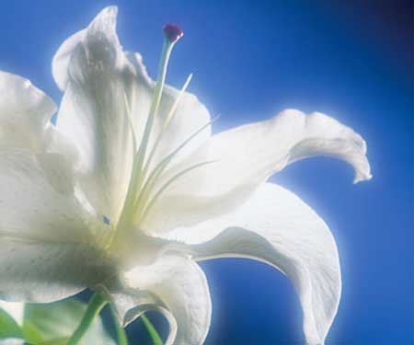
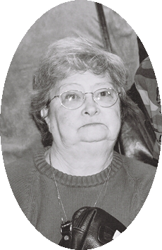
What Kind Of Funeral Do You Want?

Slide 2

What Kind Of Funeral Do You Want?
James 4:13-15
¹³ Come now, you who say, "Today or tomorrow we will go to such and such a city, spend a year there, buy and sell, and make a profit"; ¹⁴ whereas you do not know what will happen tomorrow. For what is your life? It is even a vapor that appears for a little time and then vanishes away. ¹⁵ Instead you ought to say, "If the Lord wills, we shall live and do this or that."

Slide 3
What Kind Of Funeral Do You Want?
Death Is Certain . . .
Genesis 3:19
¹⁹ In the sweat of your face you shall eat bread Till you return to the ground, for out of it you were taken; For dust you are, and to dust you shall return."
Notes:
We cannot change that fact by ignoring it, or not thinking about it
We need to prepare in our life for our death

Slide 4
What Kind Of Funeral Do You Want?
Death Is Certain . . .
Job 30:23
²³ For I know that You will bring me to death, and to the house appointed for all living.

Slide 5
What Kind Of Funeral Do You Want?
Death Is Certain . . .
Ecclesiastes 7:1-2
¹ A good name is better than precious ointment, and the day of death than the day of one's birth; ² Better to go to the house of mourning than to go to the house of feasting, for that is the end of all men; and the living will take it to heart.

Slide 6
What Kind Of Funeral Do You Want?
Death Is Certain . . .
The Time of Death Is Uncertain . . .
How We Prepare For & Face Death Is Up To Us
Hebrews 9:27
²⁷ And as it is appointed for men to die once, but after this the judgment,

Slide 7
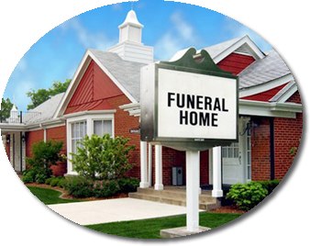
What Kind Of Funeral Do You Want?
Things Usually Considered . . .
Where Will I be Buried & The Kind of Coffin I Am Buried In
Which Funeral Home Will Handle My Funeral . . .
Who Will Preach My Funeral
The Order & Activities During My Service . . .
Do I Have Life Insurance . . .

Slide 8
What Kind Of Funeral Do You Want?
Things We Need To Consider . . .
Have I Been Buried Into Christ?
Have I Put My Life & Death In The Hands of The Lord?
What Kind of Material Have I Provided For The Preacher?
Have I Provided A Positive Influence For Others?
Eternal Life Insurance?
Notes:
This was a godly person. This was a faithful servant of the Lord
Rudy and I preach funerals for people who are not Christians.
You shall know them by their fruits
Salt of the earth, light of the world
Heb. 11 Able – though dead, he still speaks

Slide 9

What Kind Of Funeral Do You Want?
Things That Will Matter . . .
Not When You Were Born Physically – But whether or Not You Were Born Spiritually – Jn. 3:5
Not Where You Lived – But Did You Live For Christ – 2 Cor. 5:15
Not The Clothes You Wore – But The Character You Wore – Col. 3:12-15
Not Material Blessings – But What You Did With Your Material Blessings – Matt. 25:14-30
Not How Far You Traveled – But What You Did Along The Way – Can’t go back – Lk. 16:19-31
Not The Positions You Held – But Who You Served
Notes:
The greatest in the kingdom of heaven are those who served

Slide 10
What Kind Of Funeral Do You Want?
Things That Will Matter . . .
It’s Not How You Die – But How You Live!
Ecclesiastes 12:13-14
¹³ Let us hear the conclusion of the whole matter: Fear God and keep His commandments, for this is man's all. ¹⁴ For God will bring every work into judgment, including every secret thing, whether good or evil.

Slide 11
What Kind Of Funeral Do You Want?
Things That Will Matter . . .
It’s Not How You Die – But How You Live!
John 5:26-29
²⁸ Do not marvel at this; for the hour is coming in which all who are in the graves will hear His voice ²⁹ and come forth--those who have done good, to the resurrection of life, and those who have done evil, to the resurrection of condemnation.

Slide 12
What Kind Of Funeral Do You Want?
Things That Will Matter . . .
It’s Not How You Die – But How You Live!
2 Corinthians 5:10-11
¹⁰ For we must all appear before the judgment seat of Christ, that each one may receive the things done in the body, according to what he has done, whether good or bad. ¹¹ Knowing, therefore, the terror of the Lord, we persuade men.

Slide 13
What Kind Of Funeral Do You Want?
Things That Will Matter . . .
It’s Not How You Die – But How You Live!
Today Is The Day of Salvation
Ecclesiastes 9:10
¹⁰ Whatever your hand finds to do, do it with your might; for there is no work or device or knowledge or wisdom in the grave where you are going.
Notes:
You can’t make up lost time. There is no 2nd chance

Slide 14
What Kind Of Funeral Do You Want?
Things That Will Matter . . .
It’s Not How You Die – But How You Live!
Today Is The Day of Salvation
Hebrews 3:15
¹⁵ while it is said: "Today, if you will hear His voice, Do not harden your hearts as in the rebellion."

Slide 15
What Kind Of Funeral Do You Want?
Things That Will Matter . . .
It’s Not How You Die – But How You Live!
Today Is The Day of Salvation
2 Corinthians 6:2
² For He says: "In an acceptable time I have heard you, And in the day of salvation I have helped you." Behold, now is the accepted time; behold, now is the day of salvation.

Slide 16
What Kind Of Funeral Do You Want?
Death Is Certain . . .
The Time Of Death Is Uncertain . . .
How We Prepare For & Face Death Is Up To Us!

Slide 17
Salvation
Hear the gospel (Rom. 10:17)
Believe In Jesus (Jn. 8:24)
REPENT of your sins (Lk. 13:3)
Confess your faith (Matt. 10:32-33)
Baptized Into Christ (Acts 2:38)
REMISSION OF SINS
Faithful until death (Rev. 2:10)

Slide 18
Jn. 3:5 Jesus answered, "Most assuredly, I say to you, unless one is born of water and the Spirit, he cannot enter the kingdom of God.
2 Cor. 5:15 and He died for all, that those who live should live no longer for themselves, but for Him who died for them and rose again.
Col. 3:12-15 Therefore, as the elect of God, holy and beloved, put on tender mercies, kindness, humility, meekness, longsuffering; bearing with one another, and forgiving one another, if anyone has a complaint against another; even as Christ forgave you, so you also must do. But above all these things put on love, which is the bond of perfection. And let the peace of God rule in your hearts, to which also you were called in one body; and be thankful.

