Slide 1
The Nails of the Cross
Jn. 20:24-25
Notes:
A. John 20:24-25 Now Thomas was not with them when Jesus came. (25) The other disciples said to him, "We have seen the Lord." So he said to them, "Unless I see in His hands the print of the nails, and put my finger into the print of the nails, and put my hand into His side, I will not believe”
B. Nails are only mentioned 9 times in the Bible, John 20:25 is the only reference to them in the life of Christ
1. Growing up the son of a carpenter, no doubt, Jesus understood the normal use of nails
2. Nails were used to hold things together
3. Nails in the days of Christ were probably crude and rough— not smooth like the ones we purchase today
C. Our text referred to the nails used to crucify Christ
1. Man used three nails to hold Christ body on the cross until He was dead. 2 through the wrist, one through His feet
2. The pain and agony of the nails 9 hours — unbearable – He was thinking of you and me
But those nails did much more than just fasten our Lord to the cross…

Slide 2
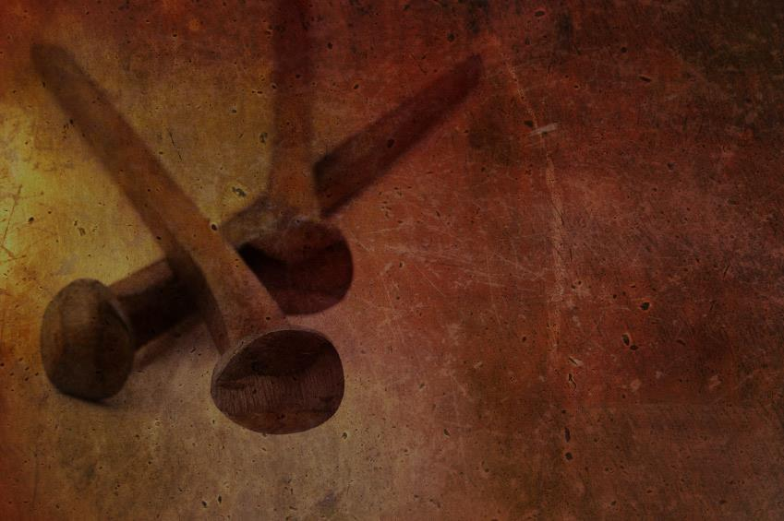
1. They Nailed Down the Faithfulness of God
2 Cor.1:20
Rom. 4:21
Eph. 3:20
Phil. 3:211
Tit. 1:2
Heb. 6:18
God’s Faithful
Promises
Now to Him who is able to do exceedingly abundantly above all that we ask or think, according to the power that works in us.
and being fully convinced that what He had promised He was also able to perform.
It is impossible for God to lie, we might have strong consolation, who have fled for refuge to lay hold of the hope set before us.
who will transform our lowly body that it may be conformed to His glorious body, according to the working by which He is able.
For all the promises of God in Him are Yes, and in Him Amen, to the glory of God through us.
In hope of eternal life which God, who cannot lie, promised before time began.
Notes:
1. THEY NAILED DOWN THE FAITHFULNESS OF GOD
Notice the promises of God fulfilled through the nails of the cross of Christ
Verses
2 Cor. 1:20 – whatever HE says He will do, and it is a yes, a permanent yes
Rom. 4:21 – Abraham believing what God had promised, although he and Sarah was past the age of having a child through which all nations would be blessed
Eph. 3:20 -
Heb. 11:11
Tit. 1:2
Heb. 6:18 - hope
3. Consider the difficulties it took to bring about Jesus Christ
a. 4,000 years of time was involved in bringing about this plan, as it was going about He would drop a hint or prophecy here or there about the one who would come to forgive sins
b. The right family (Abraham) and tribe (Judah)
c. remnant spared from captivity
d. Christ came into this world exactly when God said he would come, and where he said he would come (Bethleham)
e. We see the faithfulness of God and His promises when He sent Jesus to die for our sins, and the Father seeing it, watching it from heaven

Slide 3
1. They Nailed Down the Faithfulness of God
Jn. 8:24
Matt. 10:32-33
Mk. 16:16
Rev. 2:10
Heb.10:26-27
God’s Faithful
Warnings
You will die in your sins; for if you do not believe that I am He, you will die in your sins."
Therefore whoever confesses Me before men, him I will also confess before My Father who is in heaven. But whoever denies Me before men, him I will also deny before My Father who is in heaven.
If we sin willfully after we have received the knowledge of the truth, there no longer remains a sacrifice for sins, but a certain fearful expectation of judgment, and fiery indignation.
Be faithful until death, and I will give you the crown of life.
He who believes and is baptized will be saved
Notes:
1. While it is true that God will carry out all His promises, it is equally true that he will carry out all His warnings
2. verses
3. So the nails of the cross nailed down the fact that God will keep His promises, even at the cost of His Son’s death on the cruel cross of Calvary

Slide 4
2. They Nailed Closed the Door of Judaism
Col. 2:13-14
Eph. 2:14
Heb. 9:15
Gal. 5:4
He has made alive together with Him, having forgiven you all trespasses, having wiped out the handwriting of requirements that was against us, which was contrary to us. And He has taken it out of the way, having nailed it to the cross.
You have become estranged from Christ, you who attempt to be justified by law; you have fallen from grace.
He is the Mediator of the new covenant, by means of death, for the redemption of the transgressions under the first covenant, that those who are called may receive the promise of the eternal inheritance.
For He Himself is our peace, who has made both one, and has broken down the middle wall of separation, having abolished in His flesh the enmity, that is, the law of commandments contained in ordinances
Notes:
2. THEY NAILED CLOSED THE DOOR OF JUDAISM
We are not under the Old Testament system:
Verses
a. Gal. 5:4To try to return to that system is to fall from grace circumsion, keeping Sabbath, instruments, trying to do works to save. If a person takes some things from the OT and some from the NT until he gets a blend that he likes, has fallen from grace
3. The Old Law served as a schoolmaster, looking forward to the coming Messiah
4. The nails nailed shut are the requirements of the Old Law…

Slide 5
3. They Nailed Together Christ and His Church
Acts 20:28
Eph. 5:25
Eph. 5:31-32
FOR THIS REASON A MAN SHALL LEAVE HIS FATHER AND MOTHER AND BE JOINED TO HIS WIFE, AND THE TWO SHALL BECOME ONE FLESH.“ This is a great mystery, but I speak concerning Christ and the church.
Husbands, love your wives, just as Christ also loved the church and gave Himself for her
Take heed to yourselves and to all the flock, among which the Holy Spirit has made you overseers, to shepherd the church of God which He purchased with His own blood.
Notes:
3. THEY NAILED TOGETHER CHRIST AND HIS CHURCH
1. Many have the wrong attitude toward the church:
a. “The church is not essential to salvation”
b. “Join the church of your choice” as long as your sincere
2. THE NAILS WERE DRIVEN TO PURCHASE JESUS’ CHURCH! What He did when He went to that cross was buy for Himself a group of people called the church. And the purpose of taking those nails in his hands and feet was so that He could have you in that body
a. Acts 20:28
b. Ephesians 5:25
As in life some want to mess around with marriages, speak of the wife as if she’s not important…so also the Church…
3. Some will:
a. Forsake the church
b. Resent the church
c. Ignore the church
d. Divide the church
4. The church and Christ are as much a unit as a husband and a wife — Ephesians 5:31-32
Which leads us to consider the terms of entrance into that Church…

Slide 6
4. They Nailed Together the Blood and Baptism
Rev. 7:13-14
1 Pet. 1:18-19
Then one of the elders answered, saying to me, "Who are these arrayed in white robes, and where did they come from?" And I said to him, "Sir, you know." So he said to me, "These are the ones who come out of the great tribulation, and washed their robes and made them white in the blood of the Lamb
knowing that you were not redeemed with corruptible things, like silver or gold, but with the precious blood of Christ.
Notes:
4. THEY NAILED TOGETHER THE BLOOD AND BAPTISM
A. It is only through the blood of Christ that we have redemption in Christ

Slide 7
4. They Nailed Together the Blood and Baptism
3 Facts
Washed in His blood and in baptism – Rev. 1:5; Acts 22:16
Remission of sins in His blood through baptism – Matt. 26:28; Acts 2:38
Blood shed in His death and we are baptized into that death – Jn. 19:34; Rom. 6:3-4
Or do you not know that as many of us as were baptized into Christ Jesus were baptized into His death? Therefore we were buried with Him through baptism into death, that just as Christ was raised from the dead by the glory of the Father, even so we also should walk in newness of life.
Repent, and let every one of you be baptized in the name of Jesus Christ for the remission of sins; and you shall receive the gift of the Holy Spirit.
one of the soldiers pierced His side with a spear, and immediately blood and water came out.
For this is My blood of the new covenant, which is shed for many for the remission of sins.
And now why are you waiting? Arise and be baptized, and wash away your sins, calling on the name of the Lord.
Jesus Christ, the faithful witness... To Him who loved us and washed us from our sins in His own blood.
Notes:
2. Three facts that show beyond question the relationship between baptism and blood
We are washed from our sins in His blood (Revelation 1:5 “To Him who loved us and washed us from our sins in His own blood”). We are washed from our sins in baptism (Acts 22:16).
b. It is through the blood that we have remission of sins (Matthew 26:28). It is through baptism that we have remission of sins (Acts 2:38).
c. It was in Christ’s death that His blood was shed (John 19:34). We are baptized into His death… Romans 6:3-4
3. The nails of cross have joined baptism and the blood of Christ.
a. Man cannot draw out these nails
b. Mark 16:16
Is there then any other way?????

Slide 8
5. They Nailed Shut Every Other Way
Jn. 14:6
Acts 4:12
I am the way, the truth, and the life. No one comes to the Father except through Me.
Nor is there salvation in any other, for there is no other name under heaven given among men by which we must be saved.
Notes:
5. THEY NAILED CLOSED EVERY OTHER WAY
a. John 14:6 Not Mohamad, Pope, earn my way
b. Acts 4:12 “Nor is there salvation in any other, for there is no other name under heaven given among men by which we must be saved."
2. People will say that there are many ways of salvation, but — John 10:1 “Most assuredly, I say to you, he who does not enter the sheepfold by the door, but climbs up some other way, the same is a thief and a robber. “
3. All of this through the love of God…proven by the nails of the cross…..

Slide 9
6. They Nailed Down the Love of God
Rom. 5:8-9
Matt. 26:39
Matt. 27:46
Heb. 13:5
God demonstrates His own love toward us, in that while we were still sinners, Christ died for us. Much more then, having now been justified by His blood, we shall be saved from wrath through Him
My Father, if it is possible, let this cup pass from Me; nevertheless, not as I will, but as You will.
MY GOD, MY GOD, WHY HAVE YOU FORSAKEN ME?
For He Himself has said, "I WILL NEVER LEAVE YOU NOR FORSAKE YOU.
Notes:
6. THEY NAILED DOWN THE LOVE OF GOD
1. Romans 5:8-9 = we were filthy, ugly, diseased, hetious looking creatures spiritually before the grace of Christ. Were we not? Did we not look like death to God? The world was full of people even back then. And even then, even knowing those things God looked down and said they need help. And He was willing to send His Son, and put Him upon that cross, so that we might be cleansed from our sins, bought back from that death we were in, and be made whole, white, clean before God
2. Look at the nails when you are having a tuff time in life. Many things seem to hide the love of God from us
a. Sin may seem to hide the love of God — but it really shouldn’t
b. Sickness may seem to hide the love of God from us — but it really shouldn’t
c. Pain may seem to hide the love of God from us — but it really shouldn’t
d. Grief may seem to hide the love of God from us — but it really shouldn’t
3. But look at the nails!
a. Consider Jesus’ cry for help
1) Matthew 26:39 – What was the Father’s decision, what was Jesus decision, let this happen why? Because they love you
b. Consider the pitiful sigh from the cross
1) Matthew 27.46
2) Yes, God made the choice of Love
4. Hebrews 13:5 “Let your conduct be without covetousness; be content with such things as you have. For He Himself has said, "I WILL NEVER LEAVE YOU NOR FORSAKE YOU."
— this fact has been nailed down by the nails of the cross

Slide 10
The Nails of the Cross
1. They Nailed Down the Faithfulness of God
2. They Closed the Doors of Judaism
3. Nailed Together Christ and His Church
4. They Nailed Together the Blood and Baptism
5. They Nailed Shut Every Other Way
6. They Nailed Down the Love of God

Slide 11
The Nails of the Cross
Hear John 12:48
Believe John 8:24
Repent Luke 13:3
Confess Matt. 10:32-33
Baptized Mark 16:16
Faithful Matt. 24:13
Notes:
One day they led Him up Calvary's mountain
One day they nailed Him to die on a tree
Suffering anguish, despised and rejected
Bearing our sins, my Redeemer is He
Hands that healed nations, stretched out on a tree
And took the nails for me
Living, He loved me
Dying, He saved me
Buried, He carried my sins far away
Rising, He justified freely forever
One day He's coming
Oh glorious day
One day the grave could conceal Him no longer
One day the stone rolled away from the door
Then He arose, over death He had conquered
Now He's ascended, my Lord evermore
Death could not hold Him, the grave could not keep Him
From rising again

