Slide 1
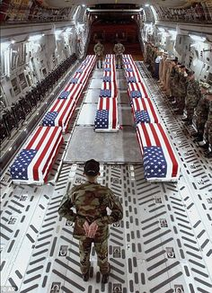
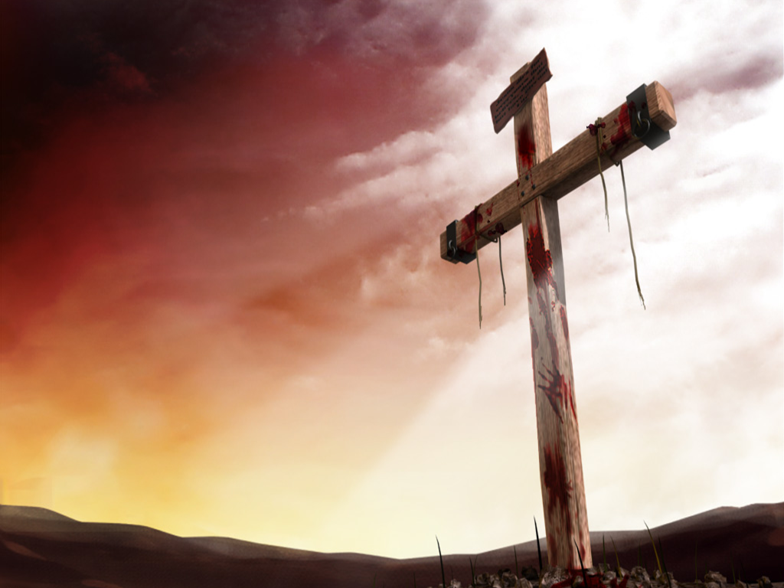
The Cost of
Freedom
Notes:
1. Traditionally, American has been one of the freest countries in the world.
2. However, it has come at great cost : 140 million have served. 1.3 million have died.

Slide 2
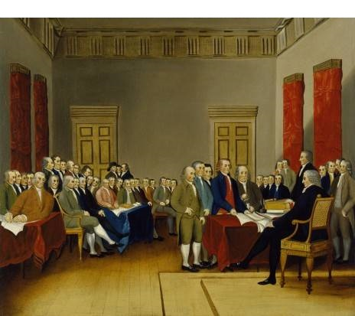
Our founders paid a heavy price for their stand. Of the 56 signers of the declaration:
- 5 were captured and tortured to death
- 12 had their homes looted and burned
- 2 lost sons, 2 more had sons captured
- 9 fought and died as a result of wounds
- The rest were impoverished in various
ways.

Slide 3
Yet today, freedom comes at great cost.
Our military budget is $612,500,000,000
473 Seaworthy Ships
13,680 Flight ready aircraft
2,266,883 People in military

Slide 4
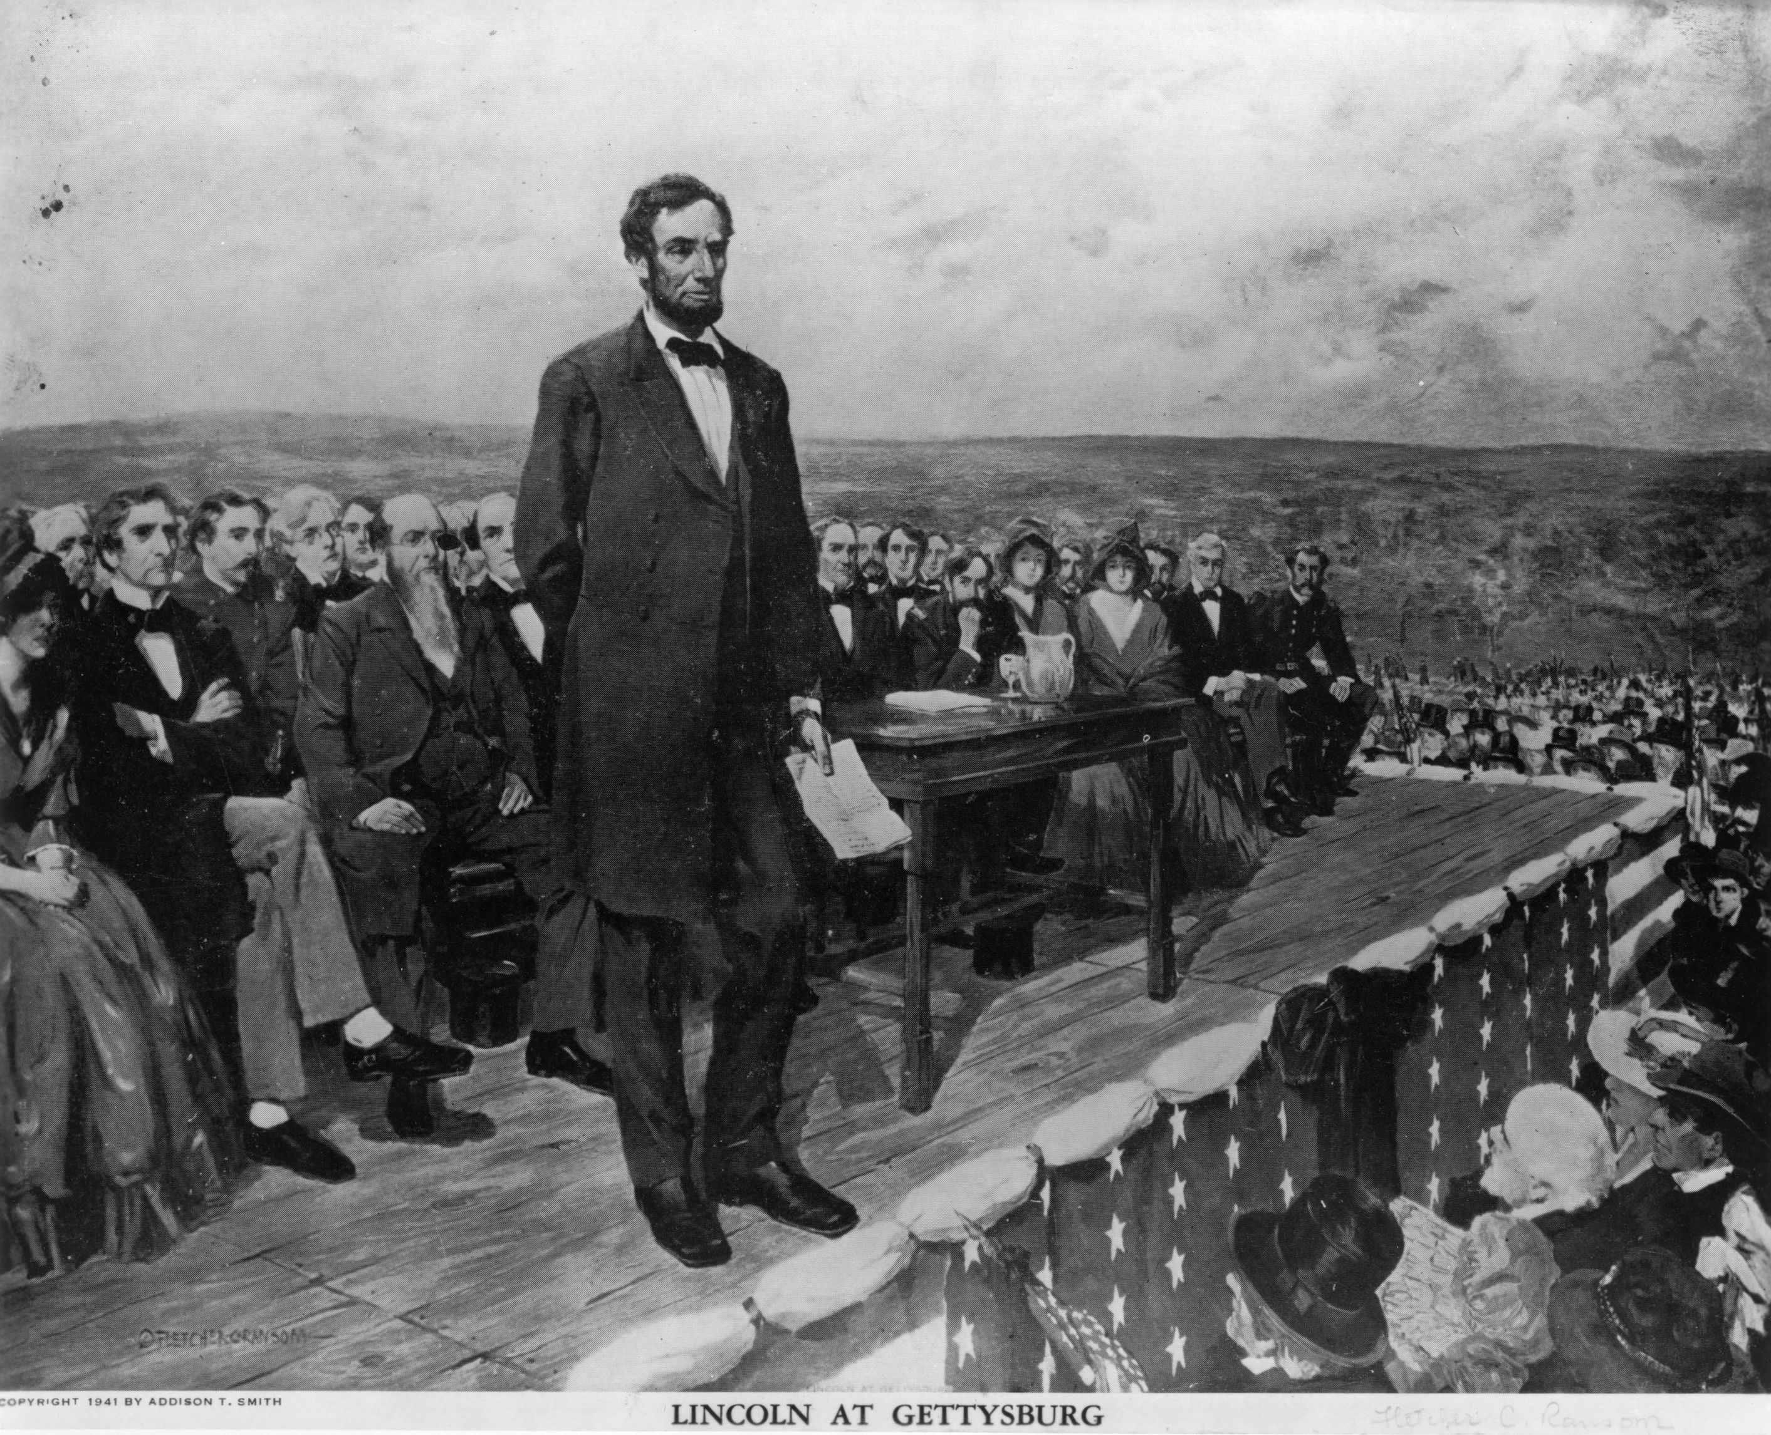
Lincoln’s Gettysburg Address
“…that we here highly resolve that these dead shall not have died in vain – that this, nation under God, shall have a new birth of freedom – and that government of the people, by the people, for the people, shall not perish from the earth.”
Notes:
Our lesson this morning will observe some to the parallels between political and spiritual freedom.

Slide 5
1
The cost of our
spiritual freedom
is also great.

Slide 6
The penalty for sin is death.
Romans 6:23
For the wages of sin is death.
Romans 3:23
For all have sinned and fall short of the glory of God.

Slide 7
Sin brought the death penalty upon all mankind.
Romans 5:12
Therefore, just as through one man sin entered into the world, and death through sin, and so death spread to all men, because all sinned.
Notes:
Read slide
There is no way a person can pay the penalty except to die.
There had to be a solution beyond the scope of man’s ability to restore life.

Slide 8
God paid the penalty for our sins by sacrificing His own Son’s blood.
John 3:16
For God so loved the world that He gave His only begotten Son, that whoever believes in Him should not perish but have everlasting life.

Slide 9
God paid the penalty for our sins by sacrificing His own Son’s blood.
Mark 10:45
For even the Son of Man did not come to be served, but to serve, and to give His life a ransom for many.

Slide 10
God paid the penalty for our sins by sacrificing His own Son’s blood.
Philippians 2:5-8
Let this mind be in you which was also in Christ Jesus, who, being in the form of God, did not consider it robbery to be equal with God, but made Himself of no reputation, taking the form

Slide 11
God paid the penalty for our sins by sacrificing His own Son’s blood.
Philippians 2:5-8
of a bondservant, and coming in the likeness of men. And being found in appearance as a man, He humbled Himself and became obedient to the point of death, even the death of the cross.

Slide 12
Jesus voluntarily sacrificed Himself to give us freedom from sin.
Titus 2: 14
Christ Jesus who gave Himself for us to redeem us from every lawless deed, and to purify for Himself a people for His own possession, zealous for good deeds.

Slide 13
2
Thanks to the sacrifice of Jesus we enjoy many freedoms.

Slide 14
Jesus gives us freedom from the Law of Sin and Death.
Romans 8: 1–2
Therefore there is now no condemnation for those who are in Christ Jesus. 2 For the law of the Spirit of life in Christ Jesus has set you free from the law of sin and of death.

Slide 15
Jesus gives freedom from the guilt of sin.
Ephesians 1:7-8
In Him we have redemption through His blood, the forgiveness of our trespasses, according to the riches of His grace which He made to abound toward us.

Slide 16
Jesus gives freedom from the guilt of sin.
Hebrews 10:17
And their sins and their lawless deeds I will remember no more.

Slide 17
Jesus was the once
for all sacrifice.
Hebrew 10:14
For by one offering He has perfected forever those who are being sanctified.

Slide 18
Freedom from the
fear of judgment.
Romans 8:1
Therefore there is now no condemnation for those who are in Christ Jesus
1 John 5: 13
These things I have written to you who
believe in the name of the Son of God, so that you may know that you have eternal life.

Slide 19
Freedom from the
fear of judgment.
1 John 4:17-18
Love has been perfected among us in this: that we may have boldness in the day of judgment; because as He is, so are we in this world. There is no fear in love; but perfect love casts out fear, because fear involves torment. But he who fears has not been made perfect in love.

Slide 20
Freedom from the fear of death.
Romans 8:9-11
But you are not in the flesh but in the Spirit, if indeed the Spirit of God dwells in you. Now if anyone does not have the Spirit of Christ, he is not His. And if Christ is in you, the body is dead…

Slide 21
Freedom from the fear of death.
Romans 8:9-11
because of sin, but the Spirit is life because of righteousness. But if the Spirit of Him who raised Jesus from the dead dwells in you, He who raised Christ from the dead will also give life to your mortal bodies through His Spirit who dwells in you.

Slide 22
3
With freedom comes responsibility, and an ongoing cost.

Slide 23
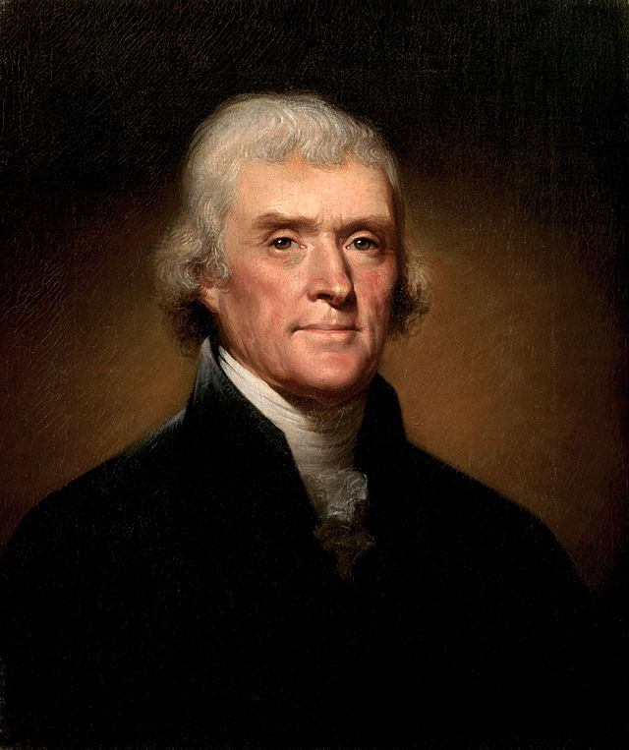
“The price of liberty
is eternal vigilance.”
- Thomas Jefferson

Slide 24
Our Christian faith is under greater attacks than those against our nation.
1 Peter 5:8
Be sober, be vigilant; because your adversary the devil walks about like a roaring lion, seeking whom he may devour.

Slide 25
Satan’s most effective tools are those that Christians do not guard against.
Hebrews 2:1
Therefore we must give the more earnest heed to the things we have heard, lest we drift away.
Notes:
1. Serve the agent of our freedom.
2. Only the idle will drift
3. An idle mind is the devil’s workshop and idle hands his favorite tools.”

Slide 26
You were saved to serve.
Hebrews 9:14
how much more shall the blood of Christ, who through the eternal Spirit offered Himself without spot to God, cleanse your conscience from dead works to serve the living God?

Slide 27
Do not become weary because
your labors will be rewards.
I Corinthians 15:58
Therefore, my beloved brethren, be steadfast, immovable, always abounding in the work of the Lord, knowing that your labor is not in vain in the Lord.

Slide 28
Our freedom was purchased
at a terrible cost.
What are we doing with it ?

Slide 29
What are you doing to make sure others enjoy what you have?
2 Timothy 2:2
And the things that you have heard from me among many witnesses, commit these to faithful men who will be able to teach others also.

Slide 30
Plan of Salvation
Hear Jn. 12:48
Believe Jn. 8:24
Repent Lk. 13:3
Confess Matt. 10:32
Baptized Mk. 16:16
Faithful Matt. 24:13

Slide 31
Deacons Work Areas
Benevolence
Worship and Education
Paul Wilson
Ken Sullivan
Treasury
Evangelism
Facilities
G.E. Midkiff
Allen Phillips
Fellowship and Youth
Brian Walker

