Slide 1
The Bible
and
Astronomy
Notes:
1. Aim: To show that the world of astronomy is another proof that the Bible is true.

Slide 2
Gen. 1:3
And God said, “Let there
be light…”

Slide 3
Gen. 1:14-19
Then God said, "Let there be lights in the firmament of the heavens to divide the day from the night; and let them be for signs and seasons, and for days and years; and let them be for lights in the firmament of the heavens to give light on the earth“ and it was so.

Slide 4
Gen. 1:14-19
Then God made two great lights: the greater light to rule the day, and the lesser light to rule the night. He made the stars also. God set them in the firmament of the heavens to give light on the earth

Slide 5
Gen. 1:14-19
and to rule over the day and over the night, and to divide the light from the darkness. And God saw that it was good. So the evening and the morning were the fourth day.

Slide 6
Astronomy
Astron = Star
Nomos = Law
Star
Law
Law
Giver
Notes:
1. The word “astronomy” derives from two roots — astron = “star” and nomos = “law.”
a. The word suggests an arrangement or distribution of the stars.
b. This, in itself, implies a law-giver or an arranger.
c. Astronomy, then, basically means star law. It suggests the idea that the stars or the heavenly bodies function according to law.
d. They are not characterized by haphazardness, randomness, but rather, they function according to what we call celestial laws.

Slide 7
Cosmos
Order
Arrangement
Design
Orderly
Notes:
1. The Greeks called the universe cosmos
a. The word “cosmos” = order, arrangement, design. It is the opposite of the word “chaos.”
b. Cosmos is that which is orderly. Chaos is that which is disorderly.
c. The universe, then, is not the chaos. It’s the cosmos.

Slide 8
Law
“ordinances of the moon and the stars for a light by night”
Jer. 31:35
“The Fixed Order” ESV
Notes:
1. The Bible itself speaks of the “ordinances” of the heavens (Jer. 31:35) “ordinances of the moon and the stars for a light by night”
a. What’s an ordinance? Well, a law. So Jeremiah then suggests the idea that the heavenly bodies are regulated according to law
b. The ESV says “The fixed order”
c. It is a fundamental principle of logic that where there is law, there must be a law-giver.
d. The U.S. Constitution did not compose itself!
e. The law-giver, the orderer of the universe, is its Creator, God.

Slide 9
1. Origin of Heavenly Bodies
Natural
Supernatural
Notes:
1. ORIGIN OF HEAVENLY BODIES
A. Only 2 possibilities as to the origin of the universe
1. It occurred either naturally or supernatural.
2. The question is: which idea is taught by the evidence?

Slide 10
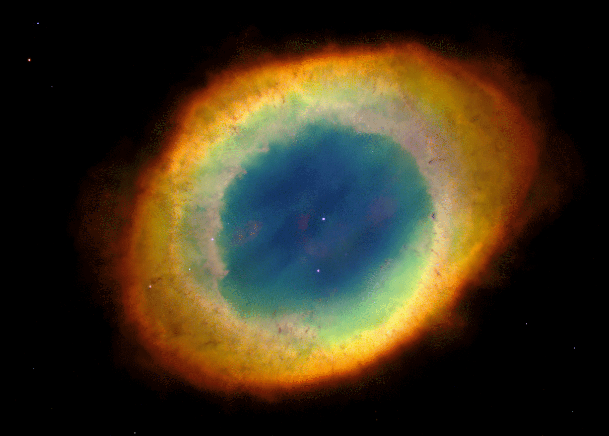
The Big Bang Theory
20 Billion years ago
Cosmic Egg
Notes:
B. The common view today is that the universe resulted from the “Big Bang Theory”
1. It is suggested that all the matter then in existence (which supposedly dates to some 20 billion years ago) “was compressed into an infinitely dense and hot mass” (called a “cosmic egg”)

Slide 11
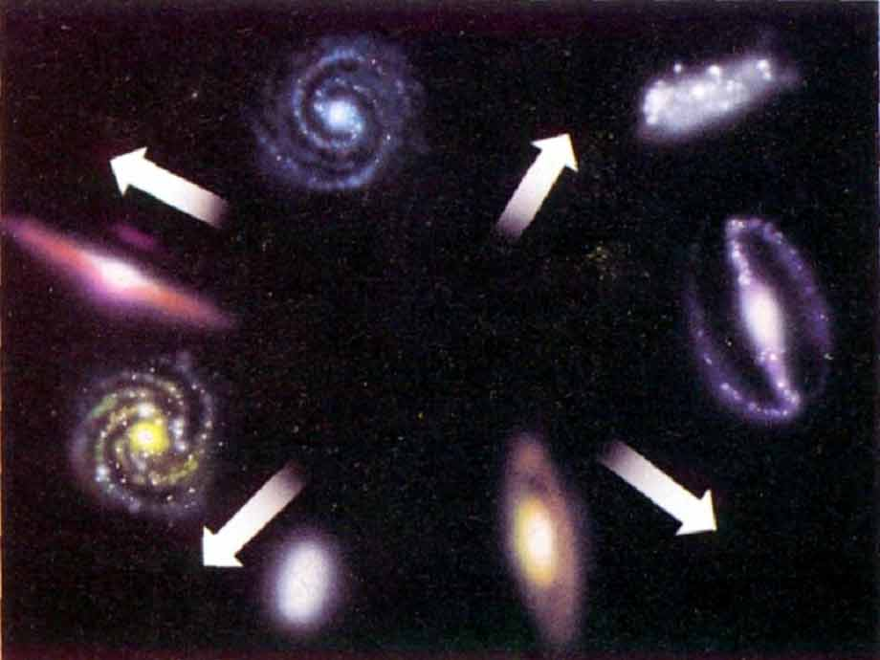
Big Bang!
Notes:
1. that finally exploded (about 10 billion years ago), thus producing the ordered systems of the universe
2. The “egg” was “many billions of times smaller than a single proton”. Where this “egg” came from, no one seems to know. Certainly no “cosmic chicken” has yet been located!
3. There are, however, many problems with the Big Bang theory. Consider just 2 of them.

Slide 12
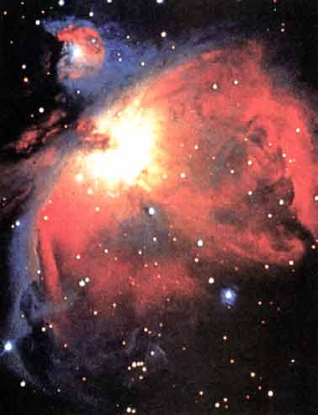
If the big bang
theory were true,
the matter would
be evenly distributed.
Instead it is “lumpy.” There are clusters of stars then great “voids.”

Slide 13
The Big Bang Theory
- Explosion would not bring order
“Every house is built by someone: but the builder of all things is God” Heb. 3:4
Notes:
a. No mere “explosion” could have made this machine we call the universe
b. A blowup in a printing factory does not produce an encyclopedia.
c. A stack of lumber and dynamite cannot construct a house.
d. An explosion propels objects radially - in all directions.
e. If you light a firecracker on the driveway, after it explodes you will find paper fragments scattered all around. There is no order to these.
f. The planets in our solar system have order, balance, and arrangement.
g. It is not just randomness. There is order.
2. “Every house is built by someone; but the builder of all things is God” (Heb. 3:4)
a. Intelligence can fashion a habitable dwelling; mere force cannot.
b. And so, “an accident” is not an adequate explanation for an ordered system.
c. Henri Poincare (1854-1912), considered to be one of the greatest mathematicians and original thinkers of his day, declared: “The world is
Divine because of its harmony”

Slide 14
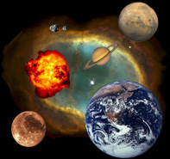
2. Astronomy
and Design
“The heavens declare the glory of God: and the sky above proclaims His handiwork.” Ps. 19:1
Notes:
2. ASTRONOMY AND DESIGN
A. David declared in Psalms 19:1 “The heavens declare the glory of God; and the sky above proclaims his handiwork.”
1. The stars testify concerning God in 2 ways:
a. The vastness of the universe is a testimony to His Power.
b. The organization is testimony to His Intelligence.

Slide 15
The Number of the
Heavenly Bodies
3,000
150 BC
100 Septillion
Notes:
A. The Number of the Heavenly Bodies is beyond our ability to understand.
1. Ancient men and astronomers tried to number the stars.
a. In 150 B.C., Hipparchus estimated there were less than 3,000 stars.
b. Three centuries later, Ptolemy suggested a slightly larger figure.
c. One of the latest estimates today is that there could be as many as 100 septillion stars in space (that's a 1 followed by 26 zeros).

Slide 16
The Number of the
Heavenly Bodies
Gen. 22:17
“As the host of heaven cannot be numbered”
Jer. 33:22
Notes:
1. All the while, though, the Scriptures had taught that the stars are numberless
a. Gen. 22:17 “I will multiply thy seed as the stars of the heaven,”
b. Jer. 33:22 “As the host of heaven cannot be numbered, neither the sand of the sea measured: so will I multiply the seed of David my servant, and the Levites that minister to me.”

Slide 17
The Number of the
Heavenly Bodies
“He counts the number of the stars; He calls them all by name.” Ps. 147:4
Notes:
1. And God knows them all by name - Psa. 147:4 “He counts the number of the stars; He calls them all by name.”
2. What power has the Maker of this universe!

Slide 18
“When I consider thy heavens, the work of Thy fingers, the moon and the stars, which thou hast ordained”
Ps. 8:3
Notes:
A. David described the starry hosts as Jehovah's “handiwork,” indeed, the exquisite work of his “fingers” (Psa. 8:3). “When I consider thy heavens, the work of thy fingers, the moon and the stars, which thou hast ordained;”
1. Job exclaimed that the heavens were “garnished” by the Creator (Job 26:13).
2. Heb. 11:3 says the “worlds” were “framed” by the words of God

Slide 19
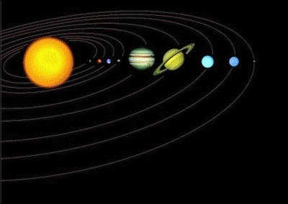
- 93 million miles away
- Spins 1,000 mph
- Orbits 66,000 mph
- Travels 595 million miles
Earth
GOD
What started this movement ?
Notes:
A. Reflect upon some of the design features of the Lord's universe. Astounding to think of the intelligence that was behind them
1. Our earth is the 3rd planet from the sun (93 million miles away). It is spinning on its axis at the rate of 1,000 miles per hour (at the equator).
a. The earth is moving in an elliptical orbit around the sun at an average speed of 66,600 m.p.h.
b. It travels 595 million miles in its yearly route around the “track.”
c. What started all this movement? How did it get started by itself as the evolutionist would claim
(1) There is no natural explanation.
(2) Sir Isaac Newton's First Law of Motion asserts that a stationary object will remain so until force is exerted upon it from some other source.
(3) This fact has forced many philosophers and logicians to postulate a “Prime Mover.”
(4) The Bible calls Him “God.”

Slide 20
- Centrifugal force, Gravity
- Steel cable 8,000 miles in diameter
- Digresses from straight line 1/9 inch every 18 miles
Notes:
1. The earth is delicately balanced in its orbit.
(1) As the earth moves around the sun, centrifugal force pushes it outward (much like a weight attached to a string and whirled above your head).
(2) At the same time, the force of gravity pulls it toward the sun.
(3) It would take a steel cable at least 8,000 miles in diameter (comparable to that of our earth) to equal the strength
of the force which ties this planet to the sun
(4) Gravity ! What a mysterious force.
(a) We constantly see its effect, but still do not fully understand it.
(b) We can explain the principle of its universal force, but we really do not even know what it is.
2. The amazing balance between these forces of nature can be explained reasonably only in the light of intelligent design.
3. Think about this. As the earth travels in its orbit around the sun, it must make minute adjustments to conform to its elliptical “track.”
a. Our planet digresses from a straight line one-ninth of an inch every eighteen miles.
b. If the modification was only 1/10 of an inch, our globe would gradually move toward outer space and eventually become a frozen ball.
e. If the adjustment was as much as 1/8 of an inch, we would be pulled toward the sun and burned up.
f. The balance is just right.

Slide 21
1 inch = 93 million miles

Slide 22
3. The Purpose of
Heavenly Bodies
Why did God Create the Sun, the Moon and the Stars ?
Notes:
3. THE PURPOSE OF HEAVENLY LUMINARIES
A. Why did God create the sun, the moon, and the stars?
1. Most of them are far beyond mans ability to visit, even if a human could survive there.
2. If one wanted to draw a map of our universe, with a scale of 1 inch = 93 million miles (the distance from earth to the sun), his paper would have to be four miles long to include our next nearest star.
3. The map would need to be 25,000 miles long just to reach to the center of the Milky Way galaxy!

Slide 23
What is man, that Thou art mindful of him? and the son of man, that Thou visits him?
Ps. 8:4

Slide 24
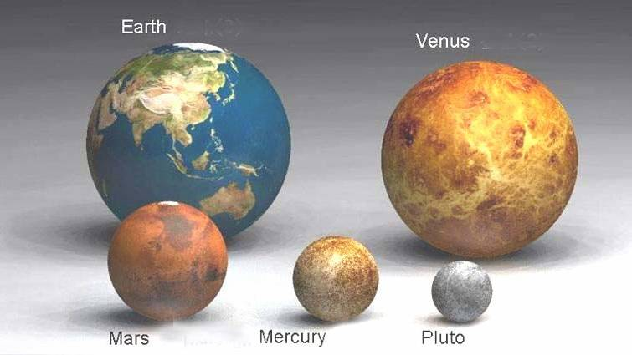
Earth
Venus
Mars
Mercury
Pluto
Notes:
1. Size of the earth with Venus, Mars, Mercury and Pluto - Larger

Slide 25
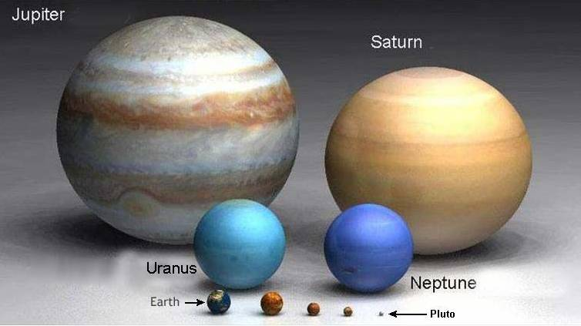
Jupiter
Saturn
Earth
Notes:
2. Comparison to Saturn and Jupiter - smaller

Slide 26
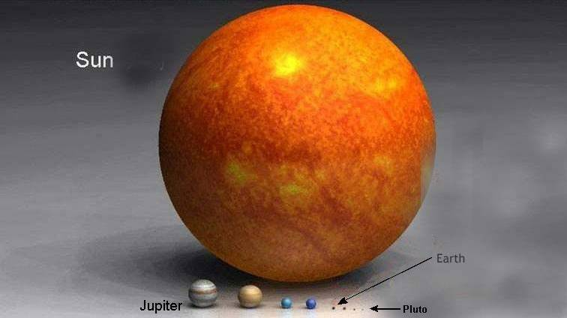
Sun
Earth
Jupiter
Notes:
3. When the Sun is shown the earth is a tiny speck

Slide 27
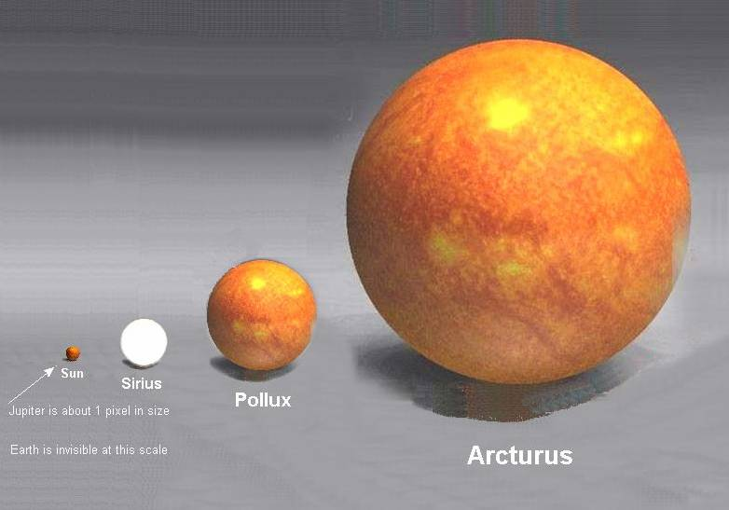
Sun
Earth is invisible
Arcturus
Notes:
1. Pollux (giant star)
2. In comparison to the star Arcturus (orange giant star) the sun is very small and the earth is invisible

Slide 28
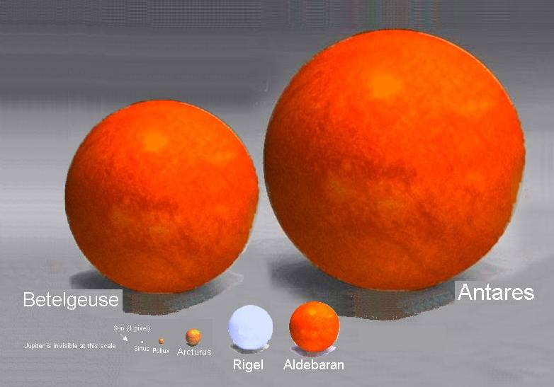
Antares
Arcturus
Notes:
5. But the Star Antares (red supergiant star) makes Arcturus look very small
6. So in comparison the earth and mankind are very small and insignificant.

Slide 29
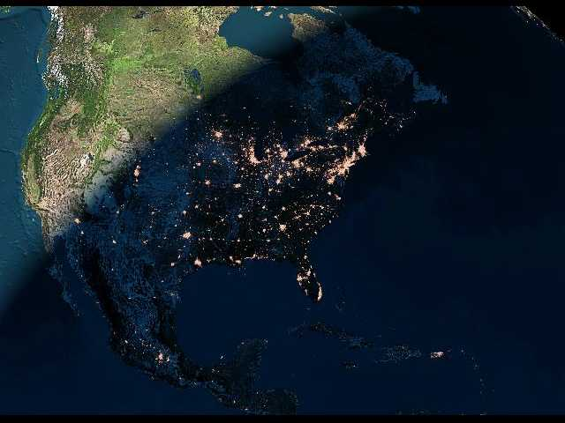
NIGHTFALL IN USA
Divide the Day from the Night
Seasons
Days
Years
Notes:
A. Moses described the purpose of the planets and stars in Genesis 1.
1. They were designed to “divide the day from the night,” to be for “signs, and for seasons, and for days and years,” and to serve in the expanse to “give light upon the earth” (1:14-15).
2. The sun provides light (and heat) upon the earth for the day time.
3. It is called the “greater” light (compared to the moon); it is significant that the inspired Writer did not say, the “greatest” light (as the sun would have appeared to the ordinary observer 15 centuries before Christ), for there are many stars larger than the sun.
4. The rotation of our earth upon its axis, in relation to the sun, produces the day-night sequence.
5. The revolution of the earth in its orbit around the sun, each 365 days, measures the year.
6. The incline or decline of the earth on its axis, relative to the sun, provides our seasons, which facilitate the growing of crops.

Slide 30
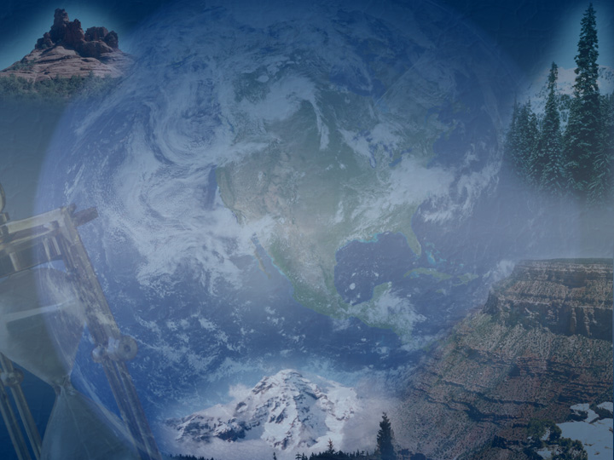
Signs
Joseph - Gen. 37
Balaam – Num. 24:17
Christ – Rev. 22:16
Wise men followed star
Notes:
1. Further, the Lord has made use of celestial bodies as “signs” for the teaching of spiritual lessons.
a. When Joseph dreamed of the sun, moon, and stars bowing down to him (Gen. 37), it was a prophetic symbol of his future glory.
b. Balaam's prophecy of a “star” to come out of Jacob (Num. 24:17), is most likely a preview of the coming of Christ, who refers to himself as “the bright and morning star” (Rev. 22:16).
c. God employed some sort of heavenly light (“star” — a generic term) to guide the wise men to the place where the infant Christ lay (Mt. 2:2, 9). This phenomenon cannot be explained except by a miracle.

Slide 31
Evidence
Of the Creator's
Genius and Power
Notes:
1. The sun, moon, and stars are magnificent evidences of the Creator's genius and power.
2. They are both beautiful and serve a purpose through a grand design
3. Dr. Arthur Harding, Professor of Mathematics and Astronomy at the University of Arkansas, wrote: As we look at the machines in some of our factories we sometimes wonder at what the mind of man has created, overlooking the fact that we are living on a little World that is a part of a gigantic machine which is operating silently in the sky . Surely here is a gigantic machine which makes us stand in awe and wonder at the power of the creator who could design such a machine and put it into operation.

Slide 32
Should not Worship
Deut. 4:19
Isa. 47:13
Jer. 44:19
Notes:
1. Unfortunately, over the centuries, some have given the heavenly bodies undue prominence.
a. It is an interesting fact that whereas in ancient times some gave much attention to the sun, moon, and stars — even worshiping them — the Hebrews were not preoccupied with such matters, doubtless due to prohibition against star worship,
b. Deut. 4:19; 17:2-5;
c. Isa. 47:13;
d. Jer. 44:19
e. Modern devotees of astrology (who allege that the sky's luminaries have control over the destinies of men) are equally pagan.

Slide 33
"The heavens declare
the glory of God;
and the firmament
shows His Handiwork"
Ps. 19:1

Slide 34
Don't put a question mark
where God put a period.

Slide 35
Plan of
Salvation
Hear John 12:48
Believe John 8:24
Repent Luke 13:3
Confess Matt. 10:32-33
Baptized Mark 16:16
Faithful Matt. 24:13

