Slide 1
How To Study
The Bible
Tools Needed
Rightly Dividing
The Words
The Context

Slide 2
Thy Word is a lamp unto my feet and a light unto my path. Ps. 119:105

Slide 4
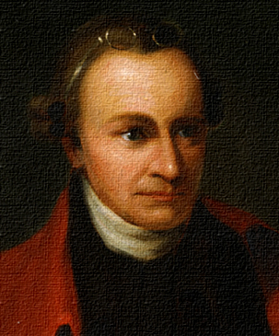
The Bible is worth all other books which have ever been printed. - Patrick Henry

Slide 5
Studying the Bible - Compared to Eating
John 6
v. 35 “And Jesus said to them, "I am the bread of life. He who comes to Me shall never hunger, and he who believes in Me shall never thirst.”
v. 63 "It is the Spirit who gives life; the flesh profits nothing. The words that I speak to you are spirit, and they are life.”
Notes:
1. Studying the Bible is comparable to eating. Just as physical life cannot exist without food and drink, it is also true concerning spiritual life.
a. John 6:35 “And Jesus said to them, "I am the bread of life. He who comes to Me shall never hunger, and he who believes in Me shall never thirst.”
b. John 6:63 “It is the Spirit who gives life; the flesh profits nothing. The words that I speak to you are spirit, and they are life.”
2. As we study the Bible there are certain tools we must have. Notice the comparison to eating or feeding the physical body with feeding the soul.

Slide 6
Requirements for Bible Study
Desire to learn
Matt. 5:6 “hunger and thirst”
1 Pet. 2:2 “desire the pure milk of the word”
Belief in Inspiration
2 Tim. 3:16-17 “inspiration of God”
Willing to put in the effort
Rev. 1:3 “Blessed is he that reads”
Notes:
Requirements for Bible Study
A. Desire to Learn
1. When we are hungry, no one has to beg us to eat. Same is true when we are spiritually hungry
2. Matthew 5:6 “Blessed are those who hunger and thirst for righteousness, For they shall be filled.”
3. 1 Peter 2:2
a. “as newborn babes, desire the pure milk of the word, that you may grow thereby”
b. Desire = to yearn, intensely crave, long after
c. The ones who will understand the Bible are those who have a great desire to do so.
d. A baby desires milk. It does not care about the color of the nursery, or the kind of clothing it is wearing, or about the kind of car you are driving.
e. A baby is single minded, it wants milk.
4. If we are going to learn the word of God, we must have a strong desire to learn.
B. Belief in Inspiration
1. If we do not believe that food is safe to eat we will leave it alone.
2. 2 Timothy 3:16-17 “All Scripture is given by inspiration of God, and is profitable for doctrine, for reproof, for correction, for instruction in righteousness, that the man of God may be complete, thoroughly equipped for every good work.”
3. If we do not believe the Bible is from God, then it will not be something we want to study.
C. Willing to Put in the effort
1. Must read
2. An unread Bible is like food uneaten, a love letter never read, a buried sword, a road map unstudied, gold never mined”
3. God’s will is revealed in written form
4. Revelation 1:3 “Blessed is he who reads and those who hear the words of this prophecy, and keep those things which are written in it.”
5. Read it silently, read it aloud, read it carefully.
6. Have a Bible reading plan.
7. Have you read the entire Bible? Have you ever read the entire New Testament?

Slide 8
Growth from Bible Study
Eat the Right Amount
Eat a Balanced Meal
Eat Correctly
Eat Healthy Food
Eat with Dignity
Notes:
Growth
A. The study of the Bible is foundational to our growth as a Christian. Therefore, every Christian should plan to study the Bible, similar to the way one eats food to grow physically.
B. Actually, several parallels may be drawn between good eating habits and a healthy approach to Bible study.
1. First, eat the right amount. Eat enough because eating too much or too little has long term implications on both the body and spirit.
2. Second, eat a balanced meal. Just as one does not grow strong physically by eating only desserts, so a Christian will not grow strong in the faith without a balanced approach to Bible study.
3. Third, eat right rather than simply stuffing your mouth, or swallowing without chewing. We need to both devour and digest the Scriptures as we study. Reading the Bible without meditating on it, is like trying to eat without swallowing.
4. Fourth, we must eat healthy food and avoid a constant diet of junk food. Many Christians get side-tracked in their Bible study by becoming
involved in speculation and meaningless side issues, such as prophecy or an endless study of numbers.
5. Fifth, we should eat with dignity, not like a dog or a pig.
a. One way to accomplish that goal is to eat routinely rather than only when you want to eat. Eating balanced meals at regular intervals is one key to long term good health.
b. Likewise, getting into the Scriptures on a daily basis is a good discipline to encourage ongoing spiritual growth.
c. The secret of our future spiritual maturity lies in our daily of Bible study.

Slide 9
Study Habits
When to Study
Where to Study
Regular Study
Notes:
Study Habits
A. When to study
1. Study when you are physically alert. (Some in the early morning, others late at night).
2. Study when you are not interrupted. TV, phones, IPads, etc.
3. Study a little each day – don’t have to study all day
a. Discipline yourself to get in the habit of regular study.
B. Where to Study
1. Familiar place.
a. If at all possible, create for yourself a special “study” in your home.
b. In a spare room, the attic, behind the garage, etc. — somewhere find a “study nook” that can be yours.
2. Make it your special place and plan to visit it regularly on each day of the week
C. Regular study
1. Many begin January 1st and then by February 1st they have forgotten
2. Make it a daily - regular habit.
3. You don’t forget to eat physically because you get hungry.

Slide 10
Tools for Bible Study
A Good Bible
Good Translation
KJV - NKJV
ASV - NASV
Notes:
TOOLS FOR BIBLE STUDY
A. Have a good Bible
1. Purchase a Bible that you can read
2. Don’t be afraid to mark in your Bible. Use special pens or pencil. Some inks bleed through the page.
B. A good Translation
1. There is a language gap - Bible written in Hebrew, Greek, and Aramaic
2. We need an accurate translation - these are called versions
a. Get a translation not a paraphrase
b. Choose a translation that is a product of a number of known, scholarly translators, not a few. The more translators working, the less the chance of letting personal bias enter.
c. Get one that has stood the test of time
3. It is probably best to use one version for regular study and memorizing
a. Comparing versions as you study is a helpful practice, especially with “difficult” passages, and words that may be difficult to understand.
b. The KJV has words that are outdated and the newer translations make it easier to understand in certain places.
4. Some of the good translations are:
a. KJV
b. NKJV
c. NASV

Slide 11
Tools for Bible Study
Bible Concordance
Bible Dictionary and Encyclopedia
Bible Atlas
Bible Commentaries
Notes:
A. Bible Concordance
1. A concordance lists key words in the Bible along with the places where those words occur. You need only one or two words of a verse in order to find it.
2. A Concordance can help you study all that the Bible says on a given subject by referring you to each place in the Bible where that subject is mentioned.
3. You should get a concordance that is adapted to the version you will use, since there are different concordances for each of the major English versions.
D. Bible Dictionary and Bible Encyclopedia
1. There is a cultural gap that must be bridged to understand the Bible
2. Bible dictionaries and encyclopedias help explain some of the differences in the culture of Bible times
3. Some books tell about the customs of Bible times and tell us something about the home life, political situation, occupations, dress, and education of the people.
4. These books are very useful in learning about places, people and things found in the Bible.
E. Bible Atlas - maps
1. These books show the geography of the Bible lands.
2. They show the various maps of Israel at different time periods, Paul’s missionary journeys, the Roman Empire.
F. Bible Commentaries
1. A commentary is an explanation by one or more persons of the meaning of the Bible or some portion of it.
2. There are commentaries which take the books of the Bible apart by verse or section and expound on the meaning.
3. These are very helpful if we keep in mind that they are the opinions of men

Slide 12
Tools for Bible Study
$ 7.00
E - Sword
Free
Notes:
Computer Software
1. A computer Bible Program has all of these tools.
2. It has a search program to help you find a verse or verses.
3. There are several translations.
4. It has a dictionary of all the Hebrew and Greek words.
5. Include several commentaries.

Slide 13
Suggestions For
Studying the Bible
Take Notes
Some Kind of Written Notes
Chapter summary
Major events
First person account
Newspaper account
Notes:
Take Notes
A. It is important as you go along to make some kind of written notes. (research has shown most of us retain more information when we write it down)
1. It might be a chapter summary in which your write a brief summary in your own words of the contents of the chapter you have read and studied
2. It could be a list of major events
3. You might have the ability to write a first person account as if it were the diary of some person in the reading.
4. Or you might write it as an imaginary newspaper account covering the events you just studied.
B. Some kind of written notes are valuable
1. It helps to remember
2. You can go back to them later and review what you have studied.
C. Get yourself a special notebook
1. Loose leaf notebook or a bound notebook
2. Computer - word processing.

Slide 14
Suggestions For
Studying the Bible
30 minutes
Schedule
5 Minutes - Review / Preview
15 Minutes - Rapid Reading
10 Minutes - Taking Stock
Look up words
Re-read parts
Summarize
Notes:
SCHEDULE - you have set aside 30 minutes
A. 5 minutes - Review / Preview
1. Look back at your notes from the previous study
2. Look ahead to the verses or section that you are planning to study
C. 15 minutes - Rapid Reading
1. Read the new material
2. Have a pencil in hand to mark words that you do not understand the meaning and that you want to go back and learn
D. 10 minutes - Taking stock
1. Look up words that are unfamiliar to you. Write down the meaning
2. Re-read parts that were not clear
3. Summarize what you have read in your own words
4. Think of the importance of what you have read and how it relates to your life.

Slide 15
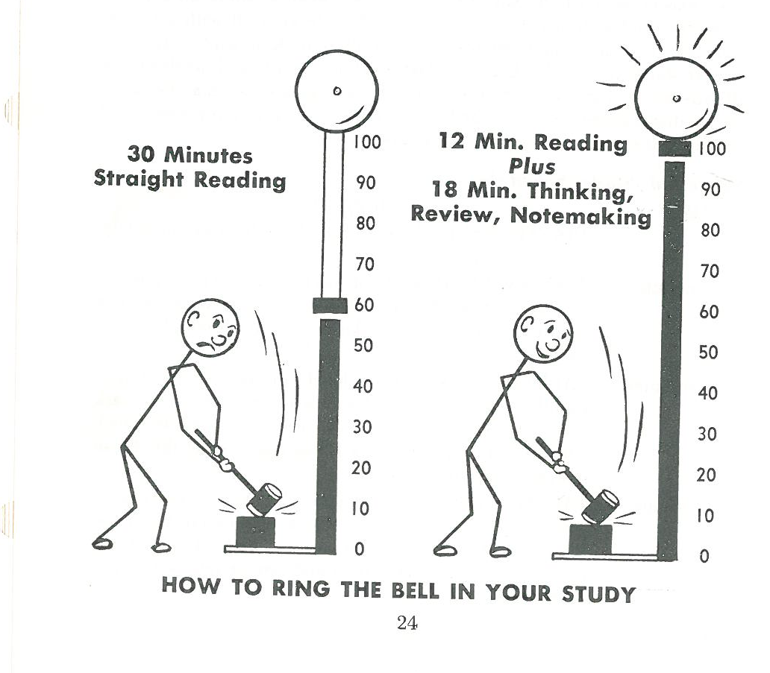
Suggestions For
Studying the Bible

Slide 16
Suggestions For
Studying the Bible
“Meditate on these things; give yourself entirely to them, that your progress may be evident to all.” 1 Tim. 4:15
Meditate = Revolve in the mind
Notes:
1. Do not try to take shortcuts. This method will help you to learn.
2. It is better to do this than just 30 minutes of straight reading.
3. 1 Tim. 4:15 “Meditate on these things; give yourself entirely to them, that your progress may be evident to all.”
4. Meditate = Revolve in the mind

Slide 17
We can understand the Bible
We must apply our mind to gain knowledge
“And you shall know the truth, and the truth shall make you free.” Jn. 8:32
Notes:
1. The Bible student must have a student’s attitude of one who does not know and realizes it. The Bible student will investigate and seek for the truth.
2. John 8:32 “And you shall know the truth, and the truth shall make you free.”
3. The Bible can be understood by the average person.
4. The word study means to apply our mind in order to acquire knowledge.

Slide 18
Hear John 12:48
Believe John 8:24
Repent Luke 13:3
Confess Matt. 10:32-33
Baptized Mark 16:16
Faithful Matt. 24:13

