Slide 1
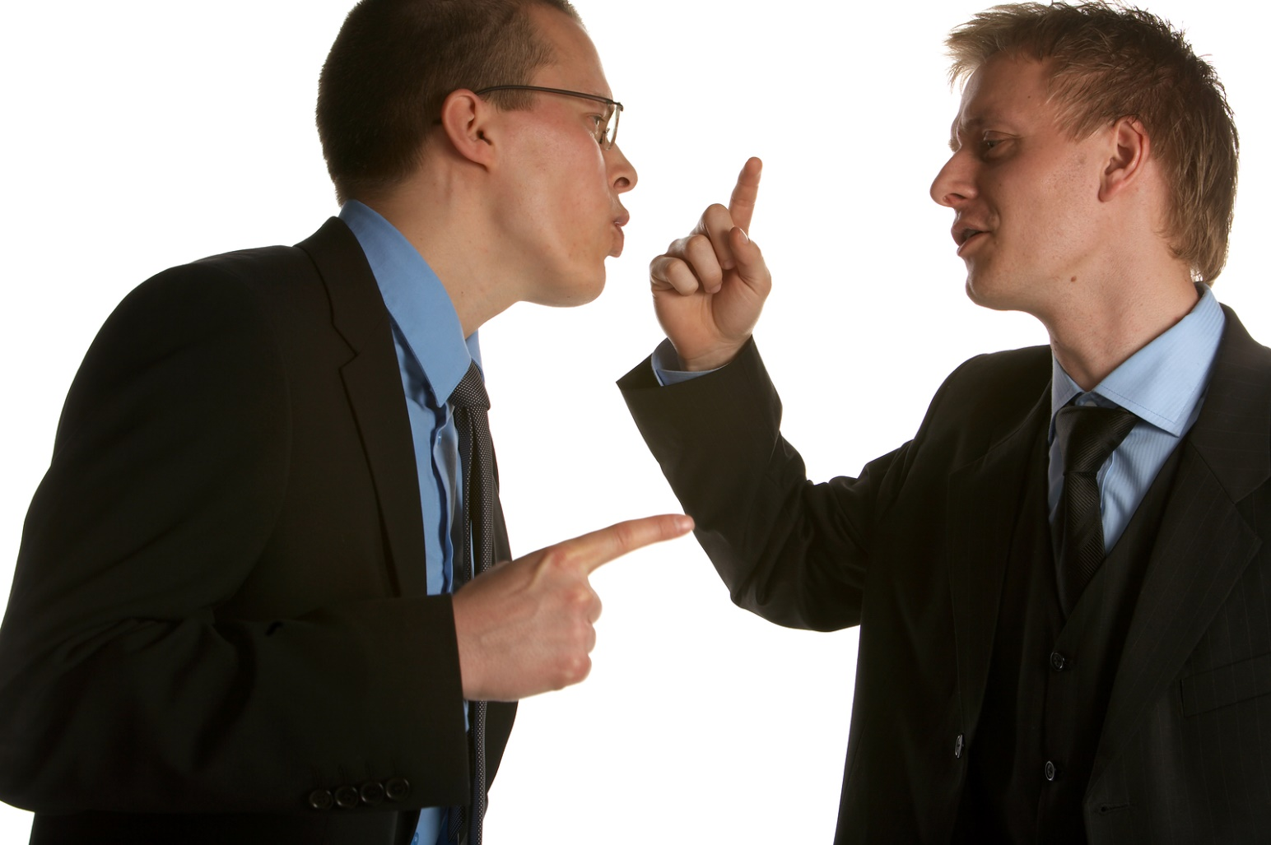
Resolving Conflict Among Brethren
Matt. 5:23-24
Notes:
I am thankful that as a congregation we have peace and unity, as Scripture demands. Many fail to realize that peace and unity does not just happen, but requires ongoing effort to sustain it.
All human relationship have conflict
a. husband - wife
b. parent – child
c. worker – superior
d. friend – friend
e. church member – church member
3. So the question is not whether we are going to have conflicts with other people, the question is, how do we deal with those conflicts when they arise?
4. The purpose of this lesson is not because of a specific problem, but to help us avoid problems in the future so that unity will continue. The answer to avoiding problems is by adhering to the Bible’s instructions when we do have problems with a brother or sister.

Slide 2
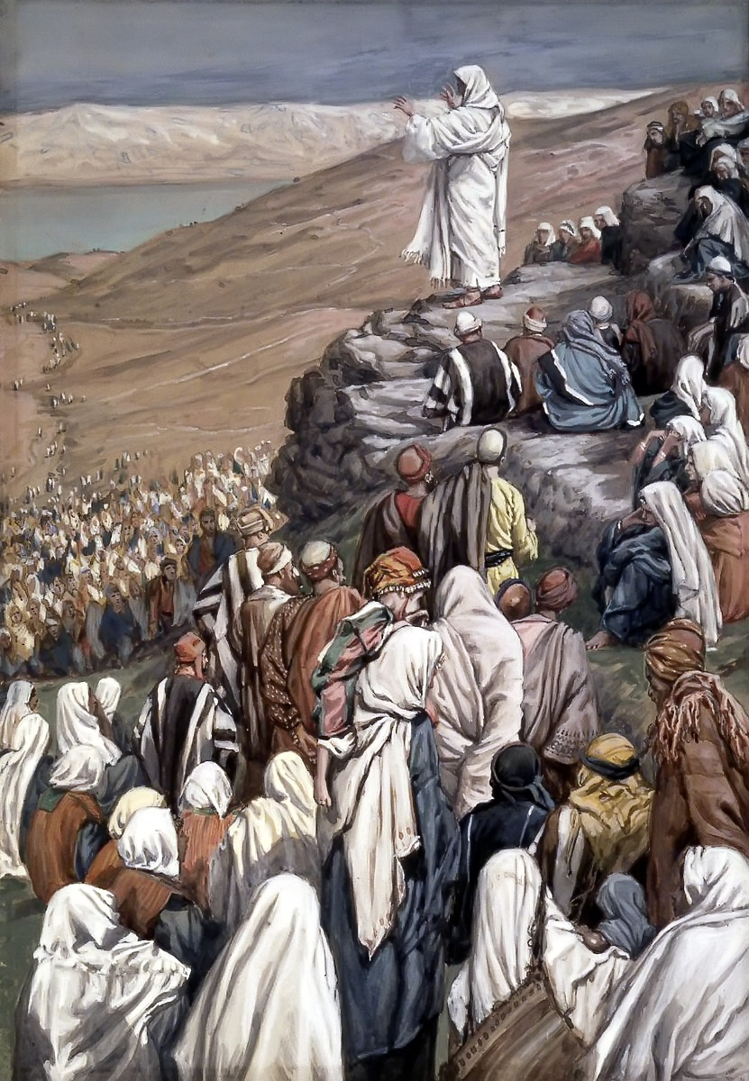
Resolving Conflict Among Brethren
“Therefore if you bring your gift to the altar, and there remember that your brother has something against you, leave your gift there before the altar, and go your way. First be reconciled to your brother, and then come and offer your gift.” Matt. 5:23-24

Slide 3
Resolving Conflict Among Brethren
“Moreover if your brother sins against you, go and tell him his fault between you and him alone. If he hears you, you have gained your brother. But if he will not hear, take with you one or two more, that 'BY THE MOUTH OF TWO OR THREE WITNESSES EVERY WORD MAY BE
ESTABLISHED.' And if he refuses to hear them, tell it to the church. But if he refuses even to hear the church, let him be to you like a heathen and a tax collector.” Matt. 18:15-17
Matt. 18:15-17

Slide 4
Resolving Conflict Among Brethren
“ESTABLISHED. And if he refuses to hear them, tell it to the church. But if he refuses even to hear the church, let him be to you like a Gentile and a tax collector.”
Matt. 18:15-17
Notes:
These words were spoken by Jesus. We are to obey Him. These are not the policies of the congregation, nor the demands of the elders, deacons, or preachers. They are the commands of Jesus who is head over the church. We cannot just ignore what He has said, b/c by His words we will be judged.
Nevertheless, in many congregations, problems arise because of a failure to heed these instructions.
The Bible gives us specific guidelines to follow when we are in conflict with a fellow Christian in the church.

Slide 5
Resolving Conflict Among Brethren
1. First Go
“If your brother sins against you, go and tell him his fault between you and him alone.” Matt. 18:15
“The Lord hates…one who sows discord among the brethren” Prov. 6:16-19
“First be reconciled to your brother…” Matt. 5:24
Notes:
First Go
1. Matt. 18:15 “If your brother sins against you, go and tell him his fault between you and him alone.”
2. No matter what the problems is, the 1st step is the same. Whether your brother/sister has something against you, or your brother sins, we must take the individual responsibility to address the problem.
3. We must first go to our brother or sister. They may be unaware of the problem or offense.
4. Sometimes we are unwilling to speak to each other because it is uncomfortable, or maybe they misunderstood, or they perceived something incorrectly and do not want to be embarrassed.
5. But no matter how hard it is, the instruction of our Lord still remains. We must obey Him to please Him, and by our obedience we maintain the unity in the congregation.
6. Problems erupt because we do not first go our brother, but first go to someone else or several others. Brethren begin to “talk” (i.e., gossip) and discuss their brothers/sisters in an ungodly way.
7. If we just speak to others about our fellow Christians, we are very likely sowing discord among the brethren.
a. This is one of the things God hates (Prov. 6:16–19).
b. So by our ignoring God’s command to go to that person, and circumvent the instruction to do what we think is best, we in fact sin against God and disrupt the unity within the congregation. Do we think that God will not hold us accountable for such things? We must be certain to follow God’s way. He knows best, even if it is hard for us to obey.
8. First, go to your brother/sister. Face the problem. Discuss the problem. Many times things are not what we think they are, and the problems are easily resolved if we will just talk to one another.
9. It is not our place to wait for our brother to come to us, but we are to go to them when there is a problem.
10. Go to him “in private” and not in a place (such as an assembly) when your discussion will be overheard by others.
11. What we should desire is to be “reconciled” (Matt. 5) so that peace and unity can exist.

Slide 6
Resolving Conflict Among Brethren
1. First Go
Principles of Resolving Conflicts
It is not you against me…
Active listening
Get on the same side of the fence
Don’t be a mind reader
Avoid character assassination
Your relationship with brother/sister more important
Love keeps no record of wrongs
Have the heart of Jesus
Notes:
The attitude we bring to the discussion will determine the outcome
1. It is not you against me; it is you and me against the problem. The problem is the problem. In a conflict, even if one side does win, the first reaction of the loser is, I want a rematch: I will come back with meaner words, harder fists and bigger bombs. By focusing on the problem, and not the person with the problem, a climate of cooperation is enhanced.
2. Practice active listening, not passive hearing. Conflicts escalate when people try to talk more than listen and then only listen as a time-out for verbal rearming. Listening well is an act of caring. If you are a good listener, you have many friends. If you are a poor listener, you have many acquaintances.
3. Get on the same side of the fence. Rather than attempting to resolve an issue "my way" or "your way," work toward a solution that represents "our way."
4. Don't be a mind reader. Discuss the problem openly. Don't try to interpret someone's thoughts or motives from their behavior. Instead, ask direct questions. Likewise, don't expect someone to know what you are thinking.
5. Avoid character assassination. As you work to resolve conflict, it's okay to talk about circumstances and behavior. However, attacking someone’s personality or character will never resolve the conflict. And we should never attack another Christian
6. Never forget that your relationship with your brother/sister is far more important than "winning" an argument or "being right."
7. Remember that love keeps no record of wrongs. Be quick to forgive, quick to admit your mistakes, and quick to move on from the conflict.
8. Have the heart of Jesus
*** If both parties brings this attitude to the discussion, the conflict will end right here

Slide 7
Resolving Conflict Among Brethren
2. Take Witnesses
But if he will not hear, take with you one or two more, that 'BY THE MOUTH OF TWO OR THREE WITNESSES EVERY WORD MAY BE ESTABLISHED. Matt. 18:16
Notes:
Take Witnesses after the 1st attempt. (read verse)
Do not take witnesses when you first go. That is not going to your brother in private.
Witnesses are taken a 2nd or even 3rd time to hear for themselves
It may be that they “will not listen” to you, nor to the “witnesses” you bring the 2nd time.
The witnesses are not just there to listen, but to also admonish and teach and plead that our brother be faithful to God.
It is rare when a Christian does not listen when we first go.
a. The problems persist and grow, and our brethren fall away from God, unwilling to listen, when we wait so long to “first go.”
b. We wait till it is too late. They have involved themselves in an attitude to such an extent they are unwilling to change or listen.
6. Church problems often arise when brethren ignore or fail to “first go” for many weeks or months.
a. Don’t wait. If you have a problem with a fellow Christian, go today

Slide 8
Resolving Conflict Among Brethren
3. Tell It To The Church
And if he refuses to hear them, tell it to the church. Matt. 18:17
Notes:
Tell It To The Church (read verse)
We are not told how to exactly follow this instruction.
If elders are present within a congregation, it is logical to speak to the elders who have the oversight.
It is also logical that they might be part of the “witnesses” in going to the brother or sister.
If there are no elders within the congregation, this must still be made known to the church.
a. There is not a right or wrong way to do this (Scripturally).
5. Sadly, many times we want to “tell it to the church” as the 1st and only step rather than the last. Comments, gossip, and rumors are too often practiced by brethren who have a problem with someone else in the congregation

Slide 9
Resolving Conflict Among Brethren
4. Let Him Be To You As A Gentile
And if he refuses to hear them, tell it to the church. But if he refuses even to hear the church, let him be to you like a Gentile and a tax collector.
Matt. 18:17
Yet do not regard him as an enemy, but admonish him as a brother.
2 Thess. 3:15
Notes:
Let Him Be To You As A Gentile (read verse)
1. Don’t miss what is said Matthew 18:17 “...if he refuses even to hear the church...”
a. The “church” is not the “elders.” Every member of a local congregation has a responsibility to speak to a brother who has refused admonition from Scripture and is in danger of walking away from God.
b. Only when he has refused the efforts of the entire congregation is he to be considered like a Gentile. (disfellowshipping)
c. He is still a brother in Christ, though wayward.
d. 2 Thessalonians 3:15 “Yet do not regard him as an enemy, but admonish him as a brother.”
2. Peace and unity are of vital importance within a congregation composed of people who desire to please God by following the instructions of Jesus. To avoid strife, we must be those who are willing to go to our brother. Even if our brother will not listen, we avoid problems within a congregation through submission to God’s will in all things. We each have a personal responsibility to God and to one another.

Slide 10
Resolving Conflict Among Brethren
5. We Must Forgive Each Other
For if you forgive men their trespasses, your heavenly Father will also forgive you. But if you do not forgive men their trespasses, neither will your Father forgive your trespasses.
Matt. 6:14-15

Slide 11
Resolving Conflict Among Brethren
“Now when Peter had come to Antioch, I withstood him to his face, because he was to be blamed; for before certain men came from James, he would eat with the Gentiles; but when they came, he withdrew and separated himself, fearing those who were of the circumcision. And the rest of the Jews also played the hypocrite with him, so that even Barnabas was carried away with their hypocrisy. But when I saw that they were not straightforward about the truth of the gospel, I said to Peter before them all, "If you, being a Jew, live in the manner of Gentiles and not as the Jews, why do you compel Gentiles to live as Jews?” Gal. 2:11-14
Notes:
Paul to Peter

Slide 12
Resolving Conflict Among Brethren

