Slide 1
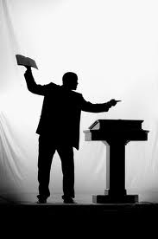
Preaching
Facts
vs.
False
Traditions
of Men

Slide 2
1 Cor. 12:11
…I am nothing
Notes:
1. Corinth in the 1st century: very corrupt. Yet many converted through gospel power.
2. Gospel can still save today!
3. Gospel is God’s ONLY power to save

Slide 3
ROM. 1:16
For I am not ashamed of the gospel of Christ, for it is the power of God to salvation for everyone who believes, for the Jew first and also for the Greek.
Notes:
1. Corinth in the 1st century: very corrupt. Yet many converted through gospel power.
2. Gospel can still save today!
3. Gospel is God’s ONLY power to save

Slide 4
ROM. 1:16
For I am not ashamed of the gospel of Christ, for it is the power of God to salvation for everyone who believes, for the Jew first and also for the Greek.
From Greek
word dunamis,
where we get
words like
dynamite, dynamo

Slide 5
1 COR. 1:21
For since, in the wisdom of God, the world through wisdom did not know God, it pleased God through the foolishness of the message preached to save those who believe.
Notes:
Preaching of that gospel saves the lost
Verse
3. Satan, knowing power of gospel, has done all possible to destroy preaching and preachers.

Slide 6
What is a preacher?
A man who is to preach the WHOLE counsel of God - TIT. 2:15

Slide 7
TITUS 2:15
Speak these things, exhort, and rebuke with all authority. Let no one despise you.
WHAT THINGS?
TITUS 2:12-14
teaching us that, denying ungodliness and worldly lusts, we should live soberly, righteously, and godly in the present age, (13) looking for the blessed hope and glorious appearing of our great God and Savior Jesus Christ, (14) who gave Himself for us, that He might redeem us from every lawless deed and purify for Himself His own special people, zealous for good works.

Slide 8
TITUS 2:15
Speak these things, exhort, and rebuke with all authority. Let no one despise you.
WHAT THINGS?
TITUS 2:12-14
teaching us that, denying ungodliness and worldly lusts, we should live soberly, righteously, and godly in the present age, (13) looking for the blessed hope and glorious appearing of our great God and Savior Jesus Christ, (14) who gave Himself for us, that He might redeem us from every lawless deed and purify for Himself His own special people, zealous for good works.

Slide 9
TITUS 2:15
Speak these things, exhort, and rebuke with all authority. Let no one despise you.
WHAT THINGS?
TITUS 2:12-14
teaching us that, denying ungodliness and worldly lusts, we should live soberly, righteously, and godly in the present age, (13) looking for the blessed hope and glorious appearing of our great God and Savior Jesus Christ, (14) who gave Himself for us, that He might redeem us from every lawless deed and purify for Himself His own special people, zealous for good works.

Slide 10
TITUS 2:15
Speak these things, exhort, and rebuke with all authority. Let no one despise you.
WHAT THINGS?
TITUS 2:12-14
teaching us that, denying ungodliness and worldly lusts, we should live soberly, righteously, and godly in the present age, (13) looking for the blessed hope and glorious appearing of our great God and Savior Jesus Christ, (14) who gave Himself for us, that He might redeem us from every lawless deed and purify for Himself His own special people, zealous for good works.

Slide 11
TITUS 2:15
Speak these things, exhort, and rebuke with all authority. Let no one despise you.
WHAT THINGS?
TITUS 2:12-14
teaching us that, denying ungodliness and worldly lusts, we should live soberly, righteously, and godly in the present age, (13) looking for the blessed hope and glorious appearing of our great God and Savior Jesus Christ, (14) who gave Himself for us, that He might redeem us from every lawless deed and purify for Himself His own special people, zealous for good works.

Slide 12
TITUS 2:15
Speak these things, exhort, and rebuke with all authority. Let no one despise you.
WHAT THINGS?
TITUS 2:12-14
teaching us that, denying ungodliness and worldly lusts, we should live soberly, righteously, and godly in the present age, (13) looking for the blessed hope and glorious appearing of our great God and Savior Jesus Christ, (14) who gave Himself for us, that He might redeem us from every lawless deed and purify for Himself His own special people, zealous for good works.

Slide 13
TITUS 2:15
Speak these things, exhort, and rebuke with all authority. Let no one despise you.
WHAT THINGS?
TITUS 2:12-14
teaching us that, denying ungodliness and worldly lusts, we should live soberly, righteously, and godly in the present age, (13) looking for the blessed hope and glorious appearing of our great God and Savior Jesus Christ, (14) who gave Himself for us, that He might redeem us from every lawless deed and purify for Himself His own special people, zealous for good works.

Slide 14
TITUS 2:15
Speak these things, exhort, and rebuke with all authority. Let no one despise you.
WHAT THINGS?
TITUS 2:12-14
teaching us that, denying ungodliness and worldly lusts, we should live soberly, righteously, and godly in the present age, (13) looking for the blessed hope and glorious appearing of our great God and Savior Jesus Christ, (14) who gave Himself for us, that He might redeem us from every lawless deed and purify for Himself His own special people, zealous for good works.

Slide 15
TITUS 2:15
Speak these things, exhort, and rebuke with all authority. Let no one despise you.
WHAT THINGS?
TITUS 2:12-14
teaching us that, denying ungodliness and worldly lusts, we should live soberly, righteously, and godly in the present age, (13) looking for the blessed hope and glorious appearing of our great God and Savior Jesus Christ, (14) who gave Himself for us, that He might redeem us from every lawless deed and purify for Himself His own special people, zealous for good works.

Slide 16
TITUS 2:15
Speak these things, exhort, and rebuke with all authority. Let no one despise you.
WHAT THINGS?
TITUS 2:12-14
teaching us that, denying ungodliness and worldly lusts, we should live soberly, righteously, and godly in the present age, (13) looking for the blessed hope and glorious appearing of our great God and Savior Jesus Christ, (14) who gave Himself for us, that He might redeem us from every lawless deed and purify for Himself His own special people, zealous for good works.

Slide 17
Preachers are to:
Take heed to self - 1 TIM. 4:16
Keep pure - 1 TIM. 5:22
Be example to believers - 1 TIM. 4:12

Slide 18
Words describing work of preacher
kerusso – proclaim gospel publicly (Acts 8:5)
dialegomai – to debate, argue (Acts 17:17)
evangelizo – to proclaim the good message (Lk. 2:10)
apologia – to make a defense of (Acts 19:33)
didasko – to teach (Matt. 28:20)
agonizomai – to strive, wrestle (1 Tim. 6:12)
parakaleo – to beg, admonish (Lk. 16:28)

Slide 19
Words describing work of preacher
parrasia – to proclaim boldly (Acts 9:27)
elegko – to expose (Eph. 5:11)
EPHESIANS 5:11
And have no fellowship with the unfruitful works of darkness, but rather expose them.

Slide 20
False concepts of preachers & preaching
Catholicism makes a distinction between “clergy” and “laity” not in Bible.

Slide 21
False concepts of preachers & preaching
Elevation of preacher led to unscriptural practices:
Improper designations (“father, reverend”)
Authority to preachers God never intended
Elevating preachers to higher degree of holiness than other members.
Preachers as mediators between God & man.
Giving “priests” authority to forgive sins and offer terms of forgiveness.

Slide 22
Refuting false traditions of men
# 1 - Clergy and laity distinction is false
Of totally human origin.
Christians are ONE in Christ, Gal. 3:27-28
ALL Christians are priests, not just a select few, 1 Pet. 2:5

Slide 23
Gal. 3:27-28
For as many of you as were baptized into Christ have put on Christ. There is neither Jew nor Greek, there is neither slave nor free, there is neither male nor female; for you are all one in Christ Jesus.
1 PETER 2:5
you also, as living stones, are being built up a spiritual house, a holy priesthood, to offer up spiritual sacrifices acceptable to God through Jesus Christ.

Slide 24
Refuting false traditions of men
# 2 – Giving titles to preachers is false
Denominational preachers are called “Reverend,” “Father,” “Pastor,” etc.
No Bible authority for such
Jesus forbids calling anyone “Father” in the sense used by religious world - MATT. 23:9

Slide 25
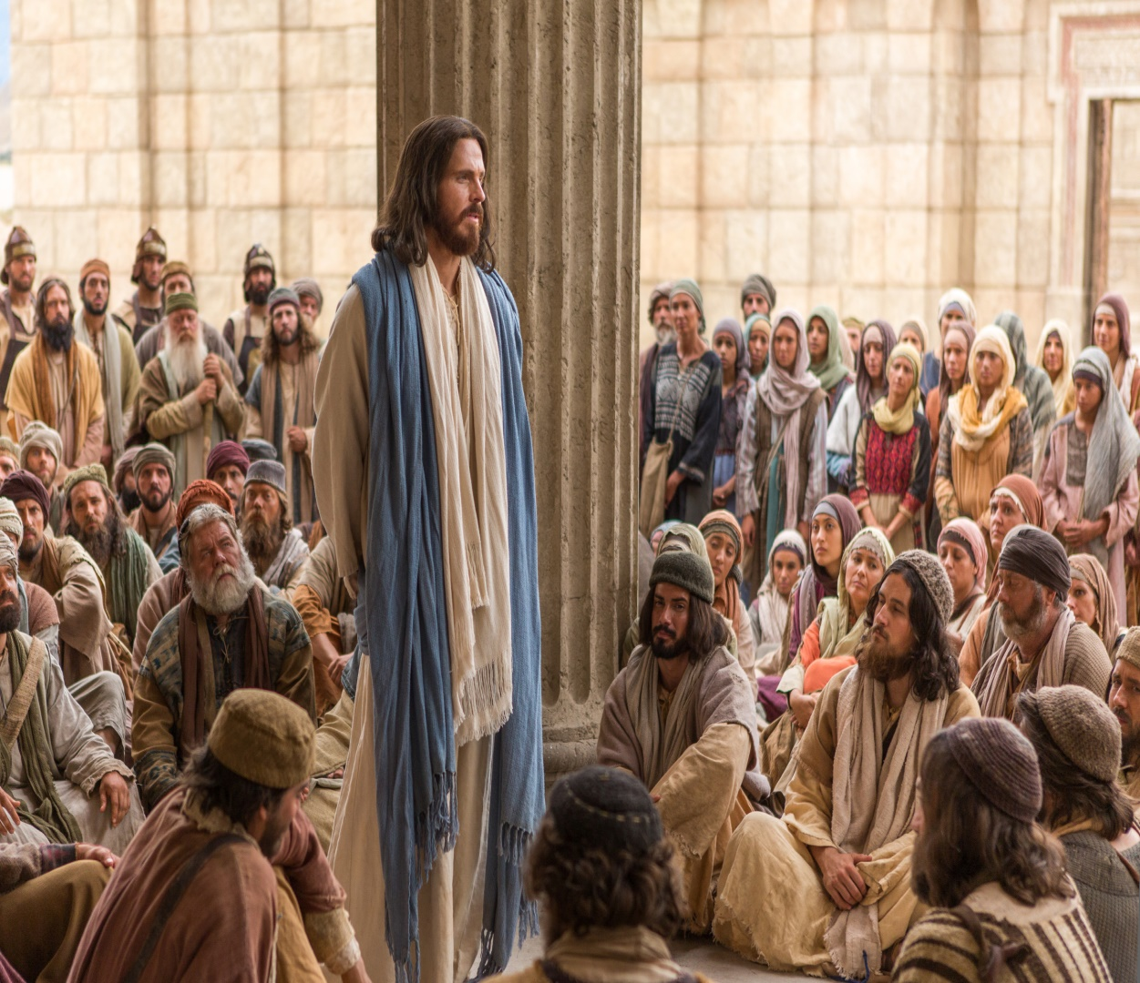
MATTHEW 23:9
Do not call anyone on earth your father; for One is your Father, He who is in heaven.

Slide 26
Refuting false traditions of men
# 2 – Giving titles to preachers is false
Denominational preachers are called “Reverend,” “Father,” “Pastor,” etc.
No Bible authority for such
Jesus forbids calling anyone “Father” in the sense used by religious world - MATT. 23:9
The word “reverend” used only once in KJV of Bible (Ps. 111:9), speaking of GOD

Slide 27
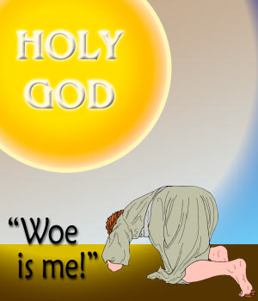
PSALM 111:9
He sent redemption unto His people: He has commanded His covenant for ever: holy and reverend is His name.

Slide 28
Refuting false traditions of men
# 3 – Saying that preachers are miraculously “called” is false
A preacher is a Christian
ALL Christians are called by the gospel, 2 THESS. 2:14

Slide 29
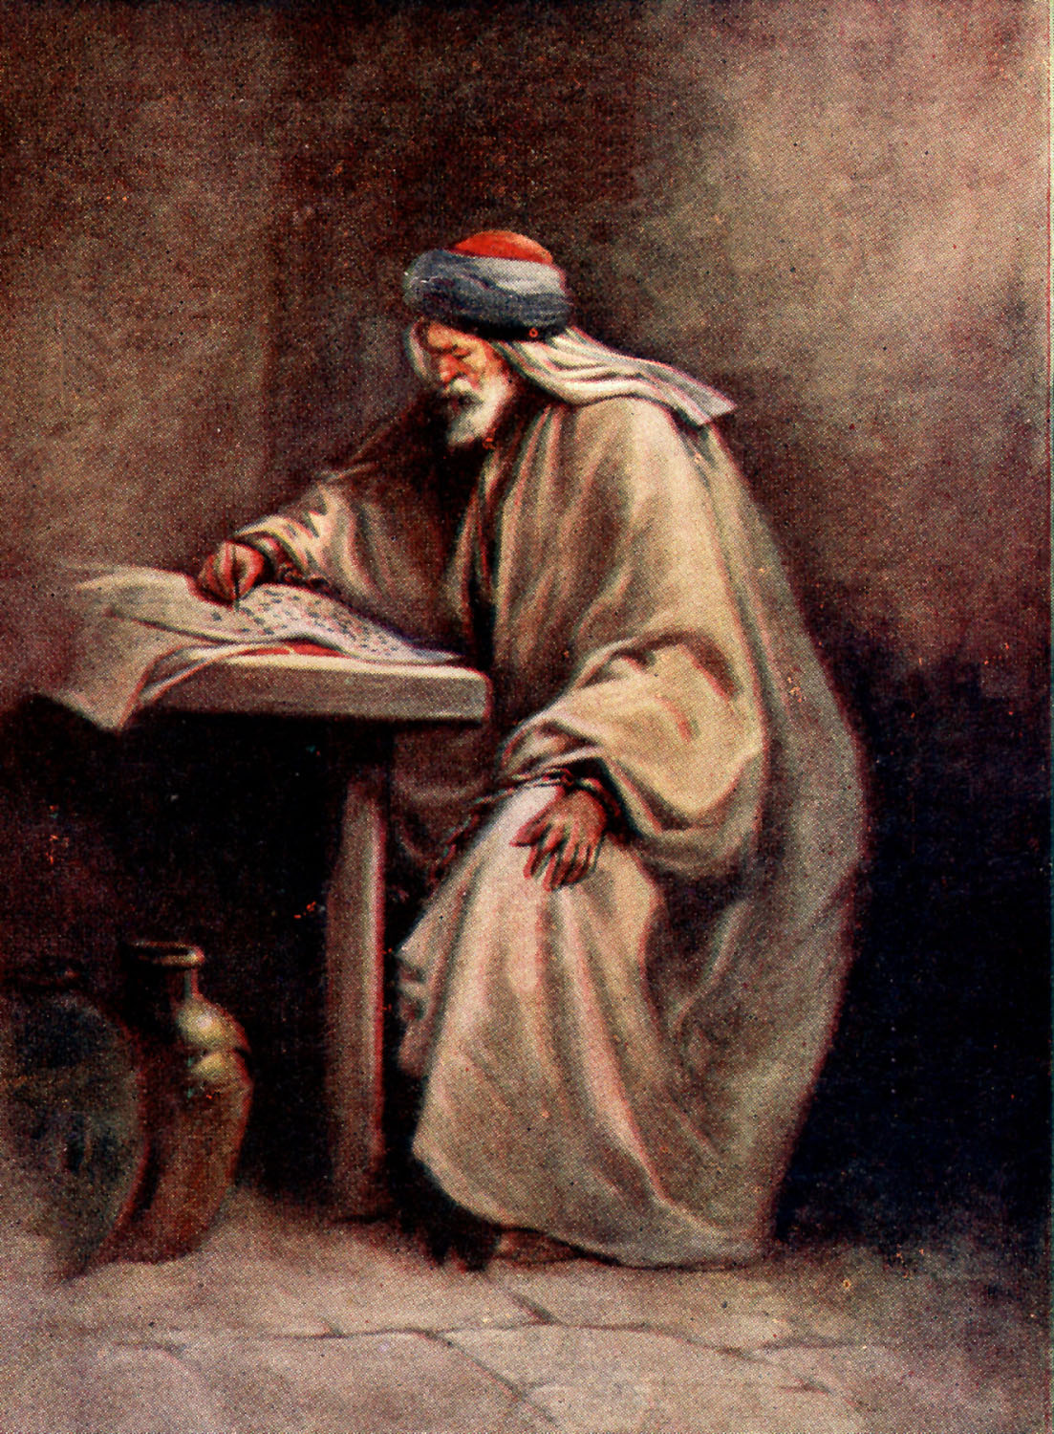
2 THESS. 2:14
to which He called you by our gospel, for the obtaining of the glory of our Lord Jesus Christ.
APOSTLE PAUL

Slide 30
Refuting false traditions of men
# 3 – Saying that preachers are miraculously “called” is false
A gospel preacher is a Christian
ALL Christians are called by the gospel, 2 THESS. 2:14
ALL Christians are called to win souls.
No one receives a “special” call from God.
Our call comes from the inspired, written word of God.

Slide 31
Refuting false traditions of men
# 3 – Saying that preachers are miraculously “called” is false
Men are led to preach by a sincere desire to preach God’s word out of love for man.

Slide 32
Refuting false traditions of men
# 4 – Saying that preachers are pastors is false
“Pastor” is used in Bible to describe ELDERS, not preachers.
A pastor must meet the qualifications listed in 1 TIMOTHY 3 and TITUS 1.
A man not meeting these qualifications is NOT QUALIFIED to be a pastor (elder).

Slide 33
Refuting false traditions of men
# 4 – Saying that preachers are pastors is false
There is no such thing as the
“pastor system” in the Bible

Slide 34
Refuting false traditions of men
# 5 – Saying that preachers must be celibate is false
Originated from false concept that human flesh was evil; marriage was viewed as evil.
“Holy” men and women were forbidden marriage: Catholic priests & nuns.
Marriage is good - HEB. 13:4

Slide 35
HEB. 13:4
Marriage is honorable among all, and the bed undefiled; but fornicators and adulterers God will judge.

Slide 36
Refuting false traditions of men
# 5 – Saying that preachers must be celibate is false
Originated from false concept that human flesh was evil; marriage was viewed as evil.
“Holy” men and women were forbidden marriage: Catholic priests & nuns.
Marriage is good, HEBREWS 13:4.
Peter was married MATT. 8:14

Slide 37
Refuting false traditions of men
# 5 – Saying that preachers must be celibate is false
Paul had the RIGHT to marry - I COR. 9:5

Slide 38
Do we have no right to take along a believing wife, as do also the other apostles, the brothers of the Lord, and Cephas? 1 Cor. 9:5

Slide 39
Refuting false traditions of men
# 5 – Saying that preachers must be celibate is false
The N.T. church has NEVER forbidden scriptural marriage to anyone.
The N.T. condemns those who falsely teach celibacy - 1 TIM. 4:1-3

Slide 40
1 TIM. 4:1-3
Now the Spirit expressly says that in latter times some will depart from the faith, giving heed to deceiving spirits and doctrines of demons, 2 speaking lies in hypocrisy, having their own conscience seared with a hot iron, 3 forbidding to marry, and commanding to abstain from foods which God created to be received with thanksgiving by those who believe and know the truth.

Slide 41
Refuting false traditions of men
# 6 – Making women preachers is false
New Testament prohibits women to teach or have authority over men - 1 TIM. 2:12

Slide 42
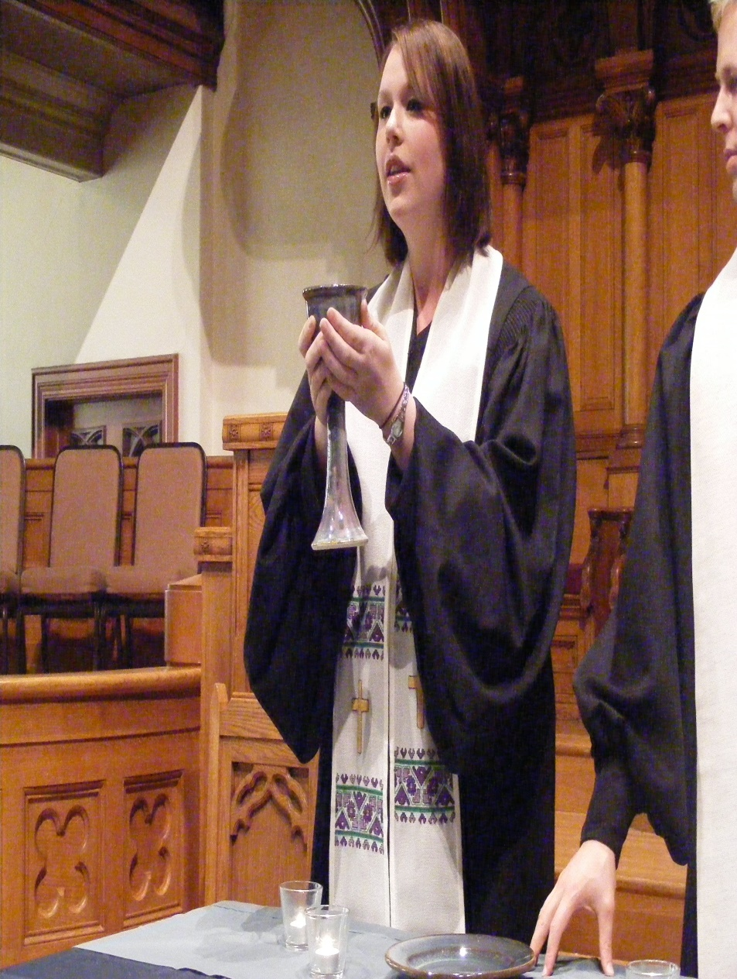
1 TIM. 2:12
And I do not permit a woman to teach or to have authority over a man.

Slide 43
1 TIM. 2:13-14
For Adam was formed first, then Eve. And Adam was not deceived, but the woman being deceived, fell into transgression.

Slide 44
Refuting false traditions of men
# 7 – Saying a preacher’s prayers or actions are more effective is false
Some believe only prayers of a preacher are effective.
Some believe only a baptism done by a preacher is valid.
The prayers of ALL righteous people are accepted by God – Jas. 5:16

Slide 45
Refuting false traditions of men
# 7 – Saying a preacher’s prayers or actions are more effective is false
Prayers of some preachers may not be acceptable because of wicked lives.
It is not the case that preachers ought to visit because “he is the preacher.”
Preachers visit because they are Christians

Slide 46
Refuting false traditions of men
# 1 - Clergy and laity distinction is false
# 2 – Giving titles to preachers is false
# 3 – Saying that preachers are miraculously “called” is false
# 4 – Saying that preachers are pastors is false
# 5 – Saying that preachers must be celibate is false
# 6 – Making women preachers is false
# 7 – Saying a preacher’s prayers or actions are more effective is false

Slide 47
ROM. 1:16
For I am not ashamed of the gospel of Christ, for it is the power of God to salvation for everyone who believes, for the Jew first and also for the Greek.

Slide 48
GOD’S SIMPLE PLAN FOR SALVATION
Rev. 2:10
Acts 2:38
baptism
JN. 12:42
confess
LK. 13:3
repent
OBEDIENT
UNTIL DEATH
JN. 8:24
believe
ACTS 3:22
hear

