Slide 1
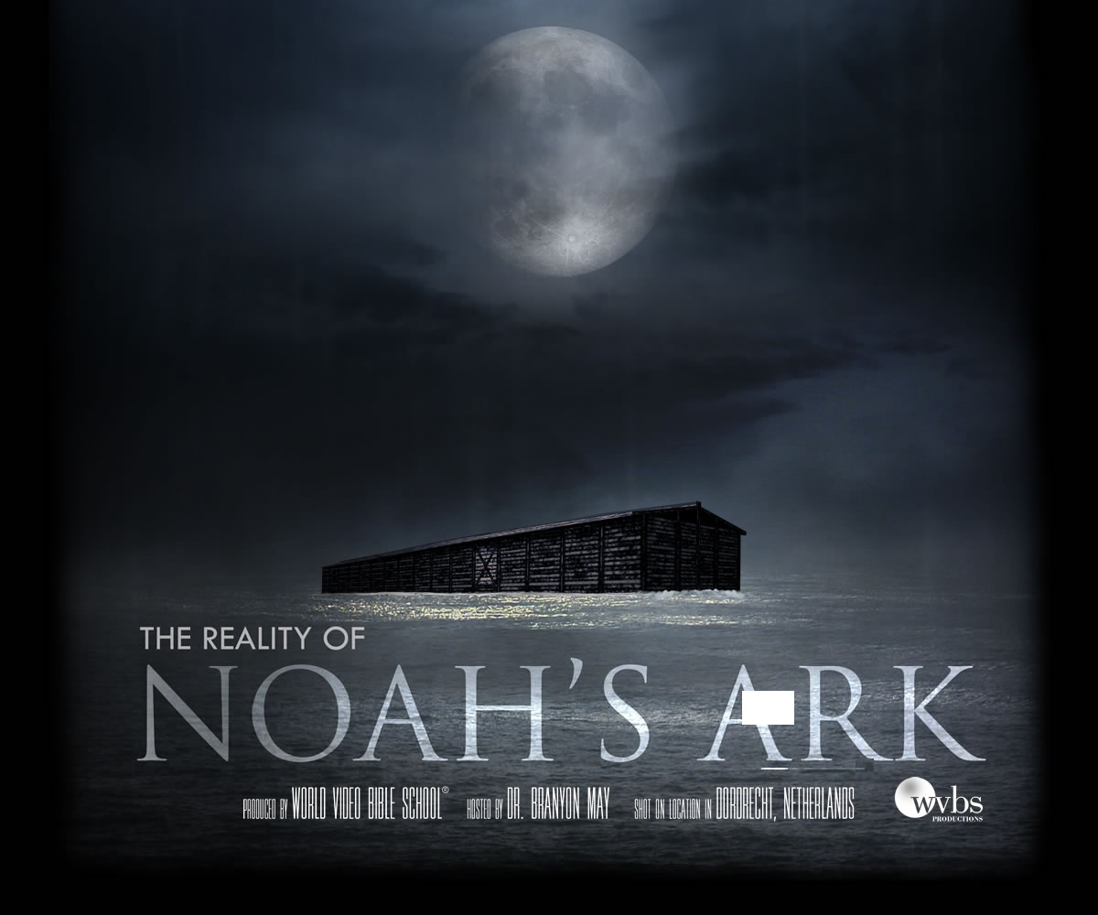
If You Had Been Noah
Notes:
1. Aim: To think about things that Noah did and ask ourself what we would have done.

Slide 2
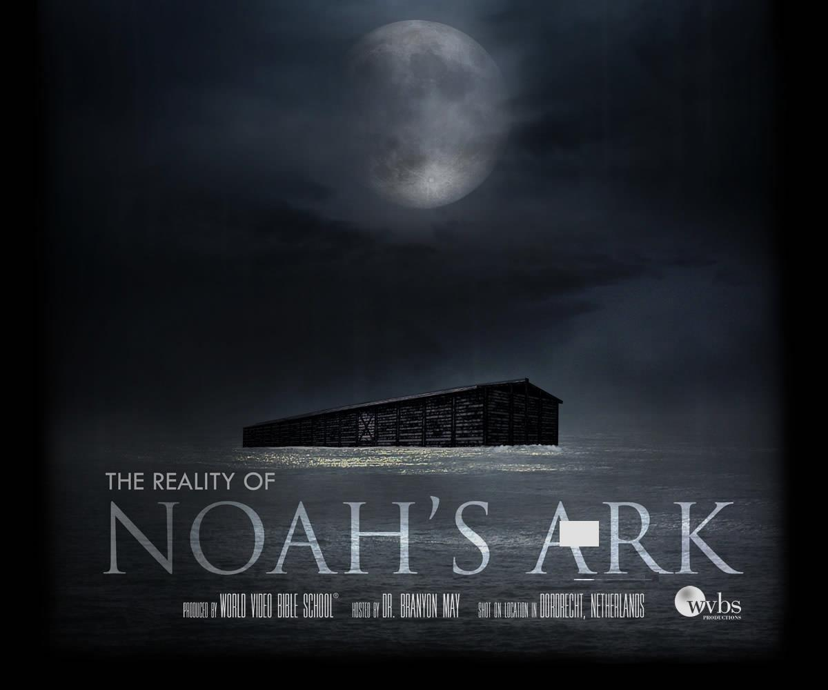
If You Had Been Noah
“By faith Noah, being divinely warned of things not yet seen, moved with godly fear, prepared an ark for the saving of his household, by which he condemned the world and became heir of the righteousness which is according to faith.” Heb. 11:7
Notes:
2. Heb. 11:7 "By faith Noah, being warned of God of things not seen as yet, moved with
fear, prepared an ark to the saving of his house; by the which he condemned the world,
and became heir of the righteousness which is by faith."
3. Often we associate self with characters we admire.
4. Look to the story of Noah. - If you had Been Noah ....

Slide 3
If You Had Been Noah
Would you have
found grace in the eyes of the Lord?

Slide 4
“But Noah found grace in the eyes of the Lord” Gen. 6:8
“These are the generations of Noah. Noah was a righteous man, and perfect in his generations: Noah walked with God.” Gen. 6:9
“Righteous” = “just” in KJV
He would not bend, he stood firm
He had convictions
“Walked with God” = to please God, devoted to God
Did not walk with wicked men
Notes:
A. Gen. 6:8 “But Noah found grace in the eyes of the LORD.”
1. Noah stood above his environment.
2. So what if everyone else is doing it. Gen 6:9 asv “These are the generations of Noah. Noah was a righteous man, and perfect in his generations: Noah walked with God.”
B. “Righteous” - “Just”(KJV)
1. Noah would not bend or weave, he stood firm.
2. He had convictions. At home, work, or play we must have convictions. “righteous” in the sight of God
C. “Noah walked with God” How?
1. Not a fleshly relationship! 2 Cor. 5:7 (For we walk by faith, not by sight:)
2. Amos 3:3. “Can two walk together, except they be agreed?”
3. So often people think there must be some mystical, mysterious connection between themselves and God. Not enough for him to take God at
his Word and by faith to do what he says.
4. Noah walked with God because he pleased God, was devoted to God, and did not walk with wicked men

Slide 5
“By faith Noah, being divinely warned of things not yet seen, moved with godly fear, prepared an ark for the saving of his household, by which he condemned the world and became heir of the righteousness which is according to faith.” Heb. 11:7
Noah acted by FAITH:
No sign a flood was coming
Never been a flood
People did not believe it
Instructions given 120 years before
Are you walking with God?
Is your life righteous?
Notes:
1. Yet, that is exactly what Noah did. Heb 11:7 “By faith Noah, being divinely warned of things not yet seen, moved with godly fear, prepared an ark for the saving of his household, by which he condemned the world and became heir of the righteousness which is according to faith.”
a. There was a flood coming that would destroy the earth and all living things
b. Noah built the ark by faith - He acted by faith:
(1) For there was no sign that a flood was coming
(2) Never had there been a flood
(3) The people did not believe it
(4) God told him about what would come
c. God gave those instructions 120 years before hand
d. Moved with fear, Noah prepared an ark to the saving of his house
(1) Acted with caution - reverence for God
(2) Saved his family from the flood
D. If you had been Noah would you have found grace in the eyes of the Lord ?
1. Are you walking with God ?
2. Is your life righteous ?

Slide 6
If You Had Been Noah
Would you have
found grace in the eyes of the Lord?

Slide 7
If You Had Been Noah
How would you have reacted to the job to be done?

Slide 8
Notes:
A. God asked a great thing of him. Gen. 6:15
1. Build an ark 300 cubits long (450 feet) 50 cubits wide (75 feet) and 30 cubits tall (45 feet high)
2. That’s BIG!! Length of football field and another half
3. Where did he plug in his skill saw? Or his Black and Decker Drill? Who made his nails for him? Use GOPHER WOOD?

Slide 9
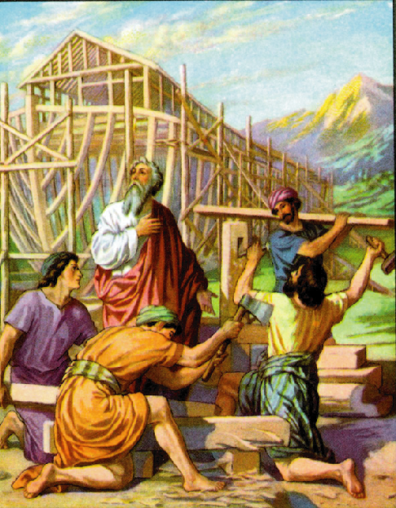
No Indication:
Noah had excuses
He argued with God
Said this is too hard
Get someone else

Slide 10
Suppose that Noah….
Started the job then quit
Got discouraged
I’ve already got a boat, let me remodel it
Notes:
?

Slide 11
Noah’s Task was not Easy!
“But seek first the kingdom of God and His righteousness, and all these things shall be added to you.” Matt. 6:33
Notes:
1. What we are saying, NOAH'S TASK WAS NOT AN EASY ONE!!!!
A. But then, the Lord has not asked man to do only what is EASY.
1. Some things required of us are most difficult, very demanding.
2. Matt. 6:33 “But seek first the kingdom of God and His righteousness, and all these things shall be added to you.”
3. Especially when we sometimes seem to stand alone, None to encourage us, None
to assist us, rather only those who oppose

Slide 12
If You Had Been Noah
How would you have reacted to the job to be done?

Slide 13
If You Had Been Noah
Would you have been satisfied with the Lord’s plan?

Slide 14
Suppose Noah Had His Own Ideas…
Change the size
Use another kind of wood
Add a door on each floor
Notes:
A. Suppose Noah had his own ideas...
1. Change the size
2. Use another kind of wood
3. Add a door on each floor.
B. People want to build their own ark, they have their own ideas, and they want to make their own arrangements.
C. No doubt, if some people of today had been Noah they would have figured out a better way of doing it.
Worship
Work of the church
Organization of the church

Slide 15
Can’t Improve On God’s Ways
God has a Plan of Salvation:
Hear, Faith, Repentance, Confession, Baptism
God has a Plan of Worship:
Sing, Pray, Give, Teach, Lord’s Supper
God has a Plan of Church Organization:
Elders, Deacons
“All Scripture is given by inspiration of God, and is profitable for doctrine, for reproof, for correction, for instruction in righteousness, that the man of God may be complete, thoroughly equipped for every good work.” 2 Tim 3:16-17
Notes:
C. But, what man has never learned is: Man cannot improve on God's ways.
1. God has given a plan of salvation: Hear, Faith, Repentance, Confession, Baptism.
a. But, if man does not like the plan, he changes it
b. Faith only, Saved by grace alone, and Baptism is not essential is taught by men.
2. God has given the plan for worship;
a. Sing, Pray, Give, Teach, Lord’s Supper
b. Men have changed every one of these acts of worship
3. God has a plan of Church organization
a. Elders, who are overseers and Deacons who are helpers
b. Men do not like this plan so they have changed it..
D. 2 Tim 3:16-17 “All Scripture is given by inspiration of God, and is profitable for doctrine, for reproof, for correction, for instruction in righteousness, that the man of God may be complete, thoroughly equipped for every good work.”
1. Doing something will not suffice, unless it is doing what the Lord says.
2. Noah could not just build a boat. Not just any boat would have floated.
3. Why GOPHER WOOD? Boy, what a drag!!
4. Why not just what is convenient, at hand??

Slide 16
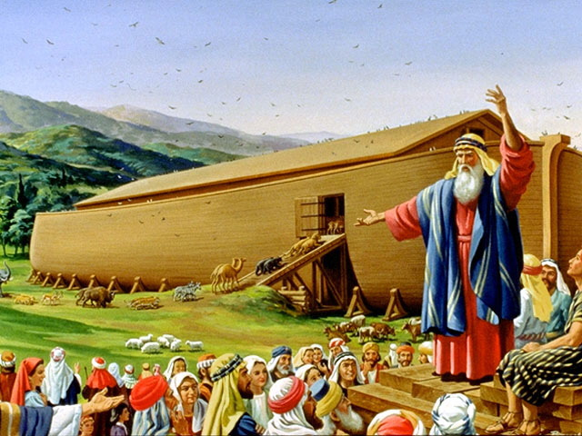
Noah did this; he did all that God commanded him. Gen. 6:22
“Whatever I command you, be careful to observe it; you shall not add to it nor take away from it.” Deut. 12:32
2 Jn. 9 - abide in the doctrine
Rev. 22:18-19 Not to add or take away
Notes:
A. Noah built the ark just as God commanded
1. Gen. 6:22 “Noah did this; he did all that God commanded him.”
2. There was nothing left undone
3. Deut. 12:32 “Whatever I command you, be careful to observe it; you shall
not add to it nor take away from it.”
4. 2 John 9 – “Whoever transgresses and does not abide in the doctrine of Christ
does not have God. He who abides in the doctrine of Christ has both the Father
and the Son.” Limited by the teachings of Christ, what He authorizes.
B. How can I know what the Lord wants me to do?
1. Listen to what He says.
2. My ideas will never count.
C. Rev. 22:18-19 – “For I testify to everyone who hears the words of the prophecy of this book: If anyone adds to these things, God will add to him the plagues that are written in this book; and if anyone takes away from the words of the book of this prophecy, God shall take away his part from the Book of Life, from the holy city, and from the things which are written in this book.”
D. Do not add to; do not take away from.....
E. If you had been Noah would you have been satisfied with the Lord’s Plan?

Slide 17
If You Had Been Noah
Would you have been satisfied with the Lord’s plan?

Slide 18
If You Had Been Noah
Would you have been satisfied just to save the ones the Lord said should be saved?

Slide 19
“Who formerly were disobedient, when once the Divine longsuffering waited in the days of Noah, while the ark was being prepared, in which a few, that is, eight souls, were saved through water.” 1 Pet. 3:20
Is that all Lord?
We have been working 120 years!
What about my friends?
A few more of my relatives?

Slide 20
“Enter by the narrow gate; for wide is the gate and broad is the way that leads to destruction, and there are many who go in by it. Because narrow is the gate and difficult is the way which leads to life, and there are few who find it.” Matt. 7:13-14
Many will be lost
Few to be saved
Noah took no consolation in seeing them lost.
It was their decision to not obey!
Notes:
How often do men today attempt to smooth over what the Lord says.
1. Matthew 7:13, 14 “"Enter by the narrow gate; for wide is the gate and broad is the way that leads to destruction, and there are many who go in by it. Because narrow is the gate and difficult is the way which leads to life, and there are few who find it.” Many to be lost; Few to be saved.
2. We need not try to soften what the Lord has said.
3. But, is not that harsh language. Sure it is, but it is also truth.
4. Not saying that we should be pleased with the fact that the multitudes will be lost.
5. Surely, Noah took no consolation when he saw the masses who refused God, drowning in the flood. But, it was not Noah's decision.
6. It was their decision; Did they not have opportunity to hear and obey Noah's preaching.

Slide 21
Do You Believe Only Members of the
church of Christ will be Saved?
He who rejects Me, and does not receive My words, has that which judges him— the word that I have spoken will judge him in the last day. Jn. 12:48
Notes:
A. Often the prejudicial question is asked: “Do You Believe only members of the church of Christ will be saved?”
1. I am not judge. Actually it matters not what I do or do not believe.
2. What does God's Word say??? We shall all be judged by the word that Jesus gave

Slide 22
Do You Believe Only Members of the
church of Christ will be Saved?
What I Must Do to Be Saved?
Hear John 12:48
Believe John 8:24
Repent Luke 13:3
Confess Matt. 10:32-33
Baptized Mark 16:16
Faithful Matt. 24:13
Notes:
This is what Christ commanded and I cannot remove it, nor lessen the demands of it.

Slide 23
Do You Believe Only Members of the
church of Christ will be Saved?
Acts 2:38 – Baptized for remission of sins
Acts 2:47 – Lord adds us to His church
Eph. 5:23 – Savoir of the body
Eph. 1:22 – Church is His body
Eph. 4:4 – 1 body, 1 church

Slide 24
Do You Believe Only Members of the
church of Christ will be Saved?
Identifying Characteristics of the Lord’s Church
1. Christ’s name is exalted (Col. 3:17)
2. Christ is supreme authority (Col. 1:18)
3. Headquarters are heaven (Phil. 3:20)
4. God’s Word is the standard (2 Tim. 2:15)
5. Autonomous congregations (Acts 14:23; 20:17)
6. Funded by free-will giving (1 Cor. 16:2)
7. Male leadership (1 Corinthians 14:34-35)
8. Plan of salvation (Mark 16:16)
9. Day of worship (Acts 20:7)
10. Form of worship (Jn. 4:23, 24)
11. Vocal/heart music (Eph. 5:19)
12. Evangelistic (Matt. 28:18-20)
13. Believes the truth (Jn. 8:31-32)
14. Practices the truth (1 Jn. 2:3)
15. Priesthood of all believers (1 Pet. 2:5)
16. Likeminded (1 Cor. 1:10)
17. Good works (Eph. 2:10)
Notes:
And, if the whole world refuses it, it still stands.

Slide 25
If You Had Been Noah
Would you have been satisfied just to save the ones the Lord said should be saved?

Slide 26
What Is My Attitude Toward
What God Has Told Me To Do?
It took FAITH on the part of Noah
It takes FAITH for us to obey God today
Notes:
1. What is my attitude toward what God has told me to do? What is yours?
2. Our attitude determines what we would have done had we been Noah.
3. Would you build??? Or would you go your merry way and ignore what he said?? Lord, don't bother me right now.
4. What a sobering thought. To be faced with the decision of whether or not to obey the commandments of the Lord.
5. But then, we have the same choice as did Noah.
6. It took FAITH on the part of Noah
7. It takes FAITH for us to obey God today

Slide 27
If You Had Been Noah
Would you have found grace in the eyes of the Lord?
How would you have reacted to the job to be done?
Would you have been satisfied with the Lord’s Plan?
Would you have been satisfied just to save the ones the Lord said should be saved?

Slide 28
If You Had Been Noah
Hear John 12:48
Believe John 8:24
Repent Luke 13:3
Confess Matt. 10:32-33
Baptized Mark 16:16
Faithful Matt. 24:13

