Slide 1
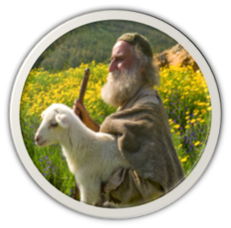
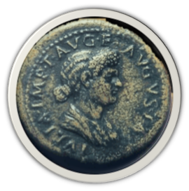
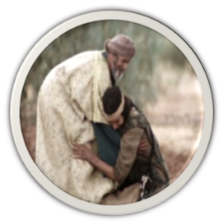
The Lost and Found

Slide 2
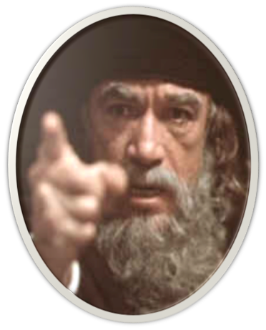
The Lost & Found Sheep, Coin & Son
Contrasting the Attitude of the
Pharisees & Jesus Toward Sinners
Matt. 9:10–13
¹⁰ Now it happened, as Jesus sat at the table in the house, that behold, many tax collectors and sinners came and sat down with Him and His disciples. ¹¹ And when the Pharisees saw it, they said to His disciples, “Why does your Teacher eat with tax collectors and sinners?”
Jesus At Matthew’s House

Slide 3
The Lost & Found Sheep, Coin & Son
Contrasting the Attitude of the
Pharisees & Jesus Toward Sinners
Matt. 9:10–13
¹² When Jesus heard that, He said to them, “Those who are well have no need of a physician, but those who are sick. ¹³ But go and learn what this means: ‘I desire mercy and not sacrifice.’ For I did not come to call the righteous, but sinners, to repentance.”
Jesus At Matthew’s House

Slide 4
The Lost & Found Sheep, Coin & Son
Contrasting the Attitude of the
Pharisees & Jesus Toward Sinners
Lk. 15:1–2
¹ Then all the tax collectors and the sinners drew near to Him to hear Him. ² And the Pharisees and scribes complained, saying, “This Man receives sinners and eats with them.”

Slide 5
The Lost & Found Sheep, Coin & Son
Contrasting the Attitude of the
Pharisees & Jesus Toward Sinners
Jesus Responds with 3 Parables

Slide 6
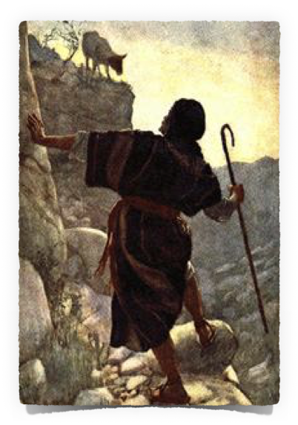
The Lost & Found Sheep, Coin & Son
The Lost and Found Sheep
What do shepherds do when a lamb goes astray? (Lk. 15:4)
How does the shepherd react when the lost sheep is found? (Lk. 15:5-6)
What does the shepherd’s reaction indicate about the value of the sheep that was lost and found?

Slide 7
The Lost & Found Sheep, Coin & Son
The Lost and Found Sheep
Lk. 15:7
⁷ I say to you that likewise there will be more joy in heaven over one sinner who repents than over ninety-nine just persons who need no repentance.

Slide 8
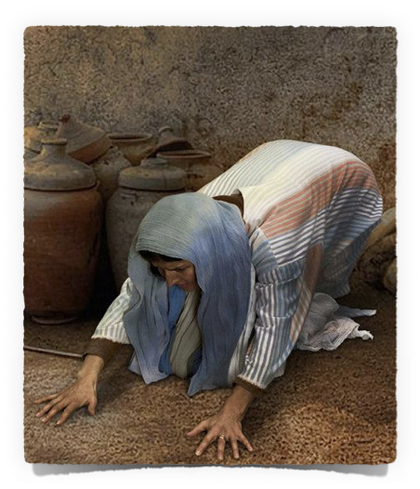
The Lost & Found Sheep, Coin & Son
The Lost and Found Coin
She placed great value on each coin – (She knew what she had or she would not have known one was missing)
Demonstrated in her diligent search for the one that was lost — (Lk. 15:8)
Rejoiced when she found it! — (Lk. 15:9)

Slide 9
The Lost & Found Sheep, Coin & Son
The Lost and Found Coin
Lk. 15:10
¹⁰ Likewise, I say to you, there is joy in the presence of the angels of God over one sinner who repents.”

Slide 10
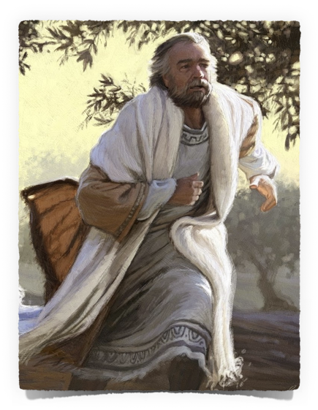
The Lost & Found Sheep, Coin & Son
The Lost and Found Son
The prodigal son made a conscious decision to leave home and waste his inheritance on sinful pleasure – (Lk. 15:11-13)
The wayward son came to realize the high cost of sin - (Lk. 15:14-16)
He came to realize he would be MUCH better off going home - (Lk. 15:17-19)

Slide 11
The Lost & Found Sheep, Coin & Son
The Lost and Found Son
The LOST son made the decision to swallow his pride and return home — (What did he expect if he returned? What was he willing to accept?) - (Lk. 15:18-19)
The son arose and went home
The FATHER’s response: He saw … ran … embraced … kissed - (Lk. 15:20)

Slide 12
The Lost & Found Sheep, Coin & Son
The Lost and Found Son
The son’s confession (I have sinned…not worthy to be called your son … make me a hired servant) – Lk. 15:21
The FATHER gladly receives the son and adorns him with a robe … a ring … and sandals (Lk. 15:22)
The FATHER has a feast prepared that they may celebrate - (Lk. 15:23)

Slide 13
The Lost & Found Sheep, Coin & Son
The Lost and Found Son
Lk. 15:24
²⁴ for this my son was dead and is alive again; he was lost and is found. And they began to be merry.

Slide 14
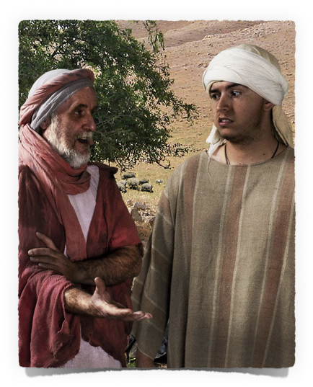
The Lost & Found Sheep, Coin & Son
The Lost and Found Son
The ANGER of the older son - He would not go in — (Lk. 15:25-28)
The FATHER goes out and pleads with the older son - (Lk. 15:28)
The son makes his case that the younger son should not be treated so well - (Lk. 15:29-30)

Slide 15
The Lost & Found Sheep, Coin & Son
The Lost and Found Son
Lk. 15:31–32
³¹ “And he said to him, ‘Son, you are always with me, and all that I have is yours. ³² It was right that we should make merry and be glad, for your brother was dead and is alive again, and was lost and is found.’ ”

Slide 16
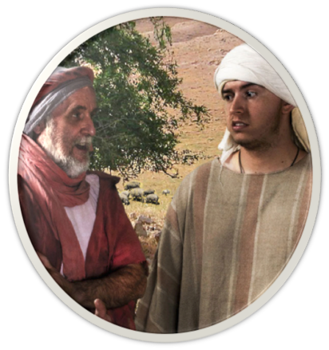
The Lost & Found Sheep, Coin & Son
4 Types of Lost Sinners
LOST SHEEP - was lost, knew it was lost, did not know the way home (had to be led home)
LOST COIN - was lost, did not know it was lost, did not know the way home (had to be found)
LOST SON - was lost, knew he was lost, knew the way home (had to decide)
ELDER BROTHER - was lost, did not know he was lost (needed to learn of his condition)

Slide 17
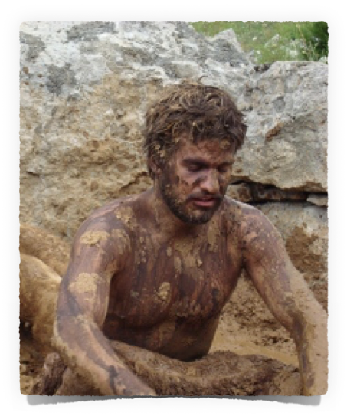
The Lost & Found Sheep, Coin & Son
The Lostness of the Lost
Sinners NEVER lose their VALUE – Matt. 16:26
They lose their way
They lose their usefulness
They lose their relationship with God
They lose their souls

Slide 18
The Lost & Found Sheep, Coin & Son
Important Lessons
Even so it is not the will of your Father who is in heaven that one of these little ones should perish.
The State of The Lost – Eph. 2:12
The Love God Has For The Lost – Jn. 3:16
The Rejoicing In Heaven For The Penitent – Lk. 15:7,10
The Value of The Lost – Matt. 18:14
Our Attitude Toward The Lost – Rom. 10:1
At that time you were without Christ…having no hope and without God in the world.
For God so loved the world that He gave His only begotten Son, that whoever believes in Him should not perish but have everlasting life.
Brethren, my heart's desire and prayer to God for Israel is that they may be saved.

Slide 19
The Lost and Found
Do You See Yourself In These Parables?
The Shepherd?
The Woman?
The Loving Father?
The Lost Sheep?
The Lost Coin?
The Lost Son?
The Eldest Son?

Slide 20
GOD’S SIMPLE PLAN FOR SALVATION
Hear John 12:48
Believe John 8:24
Repent Luke 13:3
Confess Matt. 10:32-33
Baptized Mark 16:16
Faithful Matt. 24:13

