Slide 1
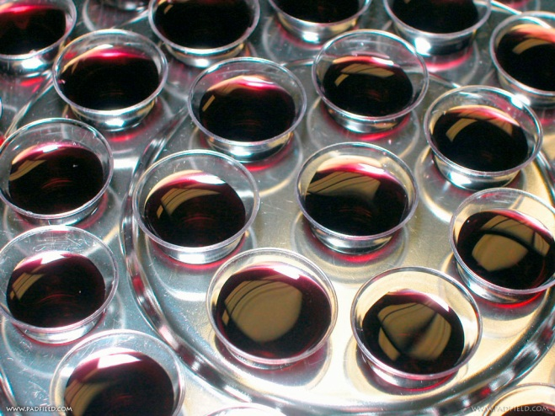
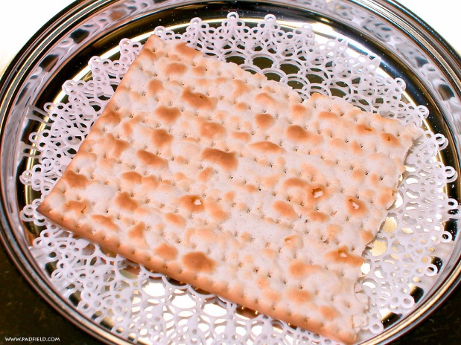
L
ooking at the
ord’s Supper
Notes:
2012
Live as though Christ died yesterday, rose from the grave today, and is coming back tomorrow
God grades on the cross, not the curve.

Slide 2
Acts 20:7 “Now on the first day of the week, when the disciples came together to break bread, Paul, ready to depart the next day, spoke to them and continued his message until midnight”
Lord's Supper - 1 Cor. 11:20
Breaking Bread - Acts 20:7, Acts 2:42
Communion - 1 Cor. 10: 16
It is never called:
Eucharist
Mass
Sacrament
Unleavened Bread
Fruit of the Vine – Cup
The word “wine” is never used in reference to the Lord’s Supper
Notes:
2. Acts 20: 7 “And upon the first day of the week, when the disciples came together to break bread, Paul preached to them, ready to depart on the morrow; and continued his speech until midnight.”
a. Nearly 2,000 years of observance (CLICK)
3. The New Testament Terms referring to the Lord's Supper
a. Lord's Supper - 1 Cor. 11:20
b. Breaking Bread - Acts 20:7, Acts 2:42
c. Communion - I Cor. 10: 16 (CLICK)
4. It is not called:
a. Eucharist - Greek church introduced this - means giving of thanks
b. Mass - Catholics introduced this term = means a sacrifice- also use the phrase “Holy
communion”
c. Sacrament - adopted by the Latin Church
d. Not found in the Bible - Why not call it by the terms in the Bible ? (CLICK)
5. The Parts or ingredients
a. Unleavened Bread and Fruit of the Vine or cup
b. The word “Wine” is not used in reference to the Lord’s Supper.
6. Let us now Look at the Lord’s Supper - Unleavened Bread & Fruit of the Vine

Slide 3
AT The
Lord’s Supper
1. Look Backward
“this do in remembrance of me.” 1 Cor. 11:24-25
“anamnesis” = recollection, remind, call to mind
“Amnesia” = memory is lost
We build Memorials to help us remember
Notes:
I. LOOK BACKWARD
A. “This do in remembrance of Me.” - 1 Corinthians 11:24-25
1. Remembrance = from a Greek word “anamnesis” = Recollection, remember again, to remind, call to mind ~ English word “Amnesia” memory is lost
2. As human beings we often forget important things
3. God has given His people memorials to help them remember - the Rainbow –
4. We build Memorials to help us remember

Slide 4
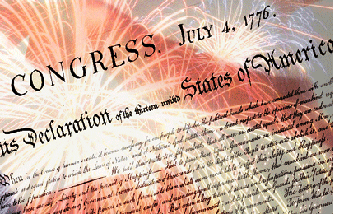
Notes:
4. We have national monuments and memorials to help us remember the people who
have contributed to this country. Veterans day is a day set aside to remember
those men and women who have helped fight in defense of our country and help
keep freedom.
5. July 4th is a celebration and remembrance of the Declaration of Independence.

Slide 5
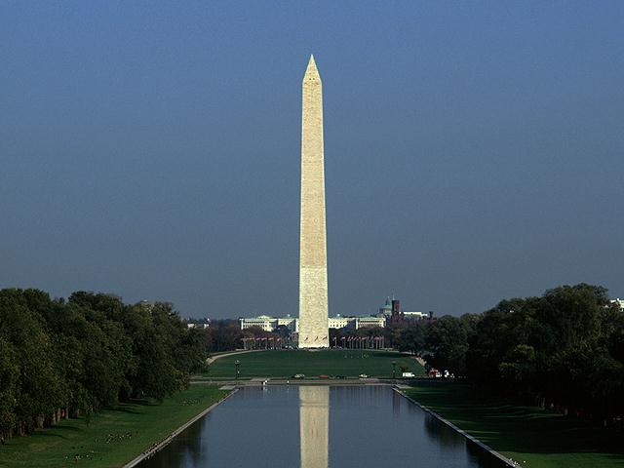

Slide 6
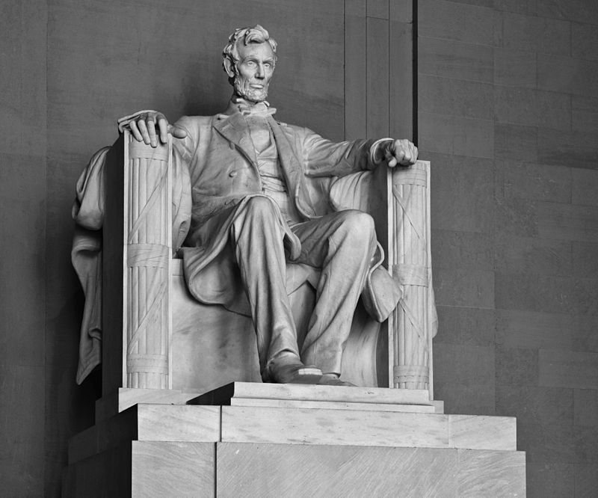

Slide 7
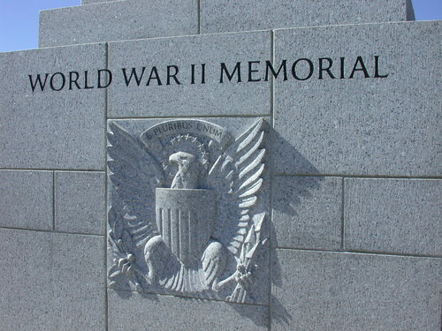
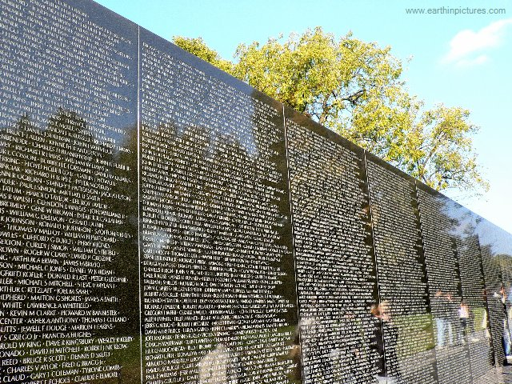

Slide 8
Notes:
2. India - See card Lord's Supper ~ To the Memory of a Dying Love - Taj Mahal

Slide 9
AT The
Lord’s Supper
1. Look Backward
Lord’s Supper is a Memorial
Type of the Passover Feast – Ex. 12
Deliverance from Egypt
Blood on two side posts and upper post
Feast of unleavened bread
Examples
Acts 2:42 – Jerusalem
Acts 20:7 - Troas
1 Cor. 11:20-34 - Corinth
Notes:
6. But the greatest and most lasting of all memorials is the Lord’s Supper.
a. An unusual thing about this memorial is that it is composed of some of the most perishable materials = unleavened bread and fruit of the vine
7. But this memorial is one that has lasted for nearly 2000 years
C. Jesus instituted the Lord’s Supper
1. Matthew 26:26-30 The Purpose - “This do in remembrance of Me”
2. The Lord's Supper is a type of the Passover Feast instituted in the O.T. at the time of the deliverance of the children of Israel out of Egypt. Exodus 12: 1-7
a. Blood from a lamb without blemish of the 1st year was to be sprinkled on two side posts and upper posts
b. Had a feast of unleavened bread
c. Unleavened = righteousness, while leavened = sin
d. Blood represents the deliverance from sin.
3. The disciples were to practice this supper called the Lord's Supper when the kingdom was established.
4. We find examples of where they were doing this.
a. Acts 2:42 at Jerusalem Acts 20:7 at Troas I Cor. 11:20—34 at Corinth

Slide 10
AT The
Lord’s Supper
1. Look Backward
Lord’s Supper is a Memorial
Jesus knew His body would not remain in tomb
Could have built some great monument
Notes:
D. The Lord's Supper is a memorial
1. Jesus knew His body would not be left in a tomb
2. He could have erected crosses all over the world
3. He could have built a great monument
a. Only could be visited by a few
b. Would eventually decay or be destroyed
4. He left a memorial that could be seen by all people of the world — that could be perpetually observed, and could stir up reverence and gratitude.
E. The Lord’s supper is a time to look backward and remember Christ:
1. Remember his birth, life and teachings
2. Remember His Death:
a. The pain he endured
b. The shame he received
c. The lowly death he endured -for our sins not his.
3. Luke 22:19 “this do in remembrance of me...”
F. While taking the Lord’s Supper we are to look backward and remember that Jesus Died for us!

Slide 11
2. Look Forward
AT The
Lord’s Supper
“For as often as you eat this bread and drink this cup, you proclaim the Lord's death till He comes.” 1 Cor. 11:26
“…this same Jesus, which is taken up from you into heaven, shall so come in like manner as you have seen him go into heaven.” Acts 1:11
Partaking the Lord’s Supper reminds us of the next coming of Jesus.
Notes:
II. LOOK FORWARD
A. I Cor. 11:26 “For as often as you eat this bread and drink this cup, you proclaim the Lord's death till He comes.”
B. Eating the Lord's supper is a weekly reminder that He Will come again
1. Acts 1:11 “...this same Jesus, which is taken up from you into heaven, shall so come in like
manner as you have seen him go into heaven”
2. Christians look -forward to the day Christ will come again
3. Christians look forward to a wonderful future. We realize that by the death of Christ, we have a home in the heaven waiting for us.
4. The partaking of the Lord's Supper arouses a desire for that better city, whose builder and maker is God.
C. The Lord’s Supper helps us to remember that Christ is coming again some Day to take those to heaven who are His people!

Slide 12
3. Look Within
AT The
Lord’s Supper
“But let a man examine himself, and so let him eat of that bread, and drink of that cup. For he that eateth and drinketh unworthily, eateth and drinketh damnation to himself, not discerning the Lord's body.” 1 Cor. 11:28-29
Unworthy – adjective – describing man
Unworthily – adverb – describing manner of taking
Baptism is more than getting wet
Lord’s Supper is more than bread and fruit of the vine
Notes:
III. LOOK WITHIN
A. I Cor. 11:28-29 “But let a man examine himself, and so let him eat of the bread and drink of the cup. For he who eats and drinks in an unworthy manner eats and drinks judgment to himself, not discerning the Lord's body.”
1. Each person is to examine himself
2. This is an individual act of worship — singing is in a group
B. Sometimes we hear people day that they don't feel worthy to take the Lord's Supper
1. None of us are worthy- but that is not the word
2. The word Unworthy is an adjective describing man
3. The Word Unworthily is an adverb describing the manner of man's eating
4. We must have the proper attitude and proper frame mind to take the Lard's Supper worthily
5. Baptism is more than getting wet — it involves the right attitude, proper frame of mind, and the right purpose.
6. Taking the Lord's supper is more than eating bread and drinking the fruit of the vine. It involves the right attitude, proper frame of mind and the right purpose.
7. John 4:24 “God is a Spirit: and they that worship him must worship him in spirit and in truth.”

Slide 13
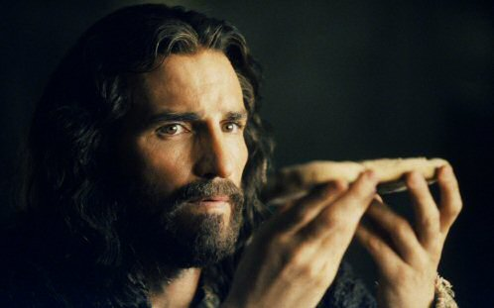
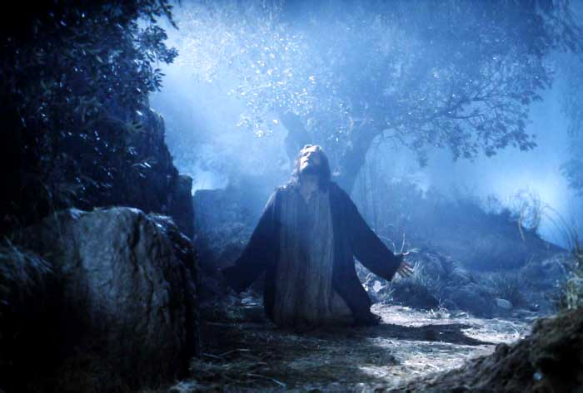
As you partake of the communion…
Go to the Upper Room
“This is my body”
“This is my blood”
Go to the Garden
“My soul is exceeding sorrowful”
“Father, if it be possible let this
cup pass from Me”
Notes:
1. As you partake of the communion,...
a. Do you by faith go to the upper room where Jesus broke the bread saying, “This is my body” and where he took the cup, saying, “This is my blood of the New Testament which is shed for many for the remission of sins?” b. Have you seen Him in the garden, prostrate on the ground, as He poured His heart out to God. And hear Him say, “My soul is exceeding sorrowful even unto death?” Matt. 26:38
c. Have you listened to his 3 hour prayer when he said: “Father, if it be possible let this cup pass from me?”
d. Do you think about Jesus, knowing what He is about to have to endure on the cross, speaking with the heavenly Father in the garden?

Slide 14
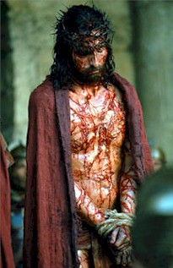
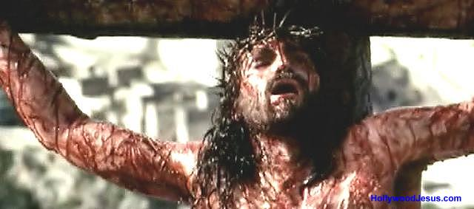
As you partake of the communion…
The Soldiers
Strip Jesus’ clothes from Him
Put a purple robe on Him
Platted a crown of sharp thorns
See the People
Come up and spit upon Him
Then they laughed at Him
Put a reed in His hand
Notes:
1. Each time we observe the Supper we should see:
a. The soldiers strip Jesus’ clothes from Him and put a beautiful purple robe on him, one like kings wear.
b. They then platted a crown of sharp thorns and placed it upon his head, the thorns cutting it Jesus' skin. In those days, the kings had crowns of jewels.
c. The people thought so little of Jesus that they platted a crown of thorns and put it upon his head as if to say, “this is the way we rate you as king.”
d. To show their contempt, for Him they actually ran up and spat upon the Lord and then laughed at Him.
e. They had placed a reed in his hand and they jerked that away from Christ and hit him over the head with it driving the thorns in deeper.
C. Does this bring vividly to your mind the fact that all this was done to redeem you from everlasting punishment — a devil's Hell - that you deserve as a penalty for your sins? Think of these things as we partake of the Lord's Supper.

Slide 15
3. Look Within
Therefore purge out the old leaven, that you may be a new lump, since you truly are unleavened. For indeed Christ, our Passover, was sacrificed for us. Therefore let us keep the feast, not with old leaven, nor with the leaven of malice and wickedness, but with the unleavened bread of sincerity and truth.” 1 Cor. 5:7-8
Eating unleavened bread – represented righteousness
Keeping our lives clean and pure
“For this cause many are weak and sickly among you, and many sleep” 1 Cor. 11:30
Notes:
D. I Cor. 5:7-8 teaches that we are to keep our lives pure and clean “Therefore purge out the old leaven, that you may be a new lump, since you truly are unleavened. For indeed Christ, our Passover, was sacrificed for us. Therefore let us keep the feast, not with old leaven, nor with the leaven of malice and wickedness, but with the unleavened bread of sincerity and truth.”
1. During the feast which lasted 7 days, they were to use unleavened bread only – this represented righteousness
2. Here he says for us not to keep the feast (Holy Day) with leaven of malice and wickedness
3. But with the unleavened bread of sincerity and truth
4. We must keep our lives clean and pure all the time. If we do, not then we will have no desire to take the feast and remember how Christ died for us.
5. Paul tells us what happens to those who do not eat unleavened bread of sincerity and truth —“For this cause many are weak and sickly among you, and many sleep.” 1 Cor. 11:30

Slide 16
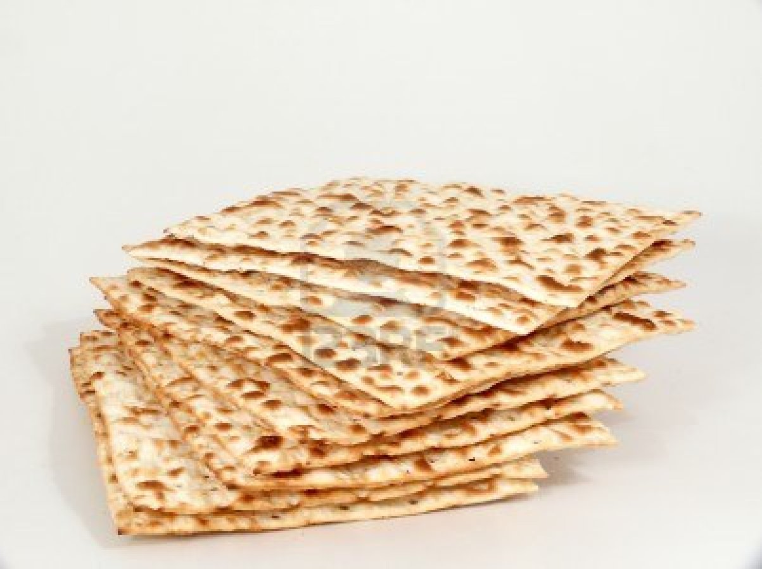
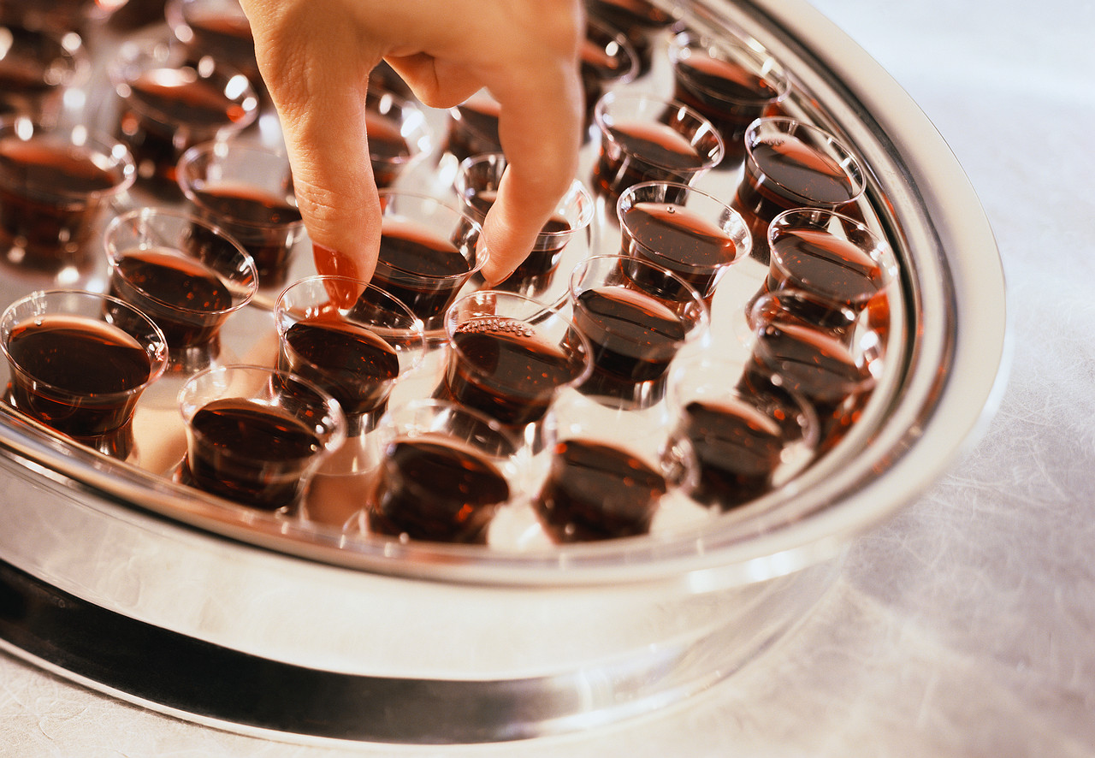
L
ooking at the
ord’s Supper
1. Backward
2. Forward
3. Within
Notes:
1. This is a weekly -feast we observe remembering the death of Christ.
2. Summary
a. Look Backward memorial
b. Look Forward = Return
c. Look Within =•- manner
3. Men choose monuments made of marble, bronze and iron to remember someone.
4. God selected a simple thing like bread and fruit of the vine and they remain fresh and
enduring through the centuries as a memorial.
5. “This do in remembrance of Me”.

Slide 17
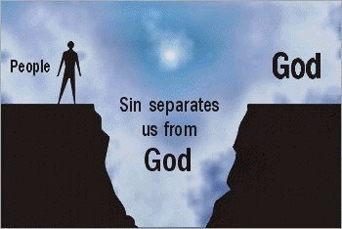
Christ
SIN

Slide 18
GOD’S SIMPLE PLAN FOR SALVATION
Rev. 2:10
Acts 2:38
baptism
JN. 12:42
confess
LK. 13:3
repent
OBEDIENT
UNTIL DEATH
JN. 8:24
believe
ACTS 3:22
hear

