Slide 1
It Is Well
With My Soul
Notes:
490

Slide 2
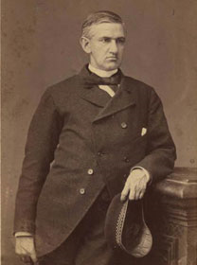
“It Is Well With My Soul”
Written in 1873 by Horatio Spafford (1828-1888)– a lawyer and real estate investor.
He was reading Psalm 46 when he wrote this song.
Notes:
In the dark, icy waters of the North Atlantic, the Ville de Havre collided with another ship off the coast of New Foundland. Only 47 of the hundreds on board survived, Spafford's wife Anna was one of the survivors. All four daughters perished. When Anna reached Wales she sent Horatio a telegram that read simply: "Saved alone." With all five of his children now gone and a grieving wife across the Atlantic, Spafford was now facing the billows of sorrow. He rushed to New York, departing on the first available ship. As the ship rolled the waves of the cold, dark Atlantic, the captain summoned Spafford to the bridge. Pointing to an area off ship's bow, he explained to Spafford that this is the area in which the Ville de Havre had gone down. Alone, Spafford bundled up and walked to the bow. Gazing out into the darkness with the moonlight dancing on the cold waves he penned these words. "When peace like a river attendeth my way, When sorrows like sea billows roll; Whatever my lot, Thou hast taught me to say, It is well, it is well with my soul." What faith it must have taken for this man who had just lost four precious daughters and a son previously to death to say "it is well with my soul". That is the type of faith I strive for, an "it is well with my soul" faith. A faith that no matter what befalls me to be able to say, "OK God, you're in control, my life and everything in it is yours, so whatever happens...good or bad...it is OK with me". My friends, to be honest with you, I am far from that. I do hope that slowly, day by day I am acquiring that faith, but I'm not there yet. As "the sea billows roll" in my life I tend to whine and complain. I find myself asking God "why" when I should be asking Him "How?" When I do have my fleeting moments of "It is well" faith, I can faintly hear God saying "Just be patient and know that I will NEVER, NEVER, NEVER leave you or forsake you". Below is the rest of "It Is Well With My Soul" "Though Satan should buffet, Though trials should come, Let this blest assurance contol, That Christ hath regarded my helpless estate, And hath shed His own blood for my soul. It is well, it is well with my soul. My sin-O the bliss of this glorious thought, My sin, not in part, but the whole, Is nailed to the corss, and I bear it no more: Praise the Lord, praise the Lord, O my soul! It is well, it is well with my soul. And Lord haste the day when my faith shall be sight, The clouds be rolled back as a scroll: The trump shall resound and the Lord shall descend, Even so-It is well with my soul. It is well, It is well with my soul.“

Slide 3
“It Is Well With My Soul”
Psalms 46:1-11
¹ God is our refuge and strength, A very present help in trouble. ² Therefore we will not fear, Even though the earth be removed, And though the mountains be carried into the midst of the sea; ³ Though its waters roar and be troubled, Though the mountains shake with its swelling.

Slide 4
“It Is Well With My Soul”
Psalms 46:1-11
⁴ There is a river whose streams shall make glad the city of God, The holy place of the tabernacle of the Most High. ⁵ God is in the midst of her, she shall not be moved; God shall help her, just at the break of dawn. ⁶ The nations raged, the kingdoms were moved; He uttered His voice, the earth melted. ⁷ The Lord of hosts is with us; The God of Jacob is our refuge.

Slide 5
“It Is Well With My Soul”
Psalms 46:1-11
⁸ Come, behold the works of the Lord, Who has made desolations in the earth. ⁹ He makes wars cease to the end of the earth; He breaks the bow and cuts the spear in two; He burns the chariot in the fire. ¹⁰ Be still, and know that I am God; I will be exalted among the nations, I will be exalted in the earth! ¹¹ The Lord of hosts is with us; The God of Jacob is our refuge.

Slide 6
“It Is Well With My Soul”
In 1861 Spafford married Anna Lawson and they settled in Chicago.
By 1871, they had one son and four daughters, but in that year, their 4 year old son died of scarlet fever.
In 1871, the Great Chicago fire wiped out Spafford's business and most of his wealth.

Slide 7
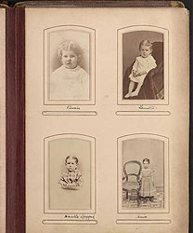
“It Is Well With My Soul”
Two years later, the family went to NY to board a ship, but business forced Spafford’s return to Chicago.
Early in the morning of Nov. 22nd 1873, the ship collided with another ship.
Notes:
Annie, Maggie, Bessie, Tanetta

Slide 8
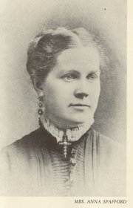
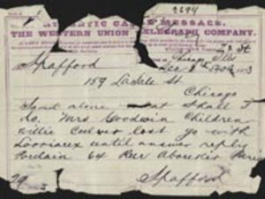
“It Is Well With My Soul”
Of the 313 passengers and crew, only 61 survived.
Among the 226 who lost their lives was Spafford's 4 daughters.
His wife survived, cabled her husband, "Saved alone – what shall I do?"

Slide 9
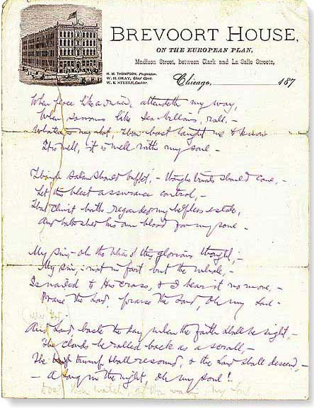
“It Is Well With My Soul”
Spafford boarded the next ship to be near his wife.
Written on the deck of the ship near the spot where his 4 daughters died.

Slide 10
“It Is Well With My Soul”
In Every Circumstance
When peace like a river attendeth my way,
When sorrows like sea billows roll,
Whatever my lot, Thou hast taught me to say, It is well, it is well with my soul.
Rejoice in the Lord always. Again I will say, rejoice!
Be anxious for nothing, but in everything by prayer and supplication, with thanksgiving, let your requests be made known to God; and the peace of God, which surpasses all understanding, will guard your hearts and minds through Christ Jesus.
whatever things are true, whatever things are noble, whatever things are just, whatever things are pure, whatever things are lovely, whatever things are of good report, if there is any virtue and if there is anything praiseworthy—meditate on these things. The things which you learned and received and heard and saw in me, these do, and the God of peace will be with you.
Therefore whoever hears these sayings of Mine, and does them, I will liken him to a wise man who built his house on the rock: and the rain descended, the floods came, and the winds blew and beat on that house; and it did not fall, for it was founded on the rock.
Be anxious for nothing – Phil. 4:4-7
Think Right – Phil. 4:8-9
LEARNING to be CONTENT– Phil. 4:11-12
Must build our life on the solid foundation - trusting God –Matt. 7:24-25

Slide 11
“It Is Well With My Soul”
Because of God’s Grace
Though Satan should buffet, Though trials should come, Let this blest assurance control, That Christ hath regarded my helpless estate, And hath shed His own blood for my soul.
The thief does not come except to steal, and to kill, and to destroy.
Your adversary the devil walks about like a roaring lion, seeking whom he may devour.
Resist him, steadfast in the faith, knowing that the same sufferings are experienced by your brotherhood in the world. But may the God of all grace, who called us to His eternal glory by Christ Jesus, after you have suffered a while, perfect, establish, strengthen, and settle you.
But God demonstrates His own love toward us, in that while we were still sinners, Christ died for us. Much more then, having now been justified by His blood, we shall be saved from wrath through Him.
Satan’s goal is to destroy us – Jn. 10:10; 1 Pet. 5:8
God cares for us – He has provided our every need – 1 Pet. 5:9-10
Our greatest need is the salvation of our souls –Rom. 5:8-9

Slide 12
“It Is Well With My Soul”
Because I Am Right With God
Then Job arose, tore his robe, and shaved his head; and he fell to the ground and worshiped. And he said: "Naked I came from my mother's womb, And naked shall I return there. The LORD gave, and the LORD has taken away; Blessed be the name of the LORD."
My sin O the bliss of this glorious thought, My sin, not in part, but the whole, Is nailed to the cross, and I bear it no more: Praise the Lord, praise the Lord, O my soul!
I have believed and obeyed the gospel – My sins have been forgiven.
No matter my physical circumstance – I have cause to praise the Lord –Job 1:20-21

Slide 13
“It Is Well With My Soul”
Because Of The Lord’s Return
These all died in faith, not having received the promises, but having seen them afar off were assured of them, embraced them and confessed that they were strangers and pilgrims on the earth. For those who say such things declare plainly that they seek a homeland…But now they desire a better, that is, a heavenly country. Therefore God is not ashamed to be called their God, for He has prepared a city for them.
Therefore, my beloved brethren, be steadfast, immovable, always abounding in the work of the Lord, knowing that your labor is not in vain in the Lord.
For God did not appoint us to wrath, but to obtain salvation through our Lord Jesus Christ, who died for us, that whether we wake or sleep, we should live together with Him.
And Lord haste the day when my faith shall be sight, The clouds be rolled back as a scroll: The trump shall resound and the Lord shall descend, Even so It is well with my soul.
By faith I am looking for that eternal city – Heb. 11:13-16
I am serving Jesus and He will reward me when He returns– 1 Cor. 15:58
These are comforting words to the righteous – 1 Thess. 5:9-10

Slide 14
“It Is Well With My Soul”
In Every Circumstance
Because of The Grace of God
Because I Am Right With God
Because The Lord Is Returning

Slide 15
Hear John 12:48
Believe John 8:24
Repent Luke 13:3
Confess Matt. 10:32
Baptized Mark 16:16
Faithful Matt. 24:13
In Every Circumstance?
Are You Right With God?
Are you Ready To Meet The Lord?

