Slide 1
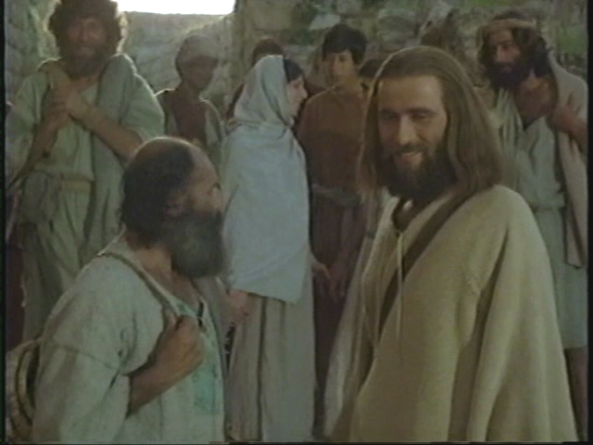
How Great is Your Faith?
Luke 7:1-10

Slide 2
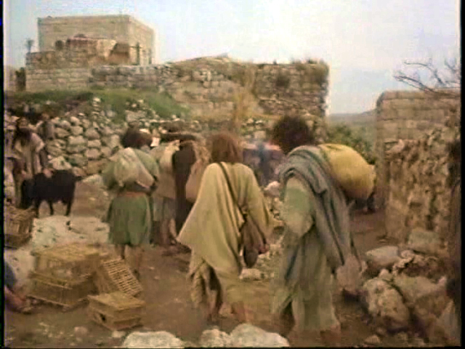
Luke 7:1 Now when He concluded all His sayings in the hearing of the people, He entered Capernaum.

Slide 3
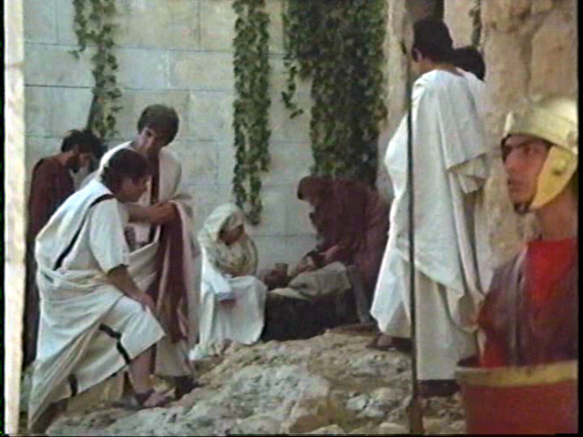
Luke 7:2 And a certain centurion's servant, who was dear to him, was sick and ready to die.

Slide 4
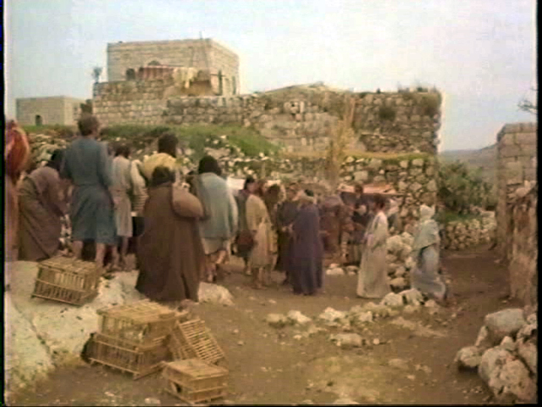
Luke 7:3 So when he heard about Jesus, he sent elders of the Jews to Him, pleading with Him to come and heal his servant.

Slide 5
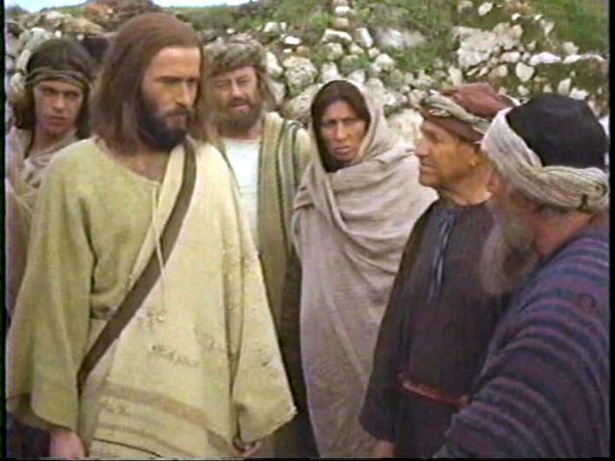
Luke 7:4-5 And when they came to Jesus, they begged Him earnestly, saying that the one for whom He should do this was deserving, for he loves our nation, and he has built us a synagogue.

Slide 6
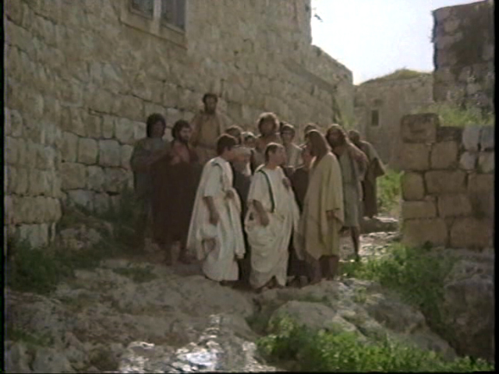
Luke 7:6 Then Jesus went with them. And when He was already not far from the house, the centurion sent friends to Him, saying to Him, "Lord, do not trouble Yourself, for I am not worthy that You should enter under my roof.

Slide 7
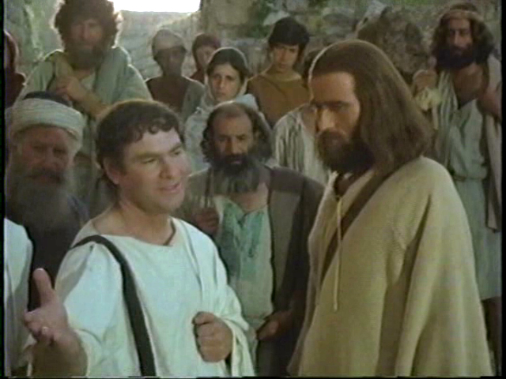
Luke 7:7-8 Therefore I did not even think myself worthy to come to You. But say the word, and my servant will be healed. For I also am a man placed under authority, having soldiers under me. And I say to one, 'Go,' and he goes; and to another, 'Come,' and he comes; and to my servant, 'Do this,' and he does it."

Slide 8
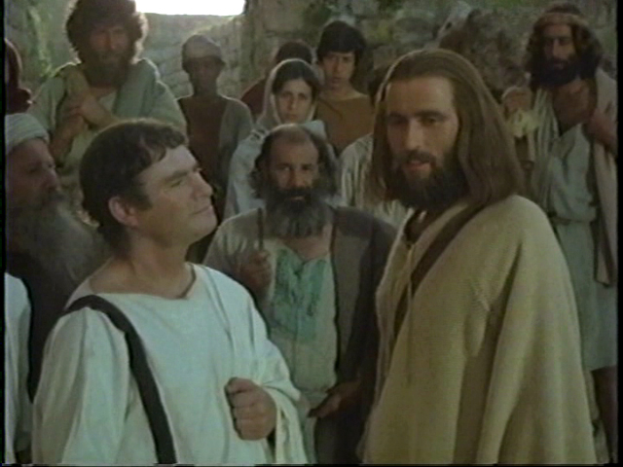
Luke 7:9 When Jesus heard these things, He marveled at him, and turned around and said to the crowd that followed Him, "I say to you, I have not found such great faith, not even in Israel!"

Slide 9
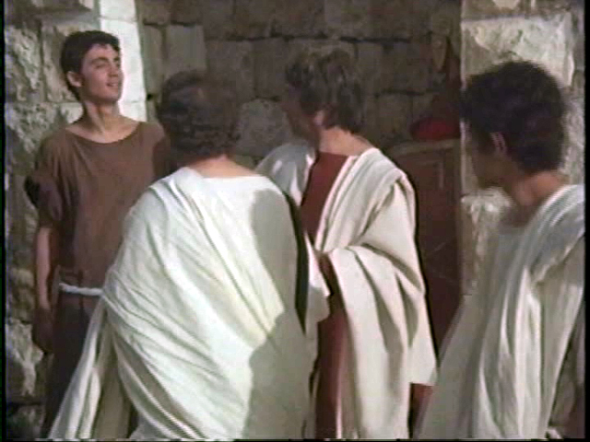
Luke 7:10 And those who were sent, returning to the house, found the servant well who had been sick.
Notes:
=

Slide 10
A Variety of Characters
The centurion
The sick slave
The Jewish elders
The friends of the centurion
Jesus
Notes:
1. This wonderful event of miraculous healing has a variety of characters: the centurion (slide)
2. The focus is on the centurion and his remarkable faith.

Slide 11
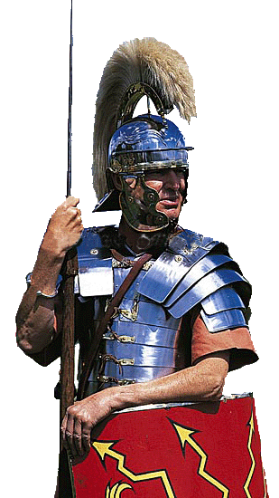
No Ordinary Man!
1. He was a centurion. (v. 2)
Notes:
No ordinary man
1. He was a centurion! (v. 2)
a. A centurion was an officer in the Roman army.
b. This means he was a Gentile, not a Jew. And, because of what takes place, that in itself is remarkable!
c. Initially a centurion was the leader of a hundred men. (A century = 100 years. In the ancient Roman army, a century was a company of soldiers of approximately 100 men.) Today he would not have been a general, but neither would he have been a sergeant. A captain might be the nearest modern equivalent.
d. Being an officer meant he was a leader and a man with important authority. Therefore, he was no ordinary man.

Slide 12
No Ordinary Man!
1. He was a centurion. (v. 2)
He displayed an unusual attitude toward his slave. (v. 3)
Notes:
He displayed an unusual attitude toward his slave! (v. 3)
a. He sent some Jewish elders asking Jesus to come and save the life of his servant.
b. Slaves in Roman antiquity had no rights. They were looked upon as tools and as the property of their owner. A slave master could mistreat his slaves with impunity.
c. One Roman writer recommended that a farmer should examine his tools every year and throw out those that are old and broken. He should do the same with his slaves. Often, when a slave was advanced in age and no longer productive, he was thrown out to die.
This centurion was very concerned about the welfare of his sick servant. He had a good heart. He was no ordinary man.

Slide 13
No Ordinary Man!
1. He was a centurion. (v. 2)
He displayed an unusual attitude toward his slave. (v. 3)
He exhibited an uncommon attitude toward the Jews. (v. 5)
“He loves our nation.”
Religious customs --
Snobbish attitudes –
Evangelistic efforts –
Lack of idols --
Notes:
He exhibited an uncommon attitude toward the Jews! (v. 5)
a.“He loves our nation.” He not only had a good heart. He also demonstrated a tolerant heart!
b. Anti-Semitism was widespread in antiquity. (In fact, I believe it furnishes the backdrop behind Paul’s letter to the Romans.) Gentiles despised the Jews for their . . .
1.Peculiar religious customs: circumcision (considered barbaric), Sabbath keeping (looked upon as laziness), refraining from the eating of pork
2. Superior and snobbish attitudes. The Jews simply thought they were better than everyone else!
3. Evangelistic efforts to proselyte and make converts to Judaism.
4. Lack of idols. Juvenal (d. 140) wrote: “They worship nothing but the clouds.” It was peculiar not to have idols. No idol = no god.
5. Most Gentiles did not have a very high opinion of Jews. This centurion was asking help from a Jewish rabbi! He had a good relationship with his Jewish neighbors. The Jewish elders of that community esteemed him, and he had assisted them in their religion. He was no ordinary man!

Slide 14
No Ordinary Man!
1. He was a centurion. (v. 2)
He displayed an unusual attitude toward his slave. (v. 3)
He exhibited an uncommon attitude toward the Jews. (v. 5)
4. He was a very generous man. (v. 5)
“He built us our synagogue”
Notes:
He was certainly a very generous man! (v. 5) “He built us our synagogue.”

Slide 15
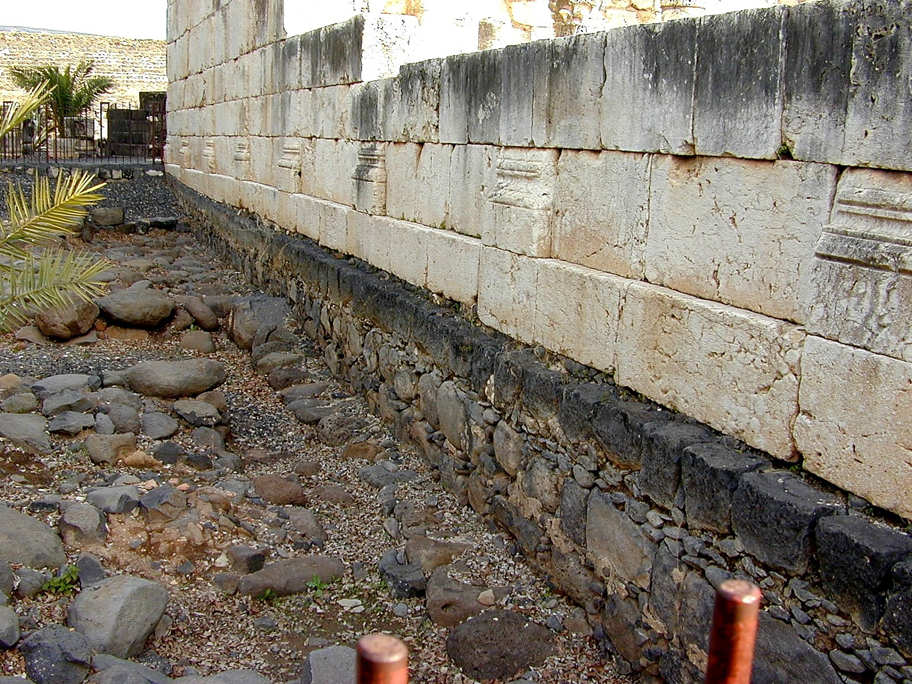
Capernaum Synagogue
Second century synagogue
Built on earlier foundations
Notes:
[Capernaum synagogue: This synaggoge from the 2nd century shows us the floor plan and what the synagogues looked in the early centuries. this one is built on the site of the previous synagogue and probably out of material from previous synagogue.
= [Note the two previous foundations for synagogues on this location. The black basalt rock foundation is the one from the time of Jesus’ day. This very centurion we are reading about built the synagogue on this level. ]
Apparently he was a man of some wealth—and he used his wealth for good purposes. He did not use his wealth simply on himself—building a mansion for himself—but on others. He used his money on God’s work: “He built us our synagogue.” That was quite an undertaking! That was a large expense. That was quite extraordinary! He was a very generous man.

Slide 16
No Ordinary Man!
1. He was a centurion. (v. 2)
He displayed an unusual attitude toward his slave. (v. 3)
He exhibited an uncommon attitude toward the Jews. (v. 5)
4. He was a very generous man. (v. 5)
5. He was a humble man. (v. 6-8)

Slide 17
No Ordinary Man!
5. He was a humble man. (v. 6-8)
“He is worthy for you to grant him this request.” (v. 4)
“Lord, do not trouble yourself further, for I am not fit for you to come under my roof.” (v. 6)
“for this reason I did not even consider myself worthy to come to you … I am a man under authority …” (v. 7)
Notes:
v. 4 In verse four, the Jewish elders said to Jesus: “He is worthy for you to grant him this request.”
v. 6 But when the second delegation is sent, he has them say, “Lord, do not trouble yourself further, for I am not fit for you to come under my roof (Surely he also realized that such an action—a Jew entering a Gentile home—would be a source of defilement in the eyes of orthodox Jews.)
v. 7 for this reason I did not even consider myself worthy to come to you . . . I am a man under authority (not “a man who has authority”—he speaks of authority in terms of his superior). He didn’t want to be an imposition upon Jesus. He was a humble man, not an ordinary man.

Slide 18
No Ordinary Man!
1. He was a centurion. (v. 2)
He displayed an unusual attitude toward his slave. (v. 3)
He exhibited an uncommon attitude toward the Jews. (v. 5)
4. He was a very generous man. (v. 5)
5. He was a humble man. (v. 6-8)
6. He was a man of great faith! (v. 9)
Notes:
1. But what is most impressive about this man was his faith!
2. This is what caused Jesus to “marvel.” “Not even in Israel have I found such great faith.” Translated that means that this Gentile pagan (godless heathen) has outshone all of God’s people. Yes! This Roman centurion was a remarkable man. He was no ordinary man!

Slide 19
No Ordinary Man!
6. He was a man of great faith! (v. 9)
What was so impressive about his faith?
How did Jesus respond to this man’s request?
Notes:
What was so impressive about his faith?
1. Simply this: He believed that Jesus could heal from a distance!
2. “Lord, you don’t have to be physically present in my house to heal my servant. Just stay where you are and speak the healing command. I know you have that kind of authority (power).” Wow! And Jesus marveled!
3. How did Jesus respond to this man’s request? Jesus may even have done one better than the man had requested!
4. The man believed if Jesus would only “speak” a healing command, the miracle would happen. But no healing word is mentioned in the text (v. 10). Did Jesus, perhaps, even go beyond the man’s expectations of faith in performing this miracle—healing the man with a mere thought, rather than with a spoken word?

Slide 20
No Ordinary Man!
1. He was a centurion. (v. 2)
He displayed an unusual attitude toward his slave. (v. 3)
He exhibited an uncommon attitude toward the Jews. (v. 5)
4. He was a very generous man. (v. 5)
5. He was a humble man. (v. 6-8)
6. He was a man of great faith! (v. 9)

Slide 21
The Importance of Faith
Heb. 11:1 Now faith is the substance of things hoped for, the evidence of things not seen.
Heb. 11:6 But without faith it is impossible to please Him, for he who comes to God must believe that He is, and that He is a rewarder of those who diligently seek Him.

Slide 22
The Importance of Faith
Heb. 11
v. 4 – By faith Able offered
v. 7 – By faith Noah built
v. 8 – By faith Abraham obeyed
v. 9 – By faith he dwelt in the land of promise
v. 17 – By faith Abraham offered Isaac
v. 21 – By faith Jacob blessed each of the sons
v. 22 – By faith Joseph gave instructions
v. 24 – By faith Moses was hidden by his parents
v. 27 – By faith Moses forsook Egypt
v. 29 – By faith they passed through the Red Sea

Slide 23
The Importance of Faith
He sought Jesus in faith …
He had conviction …
Consequently he was rewarded …
Notes:
This Gentile centurion sought Jesus in faith, and consequently he was rewarded with the blessing he sought! (Sometimes we aren’t rewarded because we don’t believe!)

Slide 24
The Importance of Faith
Do you see the implication for your life?
“heard about Jesus” – v. 3
encouragement
faith strengthened
conviction
Notes:
Now, do you see the implications for your life?
1. What is the point of this event in Luke 7?
2. How does it function for the biblical writer?
3. What purpose did it serve for the earliest Christians?
4. This story was meant to be a source of encouragement for those who had never seen Jesus with their own eyes, especially Gentile Christians. It was intended to strengthen their faith! Encouragement, faith strengthened, conviction
5. In this event, the centurion never does come face to face with Jesus. He never meets Jesus or sees the Lord with his own eyes. He has merely learned of Jesus (“heard about Jesus” – v. 3) from others (i. e., the Jews).
6. Faith comes by hearing - Romans 9:10
7. Yet, he is not at a disadvantage! Because of his “great faith” , he receives the requested blessing.

Slide 25
The Importance of Faith
Jesus doesn’t have to be here “in person” to bless us …
Though you’ve never seen Jesus with your own eyes, you are not at a disadvantage!
Notes:
Do you now see the implication for your life?
Do you believe . . .
That the power of Jesus is not limited to his physical presence
That he can bless from a distance? (Time & space is no barrier for Jesus!)
That although you have never seen Jesus with your own eyes, (never come face to face with your Lord) you are not at a disadvantage?
He rewards those who seek Him. It all depends on your faith.

Slide 26
How Great Is Your Faith?
Hear John 12:48
Believe John 8:24
Repent Luke 13:3
Confess Matt. 10:32-33
Baptized Mark 16:16
Faithful Matt. 24:13
Notes:
So the question I need to ask ypu is, How great is your faith?
1. Are you a believer?
2. Are you a trusting, obedient believer? IF NOT
3. If you’ve never expressed your faith in Jesus, are you ready to confess Him this morning and be baptized into him for the remission of sins?
4. Friend, if your faith has not been steady and strong –
5. Perhaps you need to come back to him and re-commit your life to him. You can come to Jesus now

