Slide 1
He Restores My Soul
Ps. 23:3
Notes:
1. Aim: To discuss how Jesus will restore our soul when we are in trouble.

Slide 2
“The LORD is my shepherd; I shall not want. He makes me to lie down in green pastures; He leads me beside the still waters. He restores my soul; He leads me in the paths of righteousness For His name's sake. Yea, though I walk through the valley of the shadow of death, I will fear no evil; For You are with me; Your rod and Your staff, they comfort me. You prepare a table before me in the presence of my enemies; You anoint my head with oil; My cup runs over. Surely goodness and mercy shall follow me All the days of my life; And I will dwell in the house of the LORD Forever”
Notes:
Verses
2. The LORD is a Good Shepherd who provides all that we, the sheep of His pasture, could ever need.
a. Not only is He the Good Shepherd because of His provisions of green pastures and cool, clear, clean water; but also, because of the other good things he does for us.
b. Today, we will consider the phrase, “He restores my soul…”

Slide 3
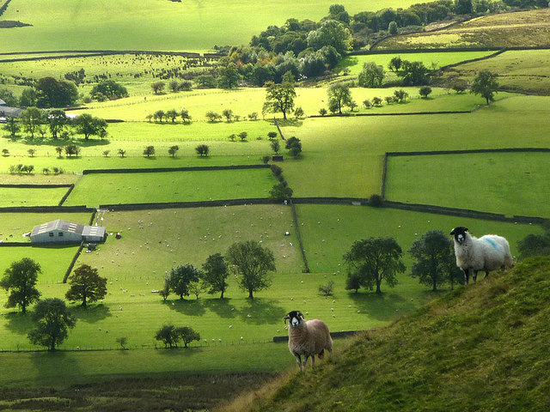
1. We are Like Sheep
“Know that the LORD, He is God; It is He who has made us, and not we ourselves; We are His people and the sheep of His pasture.” Ps. 100:3
Notes:
1. In the Bible there is this relationship between God and man. He compares it to a father and his children and a shepherd to his sheep. We are like Sheep.
a. In Psalms 23 David is not speaking as the shepherd, though he was one, but as a sheep, one of the flock.
b. David was saying that the Lord is my shepherd, my owner. He knew that the life of sheep depended upon the man who owned them and cared for them. (CLICK)
c. Ps. 100:3 “Know that the LORD, He is God; It is He who has made us, and not we ourselves; We are His people and the sheep of His pasture.”
2. As Christians, we are the sheep of God's pasture and only He can restore our souls.
3. We, the sheep of our Lord’s pasture, will at some time in our Christian lives experience this grace that the LORD ministers to those who are “cast down;” or backslidden.
a. When we, the sheep of His pasture, go astray, He never loses His love for us.
b. He watches over His sheep when they are right where they should be, and when they go astray.

Slide 4
1. We are Like Sheep
“But made His own people to go forth like sheep, and guided them in the wilderness like a flock.” Ps. 78:52
Notes:
1. WE ARE LIKE SHEEP
1. It is no accident that God has chosen to call us sheep. The behavior of sheep and human beings is similar in many ways.
2. Ps. 78:52 “But made His own people to go forth like sheep, and guided them in the wilderness like a flock.”

Slide 5
1. We are Like Sheep
Four requirements for sheep to rest:
No fear
No friction
No pests
No hunger
Matt. 6:25-34
  Don’t worry about food or water
  Don’t worry about clothing
  God knows you need these
“But seek first the kingdom of God, and His righteousness; and all these things shall be added unto you.” v. 33
Notes:
A. Sheep will not lie down (rest) unless four requirements are met:
1. They must be free of all fear
2. They must be free from friction with the other sheep
3. They must be free from pests
4. They must be free from hunger
5. A flock that is restless, discontented, always agitated, and disturbed never does well.
6. And the same is true of people.
B. We can only be at ease when we learn to conquer worry. Jesus teaches us how to do that in Matthew 6:25-34
1. Don’t worry about what you are going to eat or drink.
2. Don’t worry about the clothing that you are going to wear
3. God knows that you have need of all these things
4. Here is the way to have all these things and be content.
5. v. 33 “But seek first the kingdom of God, and His righteousness; and all these things shall be added unto you.”
a. Kingdom is the church
b. Righteousness is right living
c. Put these things first in your life -

Slide 6
1. We are Like Sheep
Sheep Must Have Water
“Blessed are they which do hunger and thirst after righteousness: for they shall be filled.” Matt. 5:6
“If any man thirst, let him come unto Me and drink.” Jn. 7:37
“His divine power has given to us all things that pertain to life and godliness, through the knowledge of Him who called us by glory and virtue” 2 Pet. 1:3
Notes:
A. Sheep must have water in order to survive
1. When sheep are thirsty, they become restless and set out in search of water to satisfy their thirst.
2. If not led to the good water supplies of clean, pure water, they will often end up drinking from the polluted pot holes where they pick up such internal parasites as nematodes, liver flukes or other germs.
3. Christ, our Good Shepherd, made it clear that thirsty souls of men and women can only be fully satisfied when their capacity and thirst for spiritual life is fully quenched by drawing on Himself. (CLICK)
4. In Matthew 5:6 He said, “Blessed are they which do hunger and thirst after righteousness: for they shall be filled [satisfied].”
5. At the great feast in Jerusalem He declared boldly, “If any man thirst, let himcome unto me and drink.”
6. God’s Word can satisfy our needs. 2 Peter 1:3 “His divine power has given to us all things that pertain to life and godliness, through the knowledge of Him who called us by glory and virtue”

Slide 7
1. We are Like Sheep
Sheep Often Lose Their Way
Wander around and get lost - can’t find their way
The shepherd must go and find them
Isa. 53:6 “All we like sheep have gone astray…”
Paul wrote, “Therefore let him who thinks he stands take heed lest he fall” 1 Cor. 10:12
Notes:
A. Sheep often lose their way.
1. They can be in a pasture with plenty of grass and adequate water, and still wander aimlessly until they have nothing to eat or drink.
2. Once lost, they can't find their way back.
3. Many animals seem to have inborn compasses – not so with sheep. Once lost, the shepherds must go and find them.
4. Spiritually, people are like sheep. (CLICK)
a. Isaiah the prophet wrote in Isaiah 53:6, “All we like sheep have gone astray…”
b. It doesn’t matter how educated, book smart, rich, popular, or how experienced you are, we can fall.
c. Paul wrote, “Therefore let him who thinks he stands take heed lest he fall”

Slide 8
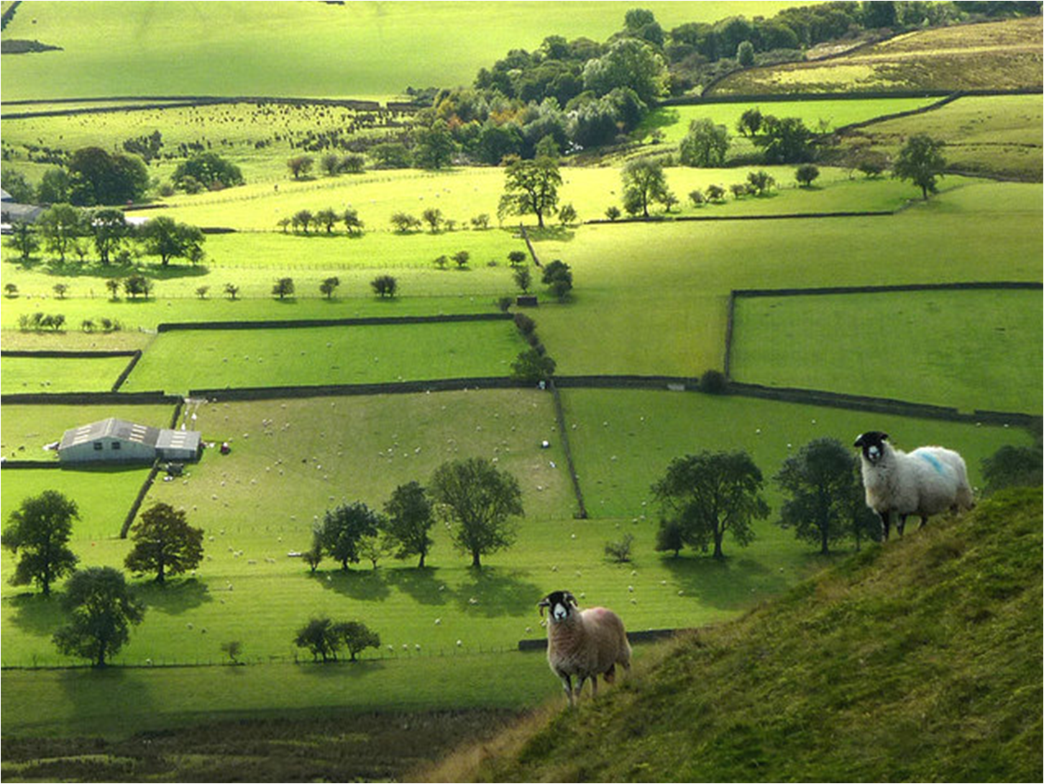
1. We are Like Sheep
“He restores my soul”
Notes:
A. In spite of all of the warnings, we can still go astray.
1. But the Lord is not finished with us when that happens.
2. The psalmist reminds us that “He restoreth my soul.”

Slide 9
2. Being Cast Down
“Why are you cast down, O my soul? And why are you disquieted within me? Hope in God; For I shall yet praise Him, The help of my countenance and my God.” Ps. 42:11
Ps. 42:6 “O my God, my soul is cast down within me”
Notes:
2. BEING CAST DOWN
B. David knew what it was to be cast down and dejected.
1. He had tasted defeat in his life and felt the frustration of having fallen under temptation.
2. David was acquainted with the bitterness of feeling hopeless and without strength in himself. (CLICK)
3. In Psalm 42:11 he cries out, “Why are you cast down, O my soul? And why are you disquieted within me? Hope in God; For I shall yet praise Him, The help of my countenance and my God.”
4. Psalms 42:6 “O my God, my soul is cast down within me.”

Slide 10
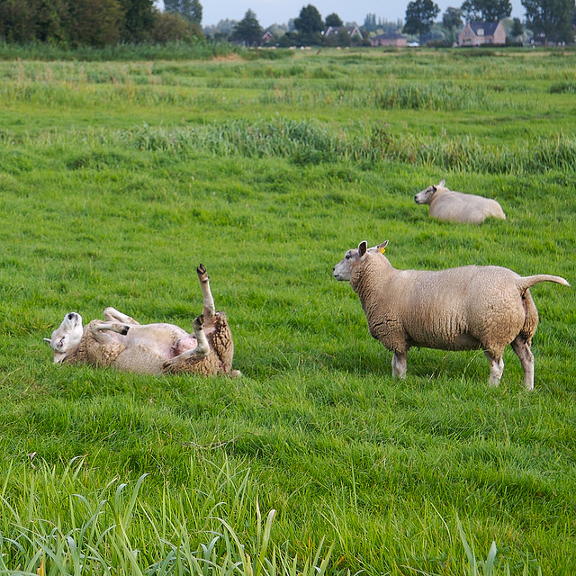
2. Being Cast Down
Notes:
1. Now there is an exact parallel to this in caring for sheep.
2. Only those intimately acquainted with sheep and their habits understand the significance of a “cast” sheep or a “cast down” sheep.
3. This is an old English shepherd's term for a sheep that has turned over on its
back and cannot get up again by itself.
4. A “cast” sheep is a very pathetic sight.
a. Lying on its back, its feet in the air, it flals away frantically struggling to stand up, without success.
b. Sometimes it will bleat a little for help, but generally it lies there lashing about in frightened frustration.
c. If the owner does not arrive on the scene within a reasonably short time, the sheep will die.
5. This is but another reason why it is so essential for a careful shepherd to look over his flock every day, counting them to see that all are able to be up and on their feet.
6. If one or two are missing, often the first thought to flash into his mind is, “One of my sheep is cast somewhere. I must go in search and set it on its feet again.”
D. In this case, the sheep needs the shepherd to turn it aright; or it will suffer greatly
or even die in a very short time.
1. Therefore, the shepherd has to keep a close watch over his flock, lest some of them suffer greatly through being “cast down.”
E. The shepherd is not the only one who watches for the “cast down” sheep.

Slide 11


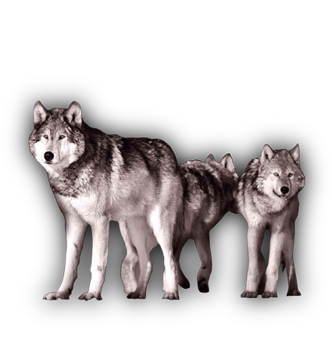
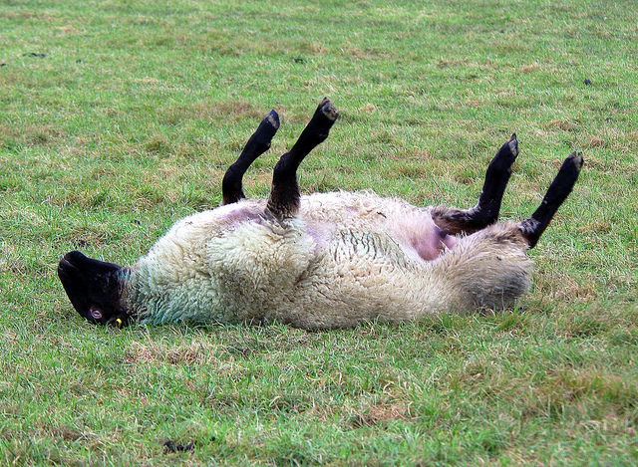
2. Being Cast Down
Notes:
1. So do the predators – wolves, coyotes, cougars, bears, vultures, etc.
2. The Devil and his ministers are always watching for those Christians who are “cast down” within themselves. They are ready to devour them.
3. 1 Peter 5:8 “Be sober, be vigilant; because your adversary the devil, as a roaring lion, walking about, seeking whom he may devour:”

Slide 12
3. Reasons Sheep are “Cast”
1. Soft, comfortable, rounded place to bed down
- Relax
- Roll over on back = cast
2. Too much wool
- Heavy, matted with mud and debris
- Thrown off balance = cast
- Must be sheared
3. Too Fat
- Hard for them to move around
- They need exercise & balanced diet
Notes:
F. Three Reasons why sheep are “cast down”
1. Sheep look for a soft, comfortable, rounded hollow in the hillside where they can bed down – the sheep relax and roll over on their backs. They are cast.
2. Too much wool.
a. As time progresses, wool becomes long, heavy, and matted with mud, manure, burrs, and other debris.
(1) Because of this, the sheep become weighted down and easily thrown off balance, causing many to be “cast down.”
(2) The only remedy for this problem is to remove the wool by the shearing of the sheep – a necessity, but an unpleasant experience for the sheep.
(3) Actually when it is all over both sheep and owner are relieved.
(4) There is no longer the threat of being cast down, for the sheep there is the pleasure of being set free from a hot, heavy coat.
3. Too fat – their weight makes it harder for them to be agile and nimble on their feet.
a. Sheep need exercise!
b. Sheep need a balanced diet (some grain and some grass).

Slide 13
3. Reasons Sheep are “Cast”
1. Soft, comfortable, rounded place to bed down
- Look for easy way
- 1 Cor. 10:12 “take heed lest he fall”
2. Too much wool
- Weighed down with debris of this life
- Heb. 12:1 “let us lay aside every weight”
- Eph. 4:22 “Put off”
3. Too Fat
- Need to be actively using the Word
- Acts 20:27 “the whole counsel of God”
- 1 Tim.4:7 “exercise yourself toward godliness.”
Notes:
Sm reasons we as Christian can become spiritually “cast”
1. Comfortable place
a. There is always danger for the Christian when he looks for the easy place, the cozy corner, the comfortable position – the place where there are no hardships, no need for endurance
b. The time when we think we have attained or have it made as Christians, it is then that we find ourselves in danger of being “cast down” through lethargy or despondency –
c. 1 Corinthians 10:12, “Wherefore let him that thinks he stands take heed lest he fall.”
2. So, too, Christians – when not quite right with the Lord, we become weighted
down with the debris of this life. This causes us to be “cast down.” Notice
the following verses.
a. Heb. 12:1 “let us lay aside every weight, and the sin which so easily ensnares us, and let us run with endurance the race that is set before us”
b. Ephesians 4:22, “that you put off, concerning your former conduct, the old man which grows corrupt according to the deceitful lusts”
c. And similarly in dealing with our old self-life, there will come a day when the Master must take us in hand and apply the keen cutting edge of His Word to our lives. It may be an unpleasant business for a time.
d. No doubt we'll struggle and kick about it. We may get a few cuts and wounds. But what a relief when it is all over.
e. Oh, the pleasure of being set free from ourselves! What a restoration!
3. We need a well-balanced diet from the Meadow and Barn of God’s Word.
a. We need much of what we like to hear (evangelism, God’s love, grace), but we also need to hear that which is not so pleasant to our ears (sin and its consequences, hell, punishment) –
b. We need to hear “the whole counsel of God.” – Acts 20:27.
c. 1 Timothy 4:7 “reject profane and old wives' fables, and exercise yourself toward godliness.”

Slide 14
4. Shepherd Cares for Sheep
“He restores my soul”
Notes:
4. The Shepherd cares for the sheep
A. The psalmist reminds us that “He restores my soul.”
1. But Who is this who will restore our souls?
The He Who will restore your soul is the He Who flung far worlds into their orbits and Who maintains them in their paths
b. The He Who will restore your soul is the He Who made the lame to walk, the blind to see, the mute to talk, the leprous to be clean, and the dead to rise.
c. The He Who will restore your soul is the He Who has all power in heaven and earth and will restore the joy of our salvation

Slide 15
4. Shepherd Cares for Sheep
“He restores my soul”
Shepherd finds a cast sheep
- Turns it over and helps it get onto its feet
- Regains it’s balance - rejoins the flock
Our Shepherd restores our soul
- Concern for us - feeling of compassion
- Jesus will pick up “cast” sheep
- Tenderness, love and patience
- Peter is an example
Notes:
2. The shepherd who finds a sheep that is cast cares for it immediately
a. He turns it over and helps it get up onto its feet.
b. Sometimes they will stumble and stagger and fall again.
c. But the shepherd keeps on helping it to get up and finally the sheep regains its equilibrium and is able to walk steadily.
d. Then it runs to rejoin the flock because it has been set free from its fears and frustrations and given another chance to live a little longer.
e. It has been restored
3. Our shepherd restores our soul
a. Many people have the mistaken idea that when a child of God falls and goes back into sin that God is disgusted, fed-up and furious with him.
b. That is not true.
c. He has the same feelings of concern and compassion for cast men and women as a shepherd has for his cast sheep.
d. He weeps over those who turn away from him and refuse to return his love by being obedient to his commands.
e. When we read the life story of Jesus Christ and examine carefully His
conduct in coping with human need, I see Him again and again as the Good
Shepherd picking up “cast” sheep.
(1) The tenderness, the love, the patience that He used to restore Peter's soul after the terrible tragedy of his temptations is a classic picture of
the Christ coming to restore one of His own.
(2) And so He comes quietly, gently, reassuringly to me no matter when or where or how I may be cast down.

Slide 16
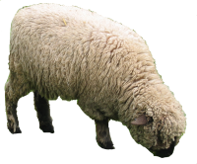
4. Shepherd Cares for Sheep
Do not know how to care for themselves
“All we like sheep have gone astray; we have turned every one to his own way” Isa. 53:6
“There is a way which seems right unto a man, but the end thereof are the ways of death.” Prov. 14:12
Notes:
1. Sheep do not know how to care for themselves
a. If left to themselves they will follow the same trails until they become ruts; graze the same hills until they turn to desert wastes; pollute their own ground until it is corrupt with disease and parasites.
b. No other livestock requires more careful handling, more detailed direction, than do sheep. No doubt David, as a shepherd himself, had learned this firsthand from tough experience.
2. Our behavior patterns and life habits are so much like that of sheep (CLICK)
a. We prefer to follow our own fancies and turn to our own ways. Isa. 53:6 “All we like sheep have gone astray; we have turned every one to his own way”
b. And this we do deliberately, repeatedly, even to our own demise.
c. We read in Proverbs 14:12, “There is a way which seems right unto a man, but the end thereof are the ways of death.”

Slide 17
4. Shepherd Cares for Sheep
Jesus is the Good Shepherd
“I am the way, the truth, and the life: no man cometh unto the Father, but by me” Jn. 14:6
“I am come that they might have life, and that they might have it more abundantly” Jn. 10:10
“If any man will come after Me, let him deny himself, and take up his cross, and follow Me.” Matt. 16:24
Notes:
1. In contrast to which Christ the Good Shepherd comes gently and says,
a. “I am the way, the truth, and the life: no man cometh unto the Father, but by me”
b. “I am come that they might have life, and that they might have it more abundantly”
c. “If any man will come after me, let him deny himself, and take up his cross, and follow me.”
2. If we follow Him and fall down, and then come back to Him he will restore our soul.
3. He knows all about us and wants us to be safe in his fold.

Slide 18
“He restores my soul”

Slide 19
What Must I Do
To be Saved ?
In Christ = SAVED
Baptized (Gal.3:27)
Confess (Rom.10:10)
Repent (Lk.13:3)
Believe (Jn.8:24)
Hear (Rom.10:17)

