Slide 1
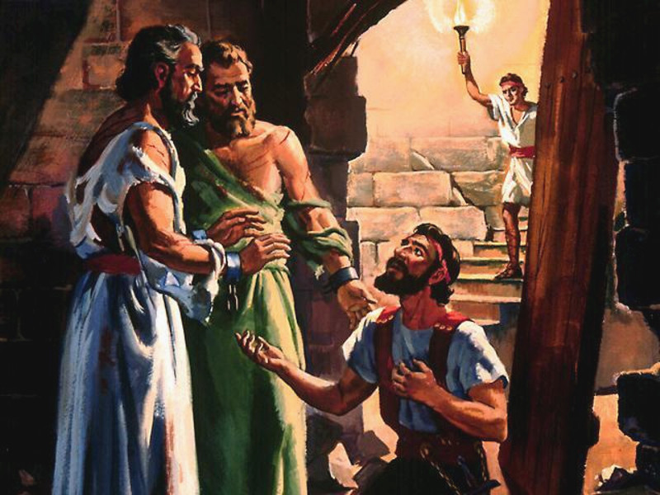
"Sirs, what must I do to be saved?"
Have You Been Converted?

Slide 2
Have You Been Converted?
Converted
verb
1 - to bring over from one belief, view, or party to another
2 - to change from one form or function to another

Slide 3
Have You Been Converted?
Converted
Original Word:
στρέφω, strephō
"to turn oneself“ namely, from one’s course of conduct, to change one’s mind.

Slide 4
Have You Been Converted?
Converted
Matthew 18:3-4 ³ and said, "Assuredly, I say to you, unless you are converted and become as little children, you will by no means enter the kingdom of heaven. ⁴ Therefore whoever humbles himself as this little child is the greatest in the kingdom of heaven.

Slide 5
Have You Been Converted?
Converted
Acts 3:19 ¹⁹ Repent therefore and be converted, that your sins may be blotted out, so that times of refreshing may come from the presence of the Lord,

Slide 6
Have You Been Converted?
Converted
James 5:19-20 ¹⁹ Brethren, if anyone among you wanders from the truth, and someone turns him back, (convert him KJV) ²⁰ let him know that he who turns (converteth – KJV) a sinner from the error of his way will save a soul from death and cover a multitude of sins.

Slide 7
Have You Been Converted?
Converted
ἐπιστροφή, epistrophē
Part Of Speech: Noun
"a turning about, or round, conversion.” The word implies "a turning from and a turning to;" corresponding to these are repentance and faith”

Slide 8
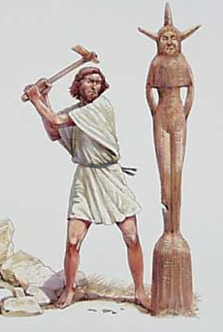
Have You Been Converted?
Converted
1 Thessalonians 1:9-10 ⁹ For they themselves declare concerning us what manner of entry we had to you, and how you turned to God from idols to serve the living and true God, ¹⁰ and to wait for His Son from heaven, whom He raised from the dead, even Jesus who delivers us from the wrath to come.

Slide 9
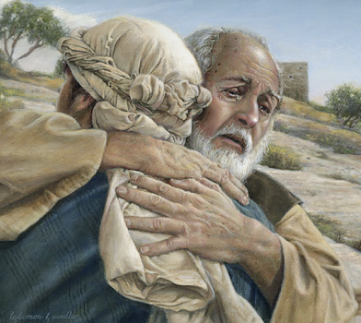
Have You Been Converted?
Converted
Not merely a change in actions
A change in knowledge
A change in conviction
A change in allegiance
A change in thinking & will
A change in commitment resulting in a change in relationship & identity
A change in who we are, how we talk, where we go, what we do
Luke 15:11-24
Notes:
Not merely a change in actions (so you can get what you want) – went home, did not have a servant mentality
Knowledge – “came to himself” this isn’t the way I ought to be living. Came to the knowledge of who his father was, blessings with father, what he was doing
Conviction – stopped believing he could provide for himself, father only one who provide what he needed
Allegiance – joined himself to the world, now decides to go back home and join myself back to my father
Thinking and Will – he made a choice to get up and go back home, he knew he had sinned against his father, not worthy to be called fathers son
Commitment – I am going home, change in his relationship “my son was dead, but now he is alive”
Change in who we are – think, talk, go, do

Slide 10
Have You Been Converted?
The Truth - John 8:32; 17:17
The REAL Gospel – Rom 1:16
One Cannot Be Taught Error –Believe Error – Obey Error and Be Converted By and To The Truth
Notes:
John 8:32 You shall know the truth, and the truth shall make you free."
John 17:17 Sanctify them by Your truth. Your word is truth.
Rom 1:16 For I am not ashamed of the gospel of Christ, for it is the power of God to salvation for everyone who believes

Slide 11
Have You Been Converted?
1
Impossible to please God without FAITH – Hebrews 11:1,6
Faith comes by hearing God’s Word – Romans 10:17
Notes:
What does true conversion require?
1. A change in conviction
Heb 11:1 Now faith is the substance of things hoped for, the evidence of things not seen.
Heb 11:6 But without faith it is impossible to please Him, for he who comes to God must believe that He is, and that He is a rewarder of those who diligently seek Him. – faith that trusts, believe what He says, follow what He says
Rom 10:17 So then faith comes by hearing, and hearing by the word of God.

Slide 12
Have You Been Converted?
1
Who God Is & What He Has Done For Us – Jn 3:16
Who Jesus Is & What He Has Done For Us – Heb 2:9-18
Who We Are, What We Have Done, & What We MUST Do – Eccl 12:13; Rom 3:23; Is 59:1-2; Acts 2:38
Notes:
Joh 3:16 For God so loved the world that He gave His only begotten Son, that whoever believes in Him should not perish but have everlasting life.
Ecc 12:13 Let us hear the conclusion of the whole matter: Fear God and keep His commandments, For this the whole duty of man.

Slide 13
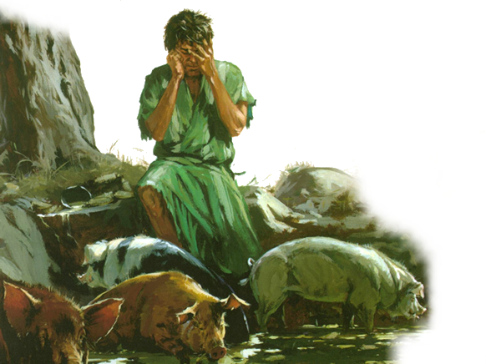
Have You Been Converted?
2
Something We Must Do - (Luke 13:3)
Repentance Requires Radical Change – (Eze. 18:30)
Luke 15:17-20
Notes:
What does true conversion require?
1. A change in will
1. Repentance Requires Radical Change, something we must do (Lk. 13:3) – not just in action, but thinking (I am not worthy to be called my fathers son)
2. Eze 18:30 "Therefore I will judge you, O house of Israel, every one according to his ways," says the Lord GOD. "Repent, and turn from all your transgressions, so that iniquity will not be your ruin. Cast away from you all the transgressions which you have committed, and get yourselves a new heart

Slide 14
Have You Been Converted?
2
Recognition – (Acknowledgement of Sin)
Remorse -(Regret & Grieving Over Sin)
Resolve – (A Change of Mind & Will)
Reformation – (A Change of Lifestyle)
Restitution – (Make Amends As Far As Possible)
Luke 15:17-20
Notes:
5 things included in repentance

Slide 15
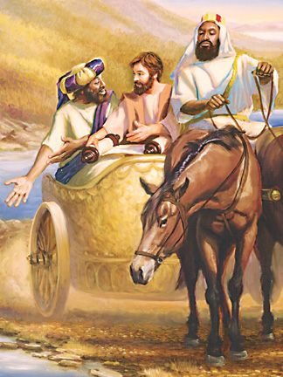
Have You Been Converted?
3
The eunuch said, "See, here is water. What hinders me from being baptized?" Then Philip said, "If you believe with all your heart, you may." And he answered and said, "I believe that Jesus Christ is the Son of God." Acts 8:36-37
Notes:
What does true conversion require?
1. A change in allegiance

Slide 16
Have You Been Converted?
3
Matthew 10:32
"Therefore whoever confesses Me before men, him I will also confess before My Father who is in heaven”

Slide 17
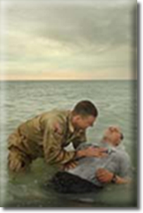
Have You Been Converted?
4
A Change In Commitment
United with Christ in His death – (Romans 6:3)
Submitting to the authority of Christ -(Receiving the remission of sins – Acts 2:38)
Becoming a child of God by faith – (Gal. 3:26-27)
Notes:
What does true conversion require?
1. A change in commitment
Rom 6:3 Or do you not know that as many of us as were baptized into Christ Jesus were baptized into His death?
Act 2:38 Repent, and let every one of you be baptized “in the name of” Jesus Christ for the remission of sins
Gal 3:26 For you are all sons of God through faith in Christ Jesus. For as many of you as were baptized into Christ have put on Christ.

Slide 18
Have You Been Converted?
2 Corinthians 5:17 ¹⁷ Therefore, if anyone is in Christ, he is a new creation; old things have passed away; behold, all things have become new.

Slide 19
Have You Been Converted?
Colossians 3:1-3 ¹ If then you were raised with Christ, seek those things which are above, where Christ is, sitting at the right hand of God. ² Set your mind on things above, not on things on the earth. ³ For you died, and your life is hidden with Christ in God.

Slide 20
Have You Been Converted?
Not merely “have you changed your actions”
But have you been changed in your convictions, allegiance, thinking, will, commitment, and relationship with God through a knowledge of the truth
True conversion results in a change in who we are – how we talk – where we go – what we do

Slide 21
GOD’S SIMPLE PLAN FOR SALVATION
Rev. 2:10
Acts 2:38
baptism
JN. 12:42
confess
LK. 13:3
repent
OBEDIENT
UNTIL DEATH
JN. 8:24
believe
ACTS 3:22
hear

