Slide 1
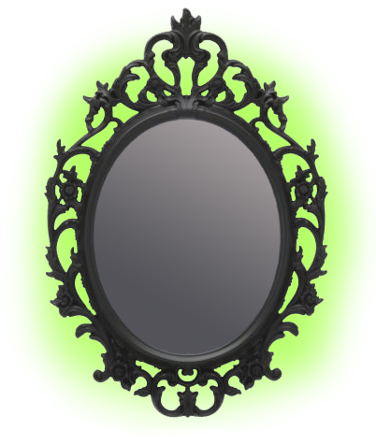
God’s
Mirror
Jas. 1:22-25
Notes:
1. Aim: To discuss what the Bible teaches about how we should examine our own lives to be sure it is pleasing to God.
2. James 1:22-25
a. James compares the Bible to a mirror.
b. The word of God is God's mirror.

Slide 2
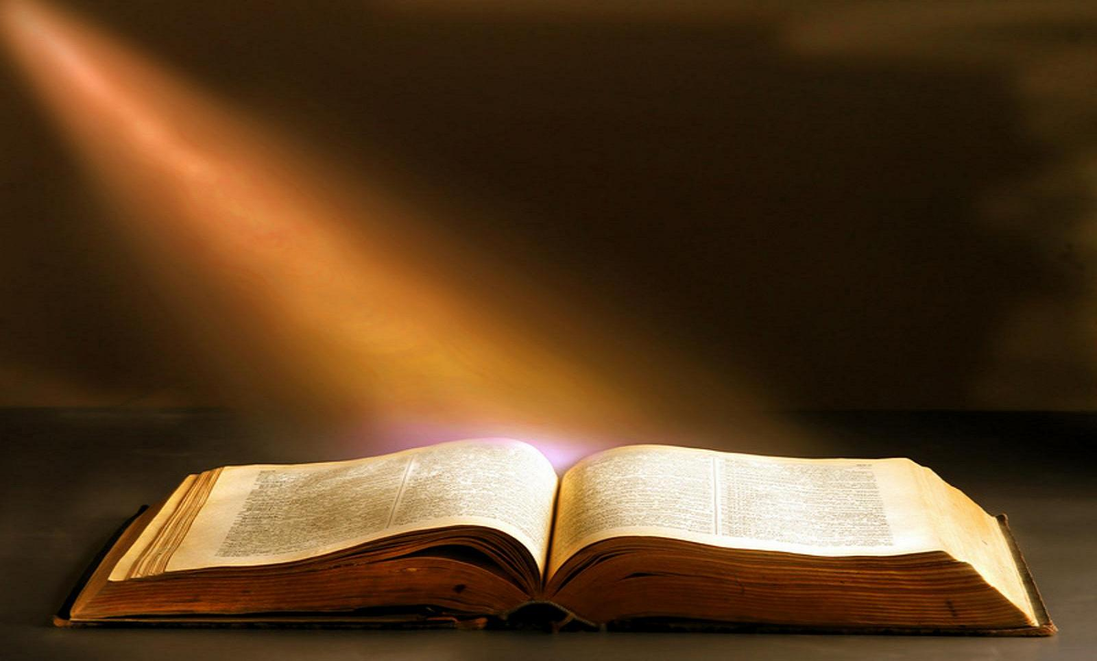
2 Cor. 13:5 "Examine yourselves as to whether you are in the faith. Test yourselves. Do you not know yourselves, that Jesus Christ is in you?—unless indeed you are disqualified."
God’s
Mirror

Slide 3
James 1:22-25
22. But be doers of the word, and not hearers only, deceiving yourselves.
23. For if anyone is a hearer of the word and not a doer, he is like a man observing his natural face in a mirror
24. for he observes himself, goes away, and immediately forgets what kind of man he was.
25. But he who looks into the perfect law of liberty and continues in it, and is not a forgetful hearer but a doer of the work, this one will be blessed in what he does.

Slide 4
God’s
Mirror
Notes:
1. When we look into this mirror {Bible} we can see:
a. Ourselves as God sees us
b. Ourselves as we really are.
c. Then we can make any changes that are needed.
2. How do you look when you stand before God's mirror?

Slide 5
James 1:22-25
22. But be doers of the word, and not hearers only, deceiving yourselves.
DOERS OF THE WORD
- Faith in action
- “poet” = creative action
NOT HEARERS ONLY
- Matt. 7:21 “he that does the will of my Father”
- Rom. 2:13 “For not the hearers of the law are just in the sight of God, but the doers of the law will be justified”
- Lk. 11:28 “Blessed are those who hear the word of God and keep it.”
DECEIVING YOUR OWN SELVES
- Deluding – not reasoning correctly
Notes:
1. Doers of the word
a. Action in our life - obedience to the word - It is faith in action -
b. Our word “Poet” comes from this word - a term denoting creative action
(1) Poetry is regarded as one of the most creative fields in all literature.
(2) A faithful Christian poetizes; his life is a perpetual poem, exhibiting the beauty and symmetry of a harmonious life, and demonstrating
always and everywhere the creative action of a productive life.
c. “keep on demonstrating yourselves as doers of the word.”
d. God has never blessed anybody in any age because of his faith until that persons faith was obedient to God’s will. One is not simply to keep on hearing the word, or even to keep on receiving it; our faith must express itself in action in our life in order to bless and to save.
2. Not Hearers only = no obedience follows
a. Some feel that just hearing the word preached is all they need.
b. Matthew 7:21 - “Not every one that says to me, Lord, Lord, shall enter into the kingdom of heaven; but he that does the will of my Father which is in heaven.”
c. Romans 2:13 “for not the hearers of the law are just in the sight of God, but the doers of the law will be justified.”
d. Luke 11:28 “blessed are those who hear the word of God and keep it.”
3. Deceiving your own selves
a. Deluding, not reasoning correctly.
b. Many people are deceiving themselves into believing that if they just hear the word of God it will benefit them.
c. Of course we must hear the truth to learn it, but there must be more than just hearing !
d. What benefit would it be if you could quote the entire New Testament if you did not practice any of it?
e. One who merely listens to a doctor, but never takes his advice, should not expect to receive benefits, likewise a disciple of Jesus is
regarded as a genuine one only if he abides in God’s word and lives by it.
f. That is one reason why we should look into the Divine Mirror!
g. God wants us to not only hear, but also obey His word!!

Slide 6
James 1:22-25
23 For if anyone is a hearer of the word and not a doer, he is like a man observing his natural face in a mirror
24 for he observes himself, goes away, and immediately forgets what kind of man he was.
Looking in mirror to see what needs changing
Read the Bible and ask “How does this apply to me?”
God’s
Mirror
Notes:
verses
1. Look at natural face to see if it needs any changes
2. If a person takes a short glance and goes on without any changes, then it did them no good to see themselves
3. Or we can look closely and make the needed changes.
4. As we read the Bible we should ask: “What is included in this verse, or chapter, that applies to me that I need to do!”

Slide 7
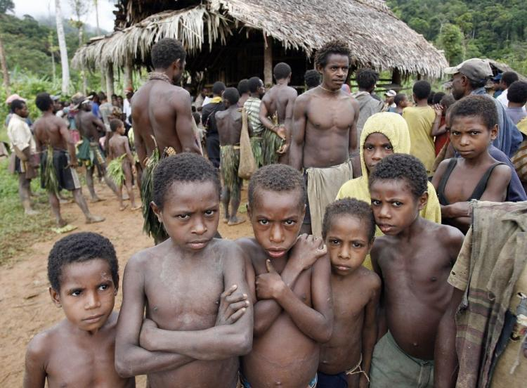
James 1:22-25
Notes:
In some part of New Guinea the primitive Tribes have no mirrors. When visitors take pictures, the natives are able to recognize others in the picture but they do not know themselves.

Slide 8
James 1:22-25
25. But he who looks into the perfect law of liberty and continues in it, and is not a forgetful hearer but a doer of the work, this one will be blessed in what he does.
Law = the New Testament
Perfect Law = Complete, last, or end
Perfect Law of Liberty = To obey God is Liberty
Doer of the work = Blessed (Jn. 13:17, Matt. 7:24)
Notes:
D. Perfect law of liberty [notice 3 things] v. 25
1. Law - the N.T. contains “law” or basic principles which must guide our life
2. Perfect law - perfect means complete, or last, or end. The New Testament is God's law that is without defect. It is God’s final revelation.
3. Perfect law of Liberty - Law and liberty are not contradictory.
a. The only truly free people, spiritually speaking, are those who have voluntarily submitted themselves to God because of their love and
appreciation.
b. It is a law of liberty, because obedience to it sets one free from the bondage of sin and Satan, and spiritual death.
c. "To obey God is liberty," said the scholarly Seneca.
E. Doer of the work = blessed
1. Jn. 13:17 “If you know these things, blessed are you if you do them.”
2. In Mt. 7:24ff Jesus said the wise builder would be blessed because his house would stand.
3. Faithful obedience is necessary to be blessed by God.

Slide 9
1. Importance of the Divine Mirror
Essential to have God’s Approval
“For not he who commends himself is approved, but whom the Lord commends.” 2 Cor. 10:18
“Whatever we ask we receive from Him, because we keep His commandments and do those things that are pleasing in His sight.” 1 Jn. 3:22
Come to have His approval and Keep His approval
How can we tell if we are approved of God?
Notes:
1. THE IMPORTANCE OF THE DIVINE MIRROR
A. It is essential to have God's approval
1. 2 Cor. 10:18 “For not he who commends himself is approved, but whom the Lord commends.”
2. I Jn. 3:22 “whatever we ask we receive from Him, because we keep His commandments and do those things that are pleasing in His sight.”
B. Two basic responsibilities
1. Coming to have God's approval
2. Keeping God's approval
C. We may be approved in our own sight, and still not have the approval of God. It is possible to be approved in the sight of others without having God's approval.
D. How can we tell if we are approved by God?

Slide 10
1. Importance of the Divine Mirror
God’s
Mirror
“Study to show yourself approved unto God, a workman that needs not to be ashamed, rightly dividing the word of truth.” 2 Tim. 2:15
Notes:
1. Look into God's mirror.
2. 2 Tim. 2:15 “Study to show yourself approved unto God, a workman that needs not to be ashamed, rightly dividing the word of truth.”
3. We must examine our lives before the divine mirror

Slide 11
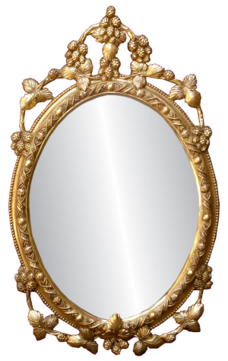
2. Purpose of the Divine Mirror
1. See how we look
Added – Subtracted – Changed
2. Improve our image
1. Look in Divine Mirror - To see how we look
Added – Subtracted – Changed
2. Improve our Spiritual Image
God’s
Mirror
Notes:
2. THE PURPOSE OF THE DIVINE MIRROR
A. When we look into an ordinary mirror, we have 2 thoughts in mind:
1. To see how we look.
a. Something should be added
b. Something should be subtracted
c. Something should be changed
2. To try to improve our appearance.
B. When we stand before the Divine mirror, we have the same 2 thoughts in our mind
1. To see how we look spiritually
a. We see something is lacking
b. We see something that should be added
c. We see something that should be changed, taken away from our life.
2. To try to improve our spiritual condition
a. We need to add the things that are lacking
b. We need to take away the things that are wrong
c. We need to change some things to be better
3. This is the purpose of the Divine Mirror.

Slide 12
3. Reflections of the Divine Mirror
God demands certain things…
Study
Pray
Attend
Working
Teaching
Giving
Helping Others
God’s
Mirror
Notes:
3. THE REFLECTIONS OF THE DIVINE MIRROR
A. God demands of us certain things we often are not doing:
1. Studying - the Bible
2. Praying
3. Attending
4. Working
5. Teaching
6. Giving
7. Helping others

Slide 13
3. Reflections of the Divine Mirror
Doing Things Against God’s Will
Our mouth is out of control
Go places we ought not go
Do things we should not do
Thinking things we should not
God’s
Mirror
We can be dirty spiritually
Notes:
A. Some things we find we are doing things that are against God's will
1. Saying things we ought not to say - our mouth
2. Going places we ought not to go - Doing things we ought not to do
3. Thinking thoughts we ought not to think.
B. Sometimes we are dirty spiritually and we need to make changes
1. Our spiritual garments must be kept pure - without spot, wrinkle, or blemish
2. It is so easy to drift and fall into sin
3. We can be restored
4. We must be ready to correct every mistake

Slide 14
How Do You Look?
Change
God’s
Mirror
Notes:
1. As you look into the divine mirror, how do you look?
a. Add some things
b. Take away other things
c. Change some actions - clean up any mess we have in our life
2. Remember that - In some parts of New Guinea the primitive Tribes have no mirrors. When visitors take pictures, the natives are able to recognize others in the picture but they do not know themselves.
3. Have you been looking in the mirror ?

Slide 15
Hear John 12:48
Believe John 8:24
Repent Luke 13:3
Confess Matt. 10:32
Baptized Mark 16:16
Faithful Matt. 24:13
God’s
Mirror
Notes:
1. As you look into the divine mirror, how do you look?
a. Add some things
b. Take away other things
c. Change some actions - clean up any mess we have in our life
2. Remember that - In some parts of New Guinea the primitive Tribes have no mirrors. When visitors take pictures, the natives are able to recognize others in the picture but they do not know themselves.
3. Have you been looking in the mirror ?

