Slide 2
For you are all sons of God through faith in Christ Jesus. For as many of you as were baptized into Christ have put on Christ. There is neither Jew nor Greek, there is neither slave nor free, there is neither male nor female; for you are all one in Christ Jesus. And if you are Christ’s, then you are Abraham’s seed, and heirs according to the promise. Gal. 3:26-29

Slide 3
People without God, have no hope at all wherever they come from.
People without God are slaves of sin, regardless of their social status.
People without God need to know what they are, and what they can become, if they humble their hearts to God
Notes:
God is willing and able to make out of the worst sinner, the best Christian you’ve ever seen.
All the person needs to do is believe and have faith that God can do it.
Then, they need to take action and obey what God is commanding them, in order to change, to move, to be transferred from the slavery of Shackles, to the privilege of being sons of God!

Slide 4
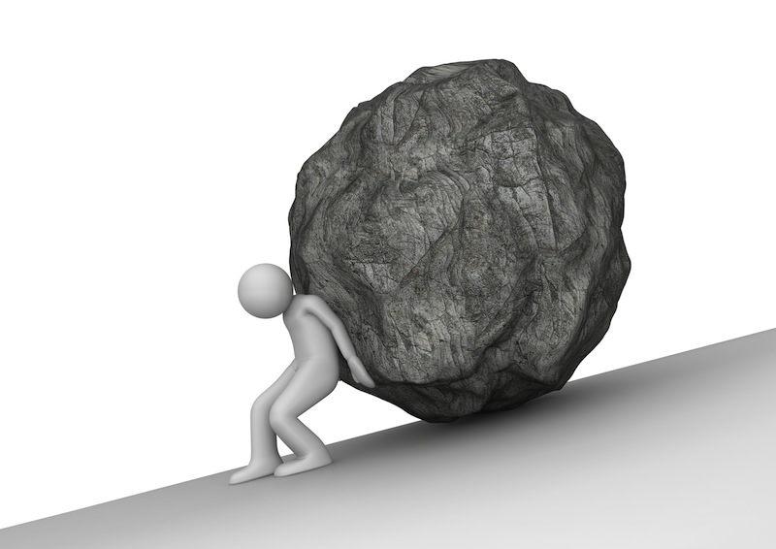
What I Was When I Was in Shackles
Sin is very heavy
People cannot release themselves on their own, they need help, they need someone stronger than themselves

Slide 5
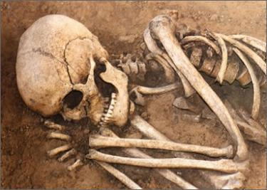
Before:
When I was in Shackles
Dead!
And you He made alive, who were dead in trespasses and sins… Eph. 2:1
The reality of men without God, is
Death!

Slide 6
Before:
When I was in Shackles
And you, being dead in your trespasses and the uncircumcision of your flesh, He has made alive together with Him, having forgiven you all trespasses. Col. 2:13
Dead!
Sin was the cause of this death
Gen. 3:3

Slide 7
Before:
When I was in Shackles
Dead!
Even when we were dead in trespasses, made us alive together with Christ (by grace you have been saved)… Eph. 2:5
Even though they are alive, they are dead!

Slide 8
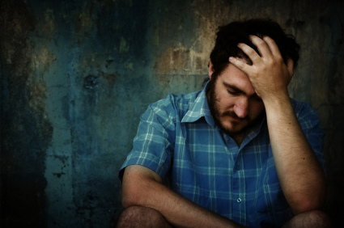
Before:
When I was in Shackles
No
Hope!
But I do not want you to be ignorant, brethren, concerning those who have fallen asleep, lest you sorrow as others who have no hope. 1 Thess. 4:13
Sad to see people walking, living, working, dying with no hope!

Slide 9
Before:
When I was in Shackles
No
Hope!
that at that time you were without Christ, being aliens from the commonwealth of Israel and strangers from the covenants of promise, having no hope and without God in the world. Eph. 2:12
Notes:
Not being a Christian makes you a person who is without God, in the world!

Slide 10
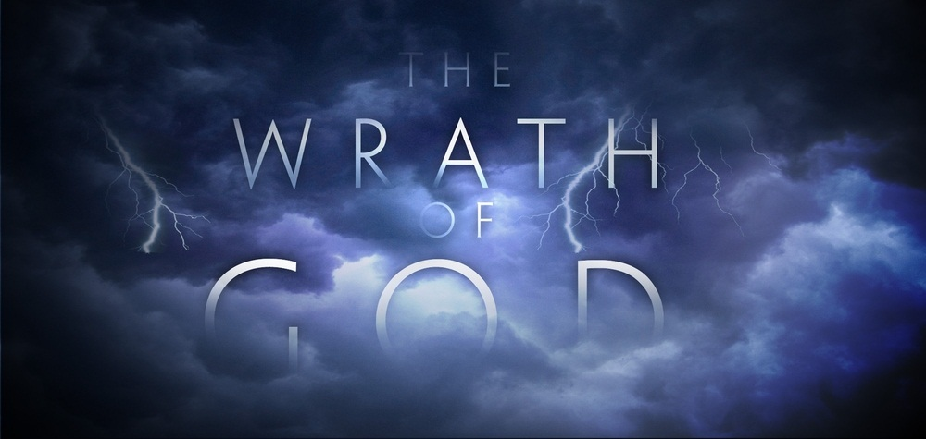
Before:
When I was in Shackles
Under
Wrath!
But in accordance with your hardness and your impenitent heart you are treasuring up for yourself wrath in the day of wrath and revelation of the righteous judgment of God Rom 2:5
Notes:
Wrath is the result of living in disobedience to God…

Slide 11
Before:
When I was in Shackles
But the heavens and the earth which are now preserved by the same word, are reserved for fire until the day of judgment and perdition of ungodly men. 2 Pet. 3:7
Under
Wrath!
Notes:
The person in Shackles does not believe in this day of judgement, and they don’t feel the need to change anything!

Slide 12
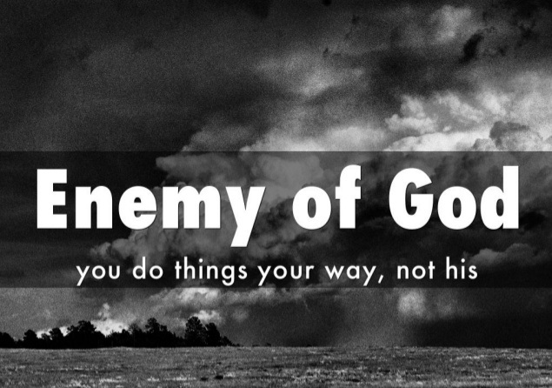
Before:
When I was in Shackles
Enemy
Of
God!
Adulterers and adulteresses! Do you not know that friendship with the world is enmity with God? Whoever therefore wants to be a friend of the world makes himself an enemy of God. Jas. 4:4
Friend of the world = enemy of God!
Enemy of God = being Dead
Being Dead = eternal punish

Slide 13
Before:
When I was in Shackles
Enemy
Of
God!
Because the carnal mind is enmity against God; for it is not subject to the law of God, nor indeed can be. Rom. 8:7
The mind who seeks after sin does not please God
The mind who does not think about eternal things does not please God

Slide 14
When I Was in Shackles, That Means That I Was:
A prisoner of sin, a person outside The Lord and The church!
Spiritually Dead
With No Hope At All
Under the wrath of God
Enemy of God for Sure!

Slide 15
What I Am Now, that I'm a son of God!
For you are all sons of God through faith in Christ Jesus. For as many of you as were baptized into Christ have put on Christ. Gal. 3:26-27
Notes:
1. The savior is willing to give us a new hope!
2. It is very comforting to know that I don’t have to wear those shackles anymore, because Jesus was willing, by His death, to remove them from me!

Slide 16
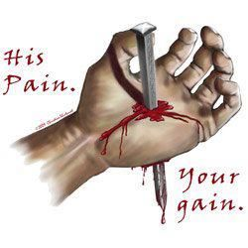
Now:
That I am a Son
I am
Free
And having been set free from sin, you became slaves of righteousness. Rom. 6:18

Slide 17
Now:
That I am a Son
I am
Free
But now having been set free from sin, and having become slaves of God, you have your fruit to holiness, and the end, everlasting life. Rom. 6:22

Slide 18
Now:
That I am a Son
I am
Free
For the law of the Spirit of life in Christ Jesus has made me free from the law of sin and death. Rom. 8:2

Slide 19
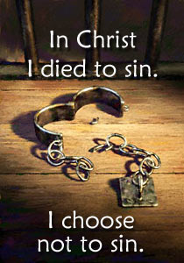
Now:
That I am a Son
Sin won’t
rule in me!
For sin shall not have dominion over you, for you are not under law but under grace. Rom. 6:14

Slide 20
Now:
That I am a Son
Sin won’t
rule in me!
Therefore do not let sin reign in your mortal body, that you should obey it in its lusts. Rom. 6:12

Slide 21
Now:
That I am a Son
Sin won’t
rule in me!
What then? Shall we sin because we are not under law but under grace? Certainly not! Rom. 6:15

Slide 22
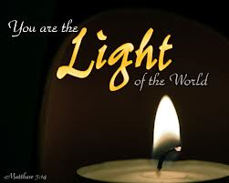
Now:
That I am a Son
that you may become blameless and harmless, children of God without fault in the midst of a crooked and perverse generation, among whom you shine as lights in the world. Phil 2:15
I am a light!

Slide 23
Now:
That I am a Son
“You are the light of the world. A city that is set on a hill cannot be hidden. Nor do they light a lamp and put it under a basket, but on a lampstand, and it gives light to all who are in the house. Matt. 5:14-15
I am a light!

Slide 24
Now:
That I am a Son
I am a light!
For you were once darkness, but now you are light in the Lord. Walk as children of light.
Eph. 5:8

Slide 25
Now:
That I am a Son
having your conduct honorable among the Gentiles, that when they speak against you as evildoers, they may, by your good works which they observe, glorify God in the day of visitation. 1 Pet. 2:12
I Am to Set
a
Good Example

Slide 26
Now:
That I am a Son
not pilfering, but showing all good fidelity, that they may adorn the doctrine of God our Savior in all things. Tit. 2:10
I Am to Set
a
Good Example

Slide 27
Now:
That I am a Son
Now to Him who is able to keep you from stumbling, And to present you faultless Before the presence of His glory with exceeding joy. Jude 24
I Am to Set
a
Good Example

Slide 28
So Being a Son Now Means That I Am
A prisoner that has been rescued by the blood of the Lamb!
Free
No sin in me
I am a light
I must set a good example

