Slide 1
Genesis 19:12–17
¹² Then the men said to Lot, “Have you anyone else here? Son-in-law, your sons, your daughters, and whomever you have in the city—take them out of this place! ¹³ For we will destroy this place, because the outcry against them has grown great before the face of the Lord, and the Lord has sent us to destroy it.”

Slide 2
Genesis 19:12–17
¹⁴ So Lot went out and spoke to his sons-in-law, who had married his daughters, and said, “Get up, get out of this place; for the Lord will destroy this city!” But to his sons-in-law he seemed to be joking. ¹⁵ When the morning dawned, the angels urged Lot to hurry, saying, “Arise, take your wife and your two daughters who are here, lest you be consumed in the punishment of the city.”

Slide 3
Genesis 19:12–17
¹⁶ And while he lingered, the men took hold of his hand, his wife’s hand, and the hands of his two daughters, the Lord being merciful to him, and they brought him out and set him outside the city. ¹⁷ So it came to pass, when they had brought them outside, that he said, “Escape for your life! Do not look behind you nor stay anywhere in the plain. Escape to the mountains, lest you be destroyed.”

Slide 4
Escape for Your Life
Tuesday September 11, 2001
Notes:
At 8:45 a.m., American Airlines Boeing 767, Flight 11, loaded with 20,000 gallons of jet fuel crashed into the north tower (93rd to 99th floors), of the World Trade Center in New York City. 18 minutes later, a second Boeing 767–United Airlines Flight 175–struck the south tower near the 60th floor. Approximately 17,400 civilians were in the World Trade Center twin towers at the time of the attacks. Amazingly, many of them escaped.
American Airlines Flight 77 circled over downtown Washington, D.C., and slammed into the west side of the Pentagon military headquarters at 9:45 a.m. killing 125 servicemen.
A fourth California-bound plane–United Flight 93–was hijacked after leaving Newark Airport in New Jersey. Passengers successfully overcame the hijackers causing the plane to crash in a rural field in western Pennsylvania at 10:10 a.m. All 45 people aboard were killed.

Slide 5
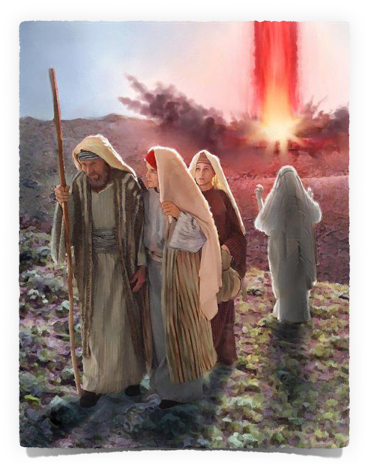
God informs Abraham of His intentions to destroy Sodom & Gomorrah – 18:20
Abraham intercedes for the cities of the plain – 18:21-33
Two angels taken in and protected by Lot – 19:1-11
Lot warned to flee - 19:12-17
Lot pleads for permission to flee to Zoar – 19:18-22
Sodom & Gomorrah is destroyed – 19:23-29

Slide 6
The Judgment of God Is Coming!
Ecc. 12:13–14
¹³ Let us hear the conclusion of the whole matter: Fear God and keep His commandments, For this is man’s all. ¹⁴ For God will bring every work into judgment, Including every secret thing, Whether good or evil.

Slide 7
The Judgment of God Is Coming!
Acts 17:30–31
³⁰ Truly, these times of ignorance God overlooked, but now commands all men everywhere to repent, ³¹ because He has appointed a day on which He will judge the world in righteousness by the Man whom He has ordained. He has given assurance of this to all by raising Him from the dead.”

Slide 8
The Judgment of God Is Coming!
2 Cor. 5:10–11
¹⁰ For we must all appear before the judgment seat of Christ, that each one may receive the things done in the body, according to what he has done, whether good or bad. ¹¹ Knowing, therefore, the terror of the Lord, we persuade men...

Slide 9
The Judgment of God Is Coming!
2 Pet. 3:10
¹⁰ But the day of the Lord will come as a thief in the night, in which the heavens will pass away with a great noise, and the elements will melt with fervent heat; both the earth and the works that are in it will be burned up.

Slide 10
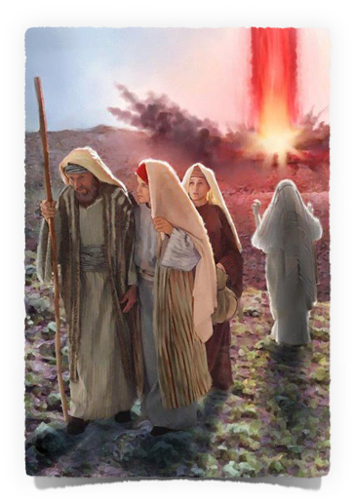
The NEED To Escape SIN!
We have ALL sinned – Rom. 3:23; 6:23
Sin cannot be escaped through our own efforts apart from faith in Christ
Morality, good works and even law-keeping cannot deliver us apart from faith in Christ – Eph. 2:8-10
Must be in Christ – Rom. 6:3-4; Gal. 3:26-27
For by grace you have been saved through faith, and that not of yourselves; it is the gift of God, not of works, lest anyone should boast.
Or do you not know that as many of us as were baptized into Christ Jesus were baptized into His death? Therefore we were buried with Him through baptism into death…
For you are all sons of God through faith in Christ Jesus. For as many of you as were baptized into Christ have put on Christ.

Slide 11
The NEED To Escape SIN!
Escape sexual immorality – Gen 39:7-10; 1 Cor. 6:9-10
Escape idolatry – Ex. 13-14; Acts 7:32-36
Temptation is serious and dangerous – Matt. 5:28-29; Rom 6:23
Sin is enslaving and destructive – Prov. 5:22; Jn. 8:34
Do you not know that the unrighteous will not inherit the kingdom of God? Do not be deceived. Neither fornicators, nor idolaters, nor adulterers, nor homosexuals…will inherit the kingdom of God.
His own iniquities entrap the wicked man, And he is caught in the cords of his sin.
Whoever looks at a woman to lust for her has already committed adultery with her in his heart. If your right eye causes you to sin, pluck it out and cast it from you; for it is more profitable for you that one of your members perish, than for your whole body to be cast into hell.
Most assuredly, I say to you, whoever commits sin is a slave of sin.

Slide 12
The NEED To Escape Evil Companions:
and delivered righteous Lot, who was oppressed by the filthy conduct of the wicked
(for that righteous man, dwelling among them, tormented his righteous soul from day to day by seeing and hearing their lawless deeds.
Be not deceived: Evil companionships corrupt good morals.
Example of Lot – Pet 2:7-8
Warning to Israel – Ex. 34:12-16
Warnings in Proverbs – Prov. 1:11-19; 4:14,15; 13:20
Warnings to us – 1 Cor. 15:33

Slide 13
The NEED To Escape Religious Error:
Example of Israel – Acts 7:38-43
Warning to Israel – Deut. 13:1-3
There are MANY false teachers – 2 Cor. 11:13; 2 Pet. 2:1
Warnings to us – 2 Jn. 1:9-10
Whoever transgresses and does not abide in the doctrine of Christ does not have God. He who abides in the doctrine of Christ has both the Father and the Son.
For such are false apostles, deceitful workers, transforming themselves into apostles of Christ.
But there were also false prophets among the people, even as there will be false teachers among you, who will secretly bring in destructive heresies, … and bring on themselves swift destruction.

Slide 14
The NEED To Escape From The World:
Do not love the world or the things in the world. If anyone loves the world, the love of the Father is not in him. For all that is in the world—the lust of the flesh, the lust of the eyes, and the pride of life—is not of the Father but is of the world. And the world is passing away, and the lust of it…
Example of Noah – Gen. 6-7
Example of Moses – Heb. 11:24-27
Do not Love the world – 1 Jn. 2:15-17
The way of escape – Matt. 7:13-14; Jn. 14:6; Mk. 16:16
Enter by the narrow gate; for wide is the gate and broad is the way that leads to destruction, and there are many who go in by it. Because narrow is the gate and difficult is the way which leads to life, and there are few who find it.

Slide 15
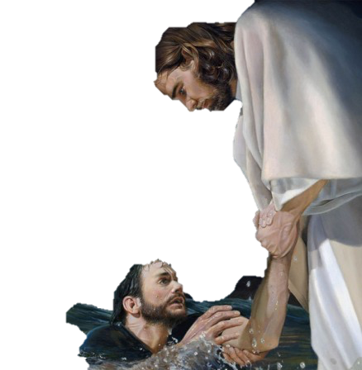
Will You Escape Condemnation?
God has given us warning – Acts 17:30-31; 2 Cor. 5:10
Jesus has made salvation possible – Jn. 3:16

Slide 16
Heaven Is A Prepared Place
For A Prepared People:
Requires intent – Matt. 7:13,14
Requires faith – Jn. 8:24; Heb 11:6
Requires repentance – Acts 17:30,31
Requires confession – Matt. 10:32
Requires baptism & continued obedience – Mark 16:16; Acts 2:38; Rom. 6:3-6,16,17; Heb. 5:8,9

Slide 17
Hear John 12:48
Believe John 8:24
Repent Luke 13:3
Confess Matt. 10:32-33
Baptized Mark 16:16
Faithful Matt. 24:13
Notes:
For the thousands of people who perished or escaped with their life - all material and earthly concerns meant NOTHING! In that moment that day
If YOU are NOT prepared when judgment day comes - NO ONE CAN SAVE YOU FROM ETERNAL DOOM! - Mat 23:33

