Slide 1
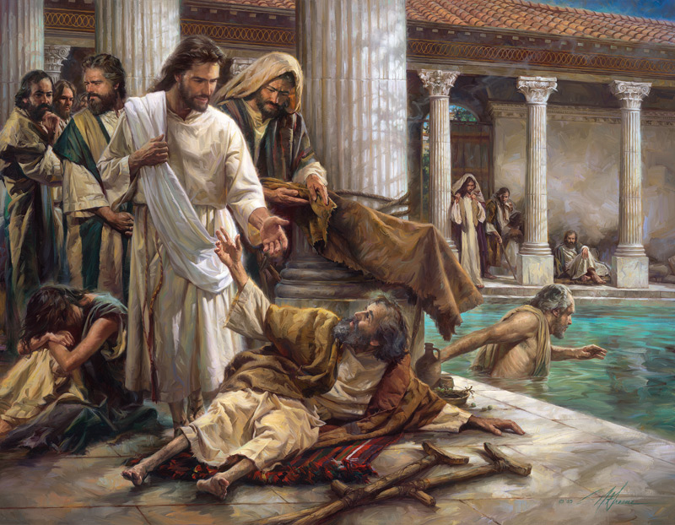
Do You Want To Be Made Well?

Slide 2
John 5:2-4
Now there is in Jerusalem by the Sheep Gate a pool, which is called in Hebrew, Bethesda, having five porches. In these lay a great multitude of sick people, blind, lame, paralyzed, waiting for the moving of the water. For an angel went down at a certain time into the pool and stirred up the water; then whoever stepped in first, after the stirring of the water, was made well of whatever disease he had.
Pool of Bethesda

Slide 3
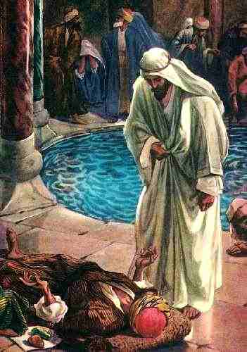
John 5:5-7
Now a certain man was there who had an infirmity thirty-eight years.
When Jesus saw him lying there, and knew that he already had been in that condition a long time, He said to him,
“Do you want to be made well?”
What did the man answer?
Notes:
What did the man answer?
Yes, I want to be healed.
Yes, I want to be made new.
Yes, I want to walk, jump and run.

Slide 4
John 5:5-7
Now a certain man was there who had an infirmity thirty-eight years.
When Jesus saw him lying there, and knew that he already had been in that condition a long time, He said to him,
“Do you want to be made well?”
What did the man answer?
"Sir, I have no man to put me into the pool when the water is stirred up; but while I am coming, another steps down before me."

Slide 5
“Men are anxious to improve their circumstances, but are unwilling to improve themselves; they therefore remain bound”
James Allen
British Philosopher

Slide 6
Or do I secretly enjoy victimhood?
Rev 12:11 And they overcame him by the blood of the Lamb and by the word of their testimony, and they did not love their lives to the death.
Rom 8:37 Yet in all these things we are more than conquerors through Him who loved us.
1Jn 4:4 You are of God, little children, and have overcome them, because He who is in you is greater than he who is in the world.
1Jn 5:4 For whatever is born of God overcomes the world. And this is the victory that has overcome the world—our faith. 5 Who is he who overcomes the world, but he who believes that Jesus is the Son of God?
Notes:
→We have, in the church and in the world, many people like this. They love feeling like victims!
→ They love when others feel sympathy, pity, and are sorry for them!
→ Is that what God wants us to be?

Slide 7
Or do I keep blaming someone else for my difficulties?
Gen 3:12 Then the man said, "The woman whom You gave to be with me, she gave me of the tree, and I ate."
Gal 6:5 For each one shall bear his own load.
2Cor 5:10 For we must all appear before the judgment seat of Christ, that each one may receive the things done in the body, according to what he has done, whether good or bad.
1 Sam. 15:13-24
Notes:
→ That is an old excuse, and we should stop using it.
→ You are who you are, that is your choice and decision!
→ Genesis 3:12; Galatians 6:5; 2 Cor 5:10; 1 Sam 15:13-24
→ Take responsibility for what you do, stop blaming others!

Slide 8
Or am I afraid to “get well?”
2Ki 5:10 "Go and wash in the Jordan seven times, and your flesh shall be restored to you, and you shall be clean.“ But Naaman became furious, and went away and said, "Indeed, I said to myself, 'He will surely come out to me, and stand and call on the name of the LORD his God, and wave his hand over the place, and heal the leprosy.
Acts 26:27 King Agrippa, do you believe the prophets? I know that you do believe." Then Agrippa said to Paul, "You almost persuade me to become a Christian."
Matt 19:16 Now behold, one came and said to Him, "Good Teacher, what good thing shall I do that I may have eternal life?“
Mat 19:22 But when the young man heard that saying, he went away sorrowful, for he had great possessions.
Acts 24:25 Now as he reasoned about righteousness, self-control, and the judgment to come, Felix was afraid and answered, "Go away for now; when I have a convenient time I will call for you."
Notes:
→ Many today do not admit that they simply need help because they are afraid, or are too proud to get well!
→ People always answer unconsciously, “I'm ok!”. You and I know that they need help, but they are always “ok”!
→ 2 Ki 5:10,11; Matt 19:16,22; Acts 24:25; 26:27-28

Slide 9
Or do I just want relief—instead of a cure?
Rom 1:18 For the wrath of God is revealed from heaven against all ungodliness and unrighteousness of men, who suppress the truth in unrighteousness
Eze 13:8 Therefore thus says the Lord GOD: "Because you have spoken nonsense and envisioned lies, therefore I am indeed against you," says the Lord GOD. "My hand will be against the prophets who envision futility and who divine lies; they shall not be in the assembly of My people, nor be written in the record of the house of Israel Then you shall know that I am the Lord GOD. “Indeed, because they have seduced My people, saying, 'Peace!' when there is no peace—and one builds a wall, and they plaster it with untempered mortar—
Isa 5:20 Woe to those who call evil good, and good evil; Who put darkness for light, and light for darkness; Who put bitter for sweet, and sweet for bitter!
Isa 30:10 Who say to the seers, "Do not see," And to the prophets, "Do not prophesy to us right things; Speak to us smooth things, prophesy deceits.
Notes:
That’s exactly what we are facing today, in many aspects of this life. Especially in doctrine and lifestyle.
Many are asking for a relief and not the real cure!
Isaiah 5:20; 30:10; Eze 13:8-10; Rom 1:18

Slide 10
Do you really want to break your addictions / habits?
1Pet 5:8 Be sober, be vigilant; because your adversary the devil walks about like a roaring lion, seeking whom he may devour.
Jas 4:7 Therefore submit to God. Resist the devil and he will flee from you.
Gal 5:16 I say then: Walk in the Spirit, and you shall not fulfill the lust of the flesh.
1Jn 2:16 For all that is in the world—the lust of the flesh, the lust of the eyes, and the pride of life—is not of the Father but is of the world.
Notes:
→ You don’t have to do it alone, Jesus is standing by you!
→ Remember the lame man? Jesus asked: Do you want to get well?
→ 1 Peter 5:8; 1 John 2:16; James 4:7; Gal 5:16.

Slide 11
Do you really want to be closer to God?
2Pet 3:18 grow in the grace and knowledge of our Lord and Savior Jesus Christ.
Col 1:9 we pray…that you may be filled with the knowledge of His will in all wisdom and spiritual understanding; that you may walk worthy of the Lord, fully pleasing Him, being fruitful in every good work and increasing in the knowledge of God.
Gal 2:20 I have been crucified with Christ; it is no longer I who live, but Christ lives in me; and the life which I now live in the flesh I live by faith in the Son of God, who loved me and gave Himself for me.
Notes:
→ It is never too late to have the desire to know more about the Lord.
→ The more spiritual we are, the less we are going to sin!
→ Time is precious, time is important, time is flying away!
→ Col 1:9-10; 2 Peter 3:18; Galatian 2:20

Slide 12
Do you want your children to be more devout?
Prov 22:6 Train up a child in the way he should go, and when he is old he will not depart from it.
Deut 6:7 You shall teach them diligently to your children, and shall talk of them when you sit in your house, when you walk by the way, when you lie down, and when you rise up.
Notes:
→ Everything first starts with you. If you are devout, they will be devout. If you are worldly, they will be worldly. It is about example!
→ Don’t come to church, swear, be a hypocrite, give bad examples, always do wrong… Do you know what you'll get? Evil people!
→ Prov 22:6; Deut 6:7

Slide 13
Do you really want to be saved?
Hear John 12:48
Believe John 8:24
Repent Luke 13:3
Confess Matt. 10:32-33
Baptized Mark 16:16
Faithful Matt. 24:13
Notes:
Jesus is waiting for you, He knows all of your trials, He knows your problems. He really wants to help you. But you first have to help yourself by coming to Him
Would you come?

