Slide 1
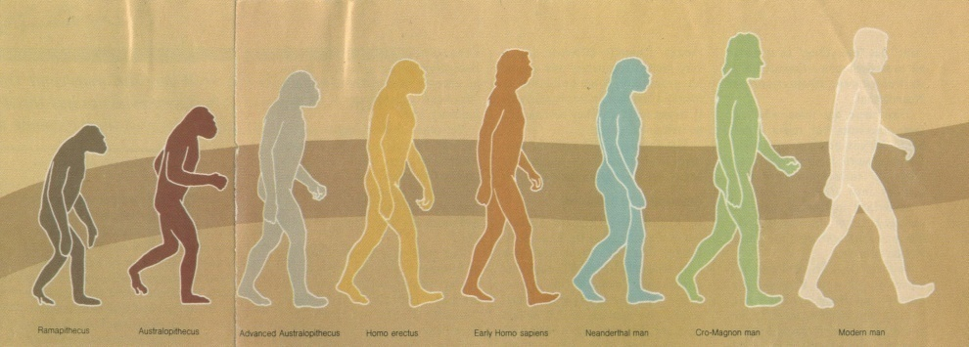
Creation or Evolution
vs.
Two views of Origin

Slide 2
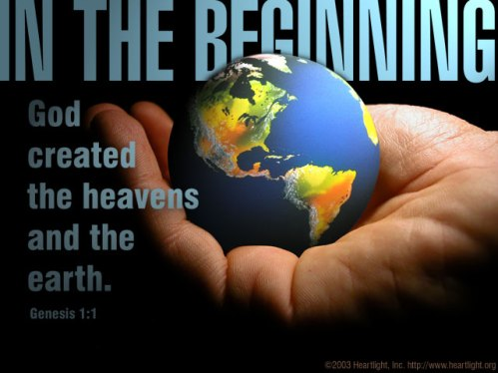
Gen. 1:1

Slide 3
“In the beginning was matter, which begat the ameba, which begat the worm, which begat the fish, which begat the amphibian, which begat the reptile, which begat the lower mammal, which begat the lemur, which begat the monkey, which begat man, who imagined God. This is the genealogy of man.”
- Charles Smith, “From Ameba to Man”
Notes:
1. [Charles Smith] [From Ameba to Man] “In the beginning was matter, which begat the ameba, which begat the worm, which begat
the fish, which begat the amphibian, which begat the reptile, which begat the lower mammal, which begat the lemur, which begat the monkey, which begat man, who imagined God. This is the genealogy of man.”
2. Evolution may be defined as the belief that somehow, millions of years ago, life began by natural causes from nonliving matter; then gradually that original life changed till from it came all the modern kinds of plants and animals including man.
3. Christians should have serious problems with the Theory of Evolution because the Bible teaches Creationism.
a. We believe that there is an all-wise, all-powerful, eternal God who created the Universe and all the forms of life in it, including humans.
b. Evolution and creation are two fundamentally different and competing beliefs about the origin of the Universe, of life, and of mankind.

Slide 4
Creation or Evolution
vs.
Can We Believe Both?
Notes:
1. Some people, even in the church, have wondered why we cannot believe both the Bible and evolution.
a. Many claim that the two can be harmonized.
b. Theistic evolutionists say that everything evolved from an original life form, but God began the process and directed it.
c. They cannot take Gen. 1 literally, so they say it is figurative speech or legend.
2. Is it possible to believe both evolution and the Bible?
a. Does evolution necessarily contradict the Bible?
b. Can a person firmly defend evolution and still be a faithful Christian?

Slide 5
Creation = God Created
#1
Evolution = Natural Processes
Notes:
1. Evolution says the universe began by natural processes, the Bible says God created the universe and everything in it
A. Evolution Is a Major Doctrine of Unbelievers.
1. The doctrine destroys faith in God, undermines the arguments for God's existence, and is a fundamental tenet of all who disbelieve the Bible.

Slide 6
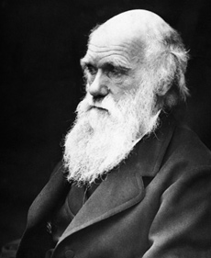
#1
Creation = God Created
Evolution = Natural Processes
“I have never been an atheist in the sense of denying the existence of a God. I think that generally (and more and more so as I grow older) but not always, that an agnostic would be the most correct description of my state of mind”
Charles Darwin
1809-1882
Notes:
Origin of Species
Agnostic = not enough evidence to prove or disprove whether there is a God. ashamed to admit their an atheist

Slide 7
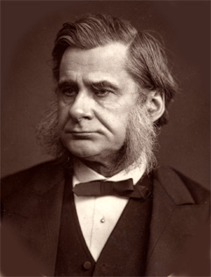
#1
Creation = God Created
Evolution = Natural Processes
“It is clear that the doctrine of evolution is directly antagonistic to that of creation; evolution if consistently applied, makes it impossible to believe the Bible."
T.H. Huxley
1825-1895

Slide 8
#1
Creation = God Created
Evolution = Natural Processes
“The God idea cannot be reconciled with our
knowledge of evolution."
- Woolsey Teller
Notes:
American Association for the Advancement of Atheism

Slide 9
#1
Creation = God Created
Evolution = Natural Processes
“God, who made the world and everything in it, since He is Lord of heaven and earth, does not dwell in temples made with hands.”
Acts 17:24
Notes:
C. While evolution (from man) teaches that all things evolved from nothing, the Bible (which has been proven to not be from man) repeatedly affirms the doctrine of creation. - Gen. 1
1. Acts 17:24 “God, who made the world and everything in it, since He is Lord of heaven and earth, does not dwell in temples made with hands.”

Slide 10
#1
Creation = God Created
Evolution = Natural Processes
“YOU, LORD, IN THE BEGINNING LAID THE FOUNDATION OF THE EARTH, AND THE HEAVENS ARE THE WORK OF YOUR HANDS.” Heb. 1:10

Slide 11
#1
Creation = God Created
Evolution = Natural Processes
“He has made the earth by His power, He has established the world by His wisdom, and has stretched out the heavens at His discretion.” Jer. 10:12
Notes:
1. Jer. 10:12 “He has made the earth by His power, He has established the world by His wisdom, And has stretched out the heavens at His discretion.”
D. The Bible repeatedly affirms throughout that the world and the life on it are the result of Divine creation.
1. To deny this denies, not just Gen. 1, but the fundamental essence of the whole Scriptures.
2. No wonder that, when people come to believe in evolution, they often lose their faith in God.
3. They have denied an obvious proof of God's existence, they have accepted a major tenet of unbelief, and they have called in question a doctrine found many times throughout the Bible.

Slide 12
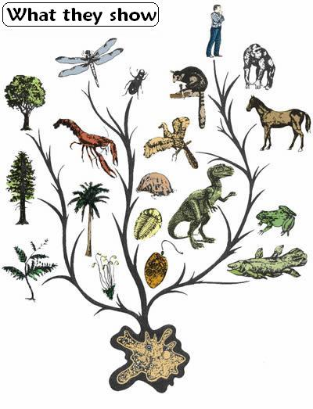
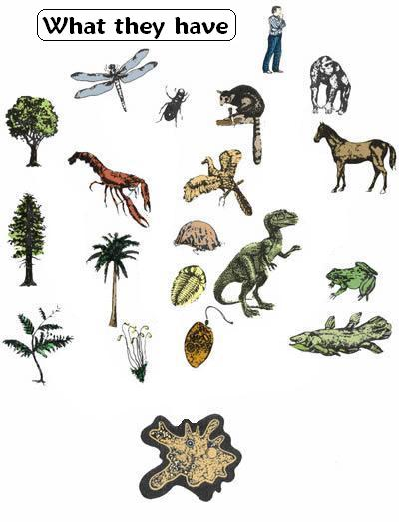
Creation = Six days Evolution = Billions of Years
#2
Evolution claims it took 10 to 20 billion years
Notes:
2. Evolution says the universe evolved over billions of years, the Bible says all was created in 6 days
A. Many scientists claim that all living things - plants, animals, and man – had their beginnings by the process of evolution over billions of years.
1. Dates range from 10 to 20 billion years
B. The first image here is a simple version of one of evolution's "Trees of Life". You can easily follow the evolutionary path and it is quite nice and convincing. But is it accurate? Let me ask you, what is on the black lines, or 'branches'? Why don't they show them?
C. The reason that they do not show what is on these lines is because they do not know. There simply is nothing to show so instead, they draw lines. What they really have is in this second image to the right: fully formed plants, animals and humans with nothing in-between! That's right, instead of a tree, what is actually found by real science are fossils of the last leaf on the end of their supposed branches. To make their trees honestly reflect what is observed in nature, we need to remove the lines. What is left, is no evidence of evolution at all.

Slide 13
Bible says it was 6 days
Creation = Six days Evolution = Billions of Years
#2
Day = was it 24 hours ?
Some say billions of years
Hebrew = “yom”
Ex. 20:8-11
Notes:
B. Genesis 1:31-2:3, says God made heavens and earth and all the host of them in 6 days and rested on the 7th day.
1. What is the significance of "day"? Should the days be understood to refer to 24 hours?
2. Some say the days were long, billions of years each.
a. This is an attempt to harmonize the Bible with evolution.
3. But consider the evidence that the days in Gen. 1 are natural days, 24 hours long as we think of days.
a. Note that the 7 "days" must all mean the same throughout Gen. 1.
b. God itemizes them one after the other and makes no distinction among them.
c. Each consists of "evening and morning," each is counted
d. The word “day” “yom” means a 24 hour period
4. Ex. 20:9-11

Slide 14
Bible says it was 6 days
Creation = Six days Evolution = Billions of Years
#2
“Remember the Sabbath day, to keep it holy. Six days you shall labor and do all your work, but the seventh day is the Sabbath of the LORD your God. In it you shall do no work...”
“For in six days the LORD made the heavens and the earth, the sea, and all that is in them, and rested the seventh day. Therefore the LORD blessed the Sabbath day and hallowed it.” Ex. 20:8-11

Slide 15
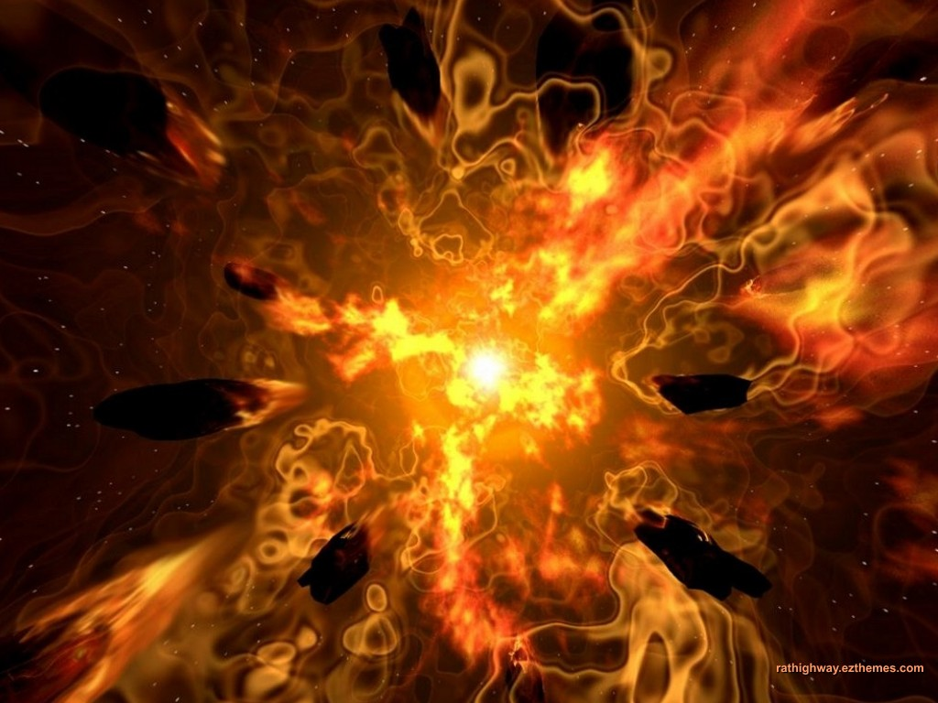
Creation = Life came from God Evolution = Life from Non-Living
#3
Spontaneous Generation
Notes:
3. Evolution says life originated from non-living matter, the Bible says life came from life, the eternal God
A. Evolution teaches that billions of years ago the first living thing came from a primordial soup in which nothing was alive.
B. Spontaneous Generation = living thing spontaneous generates from a non-living thing. Never proven, never observed, never replicated in a lab, and all of evolution hinges on this being a fact

Slide 16
Bible says ………
#3
Creation = Life came from God Evolution = Life from Non-Living
Life created by God – Gen. 1
We are offspring of God
Notes:
B. This belief of evolution conflicts with both the Bible and science.
1. Genesis 1:11,20,24,26 - The first living creatures were created by the eternal, living God. (Life came from Life)
2. This is what the Bible teaches throughout.
3. We partake of the nature of that from which we are the offspring.
a. We are the offspring of God, so we must realize that He is alive and is the giver of life.
b. Evolution, in contrast, says that life began by chance in a primordial soup. Then from that, life came all the present kinds of living things.

Slide 17
Law of Biogenesis
“Life comes from Life”
Non living matter cannot produce life!
Acts 14:15 – “Living God”
Evolution contradicts
Science & Bible
Notes:
C. One of the most firmly established laws of science is the Law of Biogenesis, which says that life comes only from living things. (law, not theory)
1. There is no evidence that non-living matter can spontaneously generate life.
2. The Bible agrees with this scientific fact, for it says that life came from the eternally living Creator Acts 14:15 – “you should turn from these useless things to the living God, who made the heaven, the earth, the sea, and all things that are in them”
3. However, evolution contradicts both science and the Bible since it demands that Non-living matter must have sometime in the past produced life. (contradicts law of biogenesis, contradicts the Word of God)

Slide 18
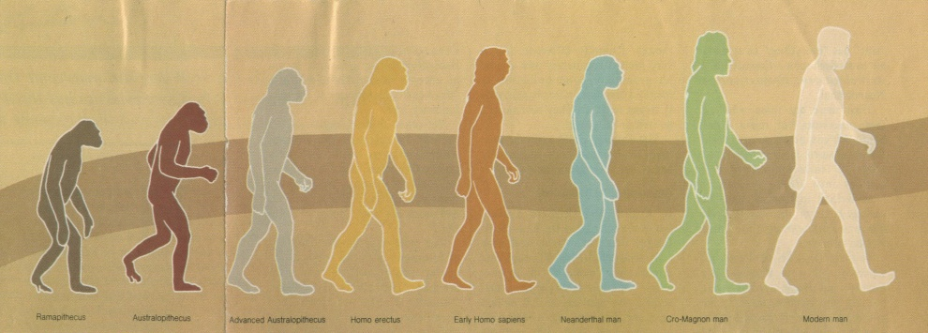
Bible = separate and unique Evolution = Man is Animal
#4
Evolution “…man’s closest living relatives are the apes”
Gen. 1:26 – “Our image”
Notes:
4. Evolution says man is an advanced animal, the Bible says is totally separate and unique from animals
A. Evolution Says Men Came from Animals.
1. Note this quote from prominent evolutionist George Simpson: "Few doubt that man's closest living relatives are the apes. ...”
2. We have already seen the flaws of evolution, but if man evolved from animals then we are just animals and no more. Why many people sometimes behave like animals, been taught they are nothing but evolved animals
B. The Bible Says Man Was Created in God's Image. Genesis 1:26 “Then God said, "Let Us make man in Our image, according to Our likeness”
1. Unlike the animals, man was created in the image or likeness of God. As a result, God gave men dominion over the animals.

Slide 19
Bible – Man was Created in Image of God
#4
Bible = separate and unique Evolution = Man is Animal
Has rational intelligence
Has power to choose
Has emotions
Has a Conscience
Has an Eternal Spirit
Notes:
What is involved in the "image of God"? It appears that man is similar to God (though not on His level) and unlike animals in the following ways:
a. Man has rational intelligence. He has ability to reason, invent, communicate, in ways far beyond animals. His ability in this regard allows him to communicate with God and understand God's will for him.
b. Man has a will, and a power to choose. He is a free moral agent. He is able to choose between alternatives and determine which course he will pursue. He is therefore accountable before God to make the choices and pursue the goals that God instructs him to.
c. Man has emotions. He can experience joy, love, anger, hatred, sorrow. The Bible also attributes such feelings to God.
d. Man has a conscience. He is able, not only to distinguish right from wrong, but also to have an inherent sense of guilt when he has done wrong and a sense of approval when he has done right. Not wrong for animals to kill other animals
e. Man has an eternal spirit which was put in man when he was created, and will live forever
*** The image of God may involve more than this, but it surely includes all this. In all these ways men are like God, but unlike animals.

Slide 20
If man evolved from animals…
Then we are just Animals
And we will act like one
Notes:
A. Here is another major contradiction between the Bible and evolution.
1. If man evolved from animals, then, we must partake of the nature of that from which we are the offspring.
2. If we evolved from the animals, we are just animals. And we will act just like them, and any other behavior should not be expected from man

Slide 21
If God Created Us…
Then we are the offspring of God
Notes:
1. But if God created us, then we are the offspring of God, and we partake of characteristics in common with God, and distinct from the animals. We have an eternal soul, and unlike the animals, we have an opportunity to dwell forever with the Lord in heaven or with Satan in a devil’s hell

Slide 22
Creation or Evolution
You cannot believe both
We must make a choice

Slide 23
Jesus Believed in Creation...
“And He answered and said to them, "Have you not read that He who made them at the beginning 'MADE THEM MALE AND FEMALE.” Matt. 19:4

Slide 24
“It is absurd for the Evolutionist to complain that it is unthinkable for an admittedly unthinkable God to make everything out of nothing, and then pretend that it is more thinkable that nothing should turn itself into anything.”
-G.K. Chesterton, The Quotable Chesterton.

