Slide 1
Conversion of a
Religious Sinner
Saul - Paul
Acts 9
Acts 22 & 26
Notes:
1. Saul – Paul conversion is recorded in Acts 9, then Paul repeats it again in Acts 22 and Acts 26
2. Saul was converted and became the apostle Paul. It is accurate to describe this as a conversion of a religious sinner.

Slide 2
Convert
transitive verb
1 - to bring over from one belief, view, or party to another
2 – to change from one form or function to another

Slide 3
Saul / Paul
Family
His father was a Pharisee
He was a Jew and a Pharisee
Born in Tarsus
Tribe of Benjamin
Notes:
II. Saul of Tarsus
A. Paul’s Family
1. His father was a Pharisee
2. He was a Jew and a Pharisee
3. He was born in Tarsus but was reared in Jerusalem
4. He was from the tribe of Benjamin
5. Phil. 3:4-6 Pharisee – “circumcised the eighth day, of the stock of Israel, of the tribe of Benjamin, a Hebrew of the Hebrews; concerning the law, a Pharisee; concerning zeal, persecuting the church; concerning the righteousness which is in the law, blameless”

Slide 4
Saul / Paul
His Early Life
Trained under Gamaliel
Learned the craft of tent making
Was Zealous
Persecuted the Church
Honest and Sincere – Acts 23:1
Notes:
B. His Early Life
1. Trained under Gamilel = most well known Jewish religious teacher, leading authority in the Sanhedrin
2. Learned the craft of tentmaking
3. Was zealous - Not one who worked in spurts - Acts 22:3 “zealous toward God”
4. Persecuted the church
5. Honest and Sincere
a. Believed he was right
b. Acts 23:1 “I have lived in all good conscience before God until this day.”

Slide 5
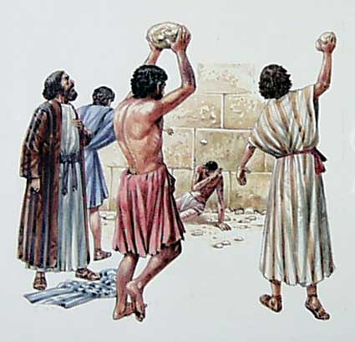
Saul / Paul
Before His Conversion
Enemy - Persecutor
Acts 7:58 - An accomplice
Acts 8:1-3 - Havoc of church / prison
Acts 9:1-2 - Threats & murder
Acts 22:4-5 – Death
Acts 26:9-11 - “Enraged against them”
Notes:
C. Before His Conversion - He was an enemy and persecutor of the church
1. An accomplice - stoning of Stephen
2. Made havoc of the church – dragging Christians out of their houses and throwing them in prison
3. Made threats and murder
4. Persecuted Christians unto death
5. “Enraged against the Christians”

Slide 6
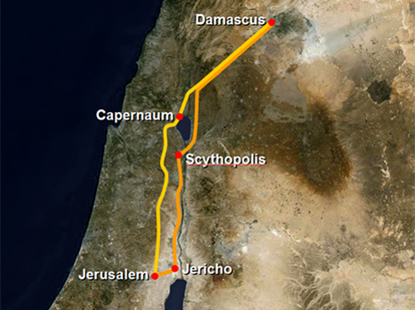
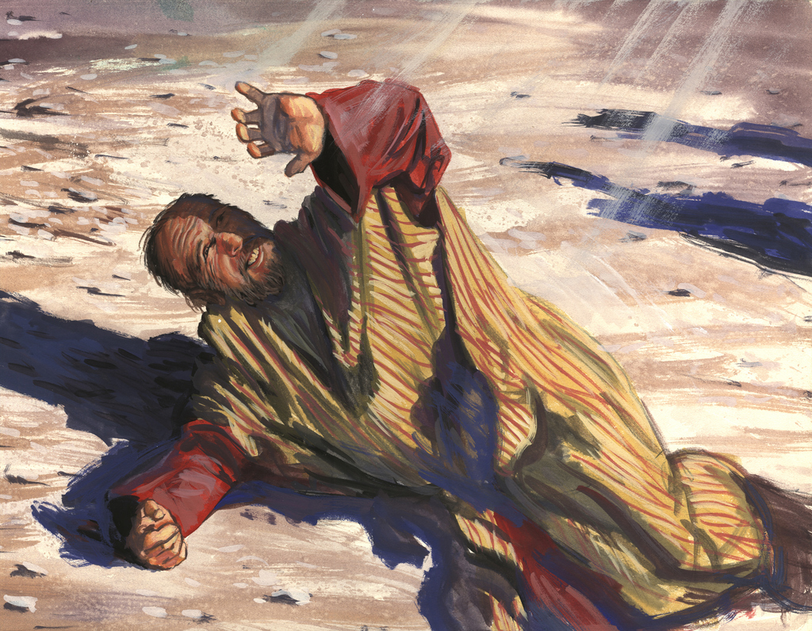
1. Paul’s Conversion – Acts 9:1-20
Notes:
III. HIS CONVERSION Acts 9:1-19
1. went to the high priest
2. asked letters from him to the synagogues of Damascus, so that if he found any who were of the Way, whether men or women, he might bring them bound to Jerusalem.
3. As he came near Damascus, suddenly a light shone around him from heaven.

Slide 7
1. Paul’s Conversion – Acts 9:1-20
“Saul, Saul, why are you persecuting Me?”
“Who are you Lord?”
“I am Jesus whom you are persecuting. It is hard for you to kick against the goads.”
“Lord, what do You want me to do?“
“Arise and go into the city, and you will be told what you must do.”

Slide 8
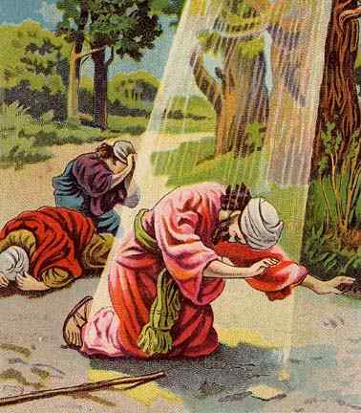
1. Paul’s Conversion – Acts 9:1-20
He was Blind
Led by others into Damascus
3 days without eating or drinking

Slide 9
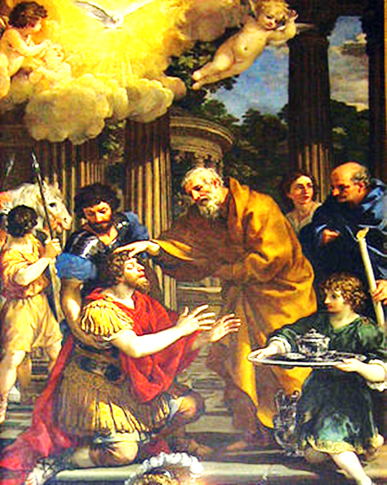
1. Paul’s Conversion – Acts 9:1-20
God tells Ananias to go speak to Saul
Ananias hesitant
He went to Saul
Notes:
A. God speaks to Ananias
1. Go to the one called Saul of Tarsus
2. Saul has seen you in a vision coming to restore his sight
3. Ananias had heard of the evil which Saul had done and what he had planned – Ananias was hesitant
4. Lord said that Saul was a Chosen Vessel, so Ananias went to Saul

Slide 10
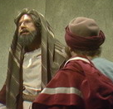
1. Paul’s Conversion – Acts 9:1-20
Jesus Sent a Preacher
Ananias Told Saul what to do
Later Paul related his conversion
“And now why are you waiting? Arise and be baptized, and wash away your sins, calling on the name of the Lord” Acts 22:16
Notes:
D. So Jesus sent a preacher. Ananias went to Saul
Put his hands on him and said: “Saul, the Lord Jesus, who appeared to you on the road as you came, has sent me that you may receive your sight and be filled with the Holy Spirit.“ Immediately there fell from his eyes something like scales, and he received his sight at once; and he arose and was baptized”
2. Scales fell from his eyes - his eyes were opened
3. He arose and was baptized
4. He ate and regained his strength - and after a few days preached about Christ in the Synagogues
E. He became a Christian and started preaching that which he once destroyed
F. He later told others about his conversion
1. Acts 22:1-21
a. He went over the details of what had happened then he quotes what Ananias told him to do
b. v. 16 “And now why are you waiting? Arise and be baptized, and wash away your sins, calling on the name of the Lord”

Slide 11
2. Lessons from Paul’s Conversion
Men can Change
“New Birth”
John 3:3-5 “Except a man be born again”
1 Pet. 1:23 “Being born again…”
Paul changed from a persecutor to the persecuted
Notes:
LESSONS FROM PAUL’S CONVERSION
A. Men can change – if Saul can with his past anyone can
1. Because men can change, becoming a Christian is called a “new birth.”
a. John 3:3-5 v. 3b “Except a man be born again, he cannot see the kingdom of God.”
b. 1 Pet 1:23 “having been born again, not of corruptible seed but incorruptible, through the word of God which lives and abides forever.”
2. Because men can change .. becoming a Christian is also called a “resurrection.” – Rom 6:3-5
3. Paul changed from a persecutor to a preacher of the gospel, and was now being persecuted himself

Slide 12
2. Lessons from Paul’s Conversion
Turned to God as Soon as He Heard
Many make excuses
I’m just as good as…
Some Christian did me wrong
When I have….
I’m too bad
Paul obeyed when he learned what to do !
Notes:
B. Turned to God as SOON as he heard what to do
1. Many people make excuses why they can't obey right away
a. I'm just as good as anyone else morally.
b. A Christian wronged me.
2. When I have more time, when the bills are all paid, when the kids are grown
3. I'm too bad a sinner. I’m not good enough to be a Christian.
4. I can't understand - I want to understand everything before I obey.
5. My friends would laugh.
6. I'd get no support from home.
7. Paul obeyed and became a Christian when he learned what he must do.

Slide 13
2. Lessons from Paul’s Conversion
Purpose of Preaching is to Open Men’s Eyes
“To open their eyes, in order to turn them from darkness to light, and from the power of Satan to God, that they may receive forgiveness of sins and an inheritance among those who are sanctified by faith in Me.” Acts 26:18
“Preach the word, be instant in season, out of season, reprove, rebuke, exhort with all longsuffering and doctrine.” 2 Tim. 4:2
Notes:
C. The purpose of preaching is to open men's eyes
1. Acts 26:18 Jesus to Paul on road to Damascus - “to open their eyes, in order to turn them from darkness to light, and from the power of Satan to God, that they may receive forgiveness of sins and an inheritance among those who are sanctified by faith in Me.”
2. I think some preachers have forgotten what the real purpose of preaching is!
a. Many preach today without a message of salvation ... without the need of repentance.
b. Paul preached to change people
3. Bible preaching opens men's eyes to their sins. 2 Tim 4:2 “Preach the word; be instant in season, out of season; reprove, rebuke, exhort with all longsuffering and doctrine.”

Slide 14
2. Lessons from Paul’s Conversion
Humans Have the Power of Choice
“O king Agrippa, I was not disobedient unto the heavenly vision” Acts 26:19
“Choose you this day whom you will serve” Jos. 24:15
Freedom to choose doe not mean we make the best choices. Acts 26:18 - Agrippa “Almost”
Notes:
D. Humans have the power of choice.
1. Acts 26:19 “O king Agrippa, I was not disobedient unto the heavenly vision”
2. Paul could have chosen to ignore the heavenly calling ... but he did not!
3. Joshua said to the people of Israel in - Josh 24:15 “... choose you this day whom you will serve...”
4. Freedom to choose does not mean every choice is equally correct!!
5. Look at Acts 26:28 “You almost persuade me to become a Christian.” Agrippa made the wrong choice!

Slide 15
2. Lessons from Paul’s Conversion
Christians Should Tell Others
About Their conversion
Paul told others:
Acts 22:1-22
Acts 26: 9-29
1 Tim. 1:12-16
This will help others learn what to do
Notes:
E. Christians should pass on the story of their conversions with others.
1. Some in the church say .. “that is a denominational practice” ...
2. Paul did ...
a. Acts 26:9-29
b. Acts 22:1-22
c. 1 Tim 1:12-16
3. When we pass on the story of our conversion we are showing how God
a. By way of the Gospel .. has enlightened our lives.
b. This is what helps others to know what to do and it will strengthen us ...

Slide 16
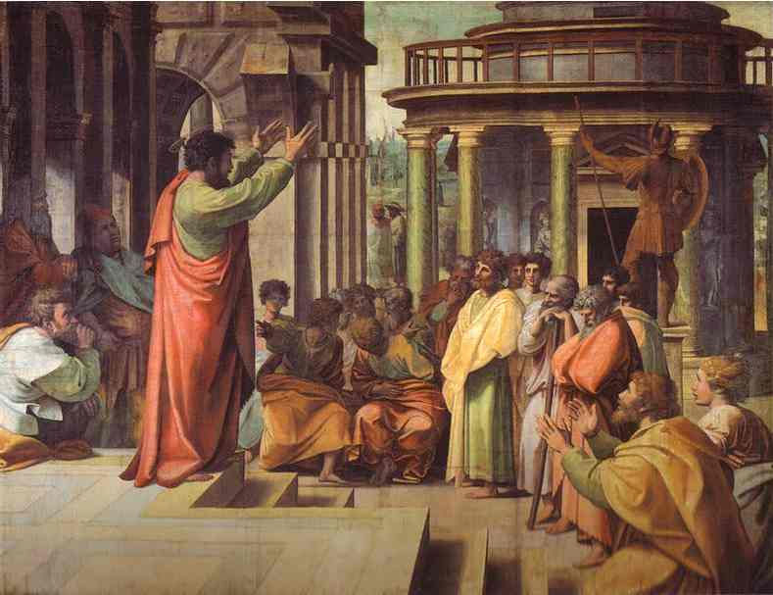
3. Paul as a Preacher

Slide 17
3. Paul as a Preacher
Faithfully Taught Others
Acts 9:20 “Immediately he preached the Christ in the synagogues, that He is the Son of God.”
Notes:
A. Paul faithfully taught others
1. After his conversion he began preaching the gospel
2. Acts 9:20 “Immediately he preached the Christ in the synagogues, that He is the Son of God.”
3. Strange indeed that he who had gone to Damascus to punish those who believed in Christ is now proclaiming Jesus from the synagogues
4. And this was not a one moment in time. Paul preached for many years after his conversion

Slide 18
3. Paul as a Preacher
He Was Not Ashamed of the Gospel
“For I am not ashamed of the gospel of Christ, for it is the power of God to salvation for everyone who believes, for the Jew first and also for the Greek.” Rom. 1:16
“but we preach Christ crucified, to the Jews a stumbling block and to the Greeks foolishness” 1 Cor. 1:23
Notes:
B. He was not ashamed of the Gospel
1. Romans 1:16 “For I am not ashamed of the gospel of Christ, for it is the power of God to salvation for everyone who believes, for the Jew first and also for the Greek.”
2. 1 Cor. 1:23 “but we preach Christ crucified, to the Jews a stumbling block and to the Greeks foolishness”

Slide 19
3. Paul as a Preacher
He Preached With Simplicity
1 Cor. 2:1-2 “And I, brethren, when I came to you, did not come with excellence of speech or of wisdom declaring to you the testimony of God. For I determined not to know anything among you except Jesus Christ and Him crucified.”
Preaching must be so we can understand Eph. 3:4
Notes:
C. He preached with simplicity
1. 1 Cor. 2:1-2 “And I, brethren, when I came to you, did not come with excellence of speech or of wisdom declaring to you the testimony of God. 2 For I determined not to know anything among you except Jesus Christ and Him crucified.”
2. Preaching must be so all can understand

Slide 20
3. Paul as a Preacher
He Did Not Preach to Please Men
“For do I now persuade men, or God? Or do I seek to please men? For if I still pleased men, I would not be a bondservant of Christ.” Gal. 1:10
Many preach today to please men
Notes:
D. He did not preach to please men
1. Galatians 1:10 “For do I now persuade men, or God? Or do I seek to please men? For if I still pleased men, I would not be a bondservant of Christ”
2. Many today would rather preach to please men and not God.

Slide 21
Conversion of a Religious Sinner
Before
Adversary
Enemy
After
Advocate
Defender
Destroyer
Persecutor
Builder
Persecuted

Slide 22
Conversion of a Religious Sinner
Paul was one of the greatest servants of Christ
Paul is an example or model for us to follow
We learn that….
When we learn the gospel, we should obey it
After conversion tell others the good news
Be steadfast and faithful
Notes:
2. Paul was one of the greatest servants the Lord ever had.
a. He gave up fame and fortune to be a Christian
b. He endured constant hardships and persecution
c. Yet he was an incredibly effective preacher of the gospel
3. Paul is an example or model for us to follow
a. Imitation is one of the main principles of education
b. We can learn to do by watching others do them and put them into practice
c. We can learn so much from the life of Paul that we can imitate in our life
4. We learn that:
a. When we learn the gospel we should obey it immediately
b. After obedience to the gospel we should tell others the good news
c. We should learn to be steadfast and faithful in service to God.

Slide 23
GOD’S SIMPLE PLAN FOR SALVATION
Rev. 2:10
Acts 2:38
baptism
JN. 12:42
confess
LK. 13:3
repent
OBEDIENT
UNTIL DEATH
JN. 8:24
believe
ACTS 3:22
hear

