Slide 1
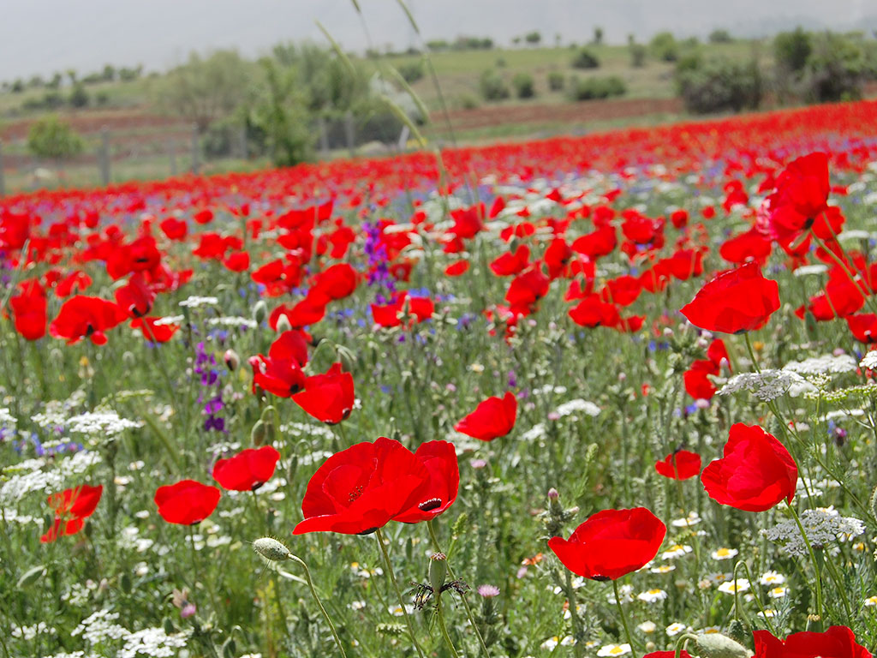
Consider The Lilies
Notes:
1. Aim: To show some valuable lessons we can learn from the lily

Slide 2
Consider The Lilies
28 "So why do you worry about clothing? Consider the lilies of the field, how they grow: they neither toil nor spin
29 and yet I say to you that even Solomon in all his glory was not arrayed like one of these.
30 Now if God so clothes the grass of the field, which today is, and tomorrow is thrown into the oven, will He not much more clothe you, O you of little faith? Matt. 6:28-30
Notes:
1. Mt. 6:28-30 "So why do you worry about clothing? Consider the lilies of the field, how they grow: they neither toil nor spin; and yet I say to you that even Solomon in all his glory was not arrayed like one of these. Now if God so clothes the grass of the field, which today is, and tomorrow is thrown into the oven, will He not much more clothe you, O you of little faith?”
a. Sight is a function, Seeing is an art!
b. Just to notice anything is not to see it!
c. You only see things when you get a vision of what is in them.
d. There is always more in something than the casual glance affords.

Slide 3
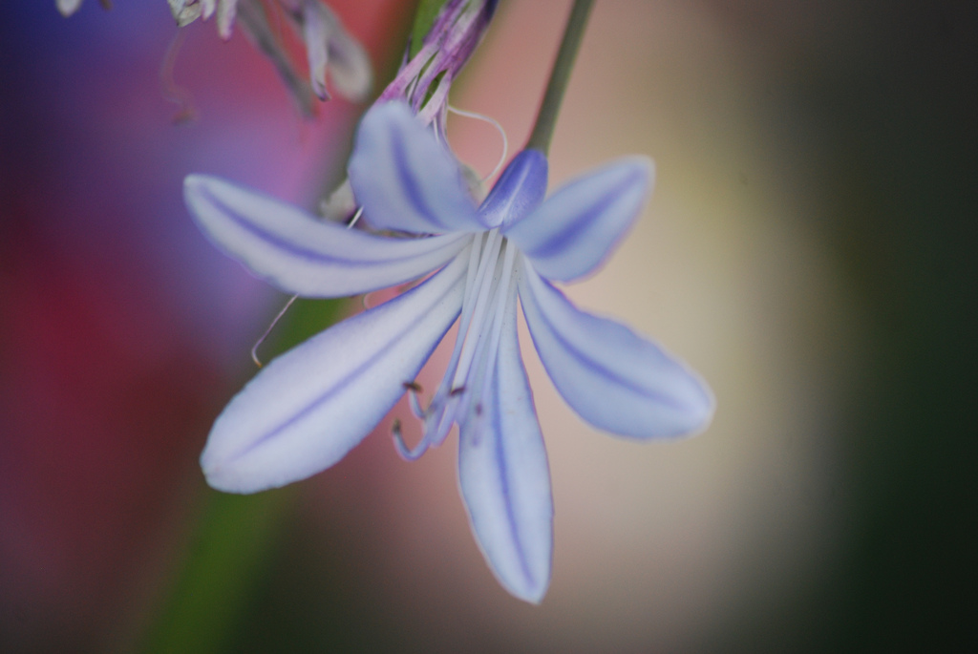
Consider The Lilies
How they Grow
Notes:
1. Context - overcoming worry - Birds, Flowers
2. Jesus suggests that we look deeper into the lily & consider it
a. CONSIDER - to learn thoroughly, examine carefully
3. Two ways of living.
a. Two men in a library
(1) One sees only books lining a shelf
(2) Another knows what is in them & they are a great thrill to him.
b. Some go through life seeing nothing & life is dull
4. What is from God's hand is worth considering. God created plant life on day 3 of creation

Slide 4
1. How They Grow
“how they grow: they neither toil nor spin”
Mankind is to toil – labor – spin – weave
Our toiling and work will result in something precious.
God will cause clothing and other things to come from our toiling.
“And why do you worry about clothes? Consider how the wild flowers grow, they neither work nor weave, but I tell you that even Solomon in all his glory was never arrayed like one of these.” - Phillips
Notes:
1. NOTICE THAT THEY GROW
A. They are not idle
1. Jesus says they neither toil nor spin
2. Toiling & Spinning is not part of their life - they grow and are not idle
3. They trust in God for their sun, air, nourishment in their soil, & water for growth
4. They lay hold of these things & grow, and then fulfill the meaning of their lives.
B. What Doesn't belong to the Lily, Belongs to man
1. We are to toil - labor - and spin - weave thread
2. As the lilies grow, we must work - not be idle
3. Continually working and trusting in God
4. The lily has no fear that their growing will not result in a bloom more radiant than Solomon ever was.
5. We must have no fear that our toil and work will result in something precious in the sight of God and man
6. God will cause clothing & every other thing we need to come from our toiling just as he causes bloom to come from the growing of the lily.
7. Philips translation - “And why do you worry about clothes? Consider how the wild
flowers grow, they neither work nor weave, but I tell you that even Solomon in all
his glory was never arrayed like one of these.”

Slide 5
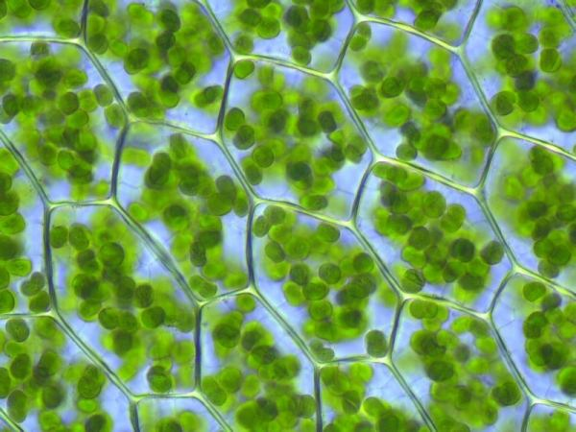
1. How They Grow
Notes:
C. The Lily's not Idle!
1. Watch a single cell - busy all the time
2. Nutrients enters, chemical processes cause it to grow, waste matter is expelled
3. The cell is at work constantly
4. Multiply this by the millions of cells and you can see how busy a lily is all the time.

Slide 6
1. How They Grow
We Must Be Busy – Not Idle
“Let him who stole steal no longer, but rather let him labor, working with his hands what is good, that he may have something to give him who has need.” Eph. 4:28
“If anyone will not work, neither shall he eat.” 2 Thess. 3:10
Notes:
A. We must be busy as the Lily – and not idle
1. Never be idle - be at work all the days of our life
2. Eph. 4:28 “Let him who stole steal no longer, but rather let him labor, working with his hands what is good, that he may have something to give him who has need.”
3. 2 Thess. 3:10 “If anyone will not work, neither shall he eat.”
4. God, who provides for the lilies as they grow, will provide for us as we work!

Slide 7

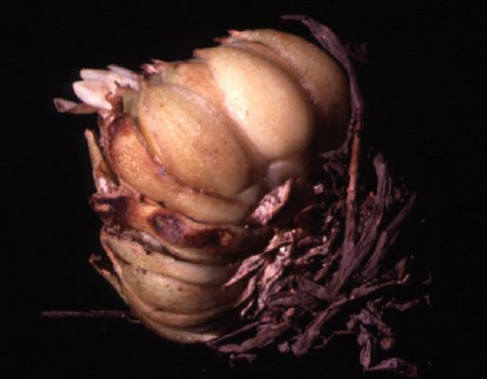
2. Lilies Grow From Bulbs
Notes:
2. LILIES GROW FROM BULBS
A. Not from Seeds
1. Plants From seeds only last one season
2. Lilies have food stored in their bulbs and they last through the winter
3. They can grow in rich soil or poor soil
4. They have root in themselves

Slide 8
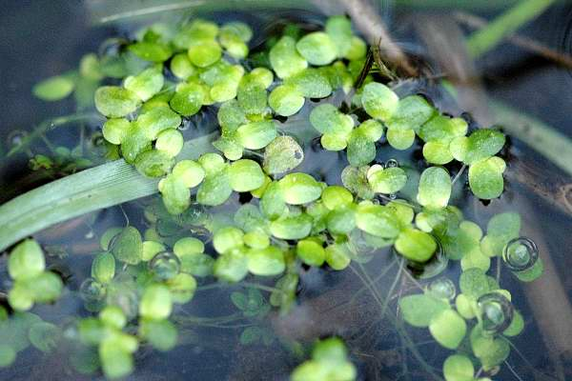
2. Lilies Grow From Bulbs
Rootless Plant
Rootless Christians
Eph. 4:14
“tossed to and fro”
“carried about with every wind of doctrine”
Notes:
A. A rootless plant in South America
1. Lemna Plant - lives on Water
2. When water dries up, it rolls into a ball
3. The wind blows it for great distances until it finds more water.
4. When it finds more water, it unrolls
5. It is a low form of plant life which bears no fragrant bloom, and is good for nothing either in smell nor for beauty.
B. Sometimes Christians can be rootless
2. Eph. 4:14 “that we should no longer be children, tossed to and fro and carried about with every wind of doctrine, by the trickery of men, in the cunning craftiness of deceitful plotting.”

Slide 9

2. Lilies Grow From Bulbs
Ready for hard times
Christians who abide in Christ are prepared
Jn. 15:4 “the branch cannot bear fruit of itself”
Eph. 3:17 “rooted and grounded in love”
Notes:
A. Lilies grow from a Bulb
1. It is ready for hard times
2. The Best Christians like the lily, bloom on, though they are not set in a garden of Eden.
3. They stand for religion in the world and make men see that religion has real stamina
B. A bulbous Christian
1. Close & constant contact with Christ is the only thing that can make us a steady and a blooming Christian all the time.
2. John 15:4 “Abide in Me, and I in you. As the branch cannot bear fruit of itself, unless it abides in the vine, neither can you, unless you abide in Me.”
3. Christ is better for the Soul than the bulb is to the Lily!
4. Let us be Christians like the Lily so “That Christ may dwell in your hearts by
faith; that we may be rooted and grounded in love”
5. Possessing resource we can flourish and bloom in is hard places.

Slide 10

3. The Lily Casts a Helpful Shadow
Notes:
3. THE LILY CASTS A HELPFUL SHADOW
A. Shadow created by Leaves and Bloom
1. Other plants that have no reserve can grow under protection of lily, which provides conditions suitable for growth
2. In Palestine, rich tufts of grass are always found under the lilies
3. Favorite feeding pieces of flocks & herds.
4. Other plants and grass and flocks and herds are helped by the shadow of the lily

Slide 11
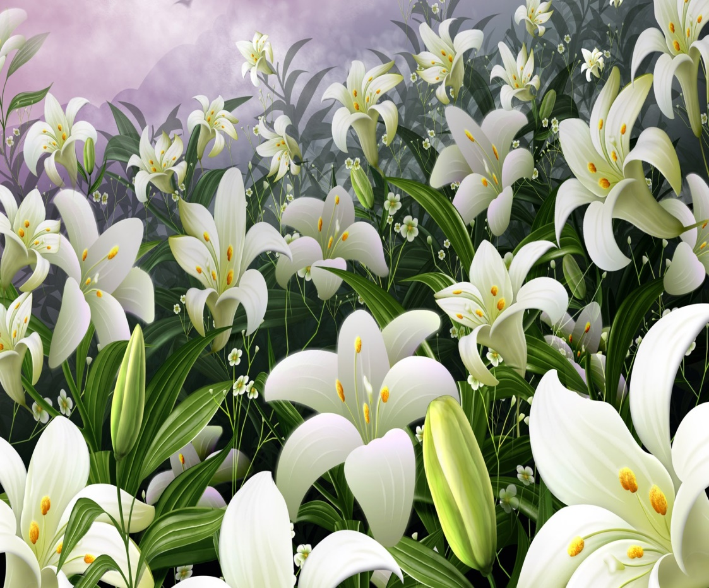
3. The Lily Casts a Helpful Shadow
Eph. 4:32 “And be kind one to another”
1 Cor. 13:4 “Love is kind”
Notes:
A. We are to be like the lilies
1. A Christian casts shadows of kindness and love on all.
2. Ephesians 4:32 “And be ye kind one to another...”
3. I Corinthians 13:4 “Love is kind”

Slide 12
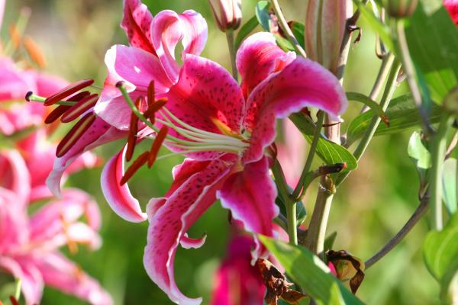
4. Glory of The Lily
Notes:
4. THE GLORY OF THE LILY
A. The lily is a beautiful flower
1. Few flowers can compare to its beauty, but the glory of the lily is not in it’s
beauty alone, it’s in it’s immortality. v.28-29 “Consider the lilies of the field, how they grow: they neither toil nor spin and yet I say to you that even Solomon in all his glory was not arrayed like one of these”
2. Solomon in all his glory passed away, but the lily blooms again every spring.
3. That is the glory of the Christian life; God’s children will live forever.

Slide 13
4. Glory of The Lily
The Clothing of A Christian
Clothed in His righteousness
Gal. 3:27 “For as many of you as have been baptized into Christ have put on Christ.”
NASB “…have clothed yourselves with Christ”
Eph. 4:24 “and that you put on the new man which was created according to God, in true righteousness and holiness.”
Notes:
A. The Clothing of a Christian
1. The rich spend hundreds and thousands on designer clothing, kings wear the finest of materials, queens the finest jewelry - but nothing compares to the garments that God covers us with.
2. We are clothed in His righteousness, and it does not fade, tare, or go out of style.
3. Gal. 3:27 “For as many of you as have been baptized into Christ have put on Christ.”
a. “Put on” = to sink into clothing, array or clothe
b. NASB “27 For all of you who were baptized into Christ have clothed yourselves with Christ. ”
4. Eph. 4:24 “and that you put on the new man which was created according to God, in true righteousness and holiness. .”

Slide 14
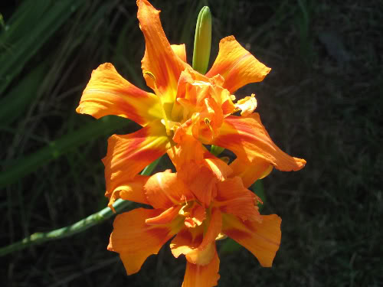
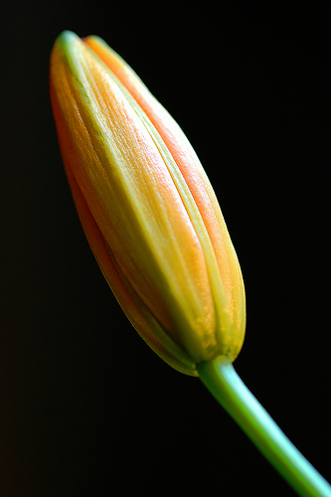
5. Lesson of a Lily
“I am the light of the world: he that follows me shall not walk in darkness, but shall have the light of life.”
Jn. 8:12
Notes:
5. THE LESSON OF A LILY
A. At sun set, it closes up
1. Street lights do not make it open
2. Moon light and star light do not make it open
B. At Sun Rise, It opens up
1. It unfolds as the rays of the Sun touch it.
2. It remains open until the setting of the sun
3. Why? Because it found in the sunlight all it needed for life & growth
C. Lesson - God is the true light of our Soul. We must close our hearts to the artificial light of sin which cannot give us life.
D. John 8:12 “I am the light of the world: he that follows me shall not walk in
darkness, but shall have the light of life.”

Slide 15

Consider The Lilies
Not Idle
Helpful
Shadow
Reserve of
Strength
Glory
Notes:
1. Let us consider the lilies & follow their example
a. They are not idle
b. They have a reserve of strength
c. They cast a helpful shadow
d. Glory - clothed in righteousness
e. Open to the sun

Slide 16
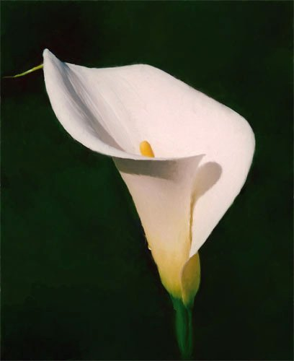
We Should Not Worry
God cares for the birds and the lilies
Why worry about clothing or necessities ?
If God Cares for You, why worry ?
Notes:
1. What is Jesus saying? We don’t need worry about anything.
a. The word worry means to be Anxious – Choke.
b. We can become choked by the problems in life.
c. Jesus reminds us that God feeds the ravens and cares for the lilies and we are more precious to Him than birds or plants. We are made in His image.
d. Why do we worry so much about clothing and what we will wear?
i. Doesn’t the Living God clothe the flowers in splendor?
ii. Will not the Living God, our Heavenly Father, also care for us?
e. God is our Heavenly Father who lovingly cares for us as a faithful gardener cares for his/her plants in the family garden.
3. Jesus concluded: If God cares for you, why worry so much?
a. Jesus taught each one of us three words that we all need to know and memorize. Jesus simply said, , “Do not worry.”
b. That’s it. “Do not worry.”
4. “Consider the Lilies”

Slide 17
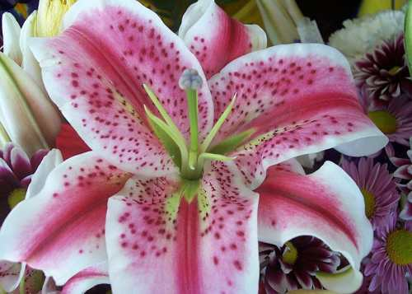
“Seek first the kingdom of God and His righteousness, and all these things shall be added to you.” Matt. 6:33

Slide 18
Salvation
Hear the gospel (Rom. 10:17)
Believe In Jesus (Jn. 8:24)
REPENT of your sins (Lk. 13:3)
Confess your faith (Matt. 10:32-33)
Baptized Into Christ (Acts 2:38)
REMISSION OF SINS
Faithful until death (Rev. 2:10)

