Slide 1
The Leper Cleansed
Luke 5:12-16
Notes:
1. Aim: To explain the miracle of the cleansing of the leper.
2. Matthew 8:1- 4 Mark 1:40- 45 Luke 5:12-16

Slide 2
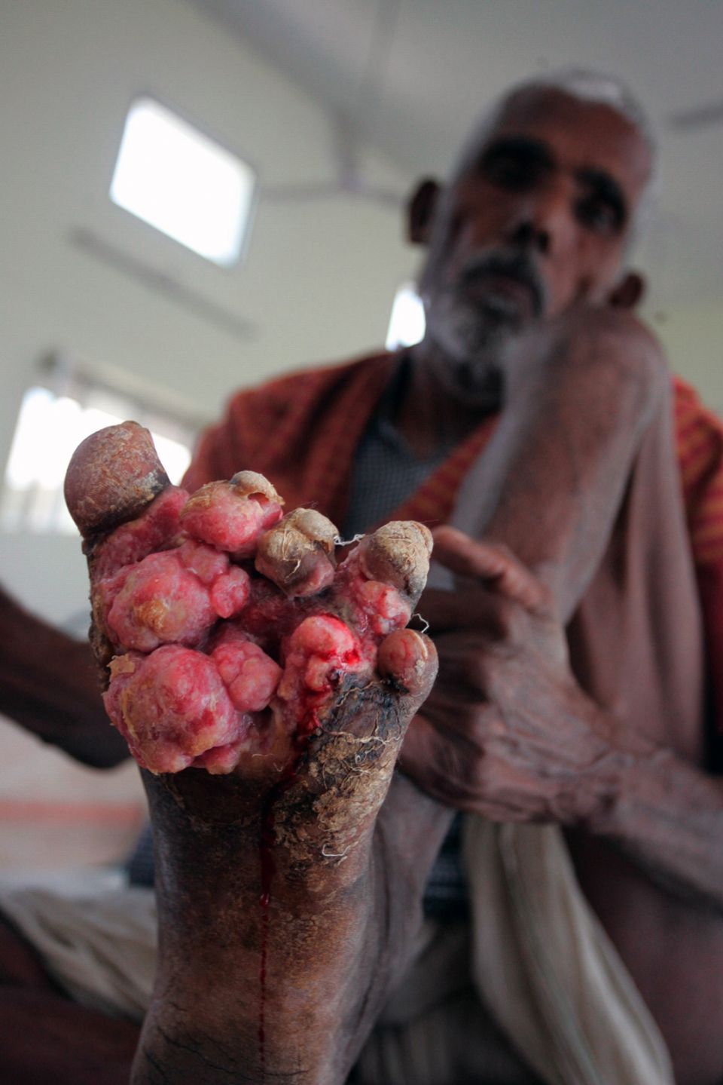
The Miracle
Luke 5:12
“And it happened when He was in a certain city, that behold, a man who was full of leprosy saw Jesus; and he fell on his face and implored Him, saying, "Lord, if You are willing, You can make me clean."
“full of leprosy” = body covered
“fell on his face” = reverence
“if you are willing” = his doubt
“you can make me clean” = his confidence
Notes:
I. THE MIRACLE
A. The leper's cry. Luke 5:12 “And it happened when He was in a certain city, that behold, a man who was full of leprosy saw Jesus; and he fell on his face and implored Him, saying, “Lord, if You are willing, You can make me clean.”
Picture
2. The severity of the disease: “Full of leprosy.” His body was literally covered.
3. His reverence: “Fell on his face.”
4. His doubt: “Lord, if you are willing.”
5. His confidence: “You can make me clean.”

Slide 3
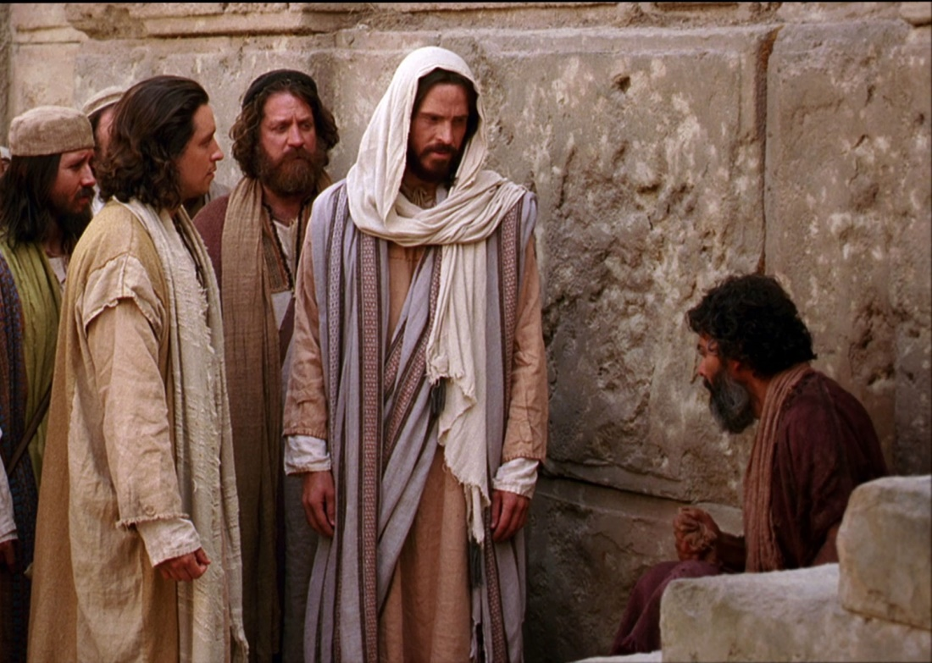
The Miracle
Luke 5:13
“Then He put out His hand and touched him, saying, "I am willing; be cleansed." Immediately the leprosy left him."
Dangerous to touch a leper
Compassion = reached out and touched
“I am willing” = removed doubt
“be cleansed” = power
“immediately” = cure was at that moment
Notes:
The Lord's answer. v. 13 “Then He put out His hand and touched him, saying, “I am willing; be cleansed.” Immediately the leprosy left him.”
1. Jesus stretched forth his hand and touched the man; it was considered a dangerous thing to touch a leper; the leper was unclean, and the one who touched him became unclean, but Jesus touched him with the healing power.
2. Compassion: “He stretched forth his hand, and touched him, saying, I am willing.” The touch of the warm hand together with the assuring “I will” must have dismissed the leper's doubt.
3. The leper had thrown himself on the mercy of Jesus, and had faith strong enough to prostrate himself at the feet of Jesus; hence Jesus said, “I will.”
4. Power: “Be cleansed. Immediately the leprosy left him.”
5. There was no hysterical praying or behavior like most modern day fake healers.
6. The cure was instantaneous; the leprosy, the cause of his defilement, “departed from him” at the very moment that Jesus spoke.

Slide 4
The Miracle
Luke 5:14
“And He charged him to tell no one, "But go and show yourself to the priest, and make an offering for your cleansing, as a testimony to them, just as Moses commanded.”
Why?
1. Not be hindered in teaching
2. Man was to show himself to the priest
Lev. 14:2 “brought to the priest”
Notes:
The Lord's charge. Luke 5:14-15 “And He charged him to tell no one, “But go and show yourself to the priest, and make an offering for your cleansing, as a testimony to them, just as Moses commanded.”
1. Jesus frequently gave this prohibition.
2. There were 2 possible reasons:
a. Jesus did not wish to draw to Himself public attention and thus be hindered in His work of teaching.
b. The man's immediate duty was to “show himself to the priest.”
(1) Leviticus 14:2 “This shall be the law of the leper for the day of his cleansing: He shall be brought to the priest.”
(2) Leviticus 14:8-9 - rules to be cleansed from leprosy

Slide 5
The Miracle
Luke 5:15
“However, the report went around concerning Him all the more; and great multitudes came together to hear, and to be healed by Him of their infirmities”
News of healing spread fast
People came to:
- Hear
- Be Healed

Slide 6
The Miracle
Luke 5:16
“And He withdrew Himself into the wilderness, and prayed.”
Touch of a leper made Jesus unclean
He went into the wilderness for a week of isolation
While there he prayed
Notes:
The Lord's withdrawal and prayer. Luke 5:16 “And He withdrew Himself into the wilderness, and prayed.”
1. To touch a leper rendered Jesus unclean
2. Jesus withdrew into the wilderness to spend his week of isolation for being unclean.
3. The verse does not say that his withdrawal was for the purpose of prayer but rather that he prayed during his withdrawal.
4. Jesus withdrew because of His uncleanness, but also to stem the tide of popularity that might cause a rebellion against Roman authorities in their rush to make Him their king.

Slide 7
Disease of Leprosy
Disease of the skin
Also considered unclean – Lev. 13
A living death
Live for years
Indescribable misery
There was no Human Cure
Contagious
Spreads
Notes:
THE DISEASE OF LEPROSY
A. Leprosy is a disease of the skin, and shows the corruption and impurity of the blood.
1. Leprosy was treated not only as a disease, but an uncleanness (Leviticus 13).
2. Leprosy was a living death.
3. Lepers might live for many years, but their lives would be years of indescribable misery.
4. Lepers might be so afflicted that their fingers and other members of their bodies would drop off one by one at the joint.
5. Leprosy was a disease for which there was no human cure – still no cure even today
a. It is fearful and contagious
b. And it spreads all over your body
6. The disease of leprosy makes its appearance first upon the skin, in the shape of certain spots, small at the outset and of a reddish color, but gradually increasing in size, and presenting a white, scaly, shining aspect.
a. After a time the spots spread over the whole body, “the hair falls from the head and eye-brows; the nails loosen, decay, and drop off; joint after joint of
the fingers and toes shrink up and slowly fall away.
b. The gums are absorbed, and the teeth disappear.
c. The nose, the eyes, and the tongue are slowly consumed, and finally, the victim sinks into the earth and disappears, while medicine has
no power to help the victim
7. So it was in fact a living death. How horrible and how hopeless the picture!
8. In this lesson, Jesus came face to face with a man afflicted with this dreadful disease.

Slide 8
Leprosy Has Similarities To Sin
It is contagious
“evil companionships corrupt good morals” 1 Cor. 15:33
Spreads
“evil men…will grow worse and worse” 2 Tim. 3:13
Painful and Loathsome
“the way of transgressors is hard” Prov. 13:15
“and be sure your sins will find you out” Num. 32:23
“whatever a man sows…reap” Gal. 6:7
Notes:
Leprosy Has Similarities To Sin
1. Leprosy dwells in the corruption and impurity of the blood, while sin dwells in the moral defilement of the nature of human beings.
2. Leprosy is contagious. So is sin - 1 Corinthians 15:33 “Be not deceived: Evil companionships corrupt good morals.”
3. Leprosy is of a spreading nature. So does sin - 2 Tim. 3:13 “But evil men and impostors will grow worse and worse, deceiving and being deceived.”
a. Sin defiles the whole of a person,
b. Sin affects body, soul, and spirit.
4. Leprosy is exceedingly painful and loathsome.
a. Sin is a hard master.
b. It brings pain, and it makes the person vile and loathsome
(1) Proverbs 13: 15 “The way of transgressors is hard.”
(2) Numbers 32:23 “and be sure your sins will find you out.”
(3) Galatians 6:7 “Be not deceived; God is not mocked: for whatsoever a man sows, that shall he also reap.”

Slide 9
Leprosy Has Similarities To Sin
Incurable by humans
- Only Christ can heal - Eph. 2:8-9
Lepers excluded from society
- Sinners excluded from communion of God
“There shall by no means enter it anything that defiles or causes abomination or a lie, but only those who are written in the Lamb’s Book of Life.” Rev. 21:27
Notes:
1. Leprosy is incurable by humans
a. Sin is incurable except through Christ
b. Eph. 2:8-9 “For by grace you have been saved through faith, and that not of yourselves; it is the gift of God”
2. Lepers were excluded from the society of the healthy.
a. Sinners are excluded from communion of God and his saints.
(1) Sin caused our first parents (Adam & Eve) to be cast out of Paradise - Genesis 3
(2) Sin caused the wicked angels to be cast out of heaven - 2 Peter 2
(3) Sin makes it necessary for the church to withdraw fellowship from its ungodly members
b. Sin will keep many out of heaven (CLICK)
(1) Revelation 21:27 “But there shall by no means enter it anything that
defiles, or causes an abomination or a lie, but only those who are written
in the Lamb's Book of Life.”
(2) Revelation 21:8 “But the cowardly, unbelieving, abominable, murderers,
sexually immoral, sorcerers, idolaters, and all liars shall have their part in
the lake which burns with fire and brimstone, which is the second death.”
(3) Galatians 5:19 - 21

Slide 10
Cure of Leprosy – Type of Salvation
The Leper
The Sinner
Must come to Jesus
Had heard of Jesus
Conscious of his disease
Had faith in Jesus
Humbled himself
Jesus had compassion
Must come to Jesus
Must hear of Jesus
Conscious of sins
Faith Jesus can save
Humbled – repent and obey
Jesus has compassion
Notes:
The Cure of Leprosy, a Type of Salvation from Sin
A. The leper came to Jesus to be healed - sinners must come to Jesus to be saved.
B. The leper had heard of Jesus and his miracles - Sinners must hear of Jesus
C. The leper came to Jesus conscious of his disease - Sinners must come to Jesus conscious of their sins
D. The leper had faith in Jesus and his power to heal - The sinner must have faith in Jesus and his power to save
E. The leper humbled himself before Jesus - Sinners must humble themselves and repent and obey
F. Jesus looked on the leper with deep compassion - Jesus has great compassion on sinners, and He will save them when they come to Him in humble faith and obedience
a. Jesus touched the leper, and he was immediately healed.
b. Jesus has all power (Matt. 28:18).
c. Jesus wills that all should be saved
d. The precious blood of Jesus is a fountain for sin and un-cleanness
e. Those who obey will be cleansed.

Slide 11
Cure of Leprosy – Type of Salvation
The Leper
The Sinner
Tell no one
Joy compelled him
Show himself to priest
Tell everyone
Joy of salvation
Inspection of Christ
Notes:
The Master's Instruction to the Leper
1. The leper was commanded to tell no one of his cure
a. He went, however, and published his cure abroad (Mark 1:45).
b. His joy compelled him to tell the story of his cure
c. Our joy of salvation should cause us to publish it abroad
d. We have been told to tell the story of Jesus
2. The leper was commanded to go show himself to the priest and offer for his cleansing those things which Moses commanded for a testimony unto them a. Jesus did not bypass the law of Moses. He left to high priest the prerogative of declaring the leper to be clean.
b. Jesus as our high priest has the prerogative to pronounce us clean
c. Jesus came to do what the law could not do
(1) The law could pronounce a sinner unclean
(2) The law could not, however, make a person clean, and the sinner was thus shut up unto faith until Christ came
3. The leper was put under the inspection of the priest. The sinner is put under the inspection of Christ, our high priest

Slide 12
Lessons We can Learn
Sin is the leprosy of the soul
Jesus is willing and able to save
To save the sinner we must touch His blood
“How much more shall the blood of Christ, who through the eternal Spirit offered himself without spot to God, purge your conscience from dead works to serve the living God?” Heb. 9:14
Notes:
LESSONS WE CAN LEARN
A. That a sinner is a moral and spiritual leper. —Sin is the leprosy of the soul.
B. That Jesus is both willing and able to heal—to save us from sin.
C. That in order to assist the sinner, the saved ones must “touch” Him
1. We must come in contact with the blood of Christ.
2. Heb. 9:14 “How much more shall the blood of Christ, who through the eternal Spirit offered himself without spot to God, purge your conscience from dead works to serve the living God?”

Slide 13
Ready for Inspection?
To determine if you are clean or unclean
Must appear before the judgment bar of Christ
2 Cor. 5:10 “For we must all appear before the judgment seat of Christ; that every one may receive the things done in his body, according to that he has done, whether it be good or bad.”
Notes:
Are you ready for inspection?
1. Are you ready to appear before Christ, our high priest, for an inspection to determine whether or not you are clean or unclean?
2. We must all appear before the judgment seat of Christ – read verse
3. If Christ were to come today, would you be able to stand the test?
4. My leprous sinner friend, will you not come to Christ in humble faith and obedience?

Slide 14
Salvation
Hear the gospel (Rom. 10:17)
Believe In Jesus (Jn. 8:24)
REPENT of your sins (Lk. 13:3)
Confess your faith (Matt. 10:32-33)
Baptized Into Christ (Acts 2:38)
REMISSION OF SINS
Faithful until death (Rev. 2:10)

Slide 15
Enhanced Benevolence - Acts 4:34-35
Why?
  One responsibility of the church is to care for needs of the saints.
  Radford has the capability to help if we are aware of needs.
What is being initiated in 2016?
  $500 gift to say “we care” when member loses close relative.
    This gift is from the congregation and is part of the church budget.
  Financial help where a serious need arises for a member.
  Visit each widow/widower at Radford to identify such needs.
What you can do.
  Contact Deacon, Preacher, Elder to “nominate” someone who is currently in need of help.
  Let a Deacon, Preacher or Elder know if you experience a serious need for help.

