Slide 1
Back To The Basics

Slide 2
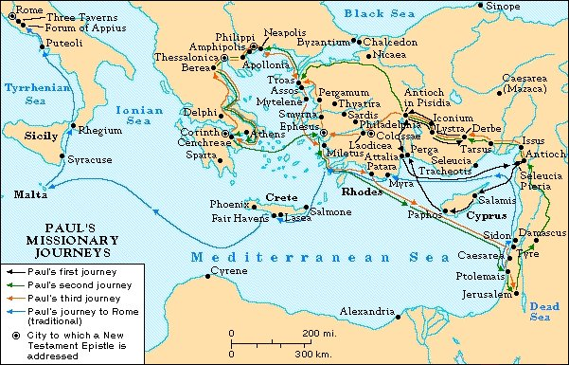
Christianity is Undenominational
Acts 2:47 “And the Lord added to the church daily those who were being saved.”
Notes:
1. Aim: To show the undenominational nature of the church.
2. Acts 2:47 - “And the Lord added to the church daily those who were being saved.” this was the day the church started
a. After this occasion the church began growing – Peter and other disciples preaching
b. Paul Missionary journey’s - church was spread to many parts of the world
c. But these congregations that were established were not denominations

Slide 3
Christianity is Undenominational
“Denomination” = a division / segment
“Denominationalism” = means devotion to denominational principles
Denominations established by men
“church of Christ” - not a denomination
Rom. 16:16
Notes:
1. Definition
a. "Denomination" signifies a division or a segment.
b. "Denominationalism" means devotion to certain denominational principles or interests.
2. All the religious denominations of our day were established by men, hundreds of years after Jesus established His church in Jerusalem on Pentecost, about 33 A.D.
3. The "church of Christ" is NOT a denomination. Here is why this claim is made.

Slide 4
I. Denominationalism is Not in Bible
Christ established one church
Matt. 16:18 “My church”
Acts 20:28 “the church” “purchased”
Eph. 4:4 “one body”
Eph. 1:22-23 - “the church, which is His body”
Notes:
I. DENOMINATIONALISM IS Not in Bible
A. Christ established ONE church
1. Matt. 16:18 “I also say to you that you are Peter, and on this rock I will build my church”
2. Acts 20:28 “to shepherd the church of God which He purchased with His own blood
3. Eph. 4:4 “one body”
Eph. 1:22-23 “gave Him to be head over all things to the church, which is His body”

Slide 5
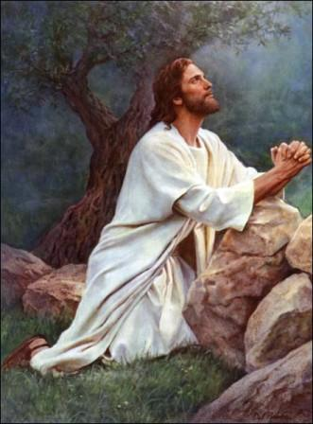
I. Denominationalism is Not in Bible
Christ Prayed for Unity
Jn. 17:20-21 "I do not pray for these alone, but also for those who will believe in Me through their word; that they all may be one, as You, Father, are in Me, and I in You; that they also may be one in Us”
Notes:
A. Jesus prayed for the unity of all believers
1. John 17:20-21 "I do not pray for these alone, but also for those who will believe in Me through their word; that they all may be one, as You, Father, are in Me, and I in You; that they also may be one in Us”
2. Our Lord did not work against His own prayer for unity by establishing conflicting
and contradictory denominations.

Slide 6
I. Denominationalism is Not in Bible
Christ Prayed for Unity
Jn. 17:20-21
He did not establish conflicting and contradictory denominations
Denominationalism causes doubt
Notes:
A. Denominationalism hinders the progress of salvation of lost souls
1. Our Lord did not work against His own prayer for unity by establishing conflicting
and contradictory denominations.
2. Denominationalism breeds skepticism and doubt to the world.
3. Different doctrines causes many in the world to lose respect for the Scriptures.

Slide 7
II. In the Beginning Christians
Belonged to no Denomination
Members of the church for which Christ died.
Accept and Obey Christ only, you become a “Christian,” a disciple of Christ.
Christians Only
Notes:
II. IN THE BEGINNING CHRISTIANS BELONGED TO NO DENOMINATION
A. Christians were members of the church for which Christ died.
B. When you accept Christ only, you become a “Christian,” a disciple of Christ.
C. Others in any place who do the same thing will be, like us, Christians only.

Slide 8
II. In the Beginning Christians
Belonged to no Denomination
“For in Him dwells all the fullness of the Godhead bodily; and you are complete in Him, who is the head of all principality and power.”
Col. 2:9-10
Christians Only
Notes:
A. When one accepts Christ, there is no need to accept anything else - Col. 2:9-10 “For in Him dwells all the fullness of the Godhead bodily; and you are complete in Him, who is the head of all principality and power.”

Slide 9
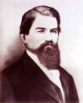
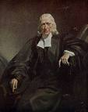
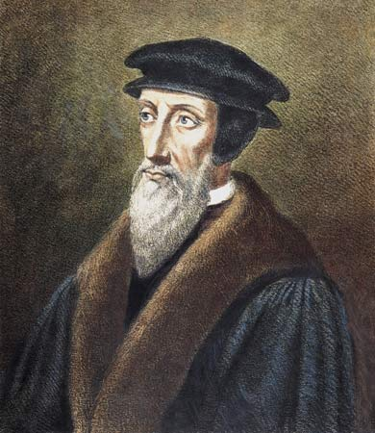
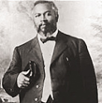
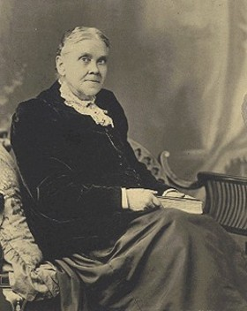
III. Characteristics of the
Undenominational Church
1.It has no denominational founder
John Smyth – 1620’s
Baptist
John Wesley – 1750’s
Methodist
Influenced by John Calvin
Presbyterian
William Joseph Seymour
Pentecostal
Ellen White
Seventh-day Adventist
Notes:
III. CHARACTERISTICS OF THE UNDENOMINATIONAL CHURCH
It has no denominational founder. Christ is the only founder of the church, He purchased it with His own blood
Baptist – John Smyth 1620’s
Methodist – John Wesley 1750’s
Presbyterian – European reformation – highly influenced by John Calvin and established in 1580-1590
Pentecostal – started in 1901 - William Joseph Seymour, but many branches have come out since then (assembly of God)
Seventh-day Adventist - 1863 Ellen White
B. Each and every denomination beginning can be traced back to a date and the founder being a man or woman.
1. Jesus said - Matt. 16:18“And I also say to you that you are Peter, and on this rock I will build My church”
2. Christ established His church NOT A MAN! And that church was established in 33 A.D. in Acts chapter 2
3. The undenominational church has no denominational founder

Slide 10
III. Characteristics of the
Undenominational Church
1.It has no denominational founder
“You are Peter, and on this rock I will build my church” Matt. 16:18
Notes:
III. CHARACTERISTICS OF THE UNDENOMINATIONAL CHURCH
It has no denominational founder. Christ is the only founder of the church, He purchased it with His own blood
Baptist – John Smyth 1620’s
Methodist – John Wesley 1750’s
Presbyterian – European reformation – highly influenced by John Calvin and established in 1580-1590
Pentecostal – started in 1901 - William Joseph Seymour, but many branches have come out since then (assembly of God)
Seventh-day Adventist - 1863 Ellen White
B. Each and every denomination beginning can be traced back to a date and the founder being a man or woman.
1. Jesus said - Matt. 16:18“And I also say to you that you are Peter, and on this rock I will build My church”
2. Christ established His church NOT A MAN! And that church was established in 33 A.D. in Acts chapter 2
3. The undenominational church has no denominational founder

Slide 11
III. Characteristics of the
Undenominational Church
2.It has no denominational head
“And He is the head of the body, the church,...” Col. 1:18
No human head or earthly headquarters.
Notes:
The undenominational church has no denominational head
1. Col. 1:18 - “And He is the head of the body, the church, who is the beginning, the firstborn
from the dead, that in all things He may have the preeminence”
2. Christ is the Sovereign Head of the church. The undenominational church does not
recognize any human head or earthly headquarters.
B. Most denominations will say that Christ is the head of their church, but I would ask these questions if that were true:
1. Why is there an earthly headquarters of your church?
2. Why can the controlling body (some called conventions, apostles, general conference, national and international bishops and archbishops) change the churches stance on any given issue by taking a vote or writing a new creed on what the scriptures teach?

Slide 12
III. Characteristics of the
Undenominational Church
3.It has no denominational creed
No Creed but Christ !
“Thou art the Christ, the Son of the living God” Matt. 16:16
No book of rules by man
2 Tim. 3:16
2 Pet. 1:3
Notes:
C. It has no denominational creed.
1. We have no creed but Christ. “Thou art the Christ, the Son of the living God” is our
confession of faith - Matt. 16:16
2. We have no book of discipline or rule of faith. We practice only the Scriptures.
3. 2 Tim. 3:16 - “All scripture is given by inspiration of God, and is profitable for doctrine, for
reproof, for correction, for instruction in righteousness, that the man of God may
be complete”
4. God's Word is sufficient to cover every problem of congregational organization, activity, and worship.
5. THEREFORE, HUMAN CREEDS ARE UNNECESSARY.
6. 2 Peter 1:3 - “As His divine power has given to us all things that pertain to life and godliness,
through the knowledge of Him who called us by glory and virtue”

Slide 13
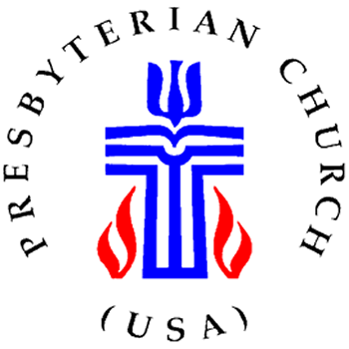
III. Characteristics of the
Undenominational Church
3.It has no denominational creed
Presbyterian
Bible, the Second Helvetic Confession, the Heidelberg Catechism, and the Westminster Confession of Faith
Methodist
Bible, the Book of Discipline of The United Methodist Church, the Twenty-five Articles of Religion.
Notes:
Methodist - The Bible, the Book of Discipline of The United Methodist Church, the Twenty-five Articles of Religion.
Presbyterian - The Bible, the Second Helvetic Confession, the Heidelberg Catechism, and the Westminster Confession of Faith.

Slide 14
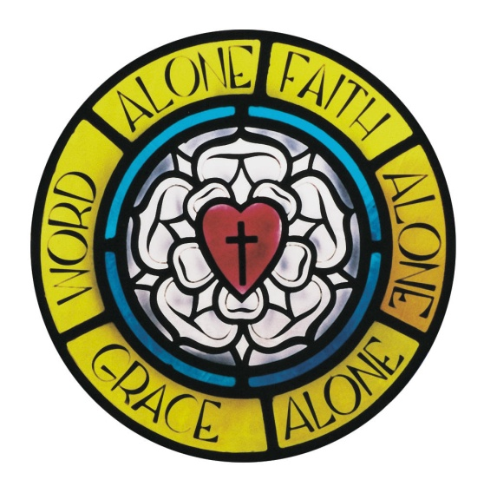
III. Characteristics of the
Undenominational Church
3.It has no denominational creed
Lutheran
Bible, The Book of Concord
Roman Catholic
Bible, the Apocrypha, and The Canon Law.
Baptist
Bible, The Baptist Manual
Notes:
Lutheran - The Bible, The Book of Concord
Roman Catholic - The Bible with the inclusion of the Apocrypha, and The Canon Law.

Slide 15
III. Characteristics of the
Undenominational Church
4.It has no denominational name
“The church” - Eph. 3:10, Col. 1:24
“The church of God” - 1 Cor. 1:2
“The body of Christ” - 1 Cor. 12:27
“The church of the Lord” - Acts 20:28
“The church of Christ” - Rom. 16:16
Notes:
The undenominational church has no denominational name.
1. Denominations, for the most part, have been named after men and women who helped to establish that particular sect of believers.
2. But the church of the New Testament was known as:
a. “The church” Eph. 3:10
b. “The church of God” I Cor. 1:2
c. “The body of Christ” I Cor. 12:27
d. “The church of the Lord” Acts 20:28
e. “The church of Christ” Matt. 16:18

Slide 16
III. Characteristics of the
Undenominational Church
4.It has no denominational name
“Disciples” “Christians” - Acts 11:26
“Saints” - Rom. 1:7, Phil. 1:1, Col. 1:2
“Brethren” - Col. 1:2, Jas. 1:2
“Children of God” - Gal. 3:26, 1 Jn. 3:1
Notes:
2. The individual members of the church were known as:
a. “Disciples” And “Christians” Acts 11:26
b. “Saints” Rom. 1:7
c. “Brethren” Col. 1:2
d. “Children of God” Gal. 3:26
e. “Priests” I Pet. 2:5

Slide 17
III. Characteristics of the
Undenominational Church
5.It has no denominational organization
No popes, cardinals, archbishops
No church councils or conventions
Each congregation is independent
Plurality of qualified elders - Acts 14:23
Notes:
E. It has no denominational organization.
1. There is no ecclesiastical organization, no popes, no cardinals, no archbishops, no
church councils or conventions.
2. Each congregation of the church in the N.T. is independent, under the authority of
Christ as revealed in the New Testament.
3. We have a plurality of qualified elders (Acts 14:23), just as was found in the 1st century church. And it is those elders of each local congregation who are the leaders of that particular congregation
4. The eldership is to guide and shepard the flock, and you and I as members are to submit to their authority, but also love, admonish, and encourage them as they work to lead us in the way of truth
5. We don’t thank our elders enough for their time and effort. Many of you encourage me after each service by telling me how much you learned from a lesson, but let’s remember to also thank our elders for their unwavering leadership and love for the truth that keeps our congregation sound and unified.
6. It has been said “A congregation is only a strong as its leadership”

Slide 18
III. Characteristics of the
Undenominational Church
6.It has no denominational Worship
“Spirit and truth” - Jn. 4:24
-Lord’s Supper Acts 20:7 - Contribution 1 Cor. 16:2
-Singing Eph. 5:19 - Praying Lk. 18:1
- Preaching/Teaching 2 Tim. 4:2
Notes:
The undenominational church has no denominational worship.
1. We have no denominational rites or ceremonies.
2. We seek to worship “in spirit and truth” (John 4:24), following the pattern of the
1st century church.
3. Each Lord's day worship consists of:
(1) Lord's Supper Acts 20:7
(2) Contribution I Cor. 16:2
(3) A cappella Singing Eph. 5:19
(4) Praying Luke 18:1
(5) Preaching II Tim. 4:2
4. Not only are these the acts of worship that God requires of us when we meet together, these are the only acts of worship that we have the authority to perform in worship to our Heavenly Father

Slide 19
III. Characteristics of the
Undenominational Church
7.It has no denominational requirements
for membership
Do only what they did in N.T.
Hear, Believe, Repent, Confess, Baptized
Not told to: “Accept the Lord Jesus Christ as your personal Savior”
Notes:
The undenominational church has no denominational requirements for membership
1. We ask people to do only what men and women in the New Testament were
commanded to do:
a. Hear and understand God's Word
b. Believe
c. Repent
d. Confess
e. Be baptized for remission of sins
2. The church does not tell people: “accept the Lord Jesus Christ as your personal Savior” and you will be saved
H. After obeying the gospel, TO WHAT DENOMINATION DID THE FIRST CENTURY
CHRISTIANS BELONG?
1. Catholicism had its beginning in the 7th century.
2. Protestantism had its beginning in the 16th century.
3. New Testament Christians belonged simply to the undenominational church.

Slide 20
IV. The Cure For Denominationalism
Commitment to Bible as Standard
Unity = when we have one authority
All men lay down creeds, disciplines, manuals, confessions of faith, catechisms, and subjective feelings.
Accept the Bible Only = UNITY
Notes:
IV. THE CURE FOR DENOMINATIONALISM
A. We must have an unreserved commitment to the Bible as the sole, objective standard in what we do as Christians
1. Unity can exist only when there is allegiance to a single objective religious authority.
2. When all men will lay down their creeds, manuals, confessions of faith, think-so's, maybe's, and subjective feelings, and turn to the Word of God, then, and ONLY then, will unity result.
B. We must be committed to being nothing, calling ourselves nothing, obeying nothing, and
saying nothing except that which is authorized by the Word of God.

Slide 21
Christianity is Undenominational
Possible to have an undenominational position.
Preach only the gospel then it will produce the true New Testament church.
Notes:
CONCLUSION
Surely, we have seen this morning, that it is possible to occupy an undenominational position.
2. If we preach ONLY the gospel, it will produce in our day the New Testament
church that it produced in the days of the apostles, when no denominations existed.

Slide 22
“As I read the Sunday paper, I ran across this line, “Today you go to your church, and I will go to mine.” I've read the Bible over and over and never found that line:“Today you go to your church, and I will go to mine.” “Upon this rock, I'll build MY Church,” The Savior said one day. And before the dear Lord died, He humbly knelt to pray: “May they be one, as we are one, those who believe on me. So the world may surely know I am loved, and sent by Thee.” Yes, you may go to “Your” church, but let me tell you this, your worship will be vain unless you go to HIS!” - unknown
Notes:
“YOUR CHURCH AND MINE”
As I read the Sunday paper, I ran across this line,
“Today you go to your church, and I will go to mine.”
I've read the Bible over and over and never found that line:
“Today you go to your church, and I will go to mine.”
“Upon this rock, I'll build MY Church,” The Savior said one day.
And before the dear Lord died, He humbly knelt to pray:
“May they be one, as we are one, those who believe on me.
So the world may surely know I am loved, and sent by Thee.”
Yes, you may go to “Your” church, but let me tell you this
Your worship will be vain unless you go to HIS!

Slide 23
GOD’S SIMPLE PLAN FOR SALVATION
Rev. 2:10
Acts 2:38
baptism
JN. 12:42
confess
LK. 13:3
repent
OBEDIENT
UNTIL DEATH
JN. 8:24
believe
ACTS 3:22
hear

