Slide 1
B
ible
aptism
Notes:
Evans church of Christ - 2008
1. Aim: To contrast some of the teachings of men about baptism with what the Bible teaches about baptism.

Slide 2
Acts 2:38 “Then Peter said to them, repent, and be baptized every one of you in the name of Jesus Christ for the remission of sins, and you shall receive the gift of the Holy Spirit.”
Many Controversies?
Who ?
How ?
Why ?
Notes:
1. Acts 2:38 “Then Peter said to them, repent, and be baptized every one of you in the name of Jesus Christ for the remission of sins, and you shall receive the gift of the Holy Spirit.”
a. There are 269 chapters in the N.T. The word Baptize or one of its related words
such as “baptized” or “baptism” appears 103 times
b. Shows that baptism is important
2. A little boy was asked in Sunday School to explain baptism. He said, "It's when the preacher holds you under water and you think about Jesus!"
3. There have been many controversies about baptism through the centuries.
a. Some have different opinions about the method of baptism.
b. There are questions about who should be baptized.
c. And there are many differences of opinion about the purpose of baptism.
4. The real reason for the controversies is because men teach what they think and like rather than what the Bible plain says.
5. But let us look at the Bible and see what it teaches.
6. We will notice Who, How and Why about Bible baptism.

Slide 3
1. Who is a Subject of Baptism ?
Men Teach
Infants
Adults
Bible Teaches
Those of an accountable age

Slide 4
1. Who is a Subject of Baptism ?
Matt. 28:19 – Teach all nations
Mark 16:16 – Believe + Baptism
Acts 2:38 - Repent and be baptized
Infants, Small Children ?
Mark 10:13-16
Notes:
The Bible Teaches
1. People who are of the age to understand are proper subjects of baptism
2. Matt 28:19 “Go therefore and make disciples of all the nations, baptizing them in the name of the Father and of the Son and of the Holy Spirit”
3. Teaching precedes baptism. One has to be taught and understand the gospel before they are a candidate for baptism
4. Mark 16:16 “He who believes and is baptized will be saved; but he who does not believe will be condemned. ” Believe + Baptism = saved. But in order to believe, we have to hear the gospel. And in order to believe the gospel we have to understand the gospel. One has to understand words like sin, lost, Jesus, forgiveness, obedience
5. Acts 2:38 - Repent and be baptized. A proper candidate for baptism must be have sins to repent of and be willing to turn away from them.
6. What about infants and small children? Mk. 10:13-16 “Then they brought little children to Him, that He might touch them; but the disciples rebuked those who brought them. But when Jesus saw it, He was greatly displeased and said to them, "Let the little children come to Me, and do not forbid them; for of such is the kingdom of God. 15 Assuredly, I say to you, whoever does not receive the kingdom of God as a little child will by no means enter it."

Slide 5
B
ible
aptism
Those who are of
Accountable Age
Who ?

Slide 6
2. How is One Baptized ?
Men Teach
Sprinkling
Pouring
Immersion
Bible Teaches
Immersion

Slide 7
2. How is One Baptized ?
"Baptism may be administered by sprinkling, pouring, or immersion, according to the choice of the applicant" Church of the Nazarene Manual, 1972 ed., p. 33
"What is the meaning of the word 'baptize'? Baptize means to apply water by washing, pouring, sprinkling, or immersing" Luther's Small Catechism, par. 244,p. 170
Notes:
1. "Baptism may be administered by sprinkling, pouring, or immersion, according to the choice of the applicant" - [Church of the Nazarene Manual]
2. "What is the meaning of the word 'baptize'? 'Baptize' means to apply water by
washing, pouring, sprinkling, or immersing" - [Luther's Small Catechism]

Slide 8
2. How is One Baptized ?
"How is baptism given? It is given by pouring water over the forehead of the person to be baptized ..." Catholic Catechism for Adults 1975 ed., p. 63

Slide 9
2. How is One Baptized ?
Rom. 6:4 “Therefore we were buried with Him through baptism into death…”
Col. 2:12 “buried with Him in baptism…”
Baptize = to immerse, or submerge
Notes:
B. The Bible Teaches:
1. Immersion - Burial
2. Rom. 6:4-5 “Therefore we were buried with Him through baptism into death, that just as Christ was raised from the dead by the glory of the Father, even so we also should walk in newness of life. For if we have been united together in the likeness of His death, certainly we also shall be in the likeness of His resurrection”
3. Col. 2:12 “you were buried with Him in baptism, in which you also were raised with Him through faith in the working of God, who raised Him from the dead.”
4. Baptize = “Baptizo” = it means: “to immerse or submerge”
5. King James was a member of the church of England. They had practiced sprinkling for many years. His translators invented the word baptism. If they would have used the original meaning of the Greek word baptizo, every time in your Bible where you read baptize it would actually read immersion.

Slide 10
2. How is One Baptized ?
Baptism Requires
Much Water - Jn. 3:23
Going to Water - Acts 8:36
Going into Water - Acts 8:38
Coming out of Water - Acts 8:39
Notes:
A. Baptism requires
1. Much Water - Jn. 3:23 “Now John also was baptizing in Aenon near Salim, because there was much water there. And they came and were baptized.”
2. Going to Water - Acts 8:36 “Now as they went down the road, they came to some water. And the eunuch said, "See, here is water. What hinders me from being baptized?"
3. Going into water - Acts 8:38 “So he commanded the chariot to stand still. And both Philip and the eunuch went down into the water, and he baptized him”
4. Coming out of water - Acts 8:39 “Now when they came up out of the water…”

Slide 11
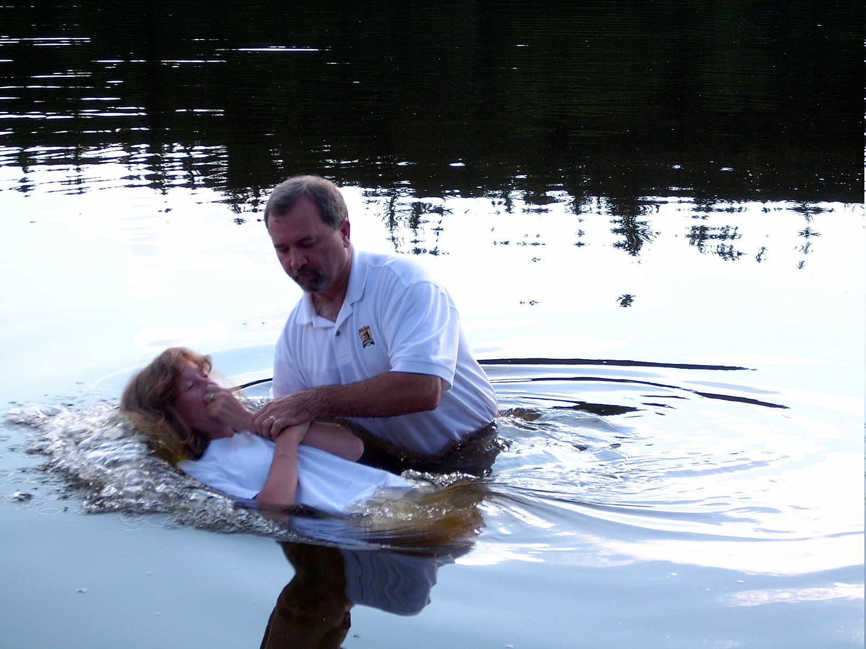
2. How is One Baptized ?
Immersion
Notes:
D. Immersion in water is the baptism of the Bible

Slide 12
2. How is One Baptized ?
Immersion
?
Notes:
E. In violation of the New Testament practice, many religious groups have substituted the practice of “sprinkling” or “pouring” in place of baptism.
1. Yet Paul tells us in Rom. 6 that baptism is a burial, and that it corresponds to the death, burial and resurrection of Christ
2. How does sprinkling compare to Jesus’ death, burial and resurrection?
a. Does one resurrect from being sprinkled?
b. If “sprinkling” is equivalent with “baptism,” then we should be able to insert “sprinkling” in the Bible for “baptism.”
c. This is how Roman 6:4 would read, “Therefore we were buried with Him through sprinkling [baptism, actual text] into death...”
d. Such a rendering is nonsense in the context of the passage
3. Such a view would have Philip and the eunuch going down “into the water” so that Philip could sprinkle him?
a. Why would they both have had to go down into the water for a sprinkling?
b. Philip could have merely grabbed a cup full of water and splashed it in the Ethiopian’s face and called it “baptism.”
4. Beware of religious groups that substitute human ways for God’s, for they are nothing more than a human substitution for the church. We must stay in the
boundaries of the Bible!

Slide 13
B
ible
aptism
Immersion
How ?
Notes:
A. How are we baptized ?
1. It is possible for a person to be sprinkled or to have water poured on them.
2. But it is not possible for a person to be baptized by sprinkling or pouring.
3. That would be like saying a person can be immersed by sprinkling or pouring.
4. That is self-contradictory.
5. According to the New Testament baptism is a burial or immersion in water.
6. “You don't make a pickle by taking a cucumber and sprinkling a little vinegar over it. You immerse it.”

Slide 14
3. Why Be Baptized ?
Men Teach
Belief=Saved
Baptized
Bible Teaches
Belief
Repent
Confess
Baptized=Saved
Notes:
A. Men Teach:
1. Believe = Salvation - then baptized
2. Many teach that the sinner comes first to salvation and then they should be baptized.
3. This is saying that they are saved before and without baptism.
4. The Bible teaches that one hear the gospel, believes the gospel, repents of their sins, baptized, and then they are in a saved condition

Slide 15
3. Why Be Baptized ?
“Then Peter said to them, repent, and be baptized every one of you in the name of Jesus Christ for the remission of sins, and you shall receive the gift of the Holy Spirit.” Acts 2:38

Slide 16
3. Why Be Baptized ?
“And now why are you waiting? Arise and be baptized, and wash away your sins, calling on the name of the Lord.” Acts 22:16

Slide 17
3. Why Be Baptized ?
"Baptism is not essential to salvation … but it is essential to obedience, since Christ commanded it. It is also essential to membership in the church which is his body”
Standard Manual for Baptist Churches, Hiscox (pp. 20-21), via
Handbook of Religious Quotations, p. 10.

Slide 18
3. Why Be Baptized ?
The Seventh Day Adventist "Baptismal Vow" requires a person, before baptism, to answer this question: "…have you accepted Jesus Christ as your personal Savior, and do you believe that God, for Christ's sake, has forgiven your sins?"
Handbook of Religious Quotations, p. 12

Slide 19
3. Why Be Baptized ?
Mark 16:16 “He who believes and is baptized will be saved; but he who does not believe will be condemned.”
He that eats and digests his food shall live; but he that eats not shall die.
Notes:
A. The Bible Teaches a different order
1. The Bible says that the sinner comes through baptism unto salvation.
2. Believe, repent, confess, baptized and then salvation comes.
3. Mark 16:16 “He who believes and is baptized will be saved; but he who does not believe will be condemned.”
(1) “He that eats and digests his food shall live; but he that eats not shall die.”
(2) No need to say “He that eats not and digests not his food shall die.”

Slide 20
3. Why Be Baptized ?
He that believes and is baptized shall be given a new car.
He that believes and is baptized shall be given $1,000.
He that believes and is baptized shall be given a free trip to Europe.
He that believes and is baptized
shall be saved. Mark 16:16
Notes:
1. We can all understand the first four. Why not the last one??

Slide 21
B
ible
aptism
Salvation
Why ?

Slide 22
How Do You
View Baptism?
Notes:
1. How Do you view baptism? As man does, or as the Bible teaches?
a. But one man may say, “According to my understanding of this controversy, it requires some knowledge of a dead language called Greek, in order to render an intelligent decision as to what baptism is; and as I am no scholar, I think God will not hold me to an account if I should happen to decide incorrectly.”
b. It is a mistake to suppose that it requires scholarship in any dead language to determine what baptism is.
c. It is possible that every person who has common sense can take their own English New Testament, and learn from a careful study of it, what God requires of them in order that they may live a life well pleasing in the sight of our Creator.

Slide 23
B
ible
aptism
Who ?
How ?
Why ?
Subjects Penitent Believers
Action Immersion
Purpose Remission of Sins
Notes:
1. What does the Bible teach about baptism?
a. Who is to be baptized? - those old enough to know and understand, penitent believers
b. How are we to be baptized? - it is a burial or immersion in water
c. Why are we baptized ? - for the remission (forgiveness) of our sins

Slide 24
Are You Ready
To Be
Baptized ?

